Slide 1


Slide 2
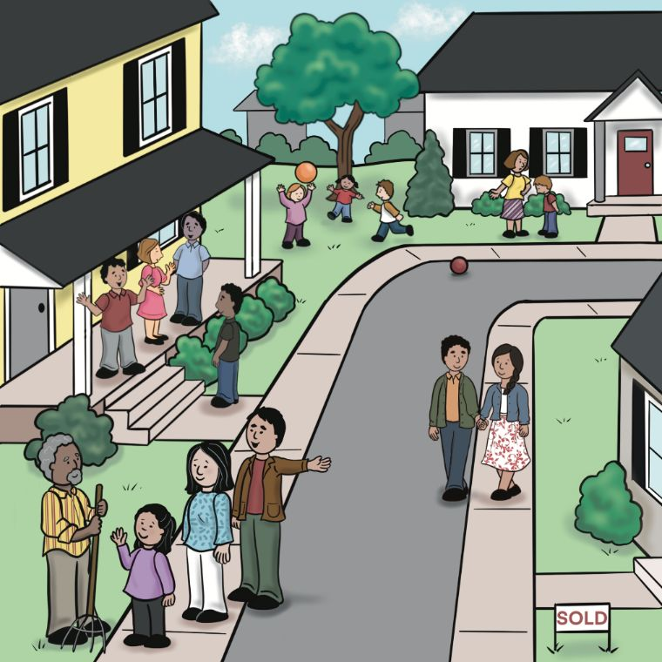
Unit 1:
The People
Closest to My Heart

Slide 3
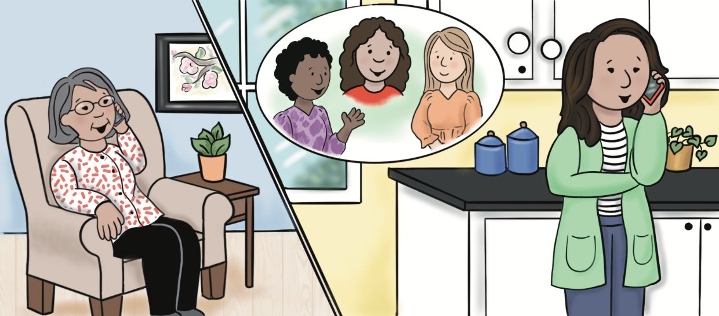
Lesson 1: What Kind of Friends Are You Looking For?

Slide 4
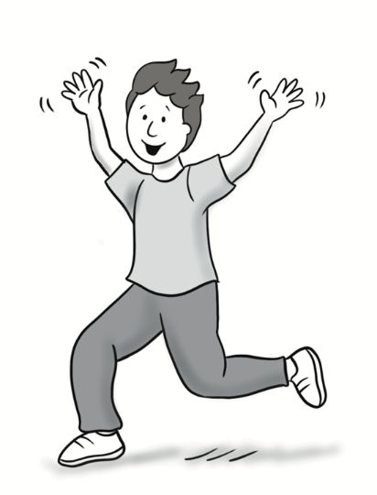
enthusiastic

Slide 5
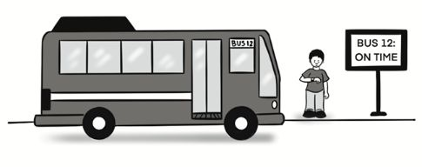
reliable

Slide 6

patient

Slide 7
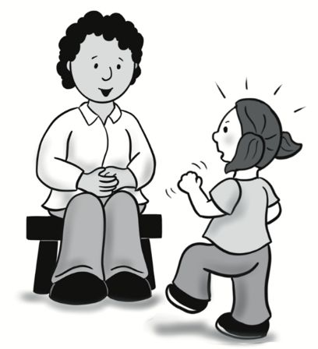
mature

Slide 8
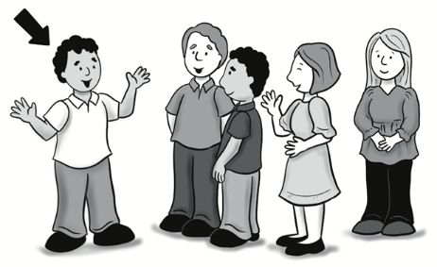
outgoing

Slide 9
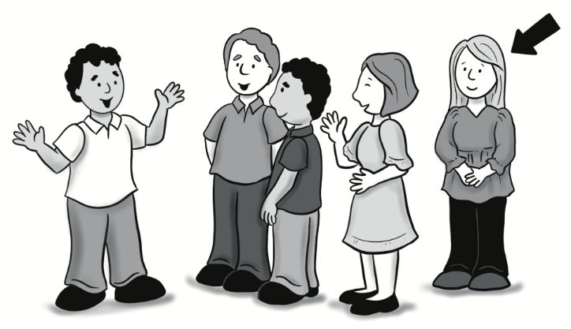
reserved

Slide 10
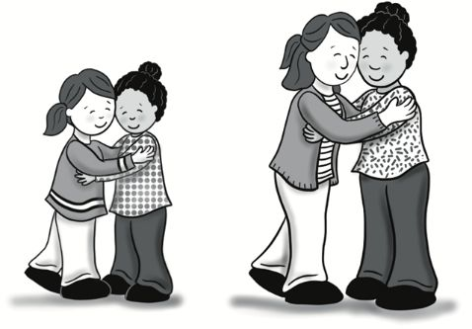
lifelong

Slide 11
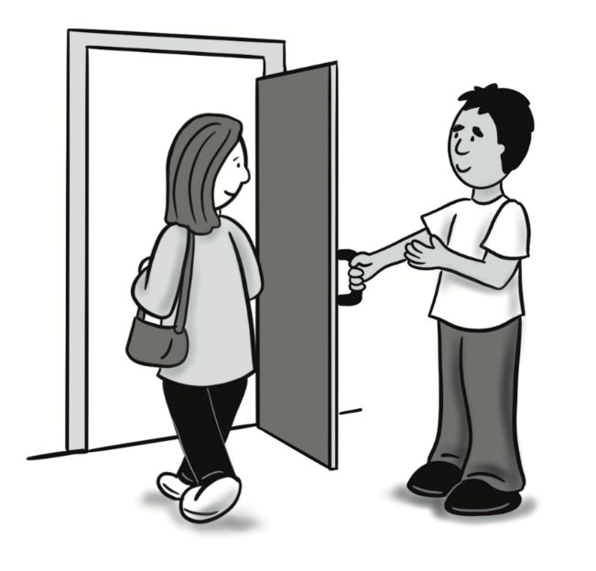
considerate

Slide 12
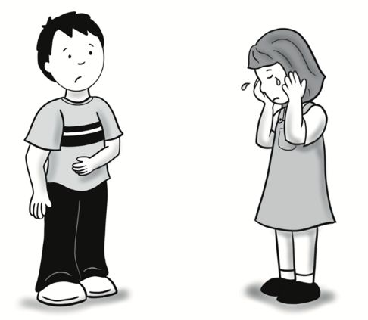
sensitive

Slide 13
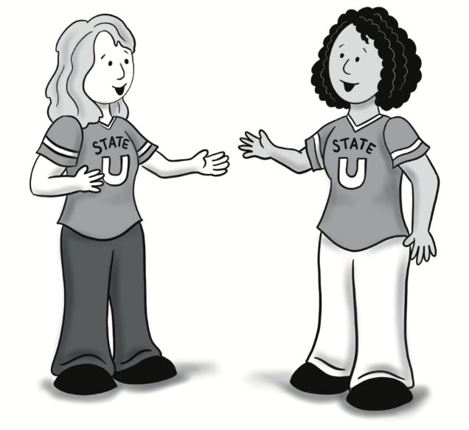
connection

Slide 14
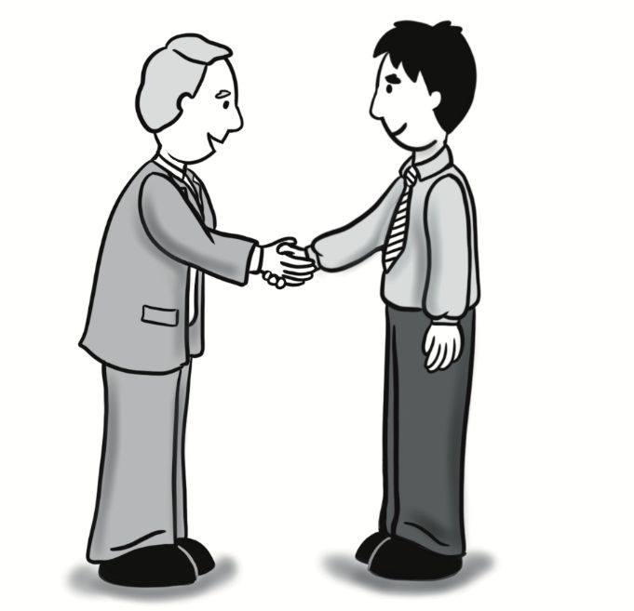
acquaintance

Slide 15
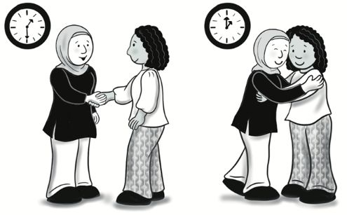
to hit it off

Slide 16
A: What kind of friends are you looking for?
B: I appreciate people who are mature.
Sentences Using Vocabulary

Slide 17
A: How’s your family doing since you moved to the new city? Have you made any new friends yet?
B: Well, I’ve met a few people, but I don’t feel the same connection with them that I’ve felt with some of my lifelong friends. I know it takes time, though.
A: That’s right. I know it’s hard to be patient, but I think it’s rare to meet someone and just hit it off right away. What kind of friends are you looking for?
B: Well, I definitely appreciate people who are considerate and sensitive to other people’s needs and feelings. I also want to know that they are reliable and mature.
Dialogue, Part 1

Slide 18
A: Does it matter to you if your friends are outgoing?
B: No, it doesn’t matter. I enjoy my friends who are outgoing and enthusiastic, but I also have friends who are more reserved. I think both kinds of people are important.
A: That’s a good point. I hope you’ll have more opportunities to spend time with your new acquaintances.
Dialogue, Part 2

Slide 19
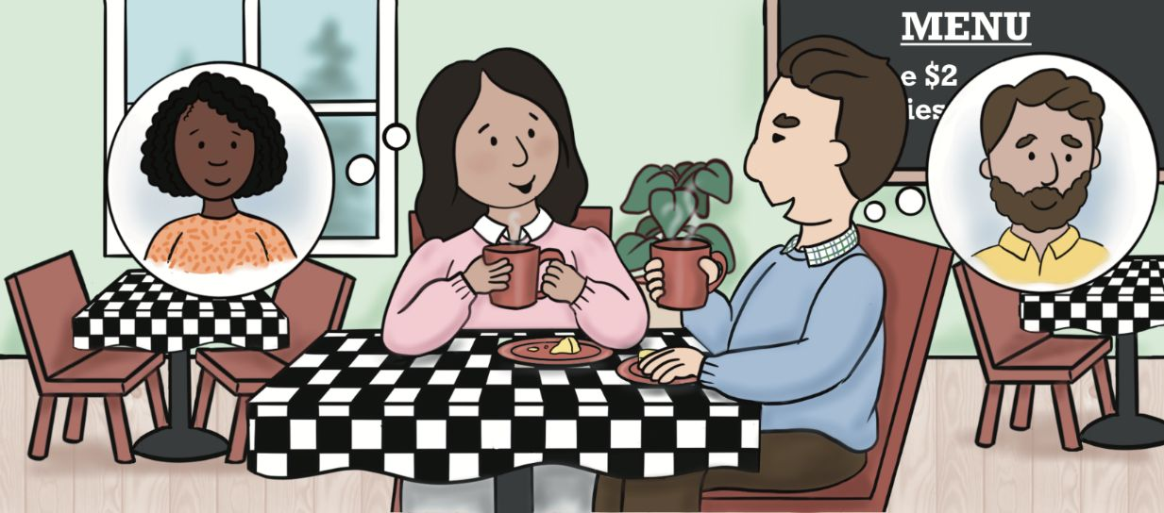
Lesson 2: He Seems Great So Far!

Slide 20
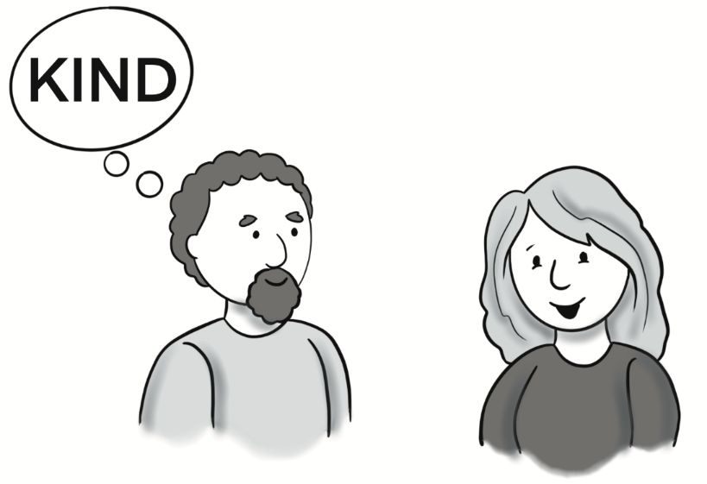
seem

Slide 21
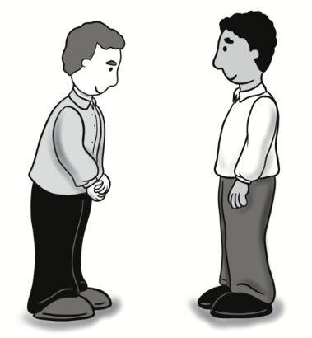
humble

Slide 22
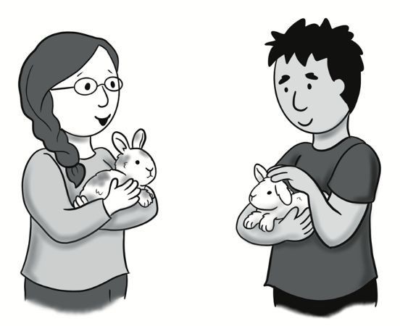
have in common

Slide 23
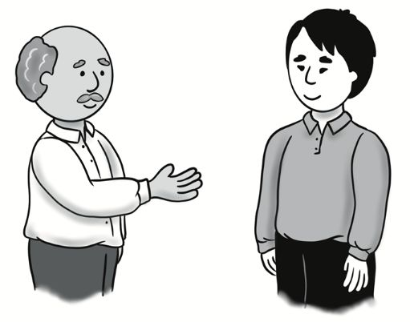
reach out

Slide 24
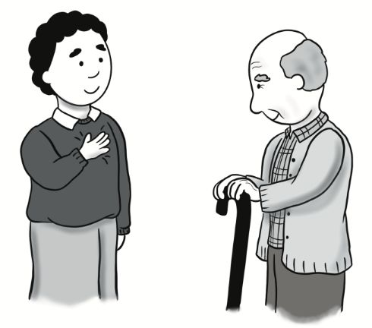
loyal

Slide 25
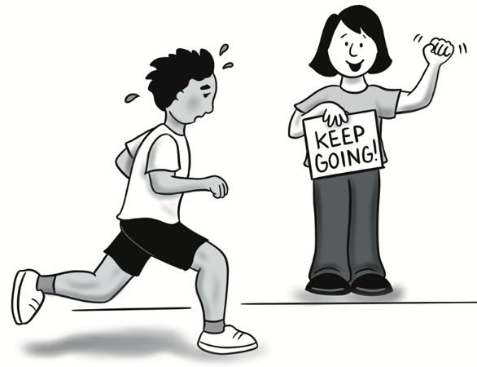
encouraging

Slide 26

optimistic

Slide 27
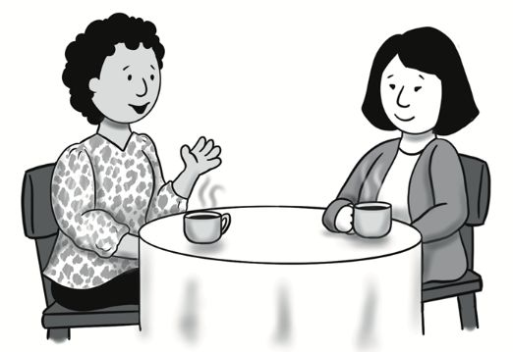
get to know

Slide 28
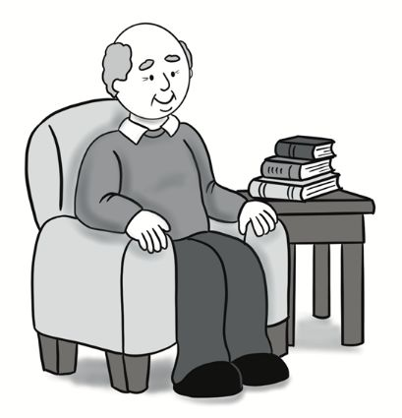
wise

Slide 29

positive

Slide 30

negative

Slide 31
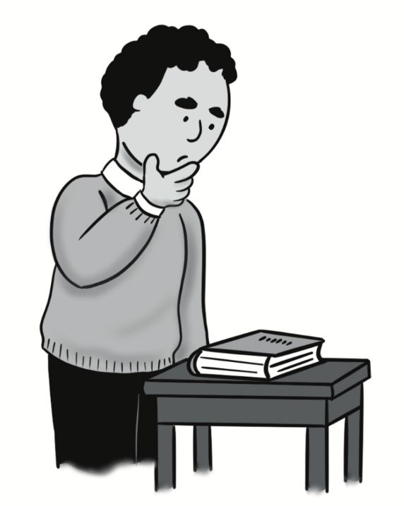
You can’t judge a book by its cover.

Slide 32

A: What is your coworker like?
B: She seems really humble.

Slide 33
A: Hey, are you still working with Paul?
B: No, he lost his job. He was always so negative, and he wasn’t loyal to the team. He cared more about looking at his phone! I have a new coworker now. His name is
Saleem.
A: Oh, really? What do you think about him?
B: Well, I know you can’t judge a book by its cover, but he seems great so far. I’m optimistic that he’ll be a good member of our team. I was frustrated with something today, and he helped me and was so encouraging to me.
Dialogue, Part 1

Slide 34
A: That’s a positive sign!
B: I think so too. Don’t you have a new coworker, too?
A: Yeah, Missy is her name. I haven’t seen her much, but I’m going to try to reach out to her on our break tomorrow and get to know her. My other coworkers tell me that she’s humble and wise and that we have a lot in common.
B: I hope you can get to know her, too!
Dialogue, Part 2

Slide 35
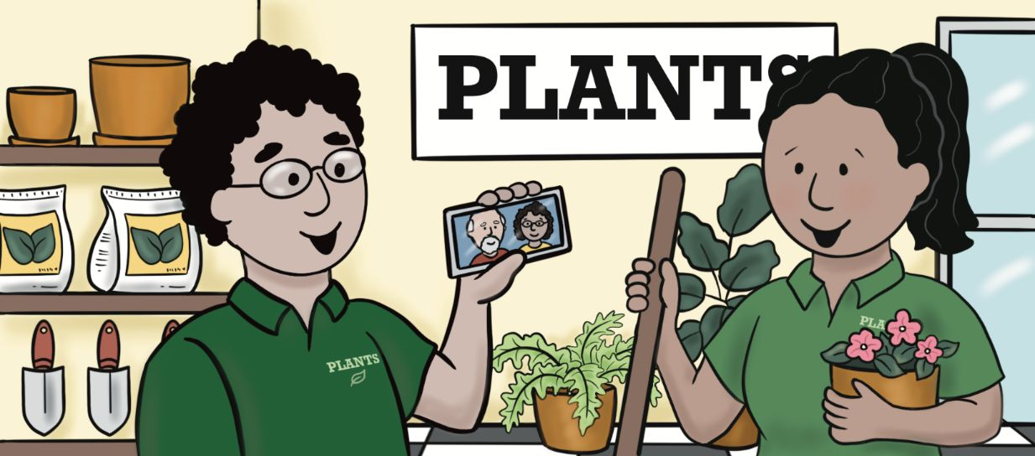
Lesson 3: My Family Relies on Each Other.

Slide 36
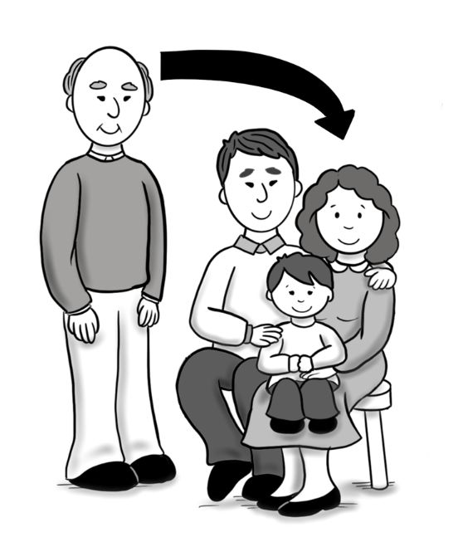
in-law

Slide 37
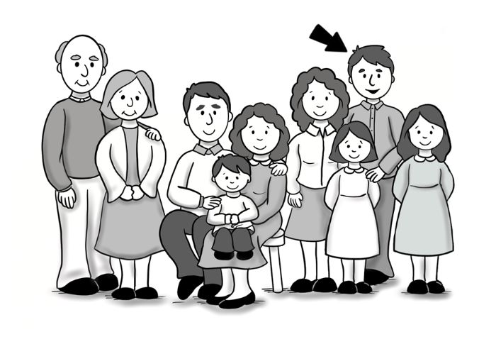
relative

Slide 38
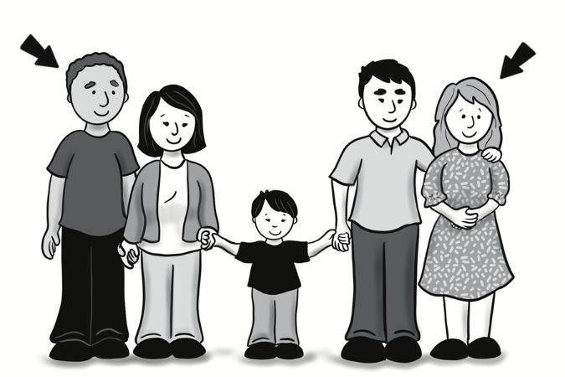
stepmother / stepfather

Slide 39
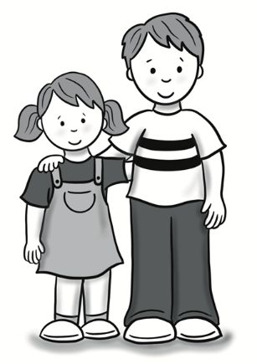
siblings

Slide 40
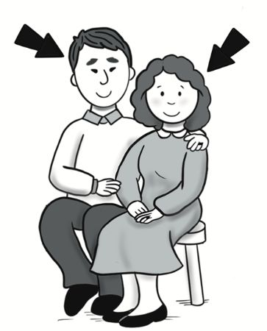
spouse

Slide 41
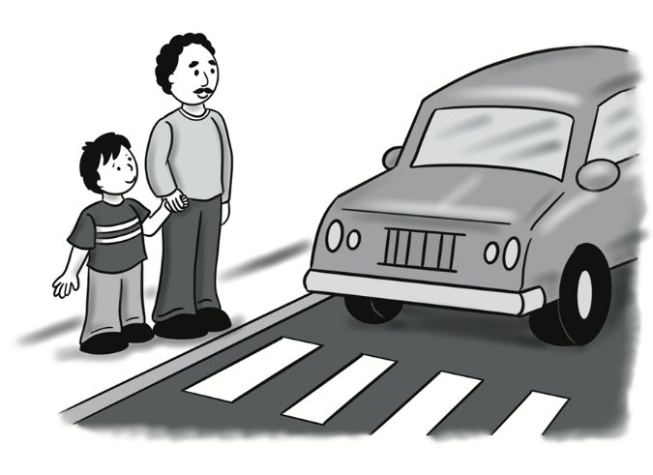
trust

Slide 42
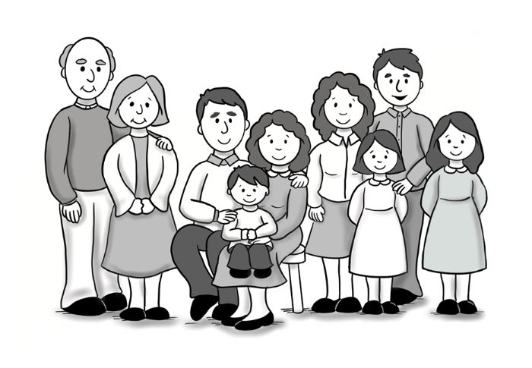
extended family

Slide 43
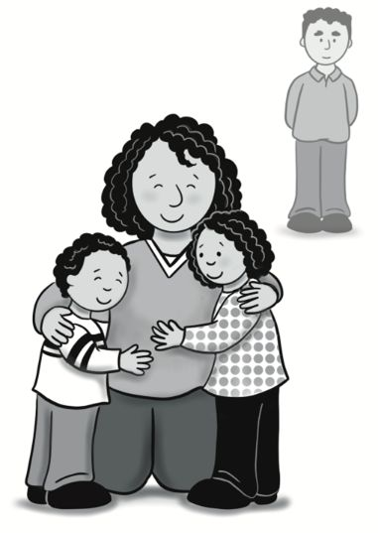
single parent

Slide 44
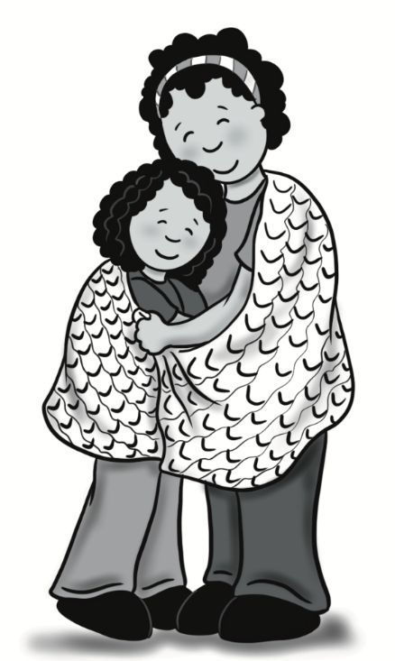
close-knit

Slide 45
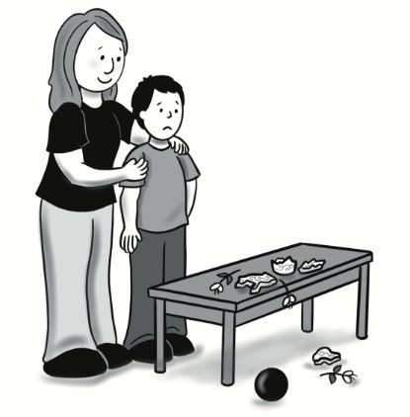
forgive

Slide 46
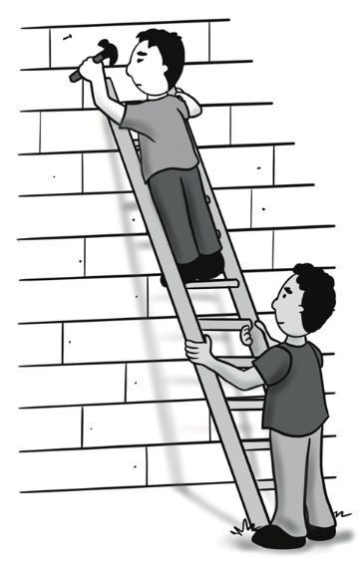
rely on

Slide 47
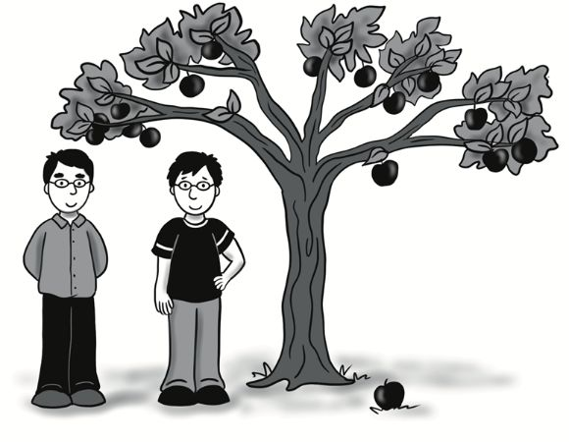
The apple doesn’t fall far from the tree.

Slide 48
A: Tell me about your extended family.
B: We rely on each other.

Slide 49
A: Did I tell you that some of my relatives are coming to visit?
B: No, you didn’t. That’s exciting! Who’s coming?
A: My mother and stepfather, my siblings, and my cousins.
B: That’s great. I didn’t know you had a stepfather.
A: Yeah, my dad passed away when I was little. My mom was a single parent until I was 13. I’m happy that she has a spouse again. Here’s a picture of them.
B: Wow, the apple doesn’t fall far from the tree. You look just like your mom!
Dialogue, Part 1

Slide 50
A: Aww, thanks. What about your family?
B: Well, I don’t have any siblings, but my extended family is pretty close-knit and spends a lot of time together. We rely on each other when we have problems and forgive each other when we mess up. We have a deep trust between us. When I lived with my parents, I was spending all of my free time with my whole family.
A: That’s really special. Are you close with your in-laws, too?
B: Not yet, but we’re working on it.
Dialogue, Part 2

Slide 51
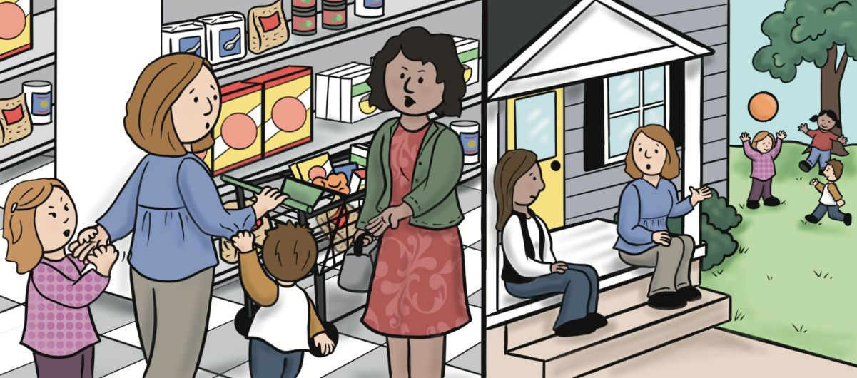
Lesson 4: I Know about Raising Kids.

Slide 52
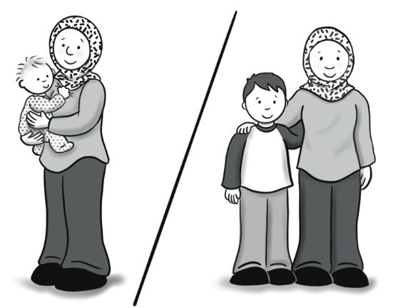
raise

Slide 53
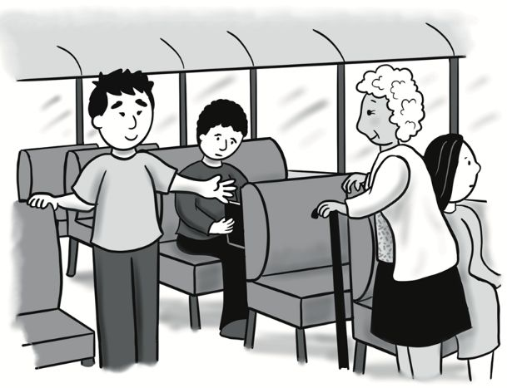
respect

Slide 54
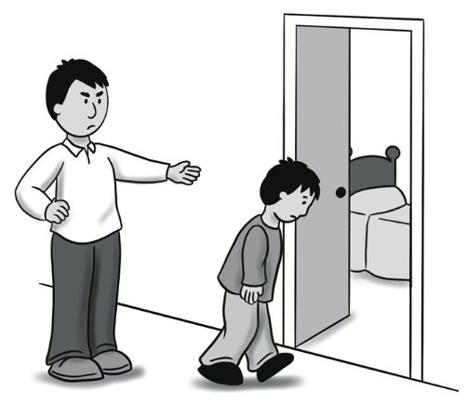
discipline

Slide 55
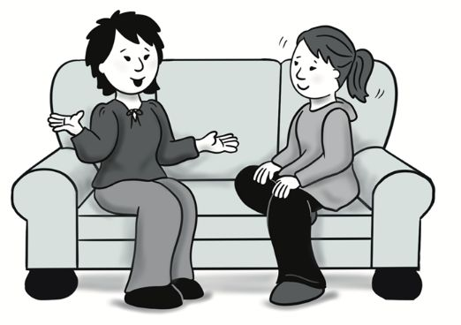
engage

Slide 56
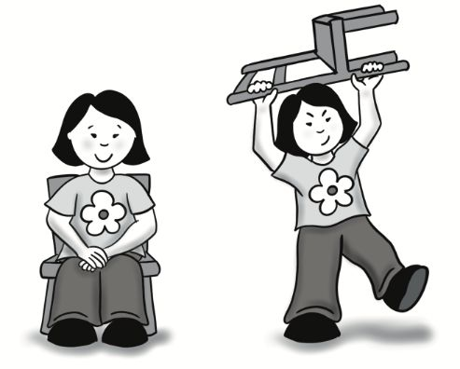
behave / misbehave

Slide 57
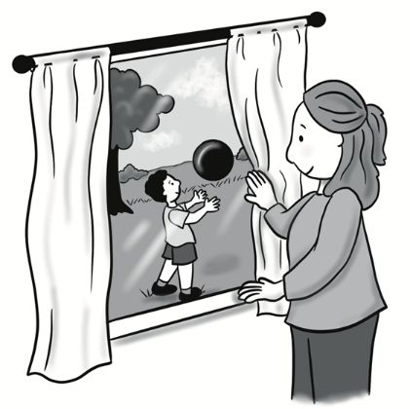
watch over

Slide 58
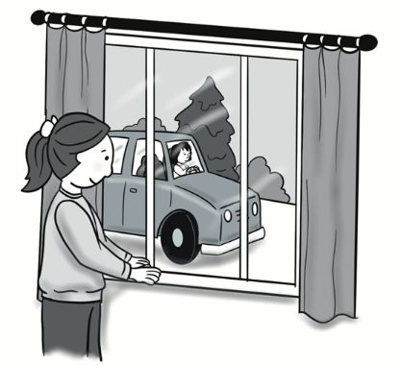
stay home alone

Slide 59
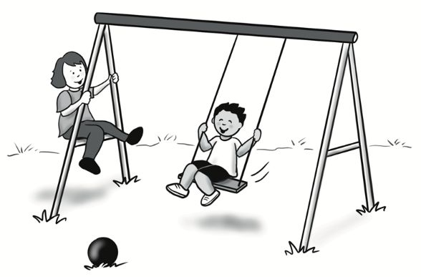
childhood

Slide 60
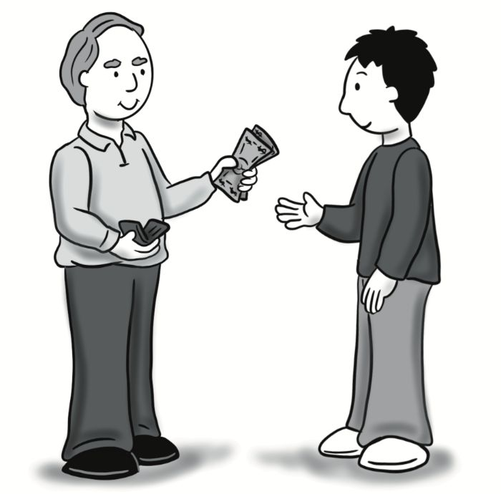
allowance

Slide 61
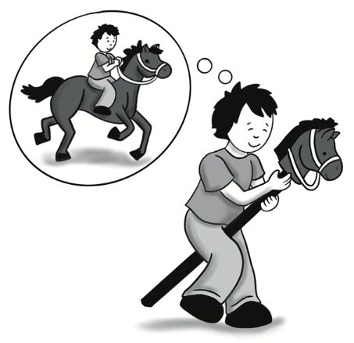
imagination

Slide 62
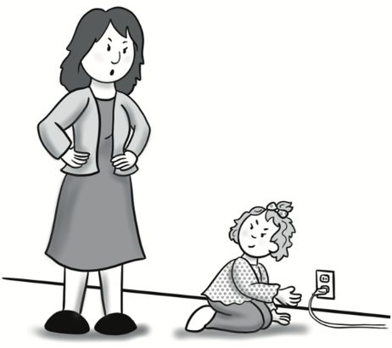
strong-willed

Slide 63
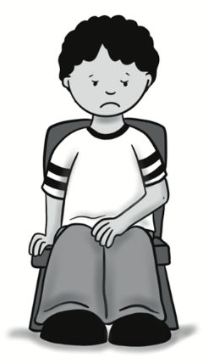
to put in time out

Slide 64
A: What should parents do for their children?
B: It’s important that they discipline their children.

Slide 65
A: I see you’ve got some strong-willed children there. Next month, I will have been a mother for thirty years, so I know about raising kids. I’m going to give you some advice.
B: Um…okay.
A: You should discipline them. Teach them to respect you. Put them in time-out if they misbehave, and when they get older, don’t give them their allowance if they don’t listen.
B: Okay, thanks.
Dialogue, Part 1

Slide 66
C: Hey, how’s it going?
B: I got a little frustrated today at the store. A woman gave me advice about raising my kids, but I didn’t even know her. The advice she gave was fine, but I hadn’t asked for it.
C: Yeah, that can be really annoying. Is there advice that you would like to get?
B: I want to know how to engage my children’s imaginations. To me, being a parent isn’t just watching over them. It’s also about helping them become curious. That’s an important part of childhood.
Later…
Dialogue, Part 2

Slide 67
C: Yes, that makes sense.
B: I also want them to learn to be independent. When they get older, I want them to be able to stay home alone and take care of themselves.
C: Yes, I definitely agree with you there!
Dialogue, Part 3

Slide 68
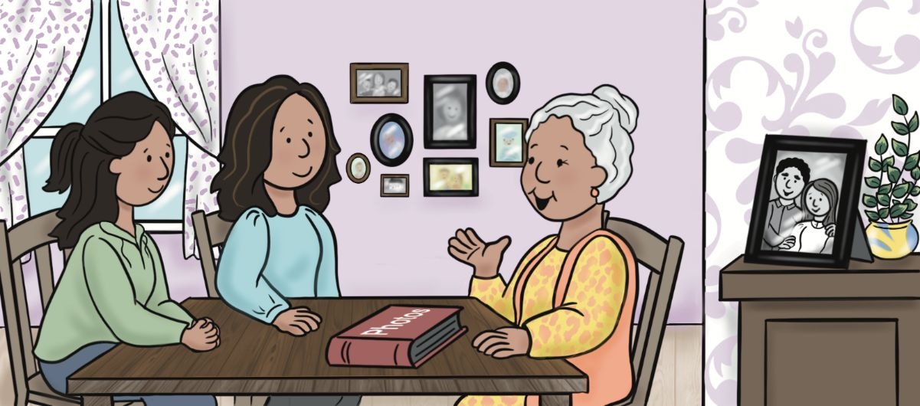
Lesson 5: Tell Us about Your Romance.

Slide 69

romance

Slide 70

newlywed

Slide 71

anniversary

Slide 72

shared values

Slide 73

click

Slide 74

propose

Slide 75

ask out

Slide 76

break up

Slide 77

go out

Slide 78

set up

Slide 79

old enough

Slide 80

blind date

Slide 81
A: Tell me about your romance.
B: When we were 18, he proposed.

Slide 82
A: Grandma, tell us about your romance with Grandpa.
B: Oh, that’s a good story. Well, we met when we were 15, and we just clicked. My father thought that I wasn’t old enough to go out with a young man yet, so we were just friends. Then, when we were 18, we started spending more time together.
A: So, did he ask you out then?
B: No, he was too nervous! But some of our friends decided to set us up. They arranged a blind date, and we were both happy when we arrived and saw each other.
A: Wow, I think your story is so sweet! So, then what happened?
Dialogue, Part 1

Slide 83
B: We found out that we had many shared values and beliefs, and we really enjoyed spending time together. We never wanted to break up. After six months, he proposed, and of course I said yes. We were very happy newlyweds, and we’re still happy now! We just had our fiftieth anniversary.
A: That’s amazing!
B: What about you? When are you going to find a nice young man?
A: Um, . . . can we talk about something else?
Dialogue, Part 2

Slide 84
B: We found out that we had many shared values and beliefs, and we really enjoyed spending time together. We never wanted to break up. After six months, he proposed, and of course I said yes. We were very happy newlyweds, and we’re still happy now! We just had our fiftieth anniversary.
A: That’s amazing!
B: What about you? When are you going to find a nice young man?
A: Um, . . . can we talk about something else?
Dialogue, Part 2

Slide 85

Unit 2:
How We Spend
Our Money

Slide 86

Lesson 6: It’s a Good Investment.

Slide 87

asset

Slide 88

installment

Slide 89

investment

Slide 90

lien

Slide 91

mortgage

Slide 92

lend

Slide 93

pay off

Slide 94

affordable

Slide 95

bankrupt

Slide 96

financial

Slide 97

valuable

Slide 98

I’m broke.

Slide 99
A: Did you read the paperwork you signed?
B: Yes, I carefully reviewed the terms of my investment.

Slide 100
A: Hey, I heard you bought a new car! Congratulations!
B: Thanks. It’s been pretty complicated, though.
A: What happened?
B: Well, I really liked the car, but after I started the process to buy it, I found out that it had a lien. The seller was going bankrupt and didn’t tell me about it.
A: No way! So, what did you do?
B: Thankfully, we were able to work things out. The seller paid off the lien, so I could buy the car. It took a lot of time to figure it out, but I believe that if you want something, then you should work hard to get it.
Dialogue, Part 1

Slide 101
A: That’s good! It looks like a valuable car. That’s a great asset. How much is it worth?
B: Um, . . . I think it’s a good investment. But tell me about buying your new house!
A: Oh, it’s been great. We talked to a financial counselor at the bank, and she helped us apply for a loan. I’m so happy the bank was willing to lend us the money. I was surprised that installments for the mortgage are really affordable! I’m glad buying a house didn’t end with us being broke!
Dialogue, Part 2

Slide 102

Lesson 7: We All Have to Pay Taxes.

Slide 103

federal

Slide 104

local

Slide 105

property tax

Slide 106

W-2

Slide 107

tax withholding

Slide 108

sales tax

Slide 109

tax return

Slide 110

retirement fund

Slide 111

tax refund

Slide 112



Slide 113

file

Slide 114

to make ends meet

Slide 115
A:What kind of taxes do you pay?
B: We pay property taxes.

Slide 116
In the United States, there are several different kinds of taxes that people must pay. All people who are employees have to pay income taxes. The government takes part of the money they make each month to pay for government services and programs.
1
Taxes in the U.S.

Slide 117

People living in the U.S., and U.S. citizens who live outside of the country, must file federal taxes every year. These taxes go to the government of the United States to pay for national programs and services. When people file taxes, they send a document, called a tax return, to the U.S. government’s tax service. Many people pay a tax preparation service or use an online service to help them fill out their tax returns because they can be very complicated.

Slide 118
For most workers, the government keeps some money from every paycheck. This is called tax withholding. Those workers receive a document called a W-2 from their employer every January that says how much money they made the previous year and how much the government took out for tax withholding. The workers use their W-2s when they file their tax returns each year. They also need to tell if they put money into a retirement fund and give other information about their family.
3

Slide 119
After submitting the tax return, some people receive tax refunds. This is money that the government gives back, saying that the person paid too much the year before. People love getting tax refund money, and some people use it to help make ends meet. However, other people file their tax returns and find out that they need to pay more taxes because they didn’t pay enough during the year.
4

Slide 120
There are other kinds of taxes in the United States, too. Most states require people to pay state income taxes, which are filed like federal taxes. Cities, counties, and towns have different kinds of taxes that people have to pay. These are local taxes. Home and business owners must pay property taxes on their land and buildings on that land. Renters do not pay these taxes. In some places, people also pay personal property tax on cars, boats, and office equipment. This money pays for local services like schools, libraries, roads, and police and fire departments.
5

Slide 121
Most states and some local areas also add different kinds of sales tax to anything that you buy, as well. This tax is not included in the price you see on the price tag. It’s added when you buy the item or service, which is why the final cost of things that you buy is usually higher than the cost that is written on the price tag.
Taxes might seem confusing, but when you understand more about each type of tax, you will be better prepared to know what you have to do for each one.
6

Slide 122

Lesson 8: I think Something’s Wrong with the Heat Pump.

Slide 123

upgrade

Slide 124

renovate

Slide 125

appliance

Slide 126

balcony

Slide 127

furnace

Slide 128

fireplace

Slide 129

porch

Slide 130

circuit breaker

Slide 131

electrical panel

Slide 132

heat pump

Slide 133

hot water heater

Slide 134

to trip the breaker

Slide 135
A: Have you renovated your home recently?
B: We upgraded our porch.
1

Slide 136
A: Could you send someone to look at our furnace?
B: Sure, I’ll send someone this afternoon.
2

Slide 137
A: You know, I enjoyed our vacation, but I’m so glad we are home again!
B: Me too. It’s so good to be—
A: Sorry to interrupt, but it’s really cold in here! Do you think something’s wrong?
B: Hmm . . . the heat pump should be running. Let me check. . . .Uh-oh. I think there’s a problem. Neither the heat pump nor the furnace is working. The hot water heater looks okay, though.
A: Did you check the electrical panel to see if any circuit breakers are tripped?
B: Yeah, they seem to be fine. Why don’t you put a fire in the fireplace? I’ll go make a call.
Dialogue, Part 1

Slide 138
C: Hello, Ray’s Heating and Cooling Service. How may I help you?
B: Hi, could you send someone out to look at our system? We just got home from vacation and we can’t get our heat to work.
C: What kind of system do you have?
B: We have a heat pump and a furnace.
C: Okay, great. Just a few more questions. Have you renovated your home recently?
B: Well, we worked on our porch and balcony and upgraded a few appliances, but we didn’t work on the heating system.
C: Okay, thank you. I can have someone there this afternoon. What’s your name and address?
(on the phone)
Dialogue, Part 2

Slide 139
C: Okay, thank you. I can have someone there this afternoon. What’s your name and address?
B: Alex Forbes, 304 Porter Lane.
C: Thanks, Mr. Forbes. You can expect one of our technicians to be at your home between 2 and 5 pm today.
B: Great, thanks. I hope that they can figure out this problem soon!
(on the phone)
Dialogue, Part 3

Slide 140

Lesson 9: You’ll Need to Read the Fine Print.

Slide 141

catalog

Slide 142

clearance

Slide 143

guarantee

Slide 144

merchandise

Slide 145

warranty

Slide 146



Slide 147

sold out

Slide 148

half off

Slide 149

enter a raffle

Slide 150

buy one, get one free

Slide 151

to read the fine print

Slide 152
A:What sales do you have right now?
B: We have merchandise for half off.

Slide 153
A:Hello, I can help the next person in line at customer service.
B: Hi. I wanted to buy a pair of skates for my son, but I couldn’t find any in his size. Could you see if you have any?
A: I’m sorry, but it looks like they’re sold out. However, you can order from our online catalog if we don’t have any in the store.
B: Oh, okay. I wish I could get them here so he could try them on, but I understand. If I order them and he doesn’t like them, can I return them?
A: Yes, we have a 30-day happiness guarantee. However, just so you know, that doesn’t apply for merchandise that is sold on clearance.
Dialogue, Part 1

Slide 154
B:Okay. Thanks. I’ll remember that. Do the skates come with a warranty?
A: Yes, they come with a one-year warranty. You’ll need to read the fine print for all of the information about that.
B: That’s good to know. I’ll look at your online catalog then. Could you tell me what other sales you have right now?
A: Sure. We have a buy one, get one free sale on all of our socks, and we also have some of our workout clothes for half off. Also, if you buy something today, you can enter our raffle to win a new bike!
B: Oh, that sounds great! We’ll look around, then!
Dialogue, Part 2

Slide 155

Lesson 10: It Looked Like a Bargain!

Slide 156

backorder

Slide 157

bargain

Slide 158

promotion

Slide 159

purchase

Slide 160

rating

Slide 161

subscription

Slide 162

store credit

Slide 163

multiple

Slide 164

in stock / out of stock

Slide 165

exchange

Slide 166

review

Slide 167

It’s a steal!

Slide 168
A: Did you order the shoes?
B: I tried to order them, but they’re on backorder.

Slide 169
A: I’m so frustrated with this online purchase I made. The website said it was in stock, but then after I bought it, they emailed me and said it was on backorder, and they don’t know when it will be available.
B: Oh, that is really frustrating. What did you buy?
A: A pair of shoes. It looked like a bargain! I was thinking about buying multiple pairs, but I’m glad I didn’t. Now I’m asking for a return for store credit so I can buy something else. I don’t want to wait months for these shoes to come.
B: Did you look at the seller’s ratings before you bought from them? Maybe you can review them so that other people know about your experience.
A: I wish I had thought to check the reviews before I ordered the shoes. I’ll do it from now on!
Dialogue, Part 1

Slide 170
Review #1: It’s a Steal! Rating: 5 out of 5 stars ★★★★★ I love these shoes! The price is great, and they are so comfortable. I’m going to buy a few more pairs before this promotion ends! If the seller starts offering a subscription service for these shoes, I’ll buy them every year! They’re a great value for your money.
Review #2: Not Great Shoes, but Good Customer Service Rating: 3 out of 5 stars ★★★☆☆ I ordered these shoes to wear to a wedding, but they were on backorder and came late. When they finally arrived, they were damaged. I contacted the seller and was able to exchange them for another pair. I got them just in time to wear to the wedding. They weren’t very comfortable, but they looked good.
Dialogue, Part 2

Slide 171

Unit 3:
I’m Getting
Hungry.

Slide 172

Lesson 11: Store Brands Can Be Found on the Shelves.

Slide 173

counter

Slide 174

self-checkout

Slide 175

staple

Slide 176

baked goods

Slide 177

junk food

Slide 178

name brand

Slide 179

shopping cart

Slide 180

store brand

Slide 181

organic

Slide 182

in season / out of season

Slide 183

browse

Slide 184

to have a sweet tooth

Slide 185
A: Could you tell me about this store?
B: Over here we have in-season produce.

Slide 186
A: Excuse me. Could you tell me where to find the baked goods? I’ve been trying to avoid junk food, but I have a sweet tooth.
B: Sure! They’re right over there.
A: Great, thank you. Could you tell me a little about this store? It’s my first time here, and I’m having a hard time finding things.
B: I’d be happy to help! In Aisles 1 and 2 we have staples like flour, sugar, rice, beans, and canned fruits and vegetables. Name brands and the store brand for each item are found next to each other on the shelves. In the back, we have a meat counter, and fish is sold there, too.
Dialogue, Part 1

Slide 187
A: Oh, great! And what about the produce?
B: Yes, on the left side we have produce, including a lot of organic options. We mostly carry in-season produce. And over here, at the front, we have the shopping carts and the self-checkout area.
A: Great, thank you so much! That’s a big help. I’m going to keep browsing now.
B: Enjoy!
Dialogue, Part 2

Slide 188

Lesson 12: I’ve Got the Check.

Slide 189

portion

Slide 190

Checks together or separate?

Slide 191

waitlist / waiting list

Slide 192

flavorful

Slide 193

full

Slide 194

savory

Slide 195

tender

Slide 196

rare

Slide 197

well done

Slide 198

devour

Slide 199

be seated

Slide 200

It’s on me.

Slide 201
A: This steak is so tender.
B: It looks great!

Slide 202
A: I’m so excited to try this restaurant! The online reviews said that the food is really flavorful.
B: Me too! I’m glad we decided to come to celebrate your new job.
C: Welcome to Martin’s Steakhouse. We don’t have any open tables right now, but I can add you to the waitlist.
A: Oh, how long will that be?
C: It’s about a 15-minute wait until you will be seated.
A: Sure, we can wait.
C: Could I get a name and how many?
A: Jacobsen, party of two.
Dialogue, Part 1

Slide 203
A: Wow, this steak is so tender! I can cut it with my fork.
B: Mine isn’t as tender as yours.
A: That’s because you ordered it cooked well done. Mine is rare.
B: Maybe so. Hey, try these mashed potatoes! They’re so savory. I think I could devour three portions of them. Those online reviews were right. There’s something special about this restaurant!
C: Here’s your cheesecake and your ice cream.
(later, at their table)
Dialogue, Part 2

Slide 204
A: I’m sorry, but I didn’t order cheesecake. I ordered chocolate cake.
C: Oh, I apologize. I’ll bring you the right cake in just a moment. Can I get you anything else?
A: Oh no, nothing else for us after these desserts. We’ll be full after that! Could we have the check, please?
C: Checks together or separate?
B: Together. It’s on me. We’re celebrating your new job!
A: Thanks!
Dialogue, Part 3

Slide 205

Lesson 13: Check the Expiration Date.

Slide 206

bacteria

Slide 207

poultry

Slide 208

expiration date

Slide 209

food poisoning

Slide 210

internal temperature

Slide 211

inedible

Slide 212

off

Slide 213

raw

Slide 214

rotten

Slide 215

contain

Slide 216

spoil

Slide 217

sick to my stomach

Slide 218
A: I’m not sure if this food is safe to eat.
B: I agree. It looks spoiled.

Slide 219
A: Hey, are you okay? You don’t look so good.
B: Well, I’m feeling better now, but I was really sick last night.
A: Oh, no. What happened?
B: I think I had food poisoning. I ate some food that had been in my fridge for a while. It looked okay, but I guess it had spoiled because later, I was sick to my stomach and I didn’t sleep all night!
A: I’m so sorry. That’s no fun at all.
B: You work in a restaurant. Tell me, how do I know if something is inedible?
Dialogue, Part 1

Slide 220
A: : It depends on the type of food. You have to be really careful with meat and poultry. I always use a meat thermometer when I cook to check if the internal temperature is high enough. That way, I know it’s cooked through and not raw in the middle. If you cook it completely, it kills any bacteria that might be inside. I also put cooked meat in the freezer if I’m not going to eat it within the next three days.
B: What about foods that don’t have meat?
Dialogue, Part 2

Slide 221
A: It’s important to check the expiration dates on your food packages and read the label to see if they contain any ingredients that need to stay in the refrigerator. You also should look at and smell food that has been in the refrigerator for a few days to notice if it seems off. And, of course, you should always throw away anything that is rotten.
B: I guess I’d better be more careful after this. I don’t want to get sick again!
Dialogue, Part 3

Slide 222

Unit 4:
May I See
Your
Insurance Card,
Please?

Slide 223

Lesson 14: Any Other Symptoms?

Slide 224

acetaminophen

Slide 225

antibiotics

Slide 226

bruise

Slide 227

infection

Slide 228

injection

Slide 229

specialist

Slide 230

symptom

Slide 231

treatment

Slide 232

virus

Slide 233

hardly

Slide 234

have a temperature

Slide 235

to lose your voice

Slide 236
A:What symptoms do you have?
B: I can hardly talk.

Slide 237
A: Hi, I’m Dr. Omar. Nice to see you today. What’s been going on?
B: I’ve had a temperature since Tuesday, and I can hardly talk. I thought it was a virus and I’d get past it, but I’m not feeling any better.
A: Yes, you have definitely lost your voice. Any other symptoms?
B: No, nothing else.
A: Okay. I want to run a test and check for a bacterial infection in your throat. If it’s positive, you can start antibiotics.
B: That sounds great. Thank you.
Dialogue 1

Slide 238
A: It looks like you’ve got a bad bruise there. What happened?
B: I fell down the steps a week ago. My knee’s been swollen and hurting since then.
A: Have you had any other treatments yet?
B: Yes, I’ve been taking acetaminophen and putting ice on it for 15 minutes every morning and evening, but it hasn’t helped a lot.
A: I see. I’m going to send you to a specialist for knee injuries. She might give you an injection or send you to physical therapy.
B: Thank you.
Dialogue 2

Slide 239

Lesson 15: She’s Been Admitted to the Hospital.

Slide 240

kidney

Slide 241

liver

Slide 242

lung

Slide 243

surgery

Slide 244

tablet

Slide 245

x-ray

Slide 246

side effect

Slide 247

admit

Slide 248

discharge

Slide 249

heal

Slide 250

swallow

Slide 251

to be back on your feet

Slide 252
A: : What’s wrong?
B: My mom was admitted to the hospital.

Slide 253
A: I’m going to need to take a few days off of work. My mom has just been admitted to the hospital.
B: Of course. I’m sorry to hear that. May I ask what’s wrong?
A: Yes. She had lung surgery last month, and she was healing, but now she’s having more problems. The doctors think she might have kidney or liver damage as a side effect of the medicine she’s been taking. She’s getting some tests and x-rays done right now.
B: Oh, I’m sorry. That’s really scary. Last year, my brother was in the hospital for a week. I remember how scared I was.
Dialogue, Part 1

Slide 254
A: What was wrong?
B: He had an infection in his throat. It was so swollen that he couldn’t swallow the tablets he needed to take, so he had to get some injections. I felt so much better when they discharged him and I knew he was healing well.
A: Yes, I’m sure I’ll feel better when my mom is back on her feet, too.
Dialogue, Part 2

Slide 255

Lesson 16: I Have Some Questions about My EOB.

Slide 256

balance

Slide 257

co-pay

Slide 258

deductible

Slide 259

estimate

Slide 260

premium

Slide 261

Explanation of Benefits (EOB)

Slide 262

insurance provider

Slide 263

covered

Slide 264

in network / out of network

Slide 265

approve

Slide 266

request

Slide 267

out of pocket

Slide 268
A: Hello, this is Healthcare Plus.
B: Hi, I have a question about my Explanation of Benefits.

Slide 269
A: Healthcare Plus, this is Robin. How may I help you?
B: Hi, I have some questions about my Explanation of Benefits.
A: Sure, as your insurance provider, I can help you with that. First, I’ll need to ask you some questions to verify your identity.
A: Thank you for answering those questions. Now, how can I help you?
B: I see on my EOB that the charge for an x-ray last month wasn’t covered. Can you tell me why?
(a few minutes later)
Dialogue, Part 1

Slide 270
A: You have a deductible of $1,000 per year. That means that the first $1,000 of expenses are your responsibility to pay out of pocket. You haven’t met your deductible yet, so you’ll need to pay the balance for that x-ray.
B: I see. What about my co-pay and my premium? I’ve already paid those.
A: The co-pay is not connected to the deductible in your plan, so you’ll still need to pay that separately every time you see a health professional. The premium is the amount you pay every month for health insurance, but it doesn’t pay for specific costs.
Dialogue, Part 2

Slide 271
B: Okay. I have another question. My doctor has been telling me that I need to have some tests done, but I need to have you approve them first. Do you know if they have been approved yet?
A: After your doctor’s office requests approval, we will usually respond within 10 business days. We will give you an estimate of costs and tell you if your plan covers it. It will depend on if the tests are necessary and also if the health professional is in network or out of network. I see in your account that your doctor submitted the request last week, so it may be a few more days before you get the decision.
B: I understand. Thank you for your help.
Dialogue, Part 3

Slide 272

Unit 5:
Let’s Hit the Books!

Slide 273

Lesson 17: There’s Even a Virtual School!

Slide 274

credit

Slide 275

GED

Slide 276

boarding school

Slide 277

special education

Slide 278

virtual school

Slide 279

religious

Slide 280

secular

Slide 281

enroll

Slide 282

evaluate

Slide 283

graduate

Slide 284

homeschool

Slide 285

to hit the books

Slide 286
A: What kind of school does your son attend?
B: He goes to a virtual school.

Slide 287
A: Hey, do you have time to talk? I’d like to have a discussion about where Julian and Marta should go to high school next year when we move. I can’t believe they’ll be graduating in just a few years!
B: Sure. What are you thinking?
A: I had thought it wouldn’t be too complicated, but now I’m a little overwhelmed. There are so many options! There’s public school, of course, but there are also some good private schools. Some are religious and some are secular. They could even enroll in a virtual school and take classes online. I also just read about a new GED program for students who aren’t able to graduate.
Dialogue, Part 1

Slide 288
B: What if we homeschooled them?
A: I hadn’t thought about that, but I guess it’s also an option if they’re interested in being homeschooled.
B: Here’s another idea. I’ve heard about some boarding schools, but I don’t want the kids to move away from us.
A: Me neither. I guess we need to have a talk with the kids first and see what they’re interested in doing. Then, we can choose a few schools to research and visit them to ask some questions. Do you have any questions for the schools?
Dialogue, Part 2

Slide 289
B: Yes, I’d like to know about how they evaluate students for class placement, if they offer any special education services, and if students can take courses for college credit.
A: I guess we should hit the books and find out whatever we can!
Dialogue, Part 3

Slide 290

Lesson 18: The Transcript Looks Good.

Slide 291

major

Slide 292

scholarship

Slide 293

transcript

Slide 294

tuition

Slide 295

associate’s degree

Slide 296

bachelor’s degree

Slide 297

community college

Slide 298

financial aid

Slide 299

higher education

Slide 300

master’s degree

Slide 301

room and board

Slide 302

to put yourself through school

Slide 303
A: Did she go to college?
B: Yes, she got financial aid.

Slide 304
A: How was your appointment at the community college?
B: It was great! I learned a lot about the higher education system.
A: What did the admissions counselor say?
B: She said that my transcript looks great. She also said I should apply for financial aid and scholarships to help pay for tuition.
A: That’s wonderful! Did she say if you can complete a bachelor’s degree at the community college?
Dialogue, Part 1

Slide 305
B: She said that this community college only offers associate’s degrees. I can live at home and work while I’m studying to help put myself through school, and in about two years, I’ll graduate. Then I can go to another university to finish my bachelor’s degree. I could even go on to get a master’s degree, as well.
A: That’s a good plan. Living at home will save you money on room and board, too.
B: The counselor also said that the college offers the major I want, so I’m excited!
Dialogue, Part 2

Slide 306

Lesson 19: I Decided to Get Certified.

Slide 307

expertise

Slide 308

instructor

Slide 309

orientation

Slide 310

promotion

Slide 311

trade

Slide 312

trainee

Slide 313

competent

Slide 314

develop

Slide 315

qualify

Slide 316

get certified

Slide 317

to pass with flying colors

Slide 318

to be well-rounded

Slide 319
A: Why did you decide to take classes?
B: I need to get certified.

Slide 320
A: I heard that you just started classes. What are you studying?
B: Yeah, I really need to develop my skills for work, so I decided to get certified in operating heavy equipment so I can do more on the job site. I’ve got to learn more about how to use the different types of machinery we work with.
A: That sounds interesting. What do you do in class?
B: The instructor starts with giving our class an orientation about the machines and information about safety and effective use. Then, the trainees get to operate the equipment. If we prove that we’re competent in operating the equipment, we’ll receive certificates at the end of each course that can help us qualify for promotions.
Dialogue, Part 1

Slide 321
A: I’m sure you’ll pass with flying colors. After this course, will you continue to grow your level of expertise?
B: Yes, I’m planning to take some other courses in other trades to become even more well-rounded. I’m hoping to get a promotion in the future.
A: If I were your boss, I would give you a promotion!
Dialogue, Part 2

Slide 322

Unit 6:
I Got the Job!

Slide 323

Lesson 20: We’ll Be in Touch Soon!

Slide 324

conflict

Slide 325

feedback

Slide 326

within

Slide 327

current

Slide 328

detail-oriented

Slide 329

open-minded

Slide 330

trustworthy

Slide 331

out of work

Slide 332

under consideration

Slide 333

do my best

Slide 334

solve a problem

Slide 335

We’ll be in touch.

Slide 336
A: What are some of your strengths?
B: I am detail-oriented.

Slide 337
A: Thank you for coming in for an interview today.
B: Thanks for having me. I’m glad to be here.
A: Let’s get started. Could you tell me about your current job?
B: Well, I’ve actually been out of work for two months now, but before that, I was a manager at Mack’s Burger Shack. The restaurant closed, so now I’m looking for work.
A: Well, I’m glad you came to interview with us! Could you tell me some of your strengths?
B: Sure. I’m detail-oriented, and I really like to get feedback from my supervisors to tell me how I’m doing and how I can improve. I also try to be a trustworthy leader.
Dialogue, Part 1

Slide 338
A:Those are great qualities. Tell me, when you were a manager, how did you solve problems between employees? You can tell me a story, if you’d like.
B: I remember one time when two of my team members had a big conflict. They had been arguing and were very angry. I talked to them separately and did my best to be open-minded and fair. Then, I talked with them together and helped them to understand each other’s views. They were able to work well together after that.
A: That’s excellent. We have a few other people under consideration, but we’ll be in touch with you within the next two weeks with our decision.
Dialogue, Part 2

Slide 339

Lesson 21: Did You Speak Up to Your Supervisor?

Slide 340

expectation

Slide 341

issue

Slide 342

management

Slide 343

policy

Slide 344

position

Slide 345

representative

Slide 346

maternity/paternity leave

Slide 347

communicate

Slide 348

interpret

Slide 349

focus on

Slide 350

speak up

Slide 351

to call in sick

Slide 352
A: Could you tell me about the policies here?
B: We encourage our employees to speak up if they have issues.

Slide 353
Employee Handbook:
Neighbor City Plastics Company Policies
Welcome to the team at Neighbor City Plastics! We’re so happy to have you join us. Please read this document carefully to understand the expectations for new workers at our company.
1. Be on time. All employees must clock in and out when their shifts start and end. If you have an emergency and need to arrive late, leave early, or call in sick, please communicate that to management as soon as possible. Any employee with attendance issues will need to meet with his/her supervisor.
Reading, Part 1

Slide 354
2. Communicate with HR if you need time off. We are proud to offer maternity and paternity leave for our employees who give birth or adopt children so they can focus on welcoming their children home. For complete information on this, talk to your HR representative.
3. We take safety seriously. If you see that someone is not following safety rules, speak up to your supervisor. You will not lose your position if you say something about this.
Reading, Part 2

Slide 355
4. If you need help with a conflict with another employee, talk to your supervisor. If you need help with a conflict with your supervisor, talk to your HR representative. Our goal is to solve conflicts so that all team members are working together well.
5. If you are able to interpret for another team member who doesn’t speak English, please talk to your supervisor. Translators can work extra hours for additional pay.
Questions? Let us know!
Reading, Part 3

Slide 356

Lesson 22:
We Talked about Making Ethical Decisions.

Slide 357

client

Slide 358

bad habit

Slide 359

code of conduct

Slide 360

dress code

Slide 361

appropriate

Slide 362

confidential

Slide 363

efficient

Slide 364

on duty / off duty

Slide 365

resign

Slide 366

make an effort

Slide 367

make ethical decisions

Slide 368

to run the risk

Slide 369
A: What did you learn?
B: We talked about the code of conduct.

Slide 370
A: Officer Gonzalez, thank you for taking the time to speak with our class.
B: I’m so happy to be here.
A: The students have written down some questions about your job, so I will read them. First, could you tell us why you wanted to become a police officer?
B: Sure. I actually used to work in insurance sales. I had a lot of clients and was very busy, but it just wasn’t for me. I was spending a lot of time trying to be efficient and make money, but not much time helping people. I realized that I wanted a job where I could be active and help people throughout our city every day, so I resigned from the insurance company and went to the police academy.
Dialogue, Part 1

Slide 371
A: What did you learn at the police academy?
B: We learned the law and the code of conduct that police officers have to follow, like our dress code, treating people with respect, and keeping private information confidential. We also talked a lot about making ethical decisions. I had already had to make good decisions in the insurance office, but as a police officer, I need to make them quickly, and that can be tough. It’s important that we make wise, fair, and appropriate decisions in this job.
A: What parts of being a police officer were difficult to adjust to?
Dialogue, Part 2

Slide 372
B: I wasn’t used to being on duty for night shifts. I used to have a bad habit of sleeping too late, but I had to change that. I was running the risk of being late for work all the time! I made an effort to set a few alarms and make sure I got up on time, and now I’m used to it.
A: How do you plan to continue developing your skills as a police officer?
B: I haven’t had much training yet in working with children, but I’d love to know how to help them feel safer in difficult situations. I’m hoping to do that soon.
A: That sounds great. Well, thank you so much for coming to our class today.
B: Thank you for having me. It was a pleasure to be here.
Dialogue, Part 3

Slide 373

Unit 7:
Think
Before
You Click.

Slide 374

Lesson 23: We’re Facing a Mental Health Crisis.

Slide 375

anxiety

Slide 376

bullying

Slide 377

depression

Slide 378

expert

Slide 379

mental health

Slide 380

parental controls

Slide 381

screen time

Slide 382

advise

Slide 383

concerned

Slide 384

strongly

Slide 385

incredibly

Slide 386
to keep an eye on

Slide 387
A:Why are you concerned about kids having too much screen time?
B: It can lead to depression.

Slide 388
Internet News Article:
Today’s Mental Health Crisis
Young people are facing a mental health crisis like never before. Experts say that the increase in screen time and social media use by children and teenagers has led to much higher rates of anxiety and depression and problems with bullying in schools. A doctor at Neighbor City Hospital said that the problem is getting worse. “I’m incredibly concerned about the youth who are struggling with mental health problems,” Dr. Amanda Wilcox said. She also said that in her first few years as a doctor, she treated far fewer young people with depression than she has in the last ten years.
Reading, Part 1

Slide 389
However, there is hope, even for young people who are struggling. Many experts strongly advise parents to take these steps:
• Delay allowing your child to use social media until he or she is an older teenager.
• Use parental controls on all technology in your home.
• Keep an eye on your child’s technology use. Don’t allow your child to use a cell phone, tablet, or computer alone in his or her room at night.
• Have regular conversations with your child. Check on his or her mental health.
• Help your child find activities to do that aren’t related to technology, like reading, cooking, sports, or other activities.
Reading, Part 2

Slide 390
Above all, it’s important to stay connected and not just through technology. Spend time together without screens and check in regularly. Time and care build the foundation for a strong relationship.
Reading, Part 3

Slide 391

Lesson 24: Hang Up the Phone Right Now!

Slide 392

fraud

Slide 393

PIN

Slide 394

identity theft

Slide 395

maiden name

Slide 396

security code

Slide 397

Social Security number

Slide 398

confirm

Slide 399

impersonate

Slide 400

shred

Slide 401

hang up

Slide 402

in private

Slide 403

to bite/hold your tongue

Slide 404
A: What personal information do I need to protect?
B: You should protect your security code.

Slide 405
A: Hello?
B: Hi, this is Mark at your bank. I’m calling to confirm some information on your account.
A: Oh, okay. What do you need to know?
B: Could you please tell me your Social Security number again?
A: Yes, it’s 238
C: Mom! What are you doing? Hold your tongue! Don’t say that on the phone!
A: This man says he’s from my bank.
Dialogue, Part 1

Slide 406
C: No, he’s not. He’s just impersonating them. You should hang up the phone right now, or he’ll be stealing all of your personal information in no time.
A: [on the phone] I’m not telling you anything! [to C] Okay, I hung up. How did you know it was fraud?
C: Your bank will never call you to ask for your Social Security number. You know, I’ve been learning about identity theft lately. It’s a huge problem. People take your personal information and use it to get fake credit cards or loans in your name.
Dialogue, Part 2

Slide 407
A: It’s so frustrating that people do these things. What else should I do to protect myself?
C: You should never give someone your personal information on the phone if they call you. If you have to give it, you should go in person to the bank and give it in private. If someone does call you and you aren’t sure if it’s real, hang up and call their office back to find out if it was a real call.
A: That’s a good idea. What other personal information do I need to protect?
Dialogue, Part 3

Slide 408
C: Don’t tell anyone your PIN for your debit card. Keep your birth certificate and Social Security card in a safe place. Don’t tell people your mother’s maiden name, either. That’s something that is often asked to confirm your identity. If you have documents that have your personal information on them, shred or burn them instead of throwing them in the trash.
A: What about the security code on the back of my credit card?
C: You might need to give that one when you’re buying something, but make sure it’s a real business and not a scam.
A: Thank you for helping me. It’s a lot to learn!
Dialogue, Part 4

Slide 409

Lesson 25: You Can’t Be Too Careful.

Slide 410

authentic

Slide 411

fake

Slide 412

suspicious

Slide 413

unique

Slide 414

phishing

Slide 415

spam

Slide 416
privacy settings

Slide 417

block

Slide 418

hack

Slide 419

give out

Slide 420

rip off

Slide 421

to play it safe

Slide 422
A: Why do you think this email is phishing?
B: The message looks suspicious.

Slide 423
News Article:
Privacy and Safety with Technology
Using technology is essential for life in the United States, isn’t it? However, you can’t be too careful about protecting your private information. Unfortunately, many criminals have learned ways to steal private information and take people’s money.
Here are some ways to avoid identity theft.
Reading, Part 1

Slide 424
• Be careful with emails. If you get an email that looks suspicious, read it carefully to look for signs that it’s not real. Check the email address to see if it’s from a person you know or if it’s fake. Phishing is when someone sends you an email trying to convince you to give out your personal information or send money to someone you don’t know.
• Delete and block spam emails. If you think they’re spam, don’t open them. Never open any files that you don’t know about.
Reading, Part 2

Slide 425
• Find out about companies before you pay them. Scammers try to rip people off by promising things that aren’t real and taking people’s money. Make sure that you’re buying products or services from authentic companies. You can check the Better Business Bureau for information about companies.
• Use the privacy settings on your social media accounts to make your information private. This keeps people you don’t know from using your personal information or contacting you.
Reading, Part 3

Slide 426
• Use unique passwords for your online accounts. Use at least 12 letters, numbers, and symbols and don’t use information that people could guess, like your birthday.
Making each password different will make it more difficult for someone to hack your accounts.
Remember: play it safe, read carefully, and ask questions when necessary to protect your personal information.
Reading, Part 4

Slide 427

Unit 8:
Rights,
Duties,
Responsibilities, and the Law

Slide 428

Lesson 26: Voters Will Cast Their Ballots.

Slide 429

campaign

Slide 430

candidate

Slide 431

democracy

Slide 432

election

Slide 433

platform

Slide 434

politician

Slide 435

primary

Slide 436

political party

Slide 437

cast a ballot

Slide 438

take a vote on

Slide 439

to stand for something

Slide 440

to throw in the towel

Slide 441
A: You heard the news about the campaign, didn’t you?
B: Yes, the candidate threw in the towel.

Slide 442
A: Tonight on Channel 3 News we’re talking about the upcoming election. There isn’t much time left in the campaign before voters cast their ballots for their chosen candidates from either the Gold Party or the Silver Party. Taylor will give us the story.
B: In June, both political parties had primaries to take a vote on which candidates would represent them in this election. Then, in August, they had meetings to officially accept those candidates and to introduce their platforms. The Gold Party’s platform this year is to lower taxes, offer quality education to everyone, and create jobs. The Silver Party’s platform is to support lower healthcare costs, improve roads, and make sure everyone has food to eat. I interviewed many voters who will be voting next week. Here’s one conversation I had.
Dialogue, Part 1

Slide 443
B: You plan to vote next week, don’t you?
C: Yes, I do.
B: Could you tell me why that is important to you?
C: Democracy as a whole is important to me because we can all vote on the things that matter to us. I’m voting for the candidate from the Silver Party because he stands for something that is important to me, too: lower healthcare costs.
A: Thank you, Taylor, for giving us that story. Next Tuesday, we’ll see which politicians will win and which ones will throw in the towel. Keep watching Channel 3 News for the latest updates.
Dialogue, Part 2

Slide 444

Lesson 27: The County Provides Many Services.

Slide 445

administration

Slide 446

council

Slide 447

county

Slide 448

judge

Slide 449

mayor

Slide 450

resident

Slide 451

service

Slide 452

school board

Slide 453

appoint

Slide 454

provide

Slide 455

make a statement

Slide 456

red tape

Slide 457
A: What can you do at the administration office?
B: You can learn about county services.

Slide 458
A: Community Information:
Living in Young County
Young County is a great place to live. The County provides the following services for residents:
• Weekly trash and recycling collection
◦ A schedule of trash and recycling pickup times can be found at our office.
• Public safety
◦ Police
◦ Rescue squad
◦ Fire department
Reading, Part 1

Slide 459
• Libraries
◦ All county residents are welcome to apply for library cards with proof of residency.
• Parks and Recreation
◦ The Young County Wellness Center offers group fitness classes, tennis courts, a pool, a gym, and more.
• Young County Courts
◦ Marriage licenses are issued by the Clerk of the Circuit Court.
Reading, Part 2

Slide 460
• Young County School District
◦ Schools offer many services to students in kindergarten–12th grade, including ESL, SPED, and other programs.
◦ Any resident may make a statement at the school board meetings held on the first Tuesday evening of each month.
• County Administration
◦ Voter registration is offered at this office.
◦ County officials are available to help with any red tape or questions you might have.
Reading, Part 3

Slide 461
Young County is led by a county manager and an elected board of supervisors, as well as many staff members in the administration offices. Judges are appointed by the governor. Decisions for the Young County School District are made by an elected school board.
The City of Danville is part of Young County. Danville’s government includes a mayor and a city council with eight members.
Reading, Part 4

Slide 462

Lesson 28: It’s Everyone’s Duty to Obey the Law.

Slide 463

duty

Slide 464

jury

Slide 465

right

Slide 466

trial

Slide 467

Pledge of Allegiance

Slide 468

just

Slide 469

defend

Slide 470

obey

Slide 471

keep up with

Slide 472

be informed

Slide 473

to take part in

Slide 474

to run for office

Slide 475
A: What must U.S. citizens do?
B: Citizens must serve on juries.

Slide 476
Information:
Rights, Duties, and Optional Activities for U.S. Citizens
In the U.S., citizens have many rights that give them certain freedoms. For example, they have the right to take part in elections, including voting and running for office. They also have the right to have a quick, public, and just trial.
U.S. citizens also have duties that are required of them. They have to serve on a jury if they are called. If the country is at war and Congress decides to have a draft, they may be called to defend the country as soldiers. If they are called, they must go. Another duty is for everyone in the U.S., citizens and non-citizens: they must obey all laws.
Reading, Part 1

Slide 477
There are also some optional activities that citizens and anyone in the U.S. can choose to do. They may choose to say the Pledge of Allegiance and to have an American flag. They can also keep up with the news to be informed about what is happening in the city, state, and country. Each person should decide what part he or she wants to have as a resident of the United States.
Reading, Part 2

Slide 478

Lesson 29: No One Is above the Law.

Slide 479

attorney

Slide 480

custody

Slide 481

lawsuit

Slide 482

court costs

Slide 483

legal fees

Slide 484

civil

Slide 485

criminal

Slide 486

guilty

Slide 487

innocent

Slide 488

testify

Slide 489

make a will

Slide 490

above the law

Slide 491
A:Tell me about your job as an attorney.
B: I work in criminal law.

Slide 492
A: Hi, I’m the new neighbor. I just moved in down the street.
B: Hi! It’s so nice to meet you. What do you do for a living?
A: I’m an attorney.
B: Oh, that’s so interesting! What kind of law — civil or criminal?
A: I work in civil law.
B: What, exactly, do attorneys in civil law do?
A: Well, I help people make wills and protect their assets. Other kinds of civil attorneys do things like file lawsuits, work on adoptions, or make decisions about child custody.
B: I see. How long have you been an attorney?
A: I’ve been doing this for eight years.
B: What made you want to be an attorney?
Dialogue, Part 1

Slide 493
A: Well, before I went to law school, I had been working in a criminal court as an administrative assistant. That work made me interested in law, although it was different from what I do now. In my job at the court, I gave directions to people who were going to testify and collected court costs.
B: Ah, yes, court costs. I’ve also heard about legal fees. Are they very expensive?
A: Unfortunately, they can be expensive. No one is above the law, but sadly, some people have an easier time when they have legal problems because they have more money.
B: So, what’s your advice for someone who is dealing with a lawsuit?
A: They should find a good attorney who will help them with their case.
Dialogue, Part 2

Slide 494
B: What if someone is arrested?
A: They should get an attorney then, too, but if they can’t afford one, the court can provide a lawyer called a public defender for free. The U.S. legal system says that everyone is expected to be innocent until they’re proven guilty, but it’s much easier to deal with if you have an attorney who is helping you.
B: That sounds like wise advice! Well, it’s been great meeting you! I need to go and make dinner for my kids now.
A: It was nice to meet you, too. I’ll see you around.
B: Yeah, sounds good. Have a great evening!
A: You too. Bye!
B: Bye.
Dialogue, Part 3

Slide 495

Unit 9:
This Land
Is Our Land

Slide 496

Lesson 30: The Colonies Decided to Break Free.

Slide 497

colony

Slide 498

Constitution

Slide 499

freedom

Slide 500

representation

Slide 501

taxation

Slide 502

timeline

Slide 503

American Revolution

Slide 504

Declaration of Independence

Slide 505

Founding Fathers

Slide 506

Great Britain

Slide 507

independent

Slide 508

to break free

Slide 509
A: What happened to create the United States?
B: The colonies broke free from Great Britain.

Slide 510
A: Could you help me understand this American history lesson? I’m confused about when each part happened.
B: Sure. Let’s draw out a timeline to help. It started in the 1600s with one colony, Virginia. Over time, more colonies were added until there were thirteen. They were part of Great Britain. Even though they were very far away from Great Britain, the people in the colonies had to follow the laws that Great Britain made and pay taxes. At first, that was okay with the colonists, because Great Britain protected and supported them. Later, though, the people in the colonies got upset about having taxation without representation.
Dialogue, Part 1

Slide 511
A: What do you mean by “taxation without representation”?
B: I mean that the colonies didn’t get to send representatives to Great Britain to speak for them. They were told to pay taxes but didn’t have a chance to argue against them.
A: Oh, okay. So, then what happened?
B: The colonies decided that they wanted to break free. That led to a war between Great Britain and the colonies called the American Revolution. The war started in 1775. The next year, a group of leaders called the Founding Fathers signed the
Declaration of Independence. That was a document that said that the colonies weren’t part of Great Britain anymore but were now an independent country. The war continued until 1783.
Dialogue, Part 2

Slide 512
A: What happened after the war ended?
B: The colonies got their freedom when they won the war, but then they had to do the hard work of creating their own country. The Founding Fathers got together again to make decisions for the new government. In 1788, the states approved the Constitution, which is the document that is still the framework for the United States today.
A: Ah, I see. Thanks for taking the time to help me. I understand U.S. history better now and why Americans are so proud of their independence.
Dialogue, Part 2

Slide 513

Lesson 31:
We’re Hoping to Travel across the Continent.

Slide 514

continent

Slide 515

Midwest

Slide 516

region

Slide 517

Great Lakes

Slide 518

Mississippi River

Slide 519

New England

Slide 520

Rocky Mountains

Slide 521

relocate

Slide 522

rural

Slide 523

suburban

Slide 524

urban

Slide 525

The grass is always greener on the other side.

Slide 526
A: Where do you want to visit next?
B: I’d love to visit New England.

Slide 527
A: My cousin and I have set a goal to visit each region in the U.S. We are hoping to travel across the continent, from the Atlantic Ocean to the Pacific Ocean.
B: Oh, that’s cool! Which region do you plan to visit first?
A: Well, I really want to visit New England in the fall. I’ve heard the leaves are beautiful there. Do you have any suggestions?
B: Two of the Great Lakes are on the border of New England and Canada. You could visit one of them.
A: That’s a good idea. What other places do you recommend?
B: If you drive across the country, you’ll have to cross the Mississippi River, so you could take some time to stop there. I also enjoyed seeing the farmland in the Midwest when I drove through it once.
Dialogue, Part 1

Slide 528
A: Oh, I’m not interested in farmland. I grew up on a farm, so that’s just boring to me. I think urban and suburban areas are more interesting.
B: Well, you know what they say. The grass is always greener on the other side. I’m from a city, so I think rural areas are beautiful and peaceful.
A: That’s true; things that are different from what we are used to are often more interesting to us! So, if you were going to relocate somewhere, where would you go?
B: I haven’t been there yet, but every time I see pictures of the Rocky Mountains, I’m amazed. I’d love to live in the West and see them every day!
Dialogue, Part 2

Slide 529

Lesson 32: The Scenery Is Beautiful!

Slide 530

capital

Slide 531

scenery

Slide 532

Golden Gate Bridge

Slide 533

Grand Canyon

Slide 534

Mount Rushmore

Slide 535

National Park Service

Slide 536

Niagara Falls

Slide 537

Statue of Liberty

Slide 538

The Everglades

Slide 539

The White House

Slide 540

travel guide

Slide 541

to get on the road

Slide 542
A: What are you doing with your time off?
B: We’re going to Niagara Falls.

Slide 543
Article:
U.S. Travel Guide
Whether you’re a first-time visitor to the U.S., have lived here for a while, or are a life-long resident, there are always more amazing places to see in the United States. Want to know where you should go? Keep reading to find out our top suggestions for places to visit across the United States, separated by region, and then get on the road and visit them!
The Northeast
New York City is the largest city in the United States and is known for its theater shows, food, buildings, and combination of cultures. Visitors often go to see the Statue of Liberty, as well.
Reading, Part 1

Slide 544
New York State also contains Niagara Falls, an incredible group of waterfalls on the border of the U.S. and Canada.
The South
If you’re interested in better understanding the United States government, you should think about visiting Washington, D.C. The city, located between Virginia and Maryland, is the capital of the United States and includes the U.S. Capitol Building and the White House.
Much farther south, The Everglades is an enormous area of wetlands in Florida with very special and rare plants and animals. The many hiking trails are taken care of by the National Park Service.
Reading, Part 2

Slide 545
The Midwest
Visitors to Mount Rushmore feel very small as they look up at the huge carved faces of four U.S. presidents on the stone mountain.
The West
The Grand Canyon is another must-see location. The scenery in this National Park is breathtaking!
If you’re planning to visit San Francisco, California, you should take the time to see the Golden Gate Bridge. You also might consider riding the famous San Francisco streetcars to get a tour of the city.
Of course, these are just a few of the many great places to visit in the United States. What’s first on your list?
Reading, Part 3

Slide 546

Lesson 33: They Want Everything Done ASAP!

Slide 547

deadline

Slide 548

ideal

Slide 549

individuality

Slide 550

merit

Slide 551

work ethic

Slide 552

direct

Slide 553

informal

Slide 554

punctual

Slide 555

self-reliant

Slide 556

as soon as possible / ASAP

Slide 557

to pull yourself up by your own bootstraps

Slide 558

small talk

Slide 559
A: In your opinion, what’s an important ideal in U.S. culture to know about?
B: You should know about having a good work ethic.

Slide 560
A: I’ve been living in the U.S. for a year now, but I’m still having a hard time understanding some of the things people do here. Since we’re from the same culture,
I wanted to ask you if you could help me.
B: Well, I’m not an expert, but I’d be glad to try. What things are confusing to you?
A: I notice that people at my job are very serious about being on time. Everything should be done early or at least by the deadline. In our culture, you don’t need to be in a rush about things, but here, they want everything done ASAP. Why is time so important here?
Dialogue, Part 1

Slide 561
B: Many people in the U.S. believe that being punctual shows respect for other people because you don’t waste their time. They see time as something that’s limited, but in our culture, most people think that there’s always more time. Also, people here believe that getting your work done before your deadline shows that you have a good work ethic. They value working hard at their jobs to prove that they can do well.
A: Is that also why people want to earn their jobs or opportunities based on merit?
B: Yes, that’s right. Many people want to work hard to earn their opportunities, not just get them because they know someone.
Dialogue, Part 2

Slide 562
A: I see. That’s interesting. Okay, another question. In our culture, most young people live with their parents until they are 30 or get married. Why do so many people here move out when they are 18?
B: Yes, that’s a big difference. Many people in the U.S. want to pull themselves up by their own bootstraps. That means that they want to be self-reliant and have success on their own, without help from other people. Also, individuality is very important. People want to make their own decisions apart from their families.
Dialogue, Part 3

Slide 563
A:That makes sense. This is really helpful. Okay, here’s my last question. In our culture, when you speak to someone who is more important than you, like your boss, you’re very careful to show respect in your words and actions. Here, though, people are very informal when they speak with people they know, even if they are important. My boss told me to be direct and tell him if I had any problems, but I don’t feel comfortable with that.
Dialogue, Part 4

Slide 564
B: Many Americans believe in the ideal that people are all equal, so they want to act that way in how they talk. One time I met the owner of our company, and he made small talk with me like I was his equal. That felt very strange to me, too! It’s still a good thing to show respect, but it just looks different here.
A: Wow. If I had known all of this before, it would have helped me out a lot. Thanks for all your help today. You’ve given me a lot to think about.
Dialogue, Part 5

Slide 565

Lesson 34:
We’ll Have Fireworks, Parades, and a Feast.

Slide 566

feast

Slide 567

festivities

Slide 568

fireworks

Slide 569

gathering

Slide 570

parade

Slide 571

country of origin

Slide 572

Independence Day

Slide 573

ethnic

Slide 574

patriotic

Slide 575

observe

Slide 576

in honor of / in memory of

Slide 577

to start with a bang

Slide 578
A: How do you celebrate this holiday?
B: We celebrate it with a parade.

Slide 579
[BANG!]
A: What was that noise?
B: Well, Independence Day is next week, but our neighbors like to start their celebration with a bang a bit early. I should have warned you about that.
A: Oh, okay. I knew about the patriotic decorations and the parades, but I wasn’t expecting fireworks!
B: Yes, that’s a big part of how people celebrate the Fourth of July. Does your country of origin have national holidays like this?
A: Yes, we have a national day of celebration with gatherings in memory of our country’s heroes. Then, we have a big feast in the evening with family and friends.
Dialogue, Part 1

Slide 580
B: That sounds like a lot of fun!
A: It is! I look forward to it all year. I’m glad I can still celebrate it, even though I don’t live in my country now. I’m part of a club with other people from my country who live here, and we observe our ethnic holidays together.
B: Could I come, even though I’m not from your country?
A: Of course! Anyone can join the festivities. But we actually just celebrated two weeks ago. I wish you could have been there.
B: Me too! Oh, well. There’s always next year!
Dialogue, Part 2

