Slide 2
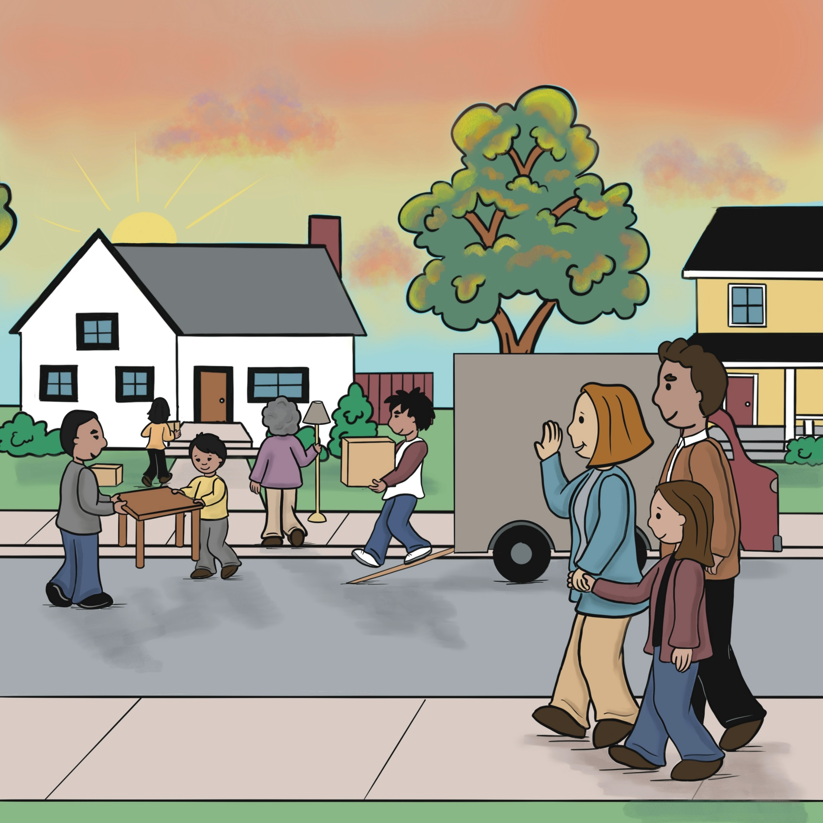
Unit 1: Where We Live

Slide 3
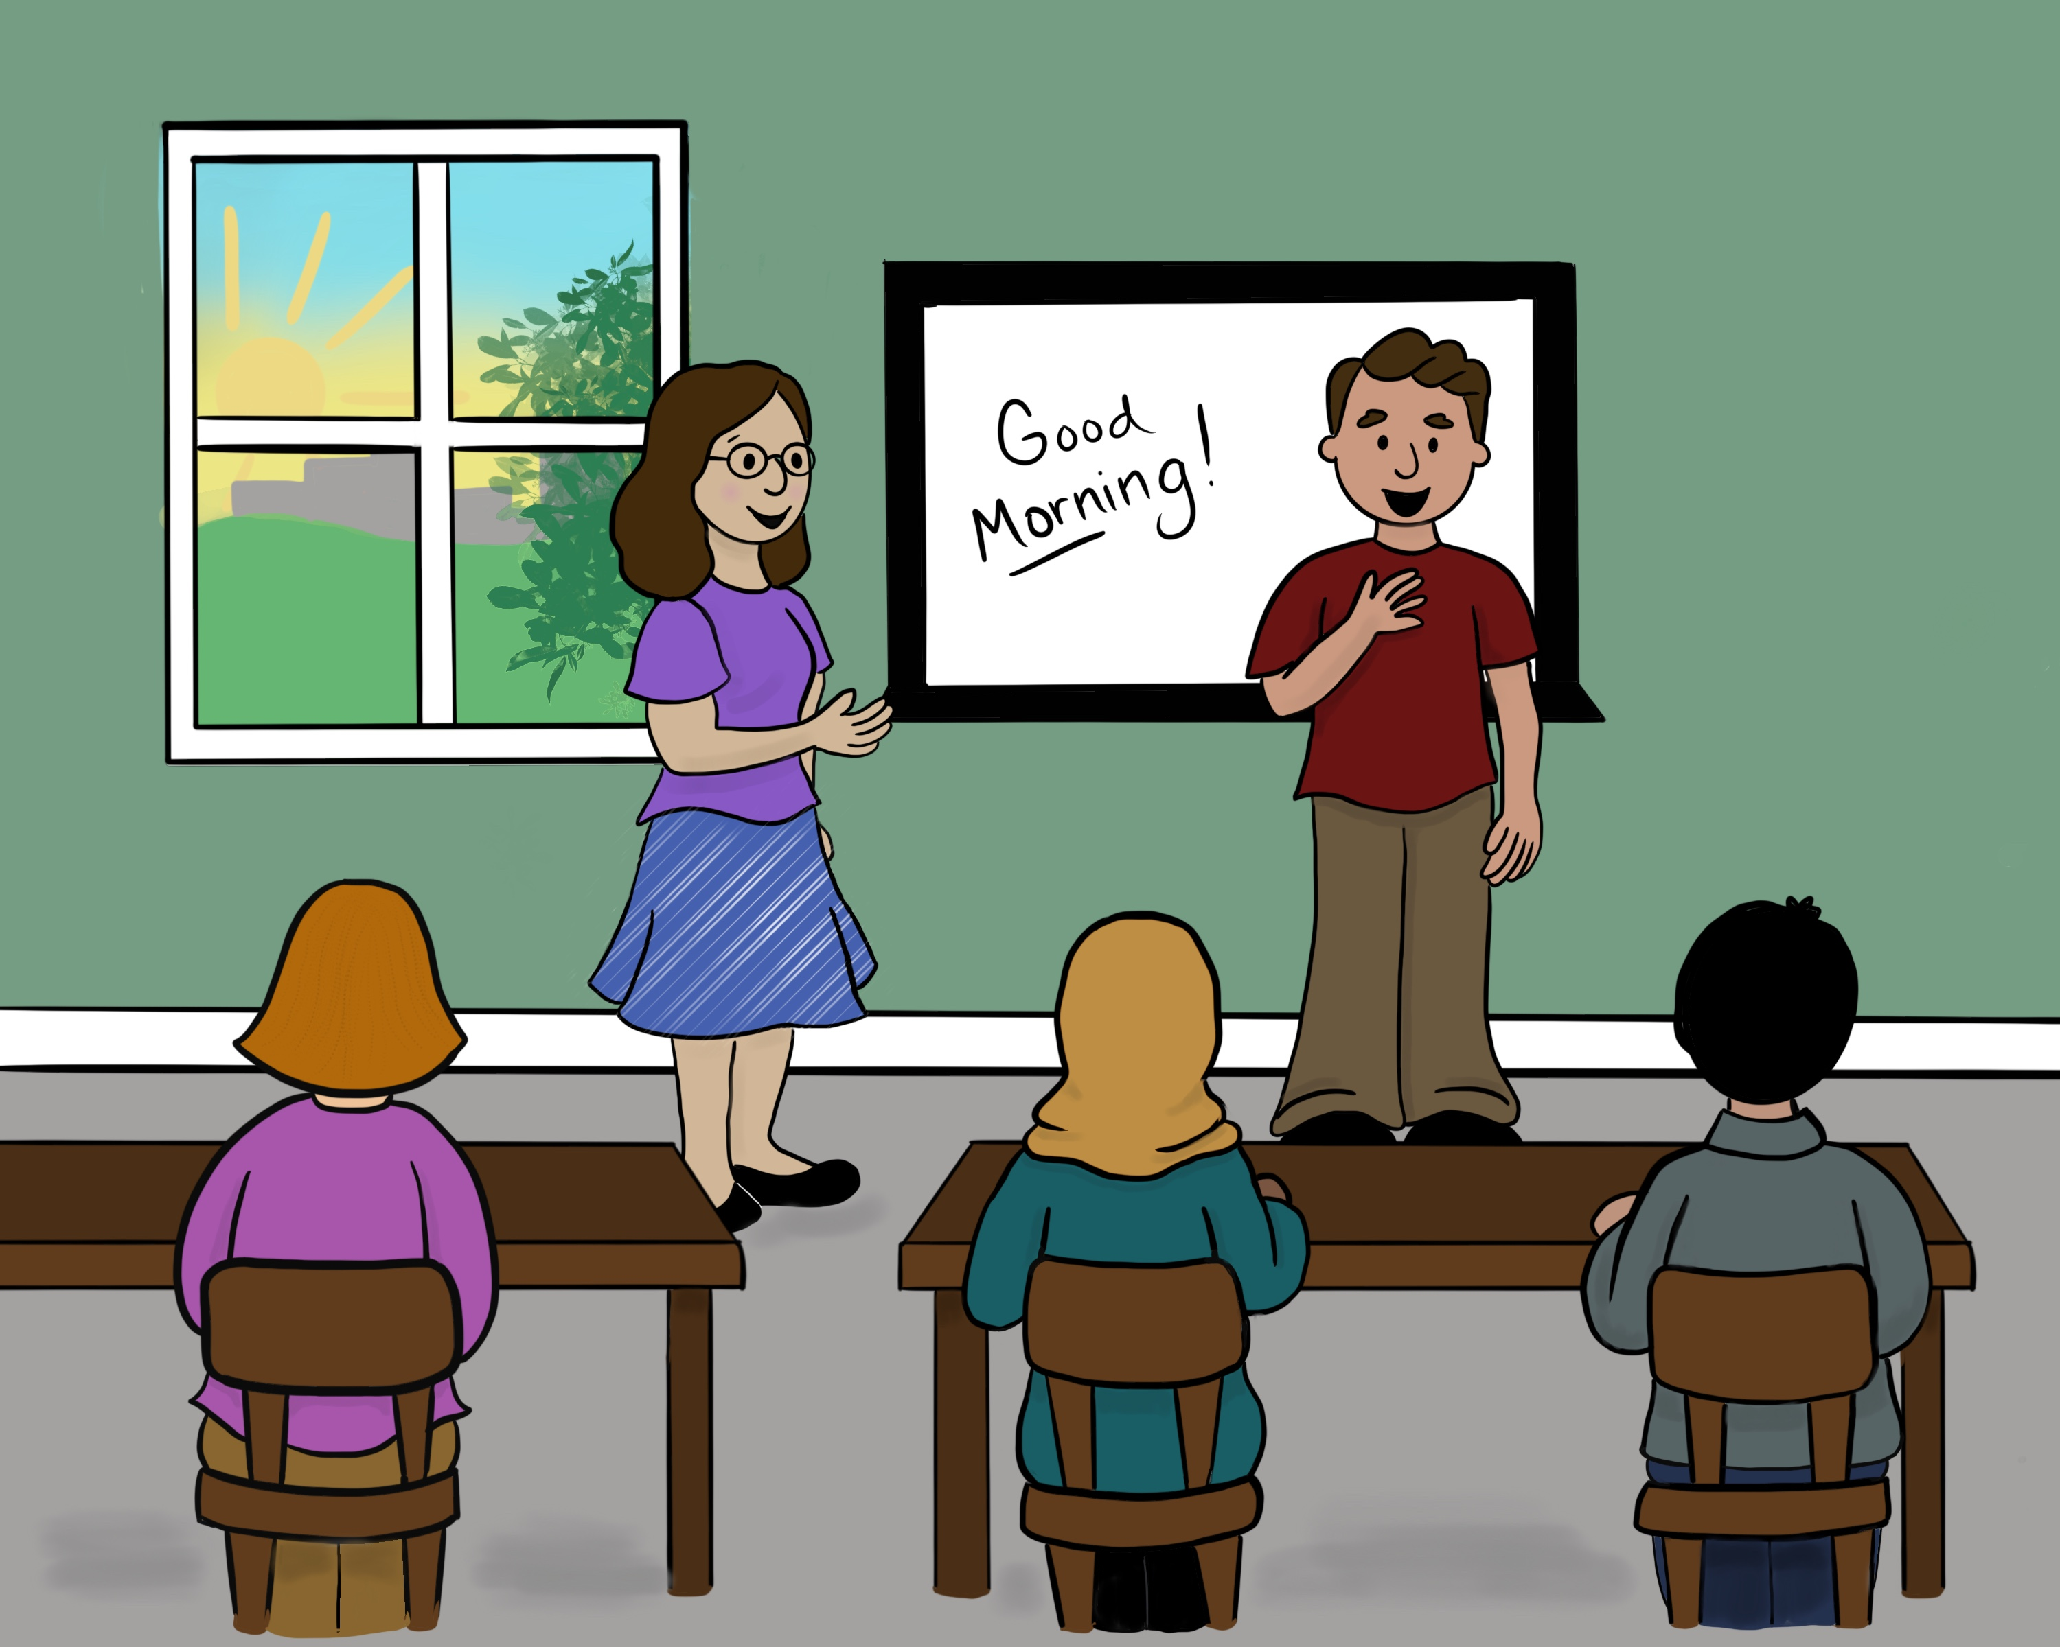
Lesson 1: Welcome to English Class!

Slide 4
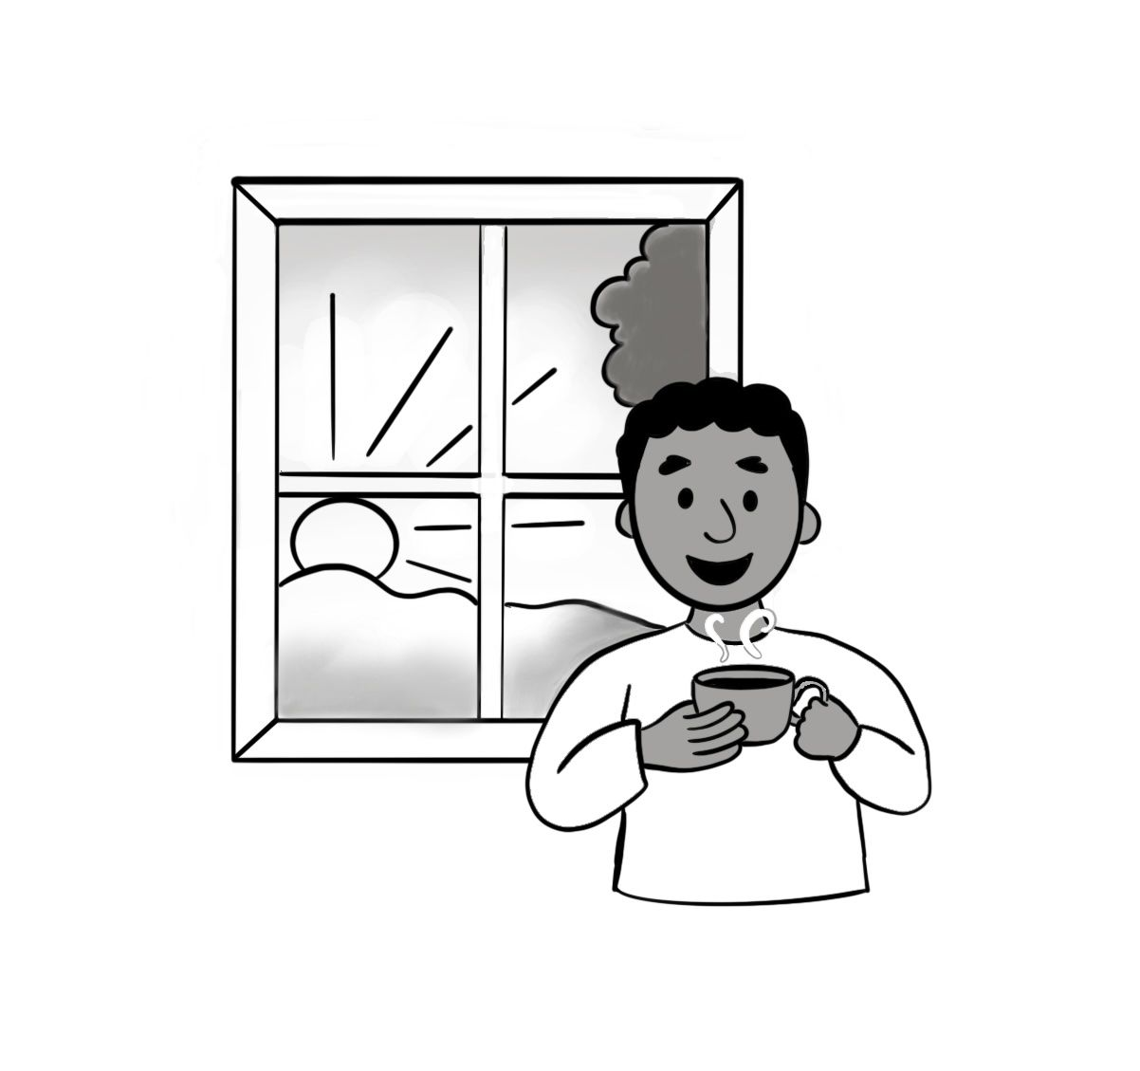
Good morning.

Slide 5
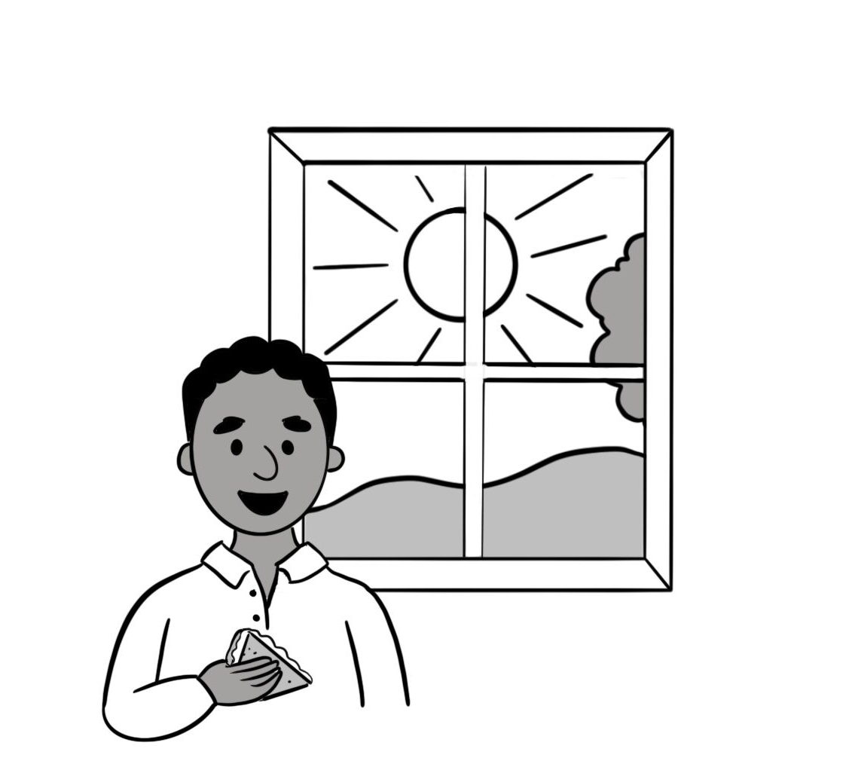
Good afternoon.

Slide 6
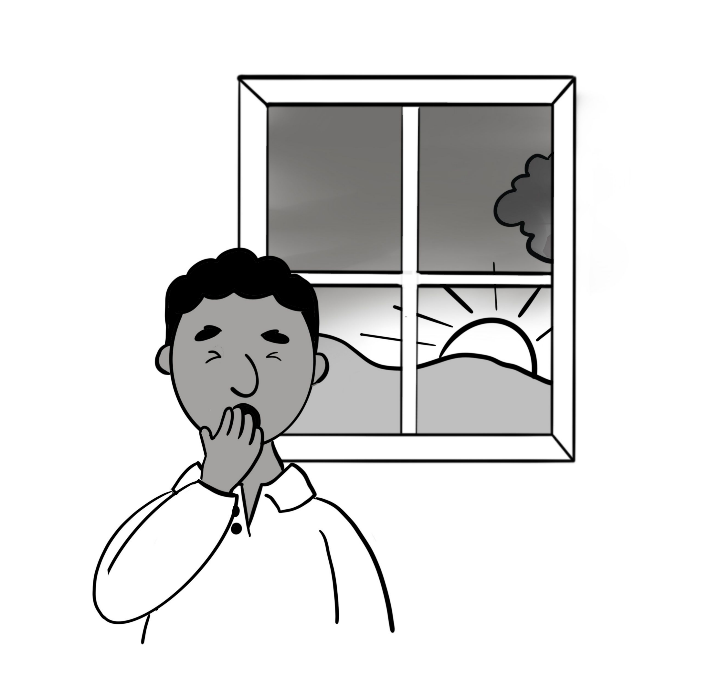
Good evening.

Slide 7
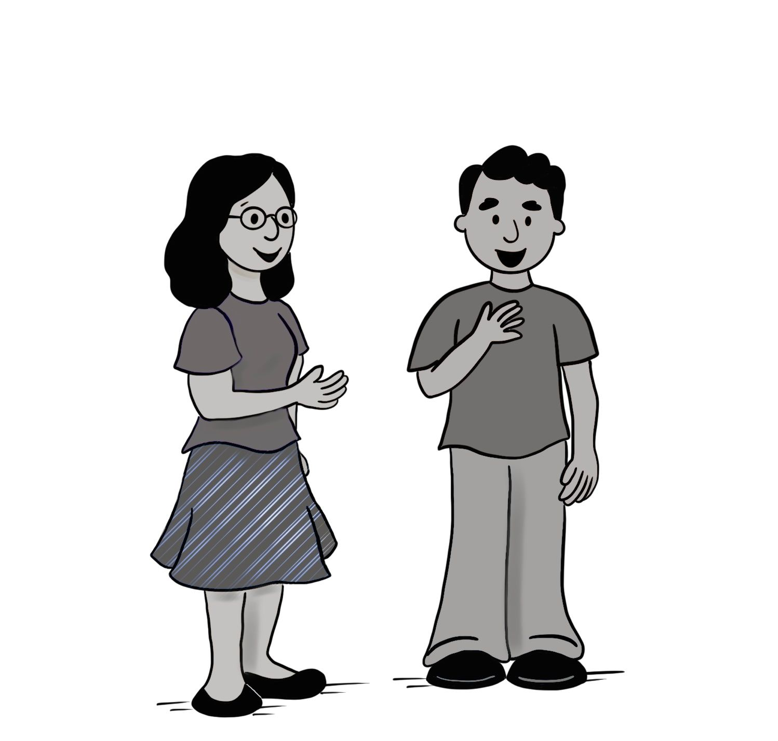
Tell me about yourself.

Slide 8
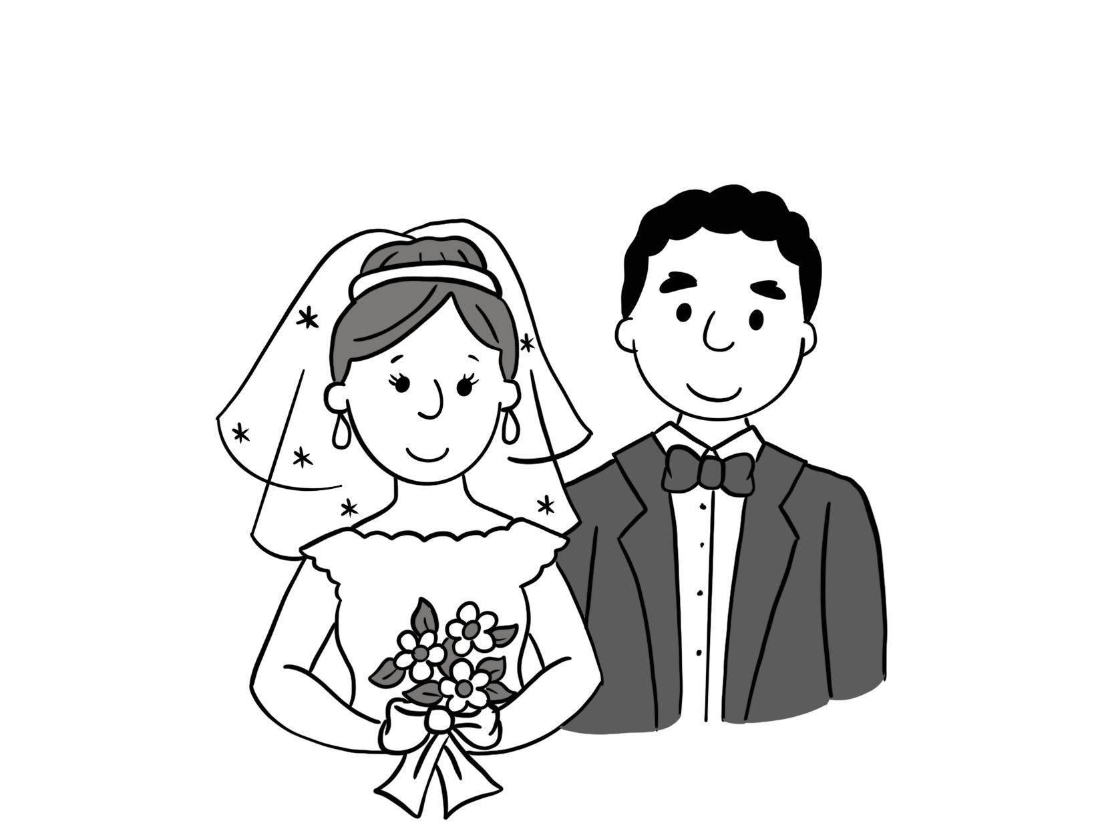
married

Slide 9
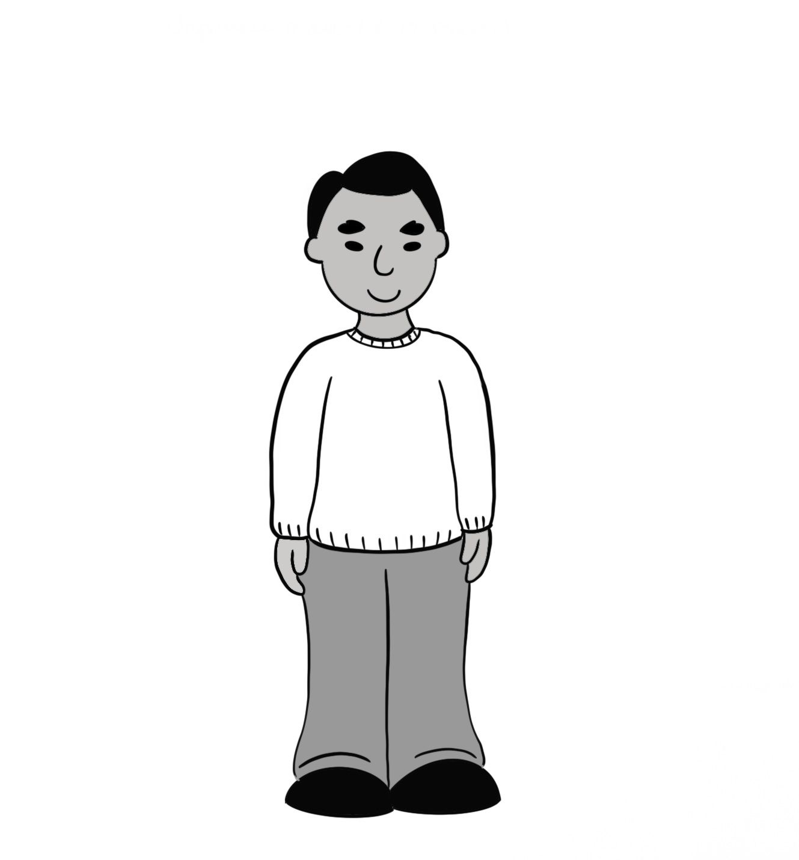
single

Slide 10
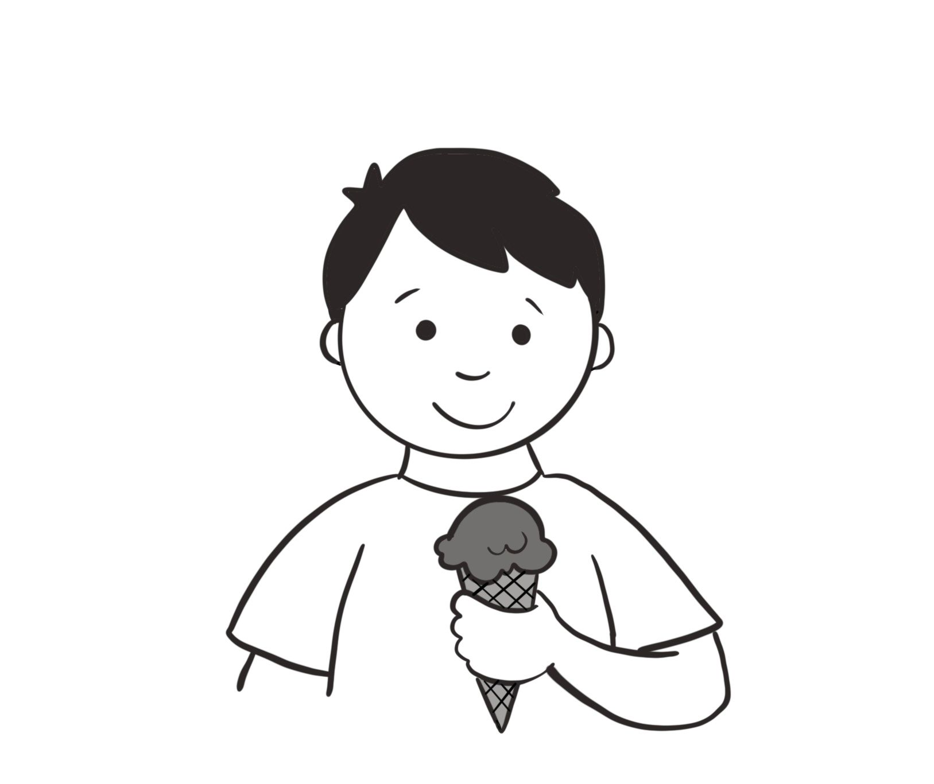
favorite

Slide 11
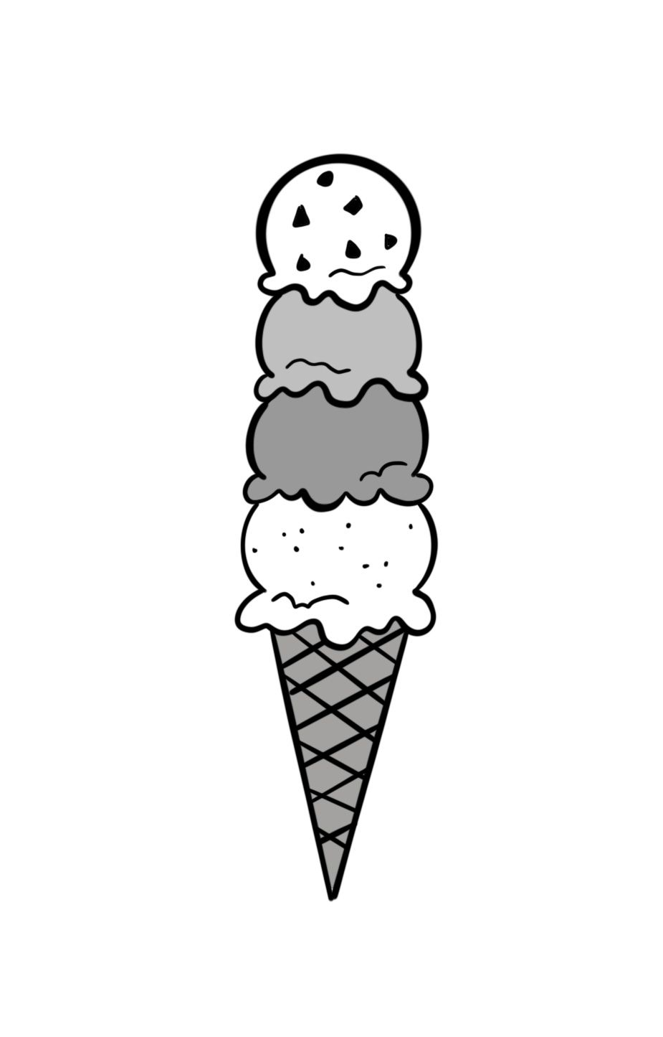
very much

Slide 12
A. Please tell us about yourself. B. I’m married, and my favorite food is pizza.
Sentences Using Vocabulary

Slide 13
A. Good morning, Paulo. B. Good morning. A. Please tell us about yourself. B. My name is Paulo. I’m from Brazil. I’m married, and my favorite food is pizza. A. Thank you very much!
Dialogue

Slide 14
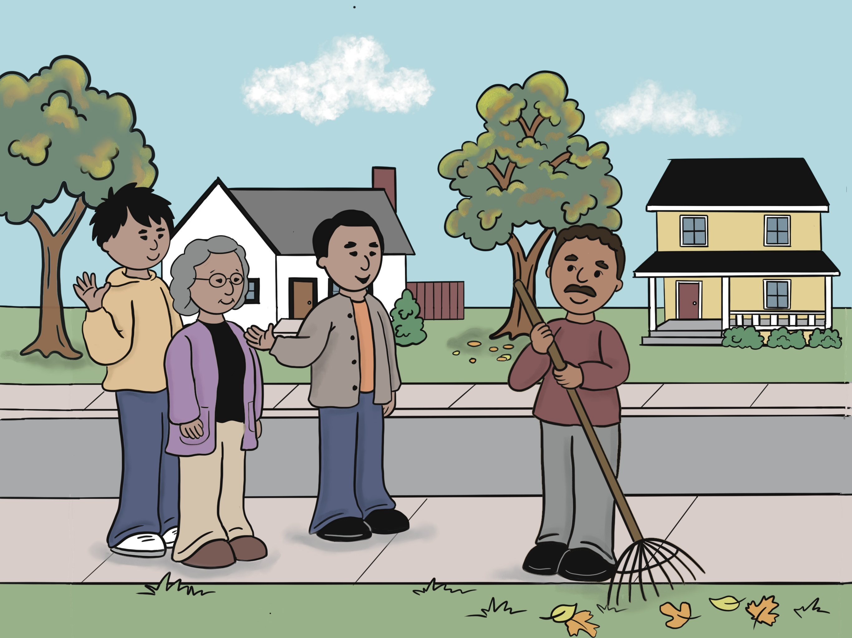
Lesson 2: This Is My Family.

Slide 15
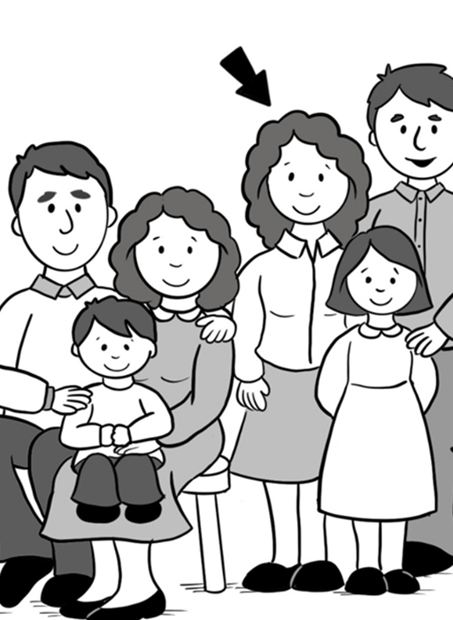
aunt

Slide 16
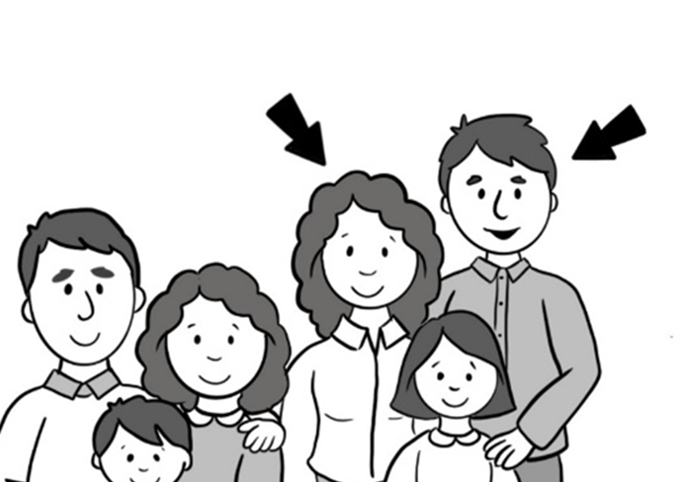
uncle

Slide 17
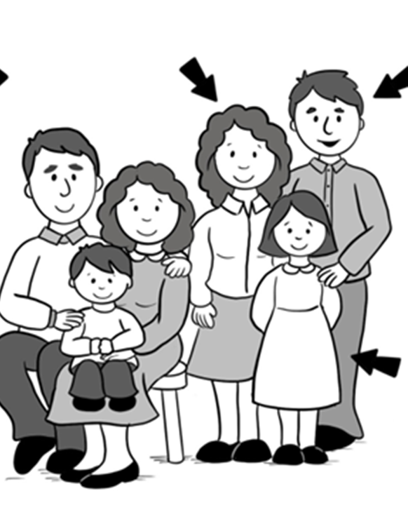
cousin

Slide 18
grandpa

Slide 19
grandma

Slide 20
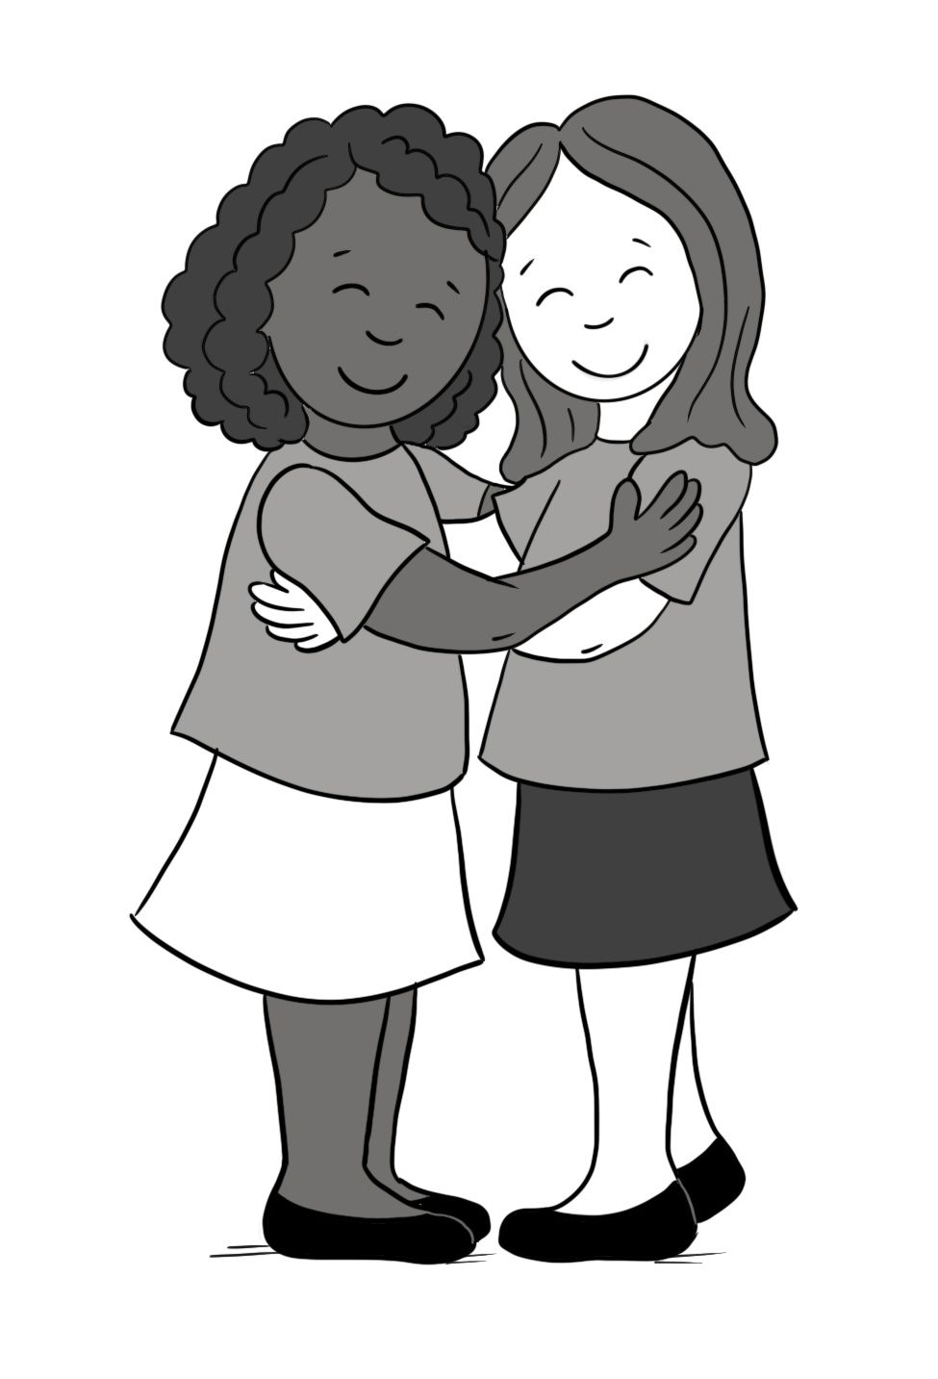
friend

Slide 21
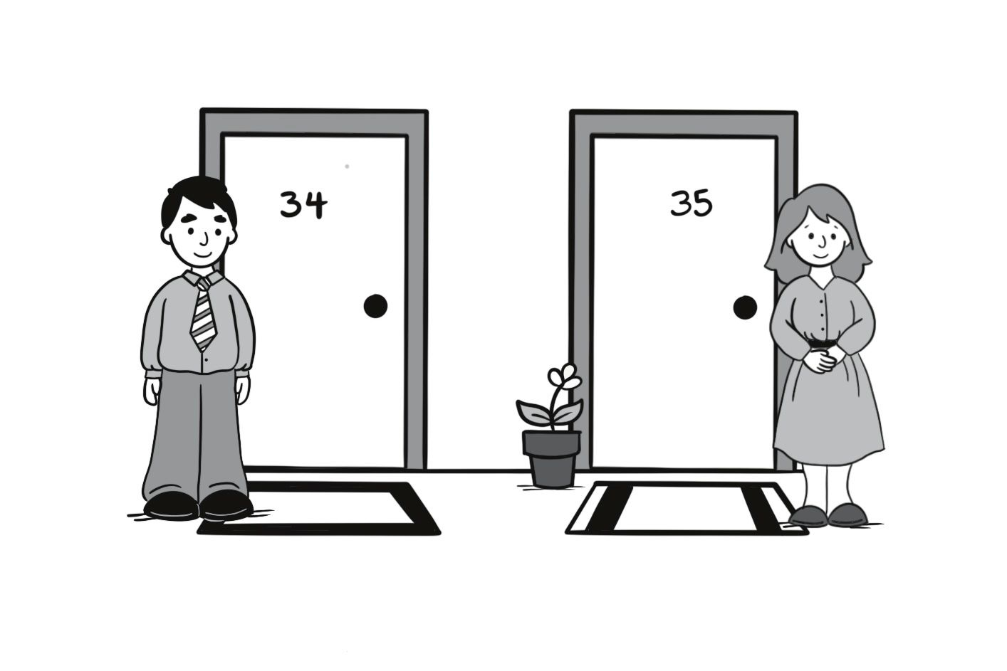
neighbor

Slide 22
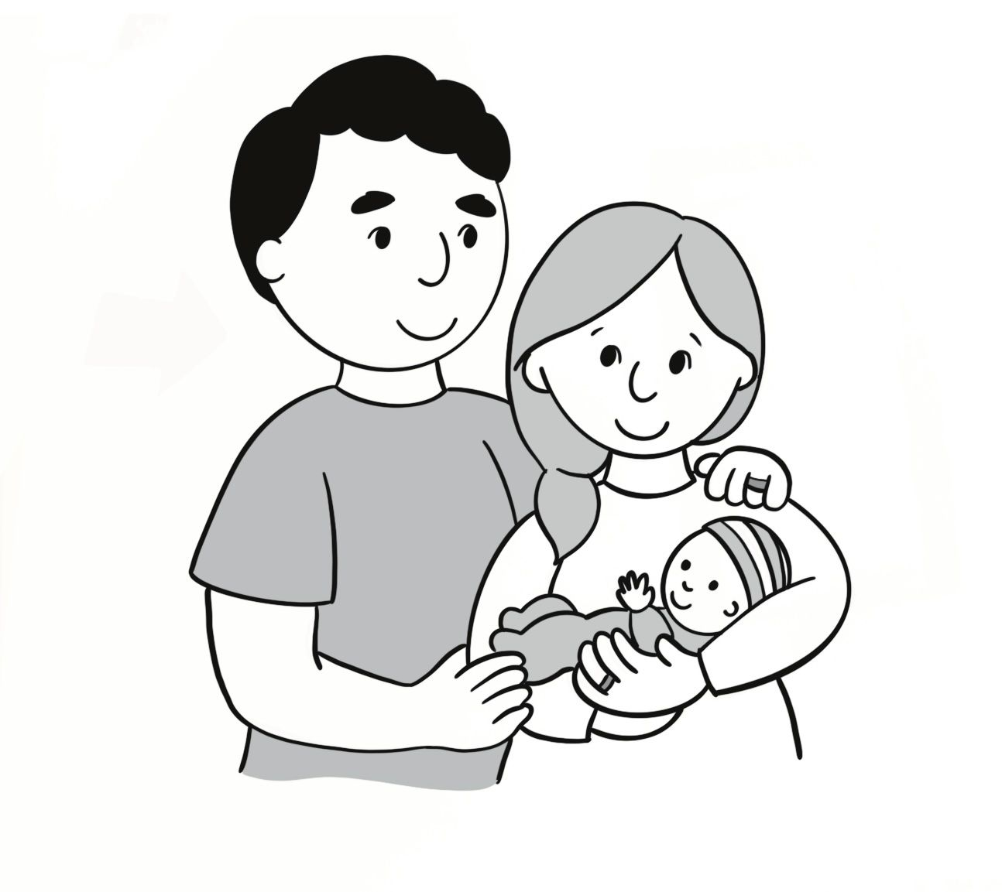
our

Slide 23
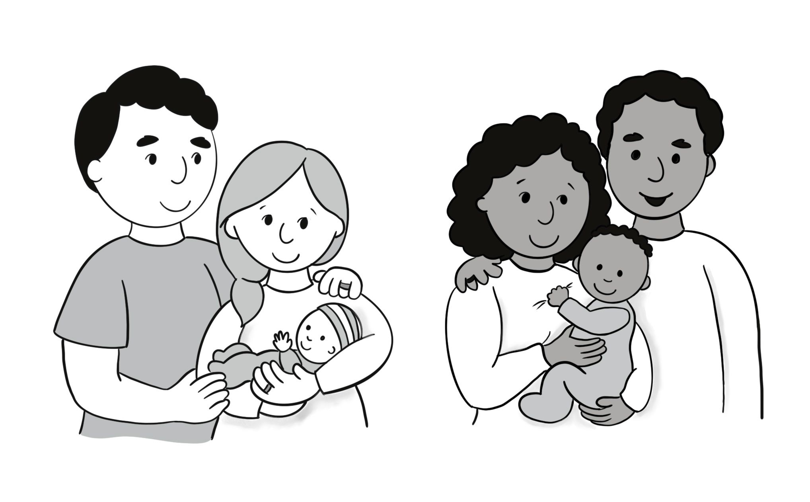
their

Slide 24
A. This is my cousin, and this is our grandma. B. Nice to meet you!
Sentences Using Vocabulary

Slide 25
A. Hey, Bima. B. Hey, Luis! This is my cousin, Adam, and this is our grandma, Hannah. A. Nice to meet you. C. Nice to meet you, too!
Dialogue

Slide 26
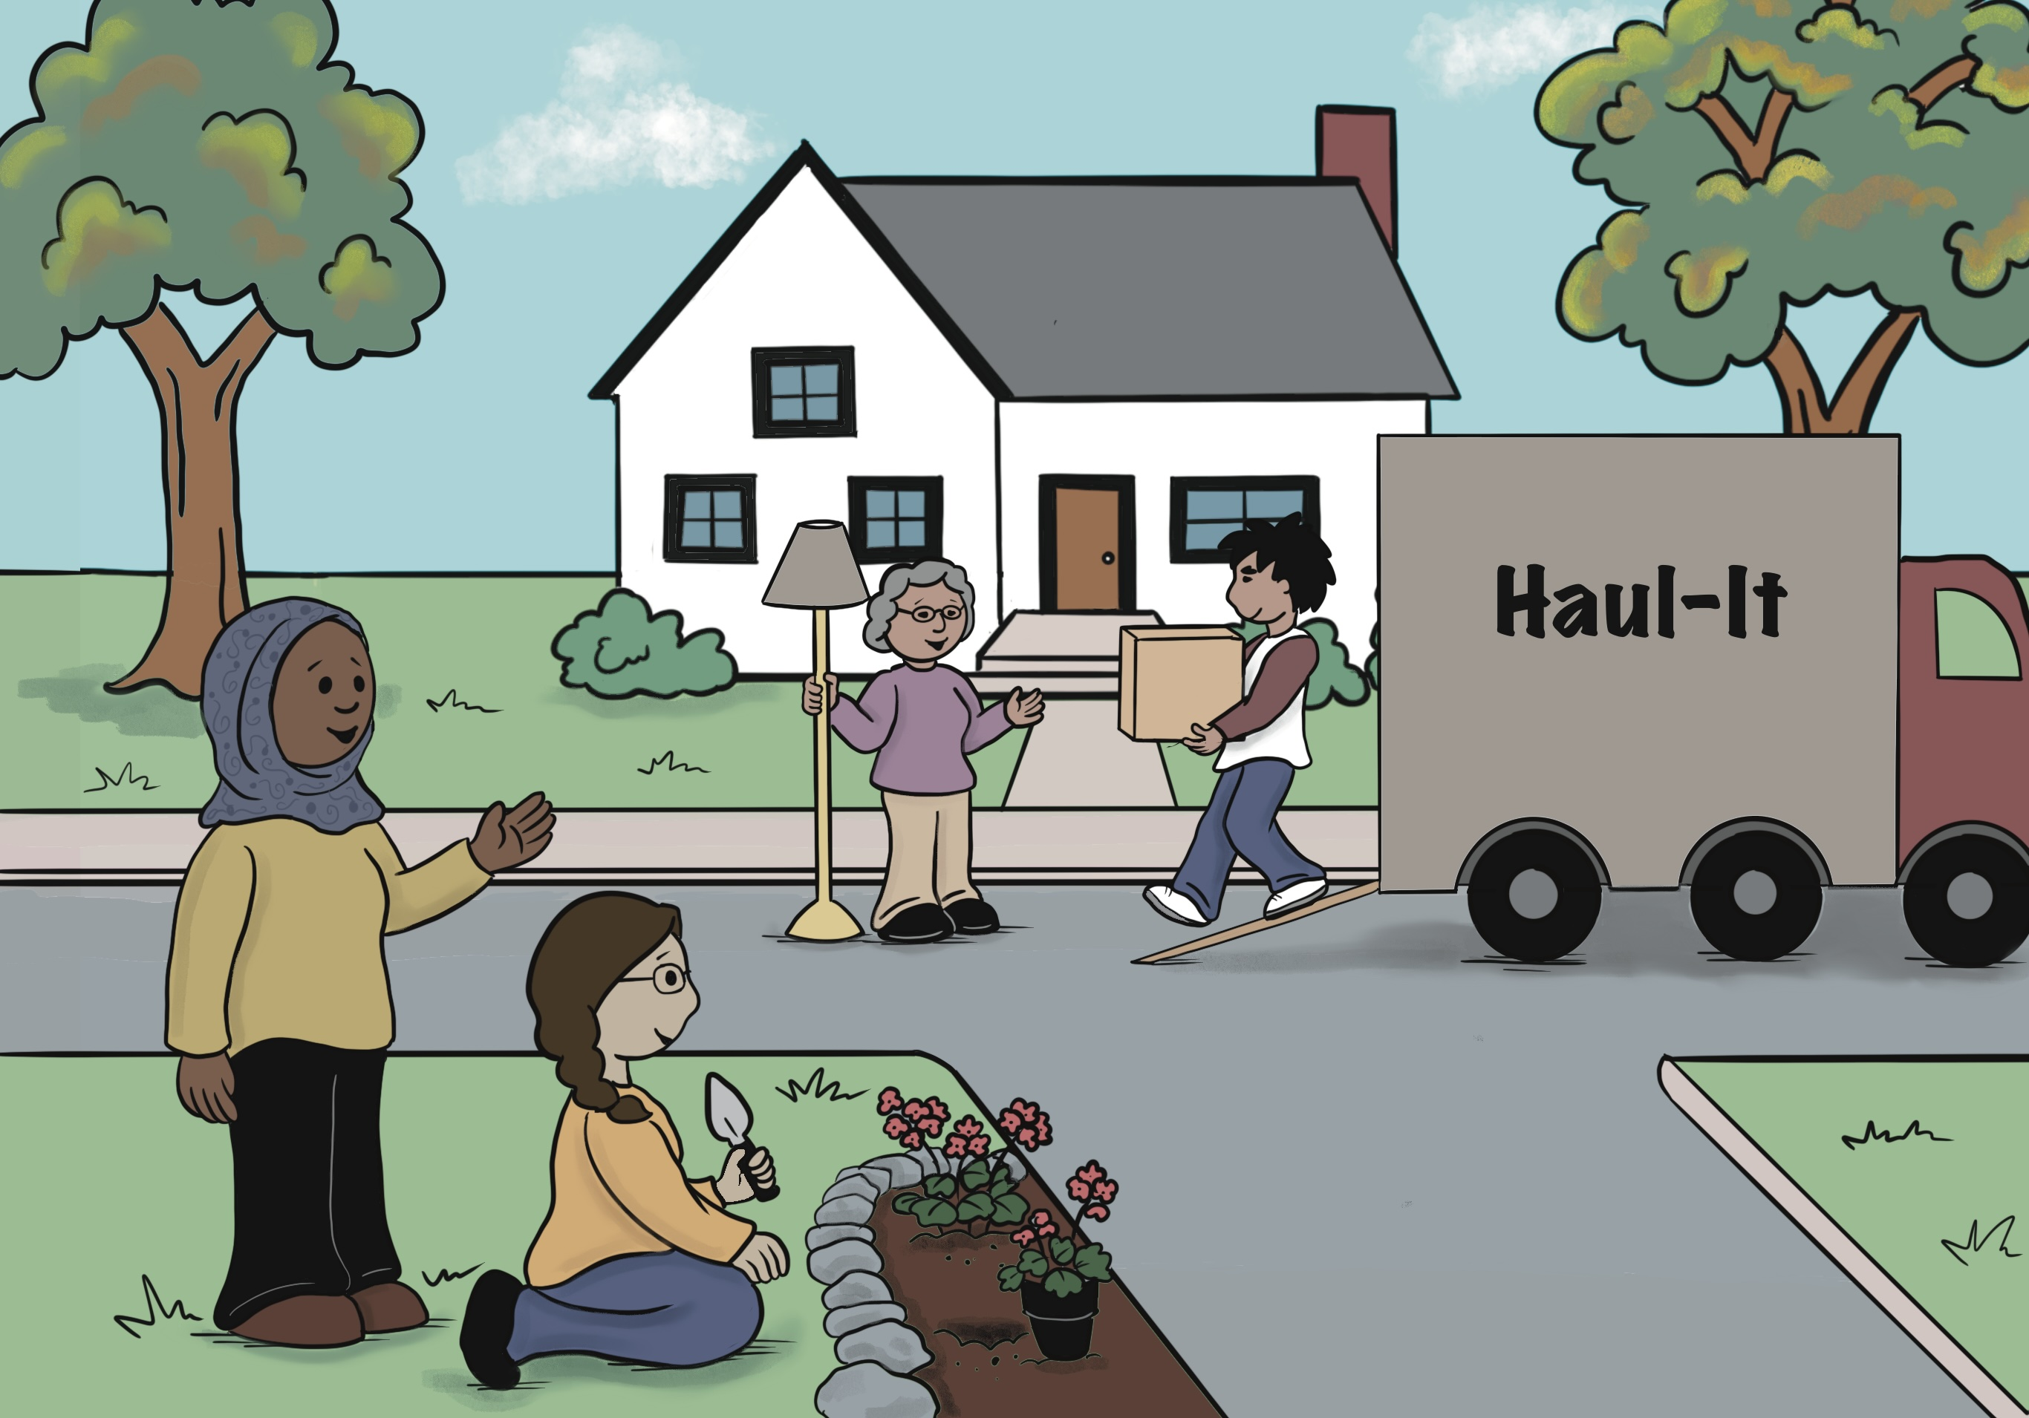
Lesson 3: There’s Our New Neighbor.

Slide 27
new

Slide 28
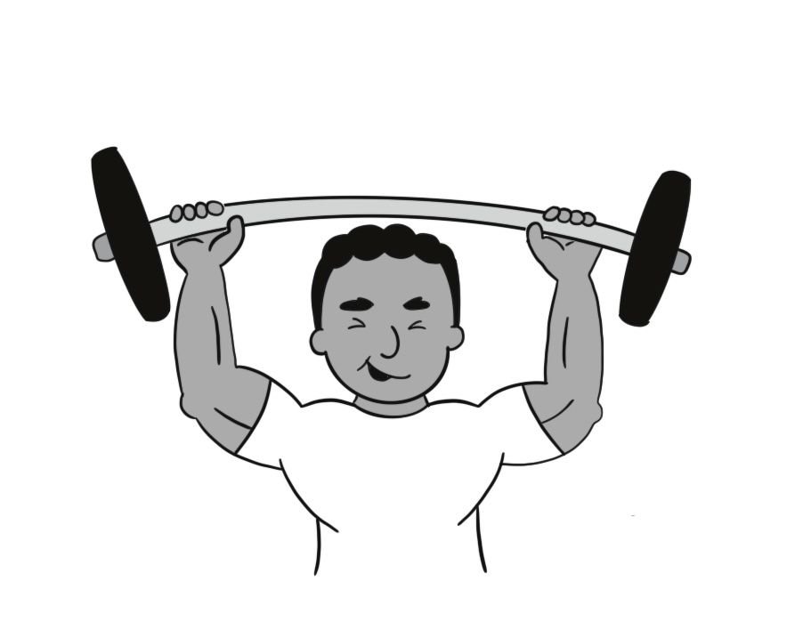
strong

Slide 29
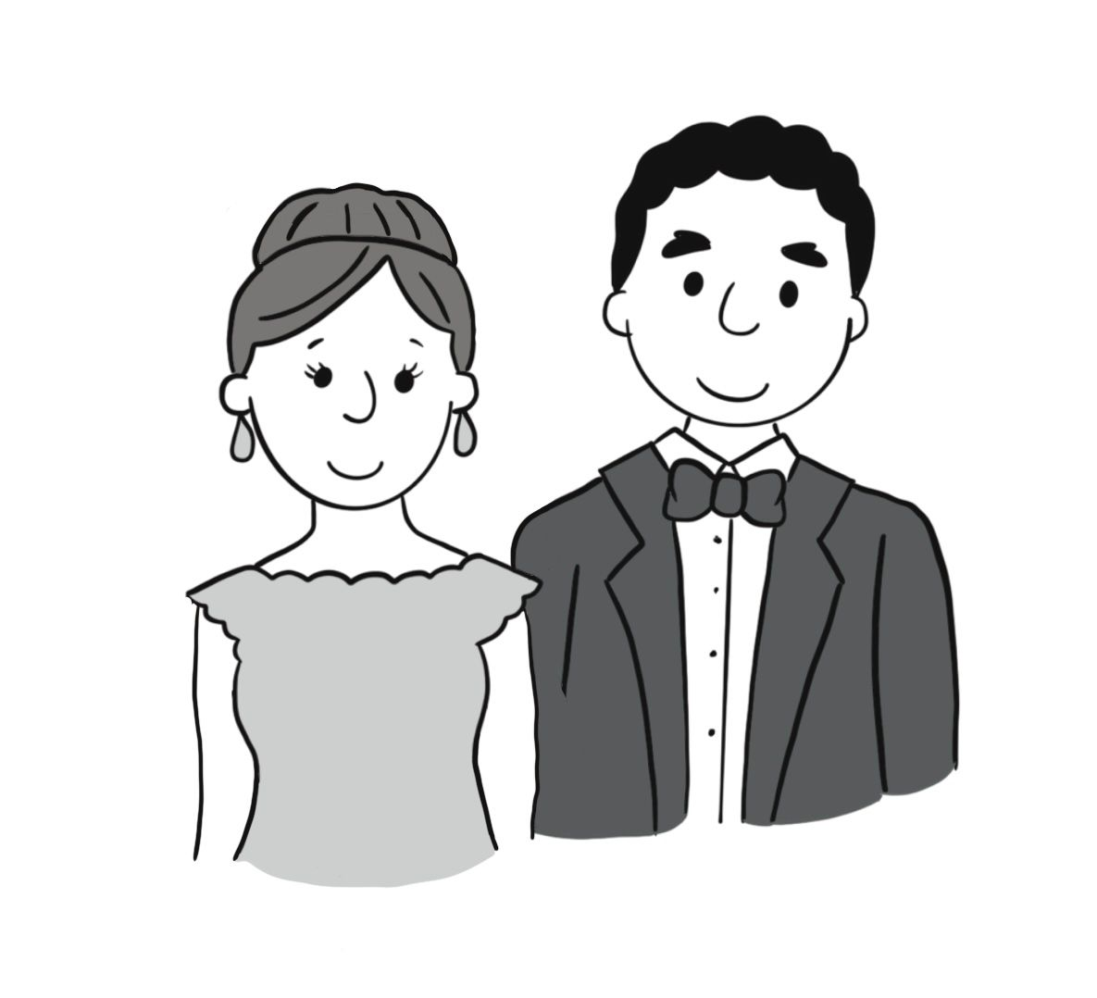
attractive

Slide 30
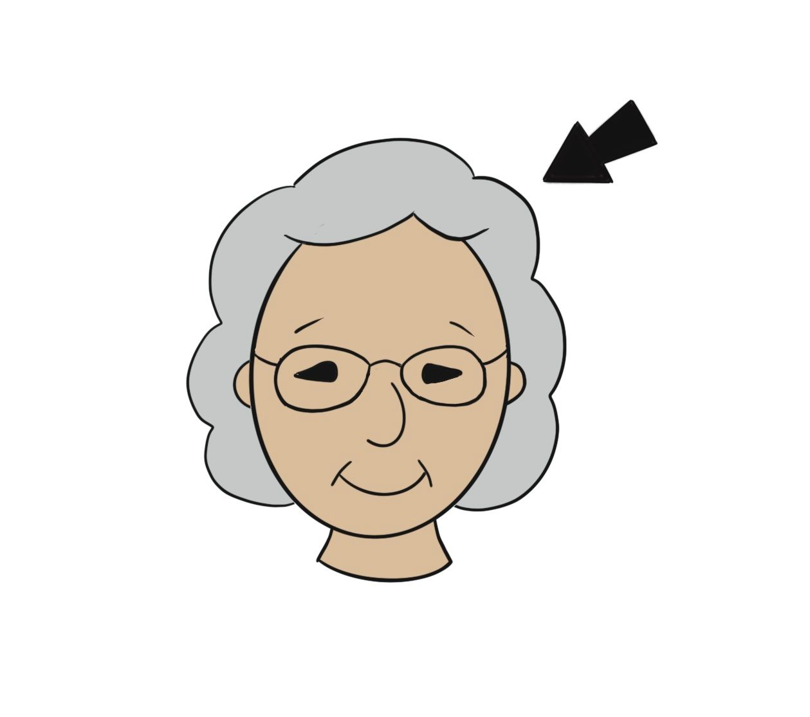
gray-haired

Slide 31
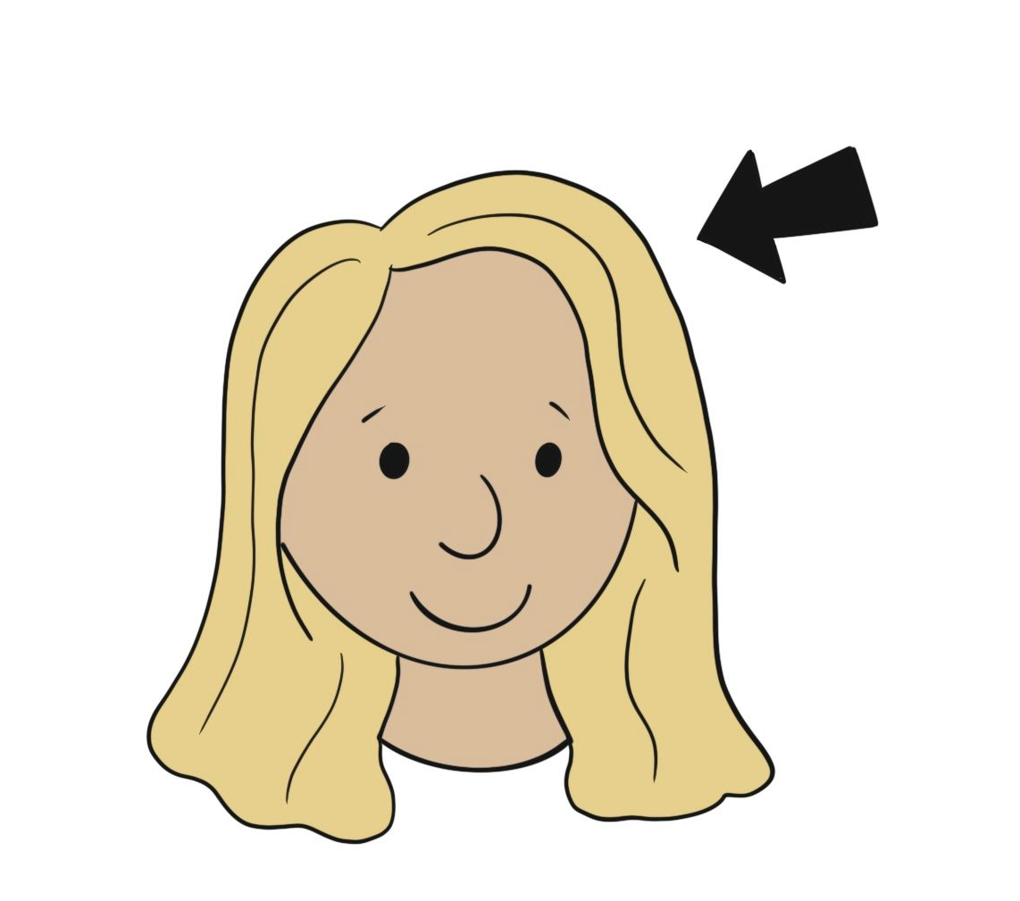
blond

Slide 32
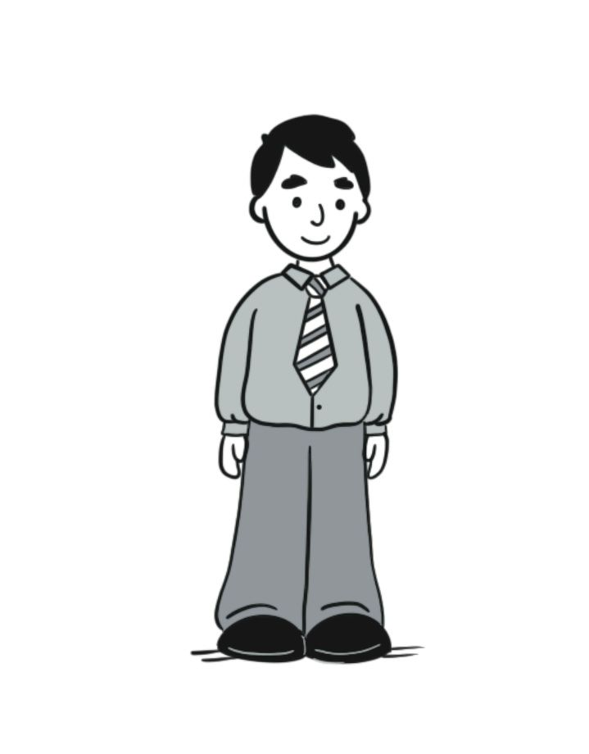
adult

Slide 33
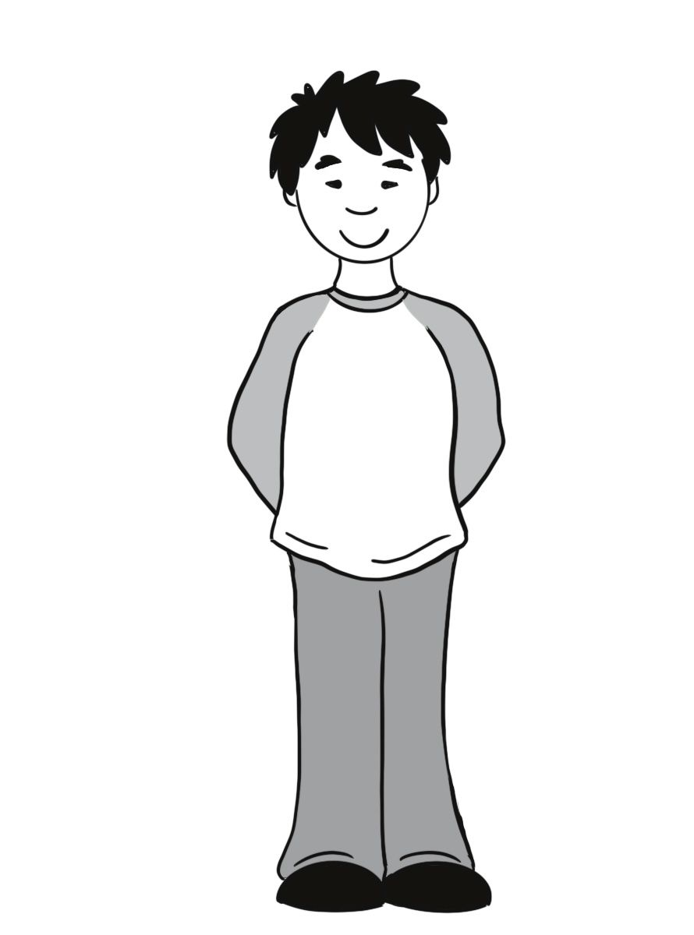
teenager

Slide 34
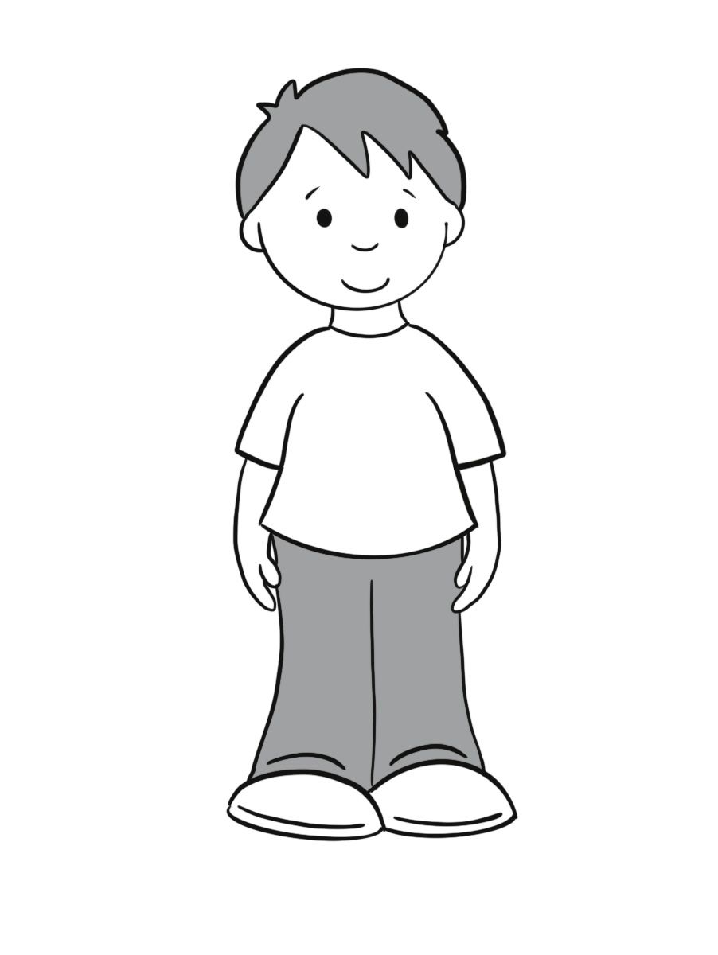
child (children)

Slide 35
kid

Slide 36
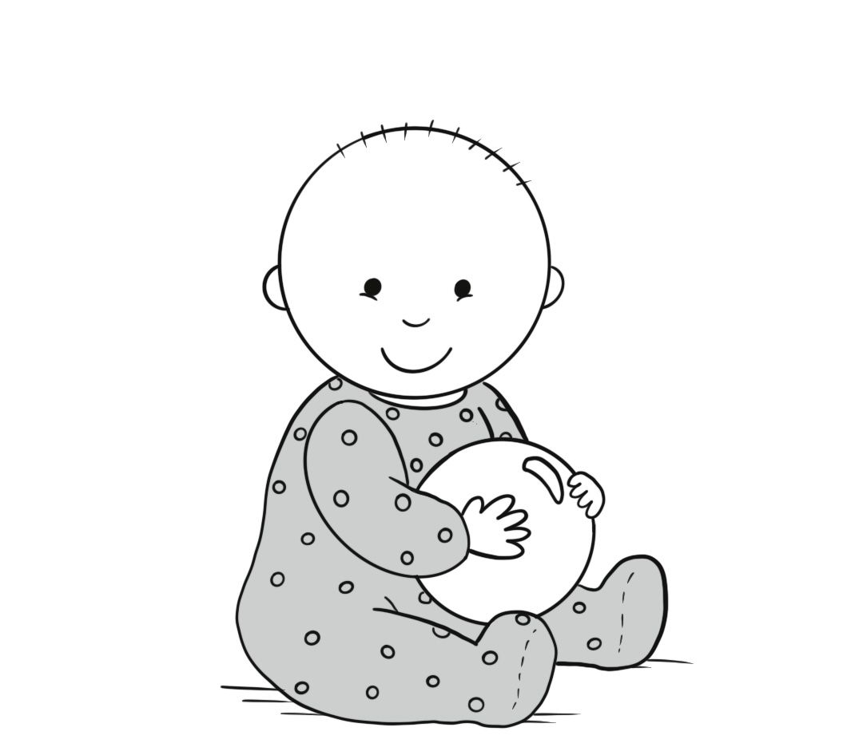
baby (babies)

Slide 37
A. Tell me about him. B. Adam is a teenager. He is strong.
Sentences Using Vocabulary 1

Slide 38
A. Who is the gray-haired woman? B. That’s Hannah.
Sentences Using Vocabulary 2

Slide 39
A. Hey, there are our new neighbors! B. Tell me about them. A. Adam is a teenager. He is strong. B. Who is the gray-haired woman? A. That’s Hannah.
Dialogue

Slide 40
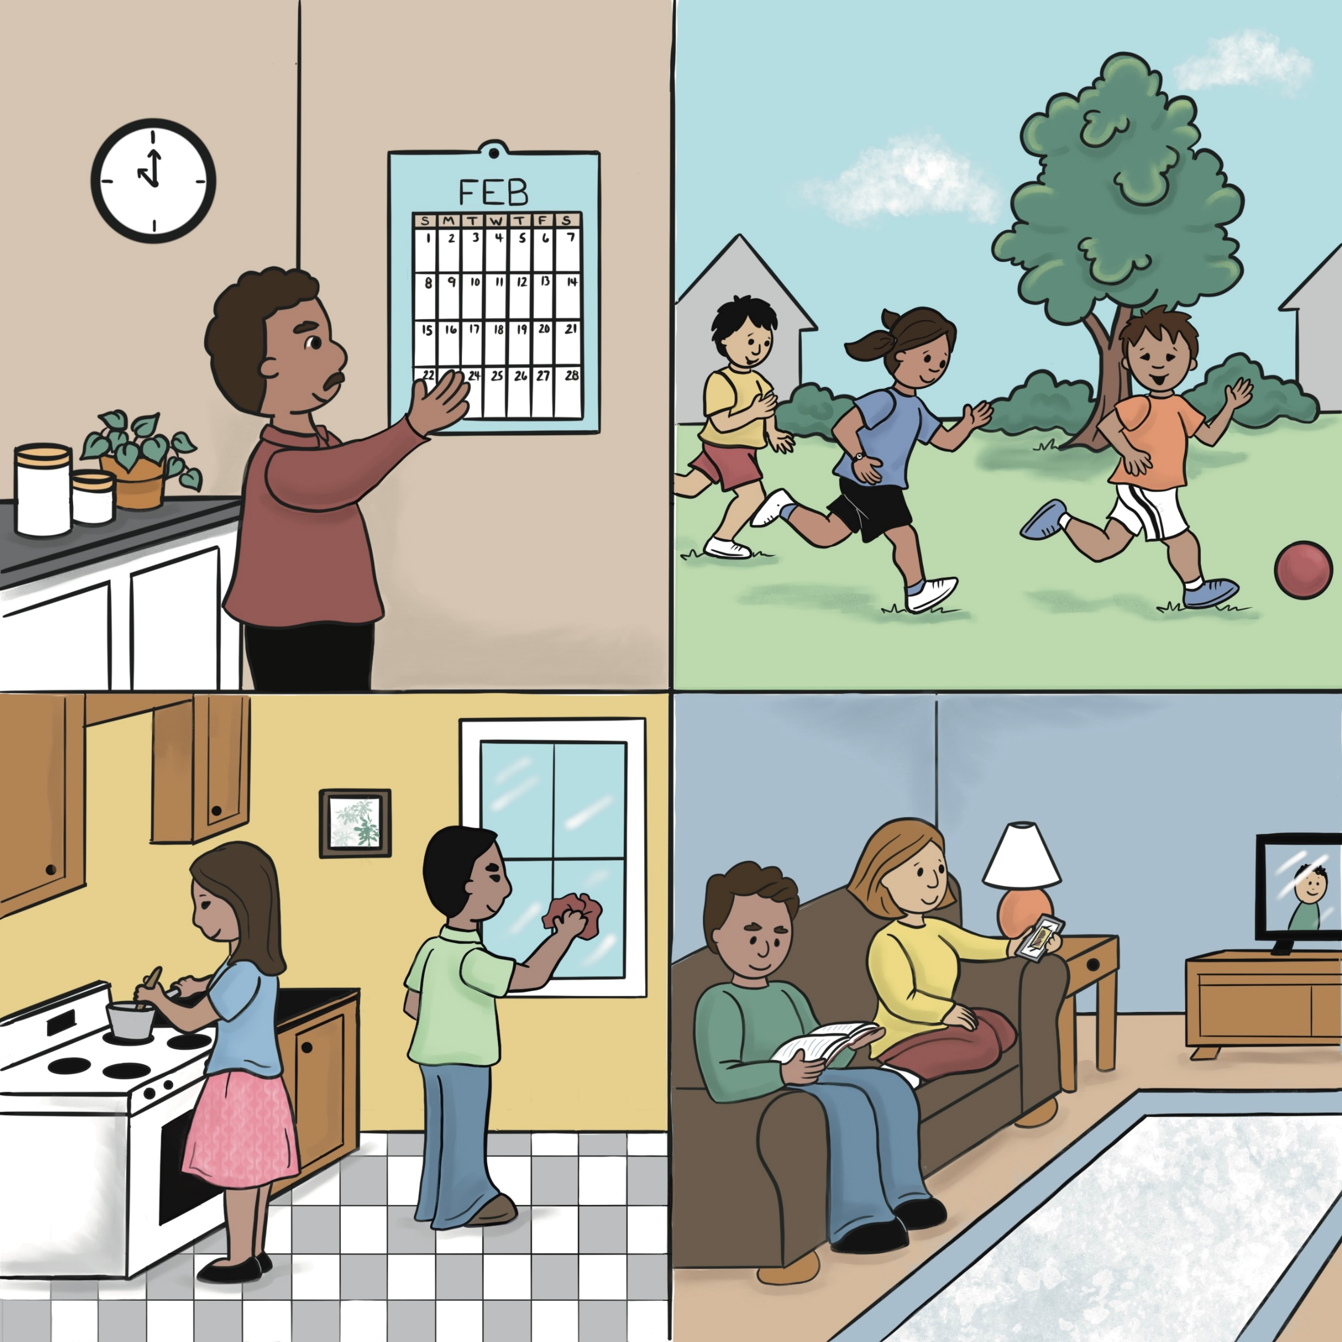
Unit 2: What We Do Every Day

Slide 41
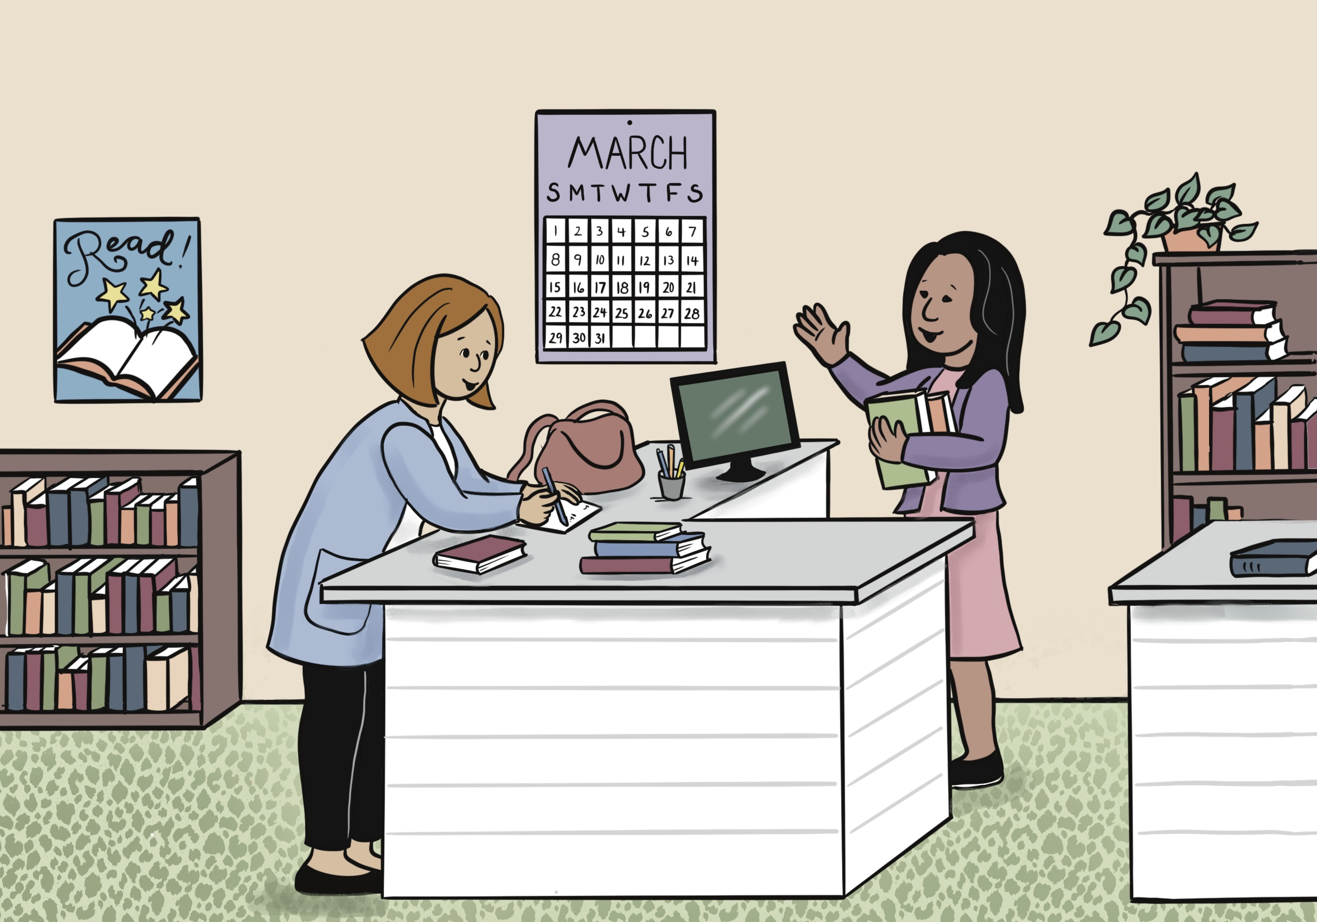
Lesson 4: What Month Is It?

Slide 42
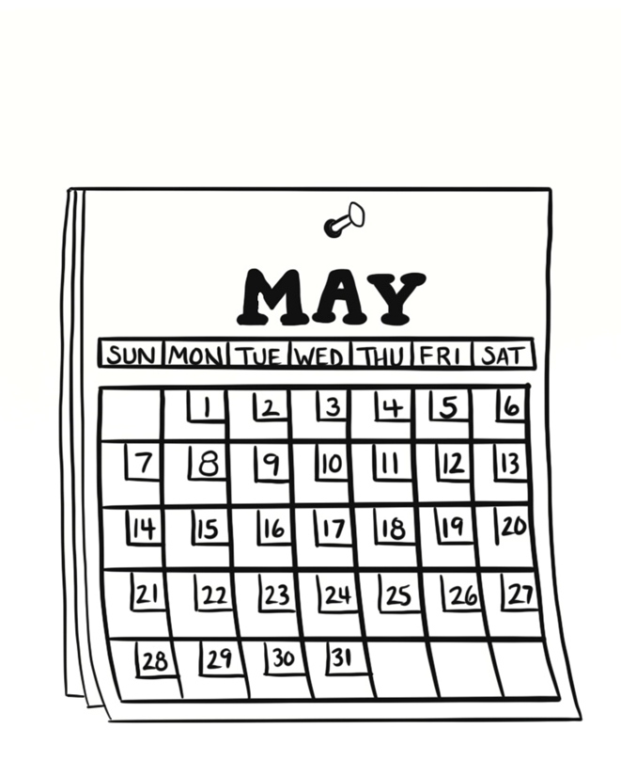
month

Slide 43
date
“Wednesday, September 4, 2024”

Slide 44
January

Slide 45
February

Slide 46
March

Slide 47
April

Slide 48
May

Slide 49
June

Slide 50
July

Slide 51
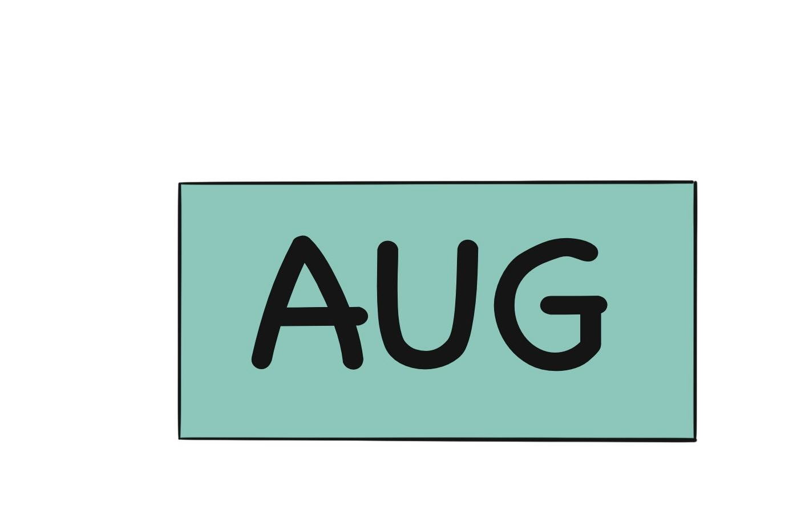
August

Slide 52
September

Slide 53
October

Slide 54
November

Slide 55
December

Slide 56
A. What month is it? B. It’s September.
Sentences Using Vocabulary

Slide 57
A. What month is it? B. It’s September. A. What’s the date? B. It’s Wednesday, September 4.
Dialogue

Slide 58
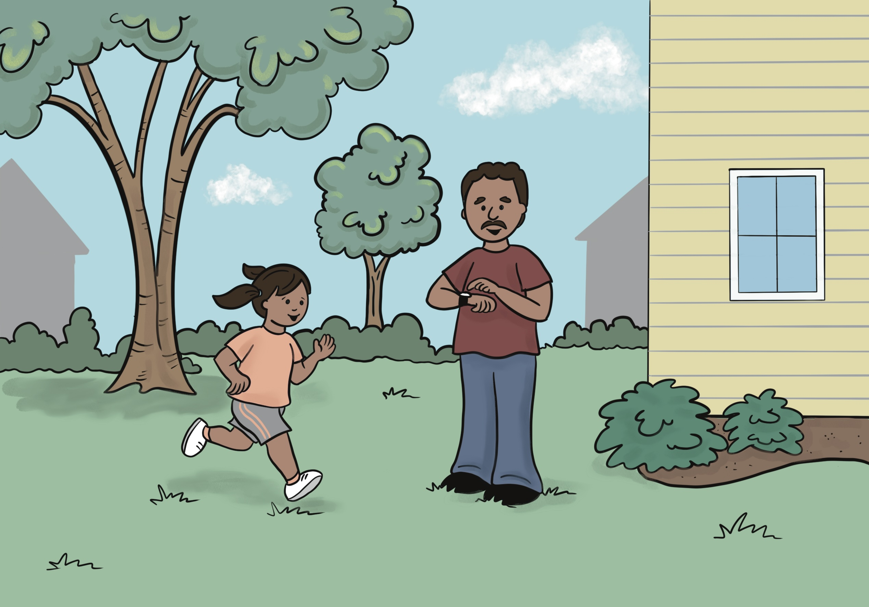
Lesson 5: Go, Go, Go!

Slide 59
hour

Slide 60
minute

Slide 61
second

Slide 62
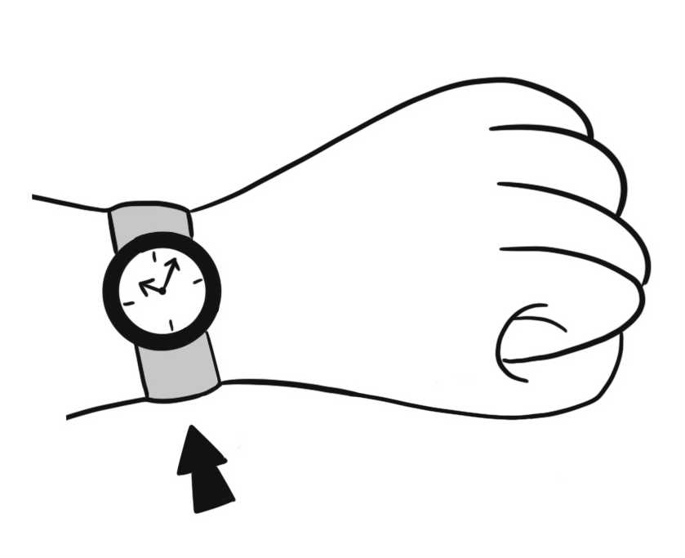
watch

Slide 63
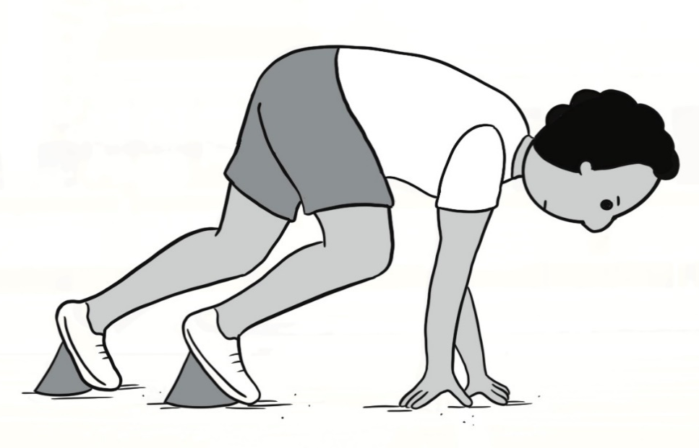
start

Slide 64
stop

Slide 65
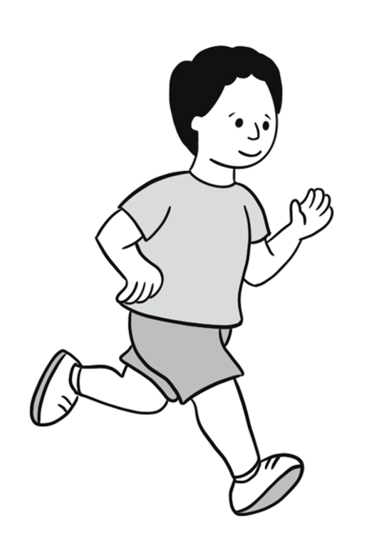
run

Slide 66
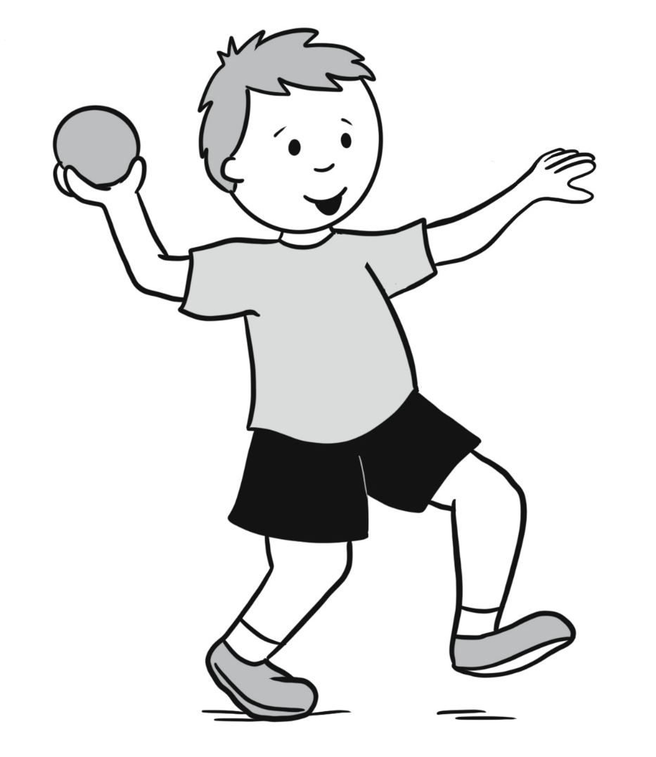
throw

Slide 67
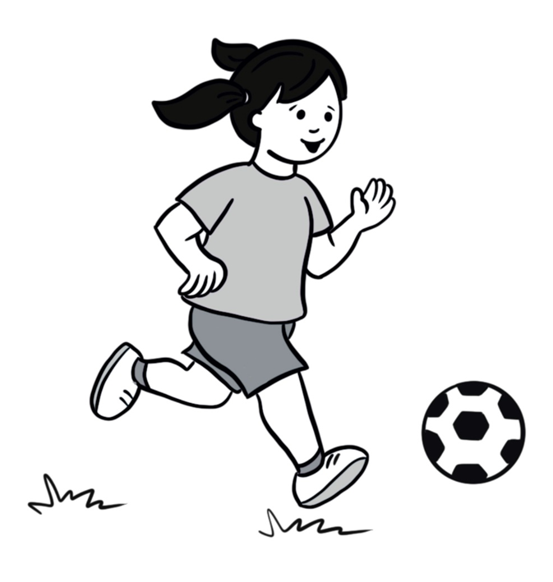
kick

Slide 68
A. Can you run for five minutes? B. Yes, I can!
Sentences Using Vocabulary

Slide 69
A. Dad, I am running! B. Great job! Can you run for five minutes? A. Yes, I can! B. I am starting my watch! Go!
Dialogue

Slide 70
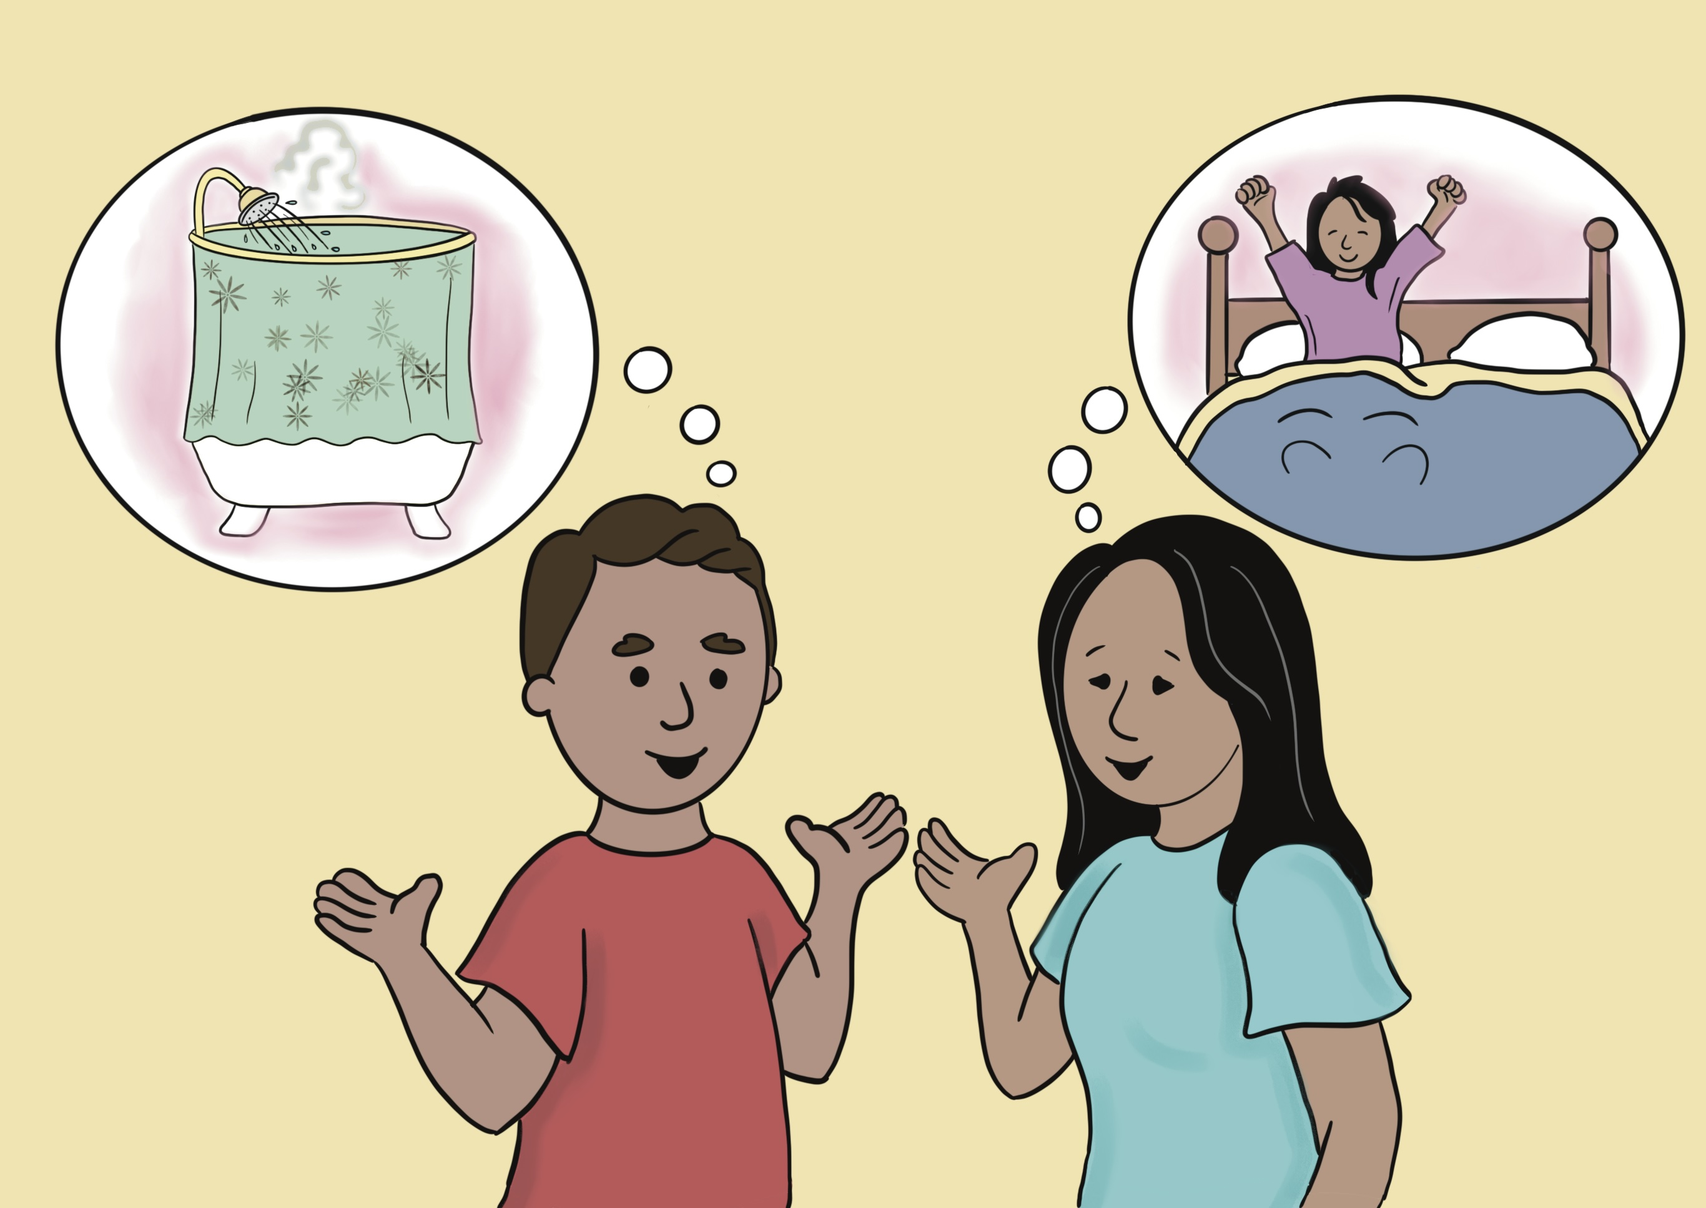
Lesson 6: Every Day, I Get Up.

Slide 71
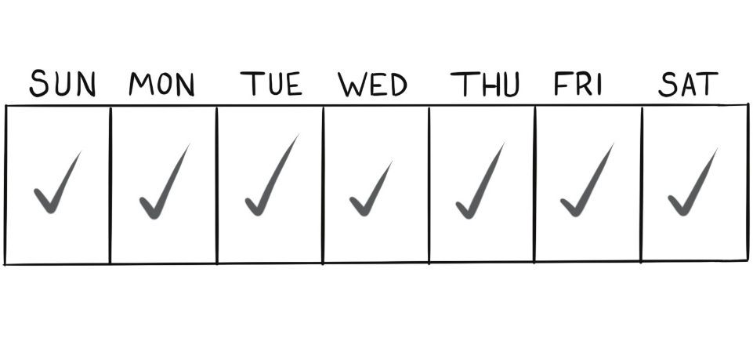
every day

Slide 72
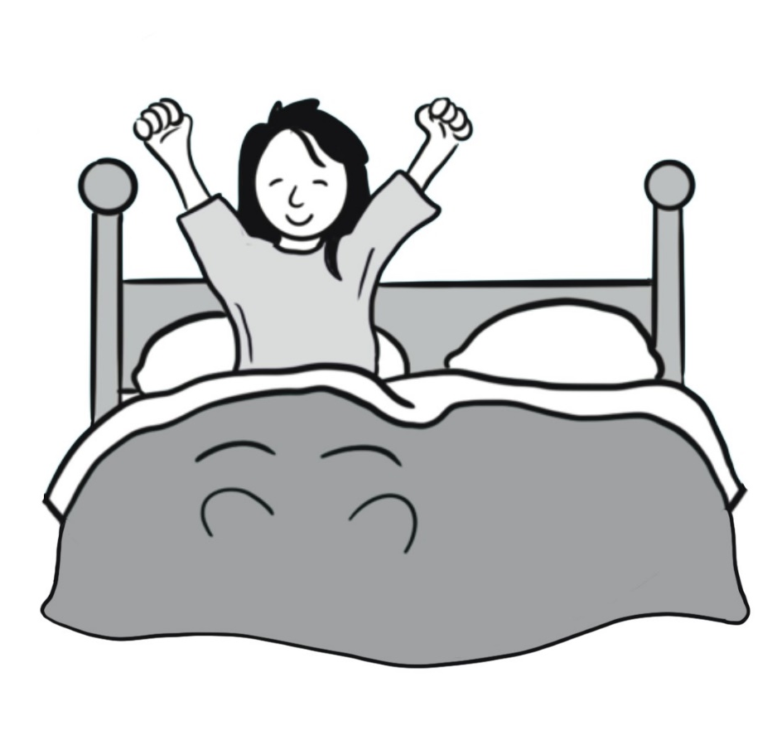
get up

Slide 73
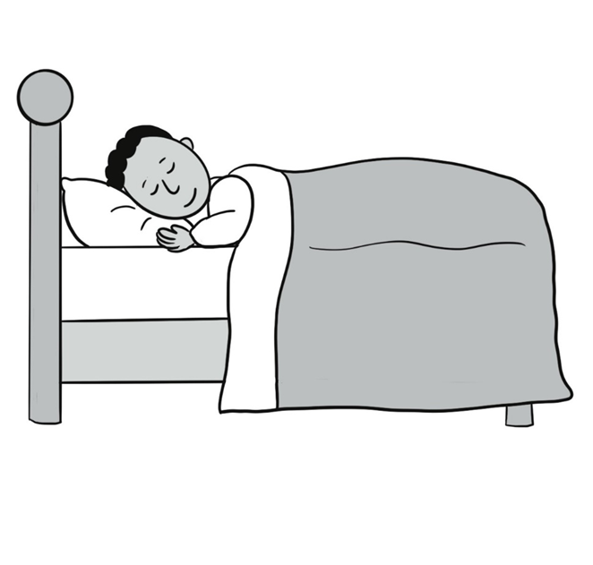
go to sleep

Slide 74
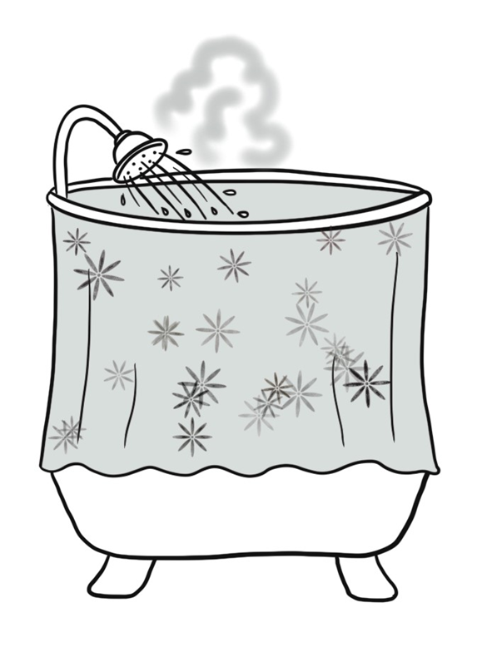
take a shower

Slide 75
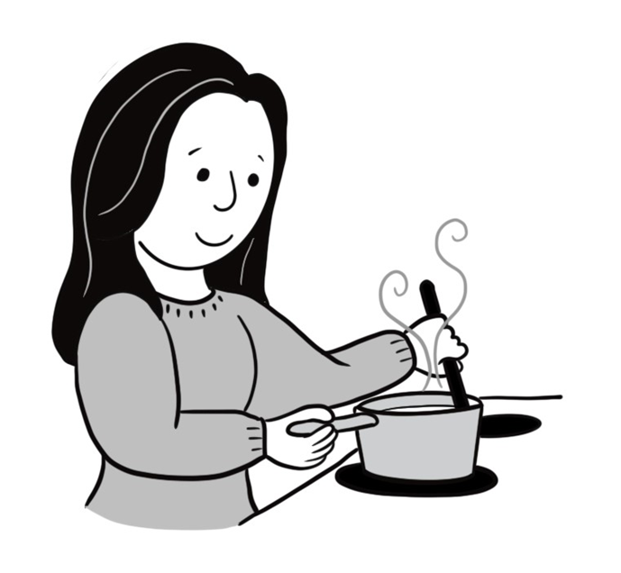
make food

Slide 76
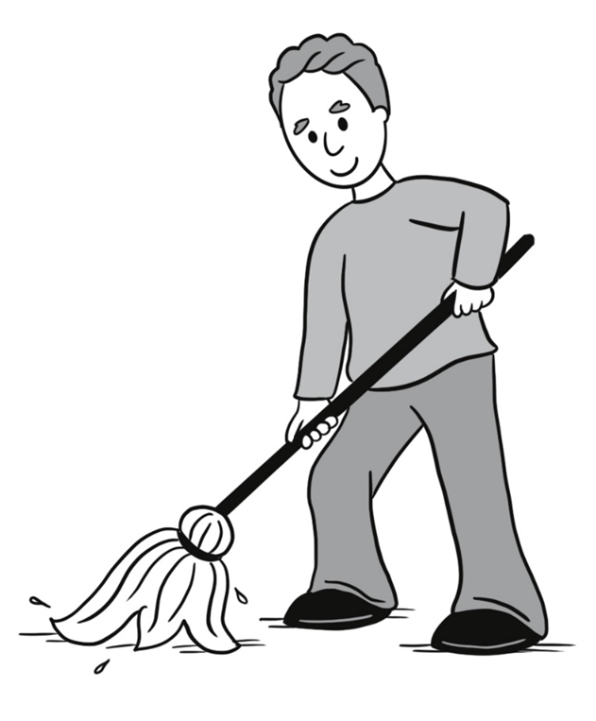
clean

Slide 77
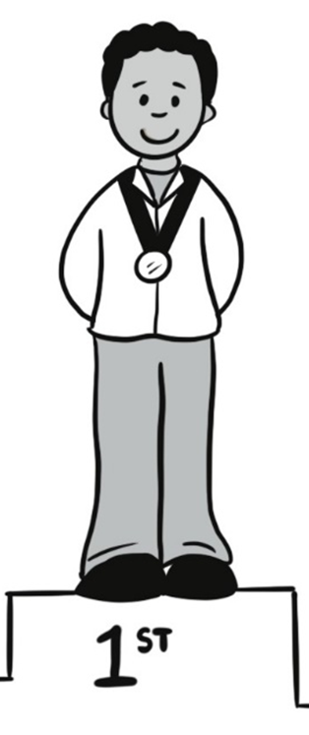
first

Slide 78
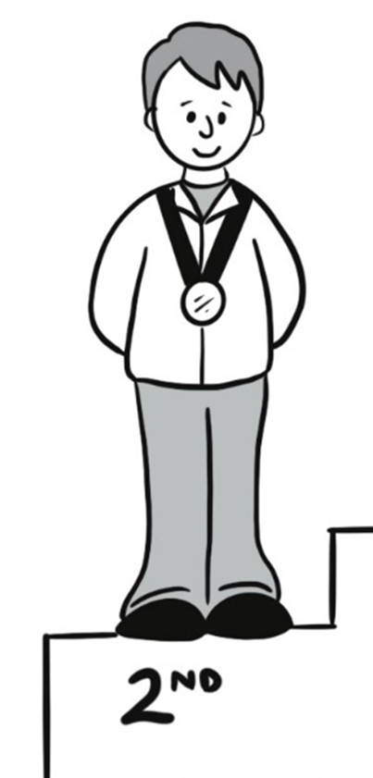
second

Slide 79
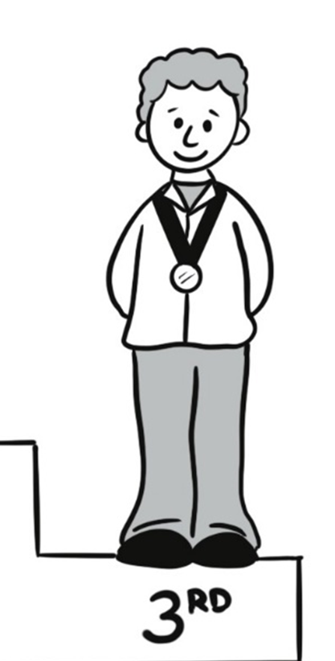
third

Slide 80
A. What do you do every day? B. First, I get up.
Sentences Using Vocabulary

Slide 81
A. What do you do every day? B. First, I get up. Second, I make food. Third, I clean my kitchen. What do you do? A. First, I take a shower. Second, I clean my house. Third, I go to sleep.
Sentences Using Vocabulary

Slide 82
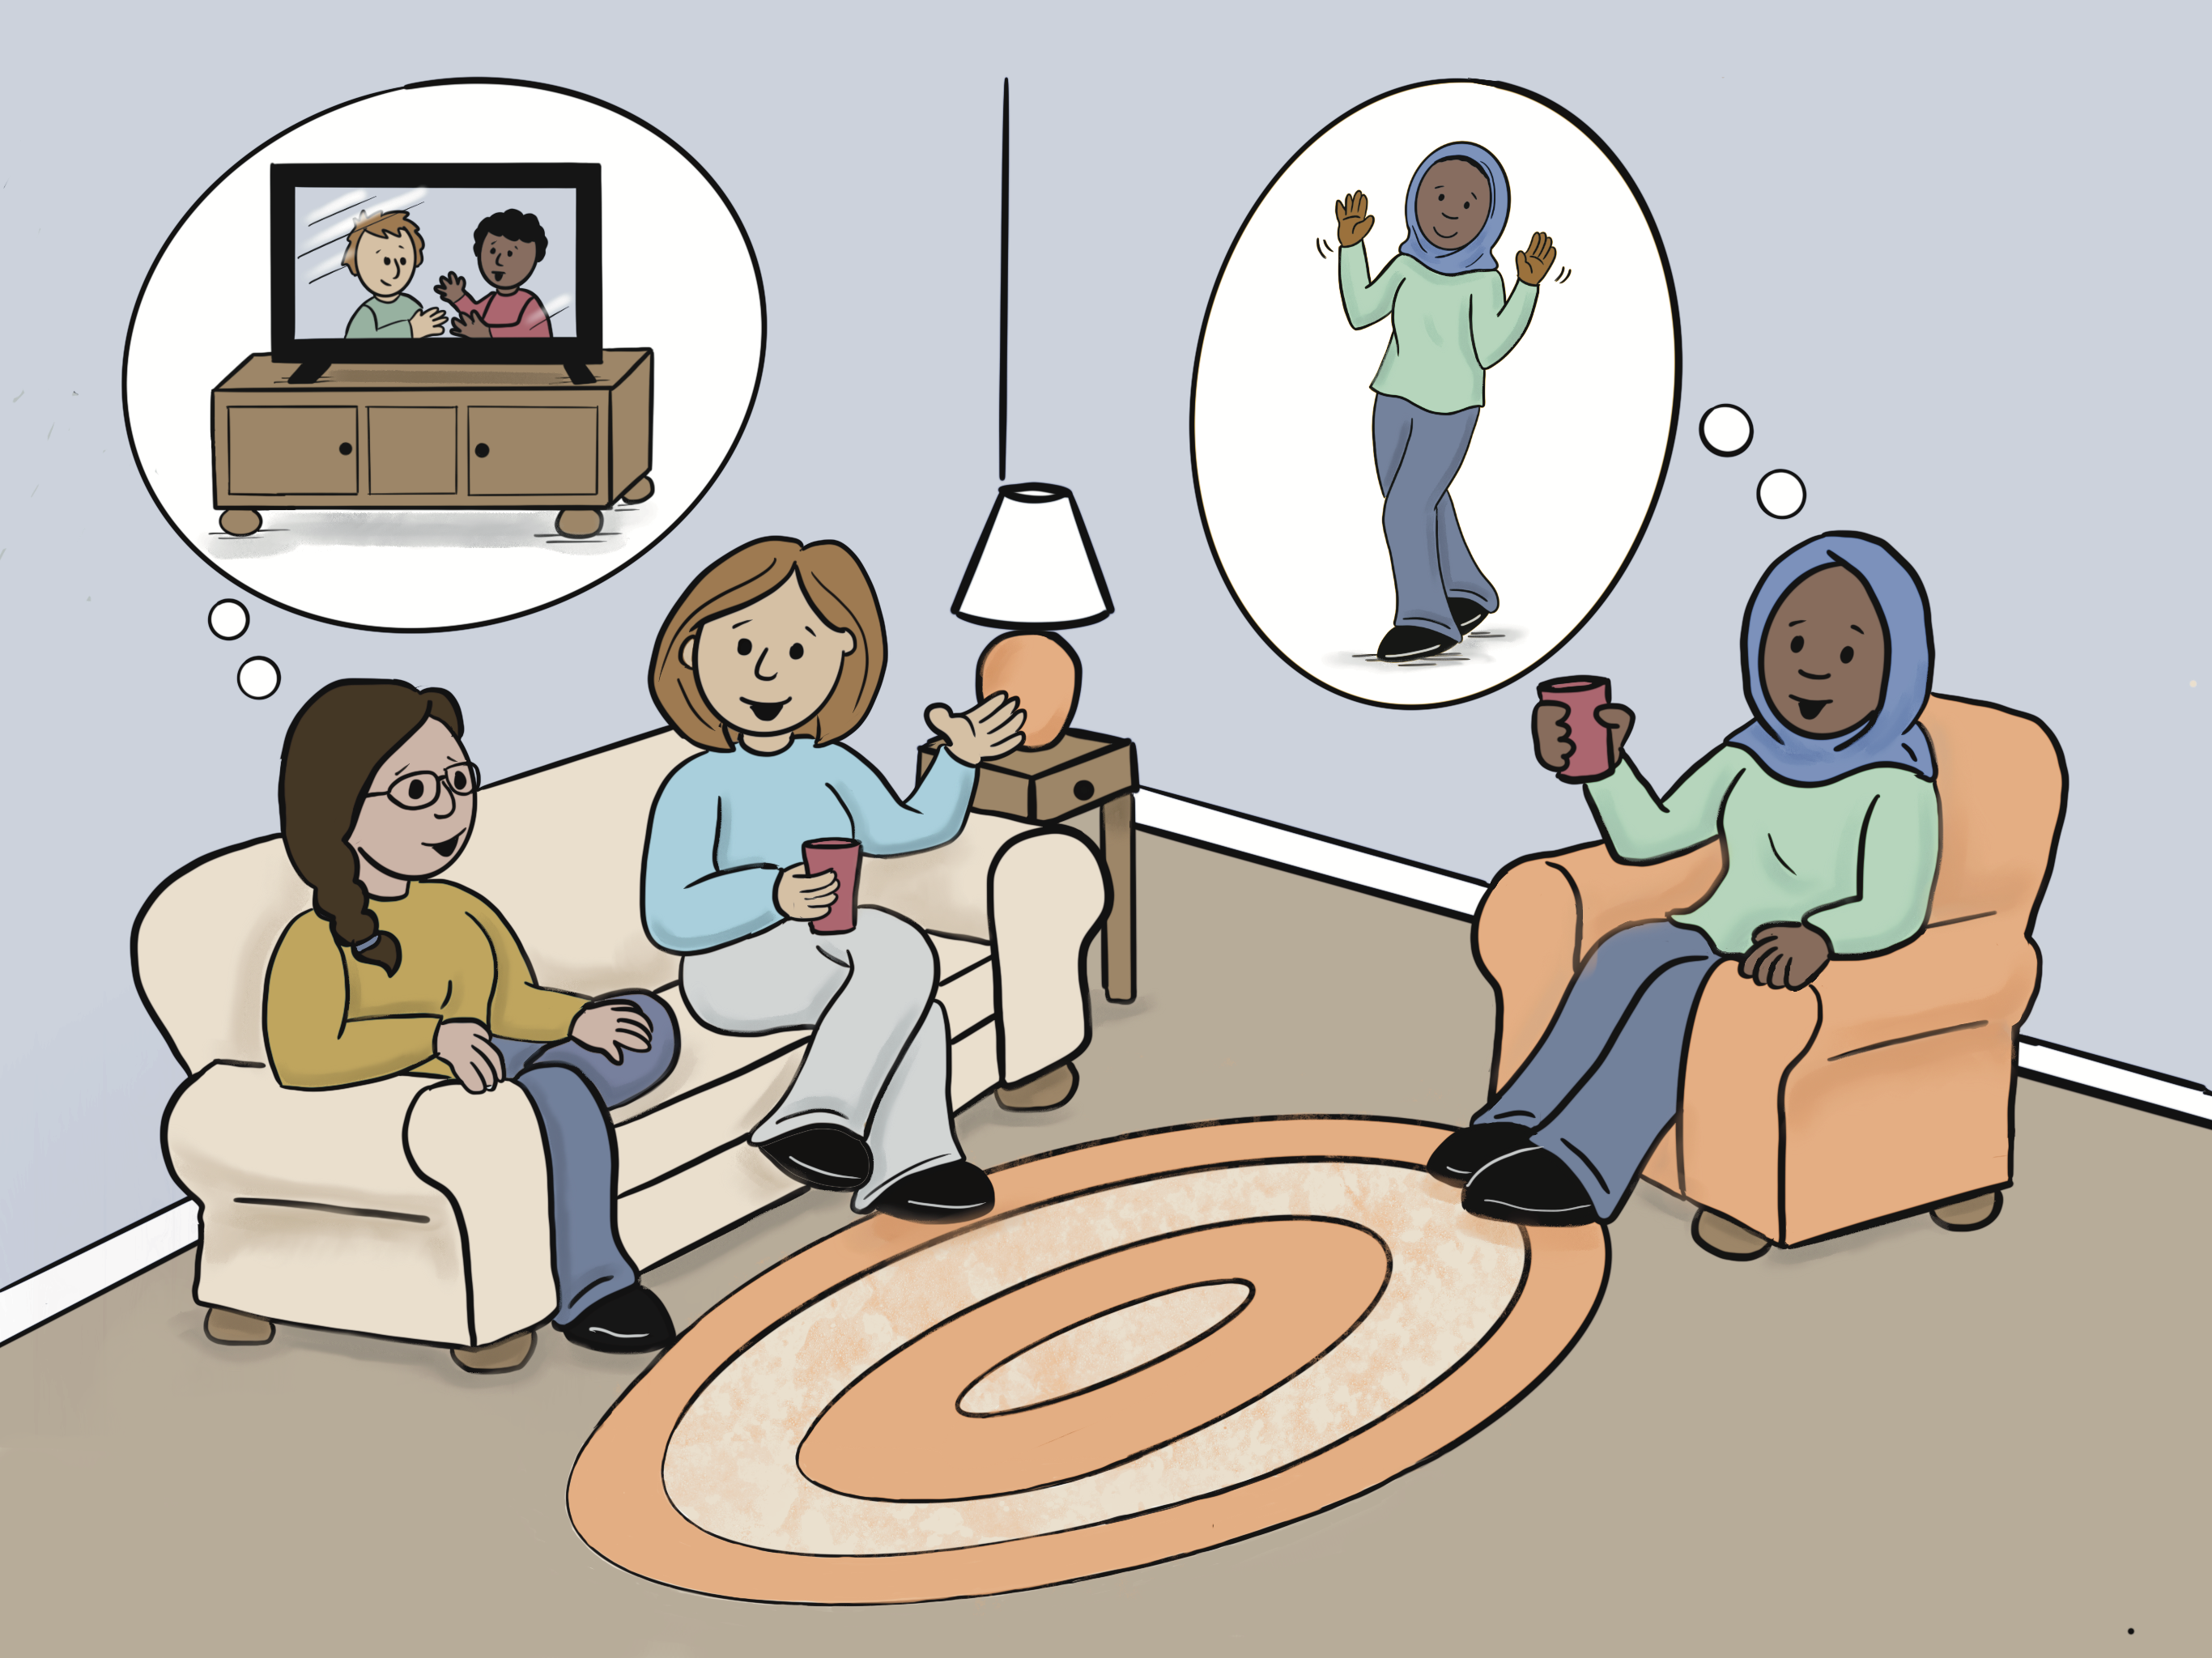
Lesson 7: Do You Dance In Your Free Time?

Slide 83
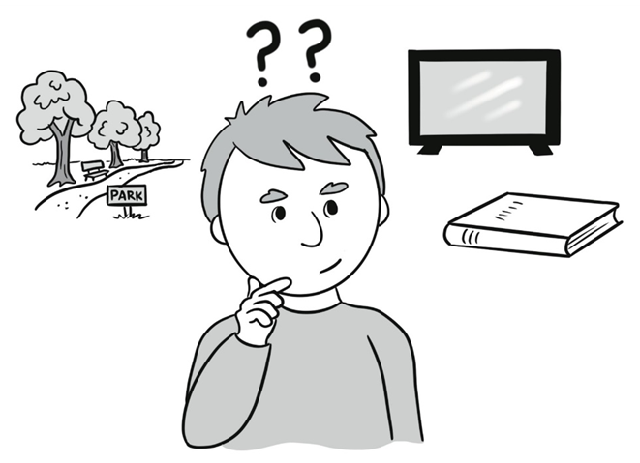
or

Slide 84
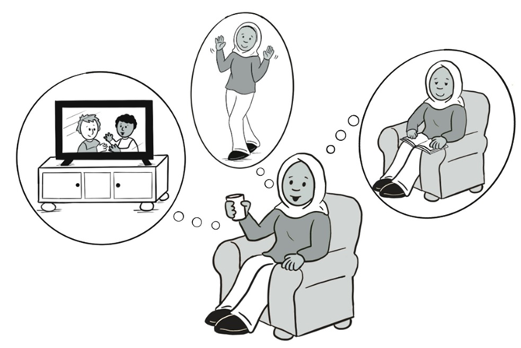
free time

Slide 85
watch TV (television)

Slide 86
look at social media

Slide 87
dance

Slide 88
draw

Slide 89
listen to music

Slide 90
play an instrument

Slide 91
take pictures

Slide 92
A. Do you dance in your free time? B. No, I watch TV.
Sentences Using Vocabulary

Slide 93
A. What do you do in your free time? B. I like to dance. A. Me, too! ____, do you dance or draw in your free time? B. No, I watch TV.
Dialogue

Slide 94
Unit 3: In Our Community

Slide 95
Lesson 8: What Does He Learn at School?

Slide 96
grade

Slide 97
homework

Slide 98
student

Slide 99
report card

Slide 100
math

Slide 101
science

Slide 102
history

Slide 103
learn

Slide 104
preschool

Slide 105
kindergarten

Slide 106
A. He is in second grade. B. What does he learn at school? A. He learns math.
Sentences Using Vocabulary

Slide 107
A. My son is eight years old. He is in second grade. B. What does he learn at school? A. He learns math, science, history, and English. This is his report card.
Dialogue

Slide 108
Lesson 9: My Child Will Be Absent on Friday.

Slide 109
come late

Slide 110
leave early

Slide 111
be absent

Slide 112
note

Slide 113
dear

Slide 114
go to an appointment

Slide 115
go to the dentist

Slide 116
will

Slide 117
write

Slide 118
A. Emily will be absent on Friday. She’ll go to the dentist. B. Ok, I’ll tell her teacher.
Sentences Using Vocabulary

Slide 119
A. Hello, this is Marie Lopes. I am Emily’s mom. B. Hello, Mrs. Lopes. A. Emily will be absent from school on Friday. She’ll go to the dentist because her tooth hurts. B. Ok, I’ll tell her teacher. Thank you!
Dialogue 1

Slide 120
A. Hey, Dad, what are you doing? B. I’m writing a note to your teacher. A. What does the note say? B. “Dear Mr. Smith. My son Gus will come late to school on Tuesday, March 3. He will go to a doctor’s appointment. Thanks, Bima Wati.”
Dialogue 2

Slide 121
Lesson 10: I Want to Send a Package.

Slide 122
want

Slide 123
send

Slide 124
cost

Slide 125
letter

Slide 126
package

Slide 127
stamp

Slide 128
envelope

Slide 129
post office

Slide 130
I don’t understand

Slide 131
A. I want to send this package. How much does it cost? B. It costs $8.25.
Sentences Using Vocabulary 1

Slide 132
A. Would you like any stamps? B. I’m sorry, I don’t understand.
Sentences Using Vocabulary 2

Slide 133
A. Hi, welcome to the post office. B. Hello, I want to send this package and this letter. How much does it cost? A. It costs $8.25. B. OK. A. Would you like any stamps or envelopes? B. I’m sorry, I don’t understand. A. Would you like any stamps or envelopes? B. Yes, I want 10 stamps
Dialogue

Slide 134
Lesson 11: May I Check Out These Books?

Slide 135
library card

Slide 136
check out

Slide 137
free

Slide 138
enjoy

Slide 139
keep

Slide 140
return

Slide 141
these

Slide 142
those

Slide 143
due

Slide 144
A. May I check out these books? B. Sure!
Sentences Using Vocabulary

Slide 145
A. Hi, may I check out these books? B. Yes, you may. A. How much does it cost? B. It’s free with your library card. A. That’s great! How long may I keep them? B. They are due in two weeks. Please return them then. Enjoy!
Dialogue

Slide 146
Lesson 12: I’m Going to Call a Handyman.

Slide 147
electrician

Slide 148
plumber

Slide 149
handyman

Slide 150
outlet

Slide 151
light switch

Slide 152
wall

Slide 153
ceiling

Slide 154
pipe

Slide 155
hole

Slide 156
A. What’s up? B. I have a hole in my wall.
Sentences Using Vocabulary 1

Slide 157
A. What’re you going to do? B. I’m going to call a handyman.
Sentences Using Vocabulary 2

Slide 158
A. Hey, Luis. What’s up? B. I have a hole in my wall. A. Oh, no! What’re you going to do? B. I’m going to call a handyman. A. Good idea!
Dialogue 1

Slide 159
A. Hey, Adam. What’s up? B. I have a broken outlet. A. Oh, no! What’re you going to do? B. I’m going to call an electrician. A. Good idea!
Dialogue 2

Slide 160
Unit 4: Time for Work!

Slide 161
Lesson 13: What Are Your Skills?

Slide 162
from __ to __

Slide 163
skill

Slide 164
training

Slide 165
education

Slide 166
work experience

Slide 167
date of birth

Slide 168
fill out

Slide 169
application

Slide 170
gender

Slide 171
A. What skills do you have? B. I can cook.
Sentences Using Vocabulary

Slide 172
A. I don’t understand this application. Could you help me? B. Sure, I can help you. We’ll fill out this application. First, write your name and date of birth here. A. OK. B. What skills do you have? A. I can cook. B. What training do you have? A. I have training from cooking school.
Dialogue, Part 1

Slide 173
B. What education do you have? A. I have a 12th grade education. B. What work experience do you have? A. I have experience from Sally’s Pizza Place, from January to June 2022. B. OK, sounds good!
Dialogue, Part 2

Slide 174
Lesson 14: I’m Really Sorry.

Slide 175
boss (bosses)

Slide 176
really

Slide 177
late

Slide 178
problem

Slide 179
My car broke down.

Slide 180
bad traffic

Slide 181
See you soon.

Slide 182
Feel better soon.

Slide 183
Goodbye. (Bye.)

Slide 184
A. I’m really sorry, but I will be late. I’m in bad traffic. B. I understand. See you soon.
Sentences Using Vocabulary 1

Slide 185
A. I’m sorry, but I can’t work today. I’m really sick. B. I understand. Feel better soon.
Sentences Using Vocabulary 2

Slide 186
A. Oh, no, I will be late to my doctor’s appointment! I’ll call the doctor’s office. B. Hello? This is Dr. Meyer’s office. A. Hi, this is Bima Wati. I’m really sorry, but I will be late for my appointment. I’m in bad traffic. B. I understand. See you soon. A. Thank you! Goodbye. B. Goodbye.
Dialogue 1

Slide 187
A. I can’t work today. I’m sick! I’ll call my boss. B. Hello? A. Hi, Sue. This is Cindy. I’m sorry, but I can’t work today. B. What’s the problem? A. I’m really sick B. I understand. Feel better soon. A. Thank you. Goodbye. B. Bye!
Dialogue 2

Slide 188
Lesson 15: It’s Time to Clock Out!

Slide 189
bakery

Slide 190
supervisor

Slide 191
uniform

Slide 192
clock in

Slide 193
clock out

Slide 194
put on

Slide 195
take off

Slide 196
instructions

Slide 197
Wash your hands.

Slide 198
Take a break.

Slide 199
A. What should I do? B. Wash your hands.
Sentences Using Vocabulary

Slide 200
A. Welcome to work at the bakery! I am your supervisor. B. Thank you! What should I do? A. These are your instructions: First, clock in. Second, put on your uniform and wash your hands. Third, make bread with me. Fourth, we will take a break. B. Sounds good!
At 4:00 a.m.
Dialogue 1

Slide 201
A. Good work today! Clock out and go home. B. Thanks! See you tomorrow A. Bye!
At 12:30 p.m.
Dialogue 2

Slide 202
Unit 5: Staying Healthy

Slide 203
Lesson 16: Are You Worried Or Calm?

Slide 204
calm

Slide 205
excited

Slide 206
bored

Slide 207
worried

Slide 208
confused

Slide 209
everyone

Slide 210
someone

Slide 211
no one

Slide 212
A. Are you worried or calm? B. I’m worried.
Sentences Using Vocabulary 1

Slide 213
A. Everyone speaks English. No one speaks Spanish. B. Can someone help you? A. My friend can help me.
Sentences Using Vocabulary 2

Slide 214
A. Tomorrow I will go to a new school. B. How do you feel? Are you worried or calm? A. I’m worried. Everyone speaks English. No one speaks Spanish. B. I understand. Can someone help you? A. My friend, Maria, can help me? B. Great! Be calm and have a good day!
Dialogue

Slide 215
Lesson 17: I’d Like to Make an Appointment.

Slide 216
knee

Slide 217
shoulder

Slide 218
neck

Slide 219
finger

Slide 220
toe

Slide 221
stomachache

Slide 222
headache

Slide 223
fever

Slide 224
cough

Slide 225
A. What’s the problem? B. My neck really hurts.
Sentences Using Vocabulary 1

Slide 226
A. What’s the problem? B. I have a headache.
Sentences Using Vocabulary 2

Slide 227
A. Hello, I’d like to make an appointment with Dr. Ming. B. What’s your name? A. My name is Selma Pasha. B. What’s the problem? A. My neck really hurts, and I have a headache. B. Can you come today at 3:45 pm? A. Yes, I can. Thank you! B. Goodbye.
Dialogue

Slide 228
Lesson 18: Do You Exercise Every Day?

Slide 229
exercise

Slide 230
pain

Slide 231
healthy

Slide 232
unhealthy

Slide 233
lose weight

Slide 234
gain weight

Slide 235
more

Slide 236
less

Slide 237
if…then

Slide 238
A. If you exercise more, then you will sleep more. B. I will exercise more.
Sentences Using Vocabulary

Slide 239
A. What’s the problem? B. I can’t sleep. A. Do you exercise every day? B. No, I don’t. A. If you exercise more, then you will sleep more. B. Ok, I will exercise more.
Dialogue 1

Slide 240
A. What’s the problem? B. I have a pain in my stomach. A. Do you eat unhealthy food? B. Yes, I do. A. If you eat healthy food, then you will have less pain. B. Ok, I’ll eat healthy food.
Dialogue 2

Slide 241
Lesson 19: Take Three Times a Day.

Slide 242
medicine

Slide 243
bottle

Slide 244
meal

Slide 245
pharmacy

Slide 246
on an empty stomach

Slide 247
how often

Slide 248
times per day (times/day)

Slide 249
prescription

Slide 250
refill

Slide 251
how long
?

Slide 252
A. How often do I take it? B. Take it three times a day with a meal.
Sentences Using Vocabulary

Slide 253
A. Hello. Welcome to the pharmacy. How may I help you? B. Hello. May I have my prescription? My name is Amal Deng. A. Here is your medicine bottle. B. Thank you. How often should I take it? A. You should take it three times a day with a meal. Don’t take it on an empty stomach.
Dialogue, Part 1

Slide 254
B. OK. Can I get a refill? A. No, there are no refills on this prescription. B. How long should I take it? A. You should take it for two weeks. B. I understand. Thank you!
Dialogue, Part 2

Slide 255
Lesson 20: I Will Wash Your Clothes.

Slide 256
nails

Slide 257
brush

Slide 258
toothpaste

Slide 259
wash your clothes

Slide 260
take a bath

Slide 261
use soap

Slide 262
use shampoo

Slide 263
use a tissue

Slide 264
sneeze

Slide 265
A. I’m late for work! Should I take a bath? B. Yes, but don’t be late!
Sentences Using Vocabulary

Slide 266
A. Oh, no! I’m late for work, but I should take a bath and use soap and shampoo first. Then, I will drive to work. B. Don’t be late! I will wash your clothes tonight. A. Thank you. I will also brush my teeth and clean my nails. Aaaa-choo! B. Here, use a tissue or your sneeze! A. Thank you.
Dialogue

Slide 267
Unit 6: We’re Ready to Eat!

Slide 268
Lesson 21: Anything Else?

Slide 269
ham

Slide 270
turkey

Slide 271
quarter pound (1/4 lb.)

Slide 272
half pound (1/2 lb.)

Slide 273
pound (lb.)

Slide 274
sliced

Slide 275
need

Slide 276
Anything else?

Slide 277
That’s all!

Slide 278
A. I need a quarter pound of sliced turkey, please. B. That’s ten ninety-nine a pound.
Sentences Using Vocabulary 1

Slide 279
B. Do you need anything else? A. No, that’s all!
Sentences Using Vocabulary 2

Slide 280
A. Hi, I need a quarter pound of sliced turkey, please. B. Here you go. That’s ten ninety-nine a pound. A. Thanks. B. Do you need anything else? A. No, that’s all!
Dialogue

Slide 281
Lesson 22: I’d Like a Burger and Fries.

Slide 282
How can I help you?

Slide 283
fast food

Slide 284
hamburger (burger)

Slide 285
fries

Slide 286
That’ll be …

Slide 287
drive-through

Slide 288
next

Slide 289
Cash or card?

Slide 290
medium

Slide 291
large

Slide 292
A. How can I help you? B. I’d like a burger and medium fries and a large cola, please.
Sentences Using Vocabulary

Slide 293
At the speaker: A. Welcome to Bob’s Fast-Food drive-through! How can I help you? B. I’d like a burger and medium fries and a large cola, please A. Anything else? B. No, that’s all. A. That’ll be $8.47. Please drive to the next window. B. Ok, thanks!
Dialogue 1

Slide 294
At the window: A. That’ll be $8.47. Cash or card? B. Cash. Here you go. A. Thanks! Here is your food. Have a great day!
Dialogue 2

Slide 295
Lesson 23: Thank You So Much!

Slide 296
food pantry food bank

Slide 297
give

Slide 298
volunteer

Slide 299
so much

Slide 300
bag

Slide 301
box

Slide 302
can

Slide 303
same

Slide 304
different

Slide 305
A. What should we do? B. Give him this bag of food.
Sentences Using Vocabulary

Slide 306
A. Thank you so much for being volunteers at the food pantry! B. We are happy to help. What should we do? A. First, I’ll give you these boxes and cans. You can put them in the bags. B. Sure, we can do that. A. These bags of food are the same. Give him this bag and give her that bag.
Dialogue, Part 1

Slide 307
B. What about those bags? A. Those bags of food are different. Give them those bags. B. Ok, we’ll do it!
Dialogue, Part 2

Slide 308
Lesson 24: Please Wash These Dirty Dishes.

Slide 309
fork

Slide 310
knife (knives)

Slide 311
spoon

Slide 312
glass (glasses)

Slide 313
plate

Slide 314
bowl

Slide 315
dish (dishes)

Slide 316
clean

Slide 317
dirty

Slide 318
hot

Slide 319
A. Please wash these dirty dishes. B. Here you go - some clean bowls!
Sentences Using Vocabulary

Slide 320
A. Hey, would you help me? B. Oh, I’m so sorry! Yes, I’ll help you. A. Thanks. Please wash these dirty dishes in hot water. B. Here you go—some clean bowls and plates! A. Great, thanks. Now I’ll wash the glasses and spoons. Would you wash the knives and forks? B. Sure, no problem!
Dialogue

Slide 321
Unit 7: Spending Time Together

Slide 322
Lesson 25: Thank You for the Visit!

Slide 323
fun

Slide 324
delicious

Slide 325
visit

Slide 326
guest

Slide 327
dessert

Slide 328
before

Slide 329
after

Slide 330
Time to go.

Slide 331
was/were

Slide 332
A. Thank you for the meal. B. Yes, the meal was delicious.
Sentences Using Vocabulary 1

Slide 333
A. Thank you for the meal. B. Yes, the desserts were great.
Sentences Using Vocabulary 2

Slide 334
A. Before we go, I want to say thank you for the meal. B. Yes! The meal was delicious, and the desserts were great. C. Thank you for the visit! It was fun. Bye! A and B: Goodbye!
Dialogue

Slide 335
Lesson 26: It Was a Wonderful Date.

Slide 336
chocolate

Slide 337
wonderful

Slide 338
on a date

Slide 339
taste

Slide 340
smell

Slide 341
laugh

Slide 342
say (said)

Slide 343
again

Slide 344
together

Slide 345
A. This sounds fun! B. Yes, it was! We smelled the flowers.
Sentences Using Vocabulary

Slide 346
A. On Sunday, I was on a date with Pat. B. That sounds fun! A. Yes, it was! We walked in the park and smelled the flowers together. We laughed so much! Then, we tasted chocolates at a dessert restaurant. It was a wonderful date. B. Will you go on a date again? A. Yes, Pat said, “We should go on a date again!”
Dialogue

Slide 347
Lesson 27: I Went to a Birthday Party!

Slide 348
jewelry

Slide 349
candy (candies)

Slide 350
card

Slide 351
party (parties)

Slide 352
Happy Birthday!

Slide 353
cake

Slide 354
gift

Slide 355
sing (sang)

Slide 356
get (got)

Slide 357
A. Did you have fun at the birthday party? B. Yes, we played games and ate cake.
Sentences Using Vocabulary

Slide 358
A. I went to Hannah’s birthday party yesterday. B. Did you have fun? A. Yes! We played games and ate cake. We sang, “Happy Birthday!” to Hannah. B. Did she get gifts? A. Yes, she did. She got jewelry, cards, and candy.
Dialogue

Slide 359
Unit 8: It’s Time to Go!

Slide 360
Lesson 28: I’m Going on a Trip!

Slide 361
airplane

Slide 362
fly (flew)

Slide 363
trip

Slide 364
beach (beaches)

Slide 365
mountains

Slide 366
river

Slide 367
forest

Slide 368
how

Slide 369
A. Where are you going? B. I’m going to the beach.
Sentences Using Vocabulary 1

Slide 370
A. How are you getting there? B. I’m flying on an airplane.
Sentences Using Vocabulary 2

Slide 371
A. I’m going on a trip next month! B. That’s great! Where are you going? A. I’m going to the beach. B. How are you getting there? A. I’m flying on an airplane.
Dialogue

Slide 372
Lesson 29: Does the Bus Arrive at 2:00 pm?

Slide 373
station

Slide 374
arrive

Slide 375
leave (left)

Slide 376
schedule

Slide 377
weekday

Slide 378
weekend

Slide 379
holiday

Slide 380
route

Slide 381
fare card

Slide 382
A. Does the bus leave at 2:00 pm today? B. No, the schedule is different on holidays.
Sentences Using Vocabulary

Slide 383
A. Excuse me. Does Bus 26 go to the hospital? B. Yes, the hospital is on that route. A. Great, thanks. Does it leave the station at 2:00 pm today? B. No, the schedule is different on holidays. Today is a holiday, so the bus leaves here at 2:30 pm. A. Oh, OK. When will Bus 26 arrive at the hospital? B. It’ll arrive at the hospital at 3:15 pm. Do you have a fare card? A. No, but I’m going to buy one now!
Dialogue

Slide 384
Lesson 30: I Got a Ticket.

Slide 385
ticket

Slide 386
driver’s license

Slide 387
seatbelt

Slide 388
speed limit

Slide 389
too fast

Slide 390
police officer

Slide 391
always

Slide 392
sometimes

Slide 393
never

Slide 394
A. You didn’t wear your seatbelt and you drove too fast. B. I’m sorry.
Sentences Using Vocabulary 1

Slide 395
A. You should always drive the speed limit. B. Yes, I will!
Sentences Using Vocabulary 2

Slide 396
A. Please give me your driver’s license, registration, and insurance. B. Here you go, Officer. A. I’m writing you a ticket. You didn’t wear your seatbelt and you drove too fast. The speed limit here is 35. B. I’m sorry. A. You should always wear your seatbelt and drive the speed limit. B. Yes, I will!
Dialogue

Slide 397
Unit 9: Staying Safe

Slide 398
Lesson 31: What Is Your Emergency?

Slide 399
fire department

Slide 400
fire

Slide 401
911 (nine-one-one)

Slide 402
accident

Slide 403
correct

Slide 404
ambulance

Slide 405
emergency (emergencies)

Slide 406
Take a deep breath.

Slide 407
I don’t know.

Slide 408
A. 9-1-1. What is your emergency? B. I had a car accident. I need help.
Sentences Using Vocabulary

Slide 409
A. 9-1-1. What is your emergency? B. I had a car accident. I need help! A. Ok. Be calm. Where are you? B. I am on Smithland Road. A. You are on Smithland Road. Is that correct? B. Yes. A. Are you hurt?
Dialogue Part 1

Slide 410
B. I don’t know. A. Ok. Is there a fire? B. No. A. Take a deep breath. The police, an ambulance, and the fire department will come. B. Ok. Thank you.
Dialogue Part 2

Slide 411
Lesson 32: Maybe It Will Flood!

Slide 412
lightning

Slide 413
thunder

Slide 414
storm

Slide 415
hurricane

Slide 416
flood

Slide 417
tornado (tornadoes)

Slide 418
warning

Slide 419
maybe

Slide 420
Stay inside.

Slide 421
until

Slide 422
A. I’m worried about the storm. B. Don’t worry.
Sentences Using Vocabulary

Slide 423
A. I’m worried about the storm. Maybe it will flood! B. Don’t worry. We will stay inside and watch the warnings on TV. A. But there will be rain, lightning, and thunder until 3:00 am! B. Yes, but we should all be calm. We will be fine.
Dialogue

Slide 424
Lesson 33: My Electricity Isn’t Working.

Slide 425
smoke alarm smoke detector

Slide 426
change the battery (batteries)

Slide 427
heat

Slide 428
gas

Slide 429
electricity

Slide 430
internet

Slide 431
bill

Slide 432
isn’t working

Slide 433
have to (had to)

Slide 434
pay

Slide 435
A. My heat isn’t working. B. You have to pay the bill.
Sentences Using Vocabulary

Slide 436
A. My heat isn’t working. B. You have to pay the bill. A. Oops! I will pay it today!
Dialogue 1

Slide 437
A. My smoke alarm isn’t working. B. You have to change the battery. A. Oops! I will change it today!
Dialogue 2

Slide 438
Lesson 34: Be Careful in the Parking Lot.

Slide 439
sidewalk

Slide 440
dangerous

Slide 441
safe

Slide 442
lock

Slide 443
cross

Slide 444
Be careful!

Slide 445
parking lot

Slide 446
bright

Slide 447
dark

Slide 448
A. Be careful in the parking lot! B. Thanks. I always walk on the sidewalk.
Sentences Using Vocabulary

Slide 449
A. Are you going home now? B. Yes, but first, I have to lock the door. A. Be careful in the parking lot. It can be dangerous in the dark. Sometimes, people who are driving cars can’t see you. B. Don’t worry. I always wear bright clothes and walk on the sidewalk until I cross the parking lot to my car. A. Great! It’s good to be safe!
Dialogue

