Slide 2
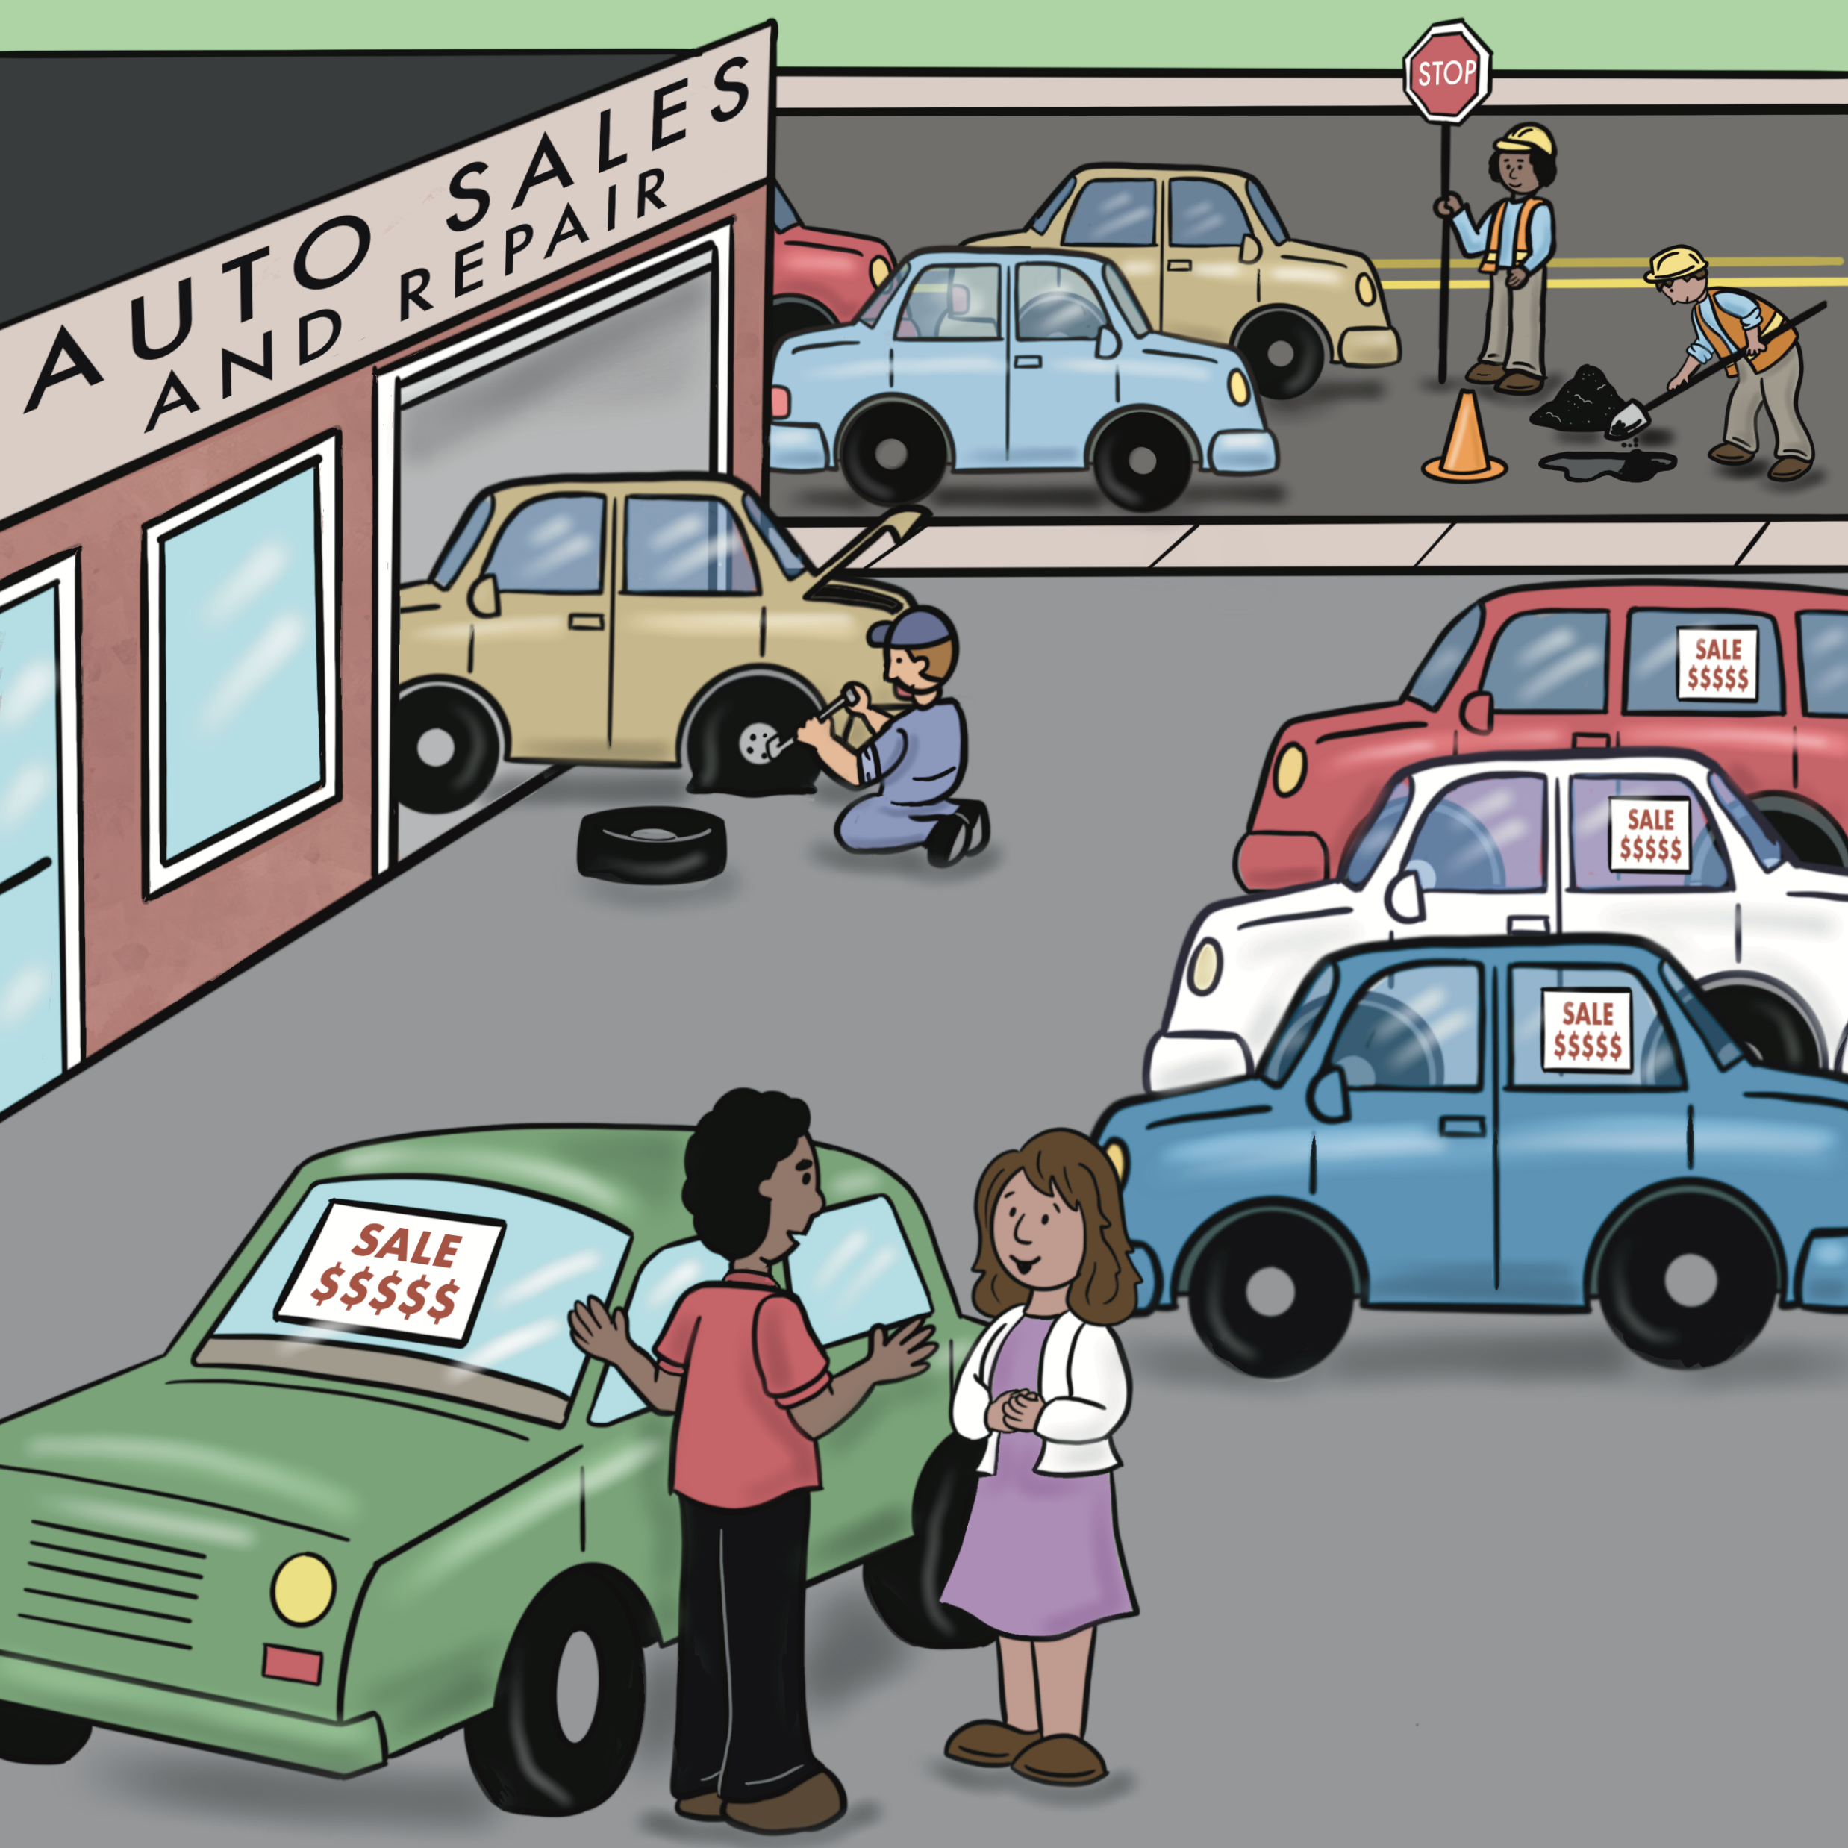
Unit 1: In My Community

Slide 3
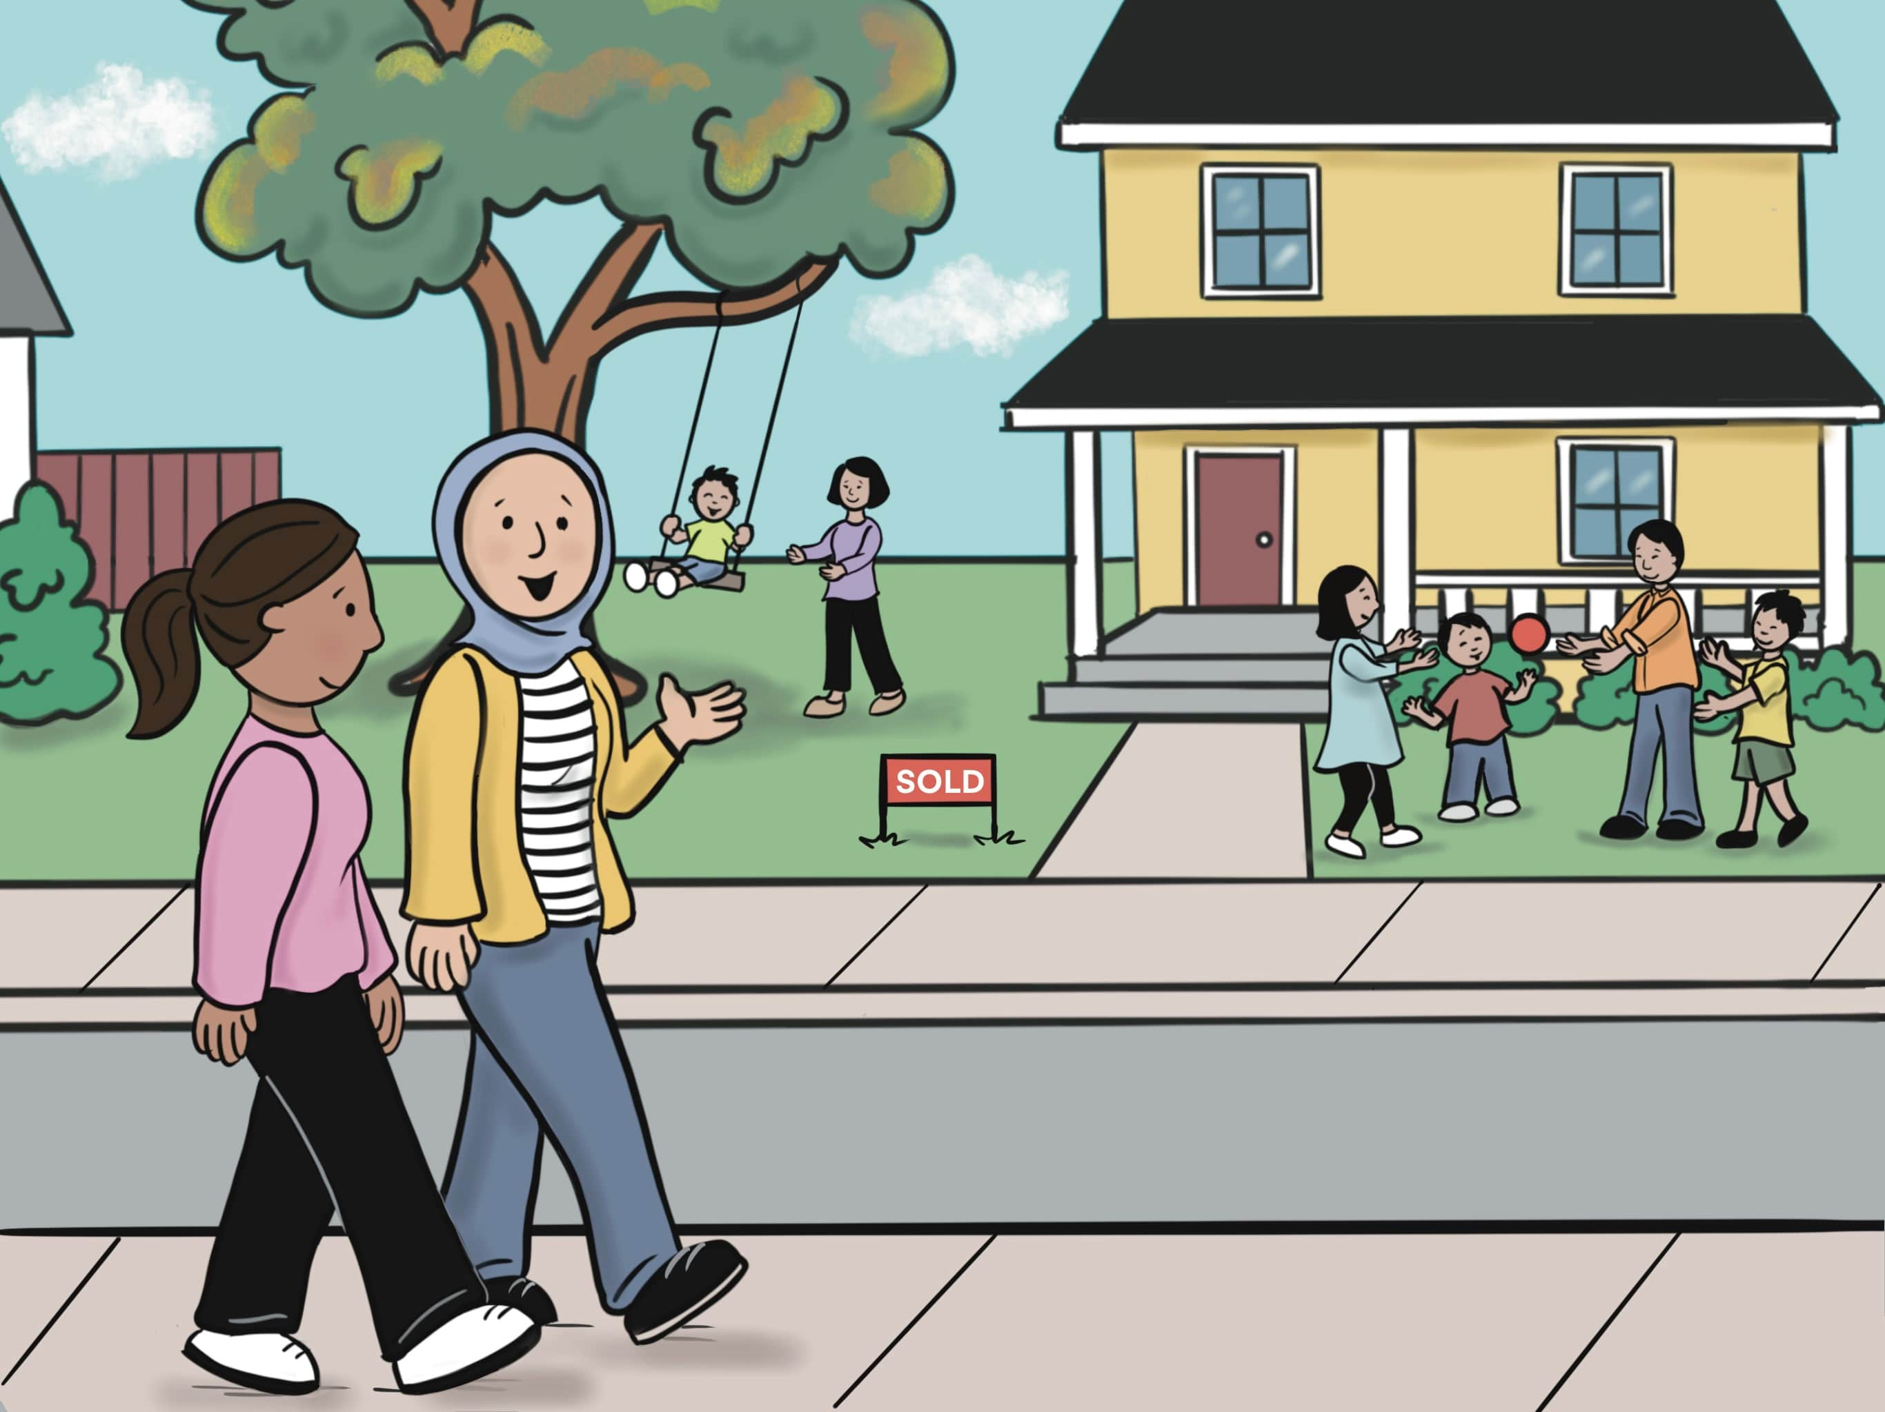
Lesson 1: Did You Meet the New Neighbors?

Slide 4
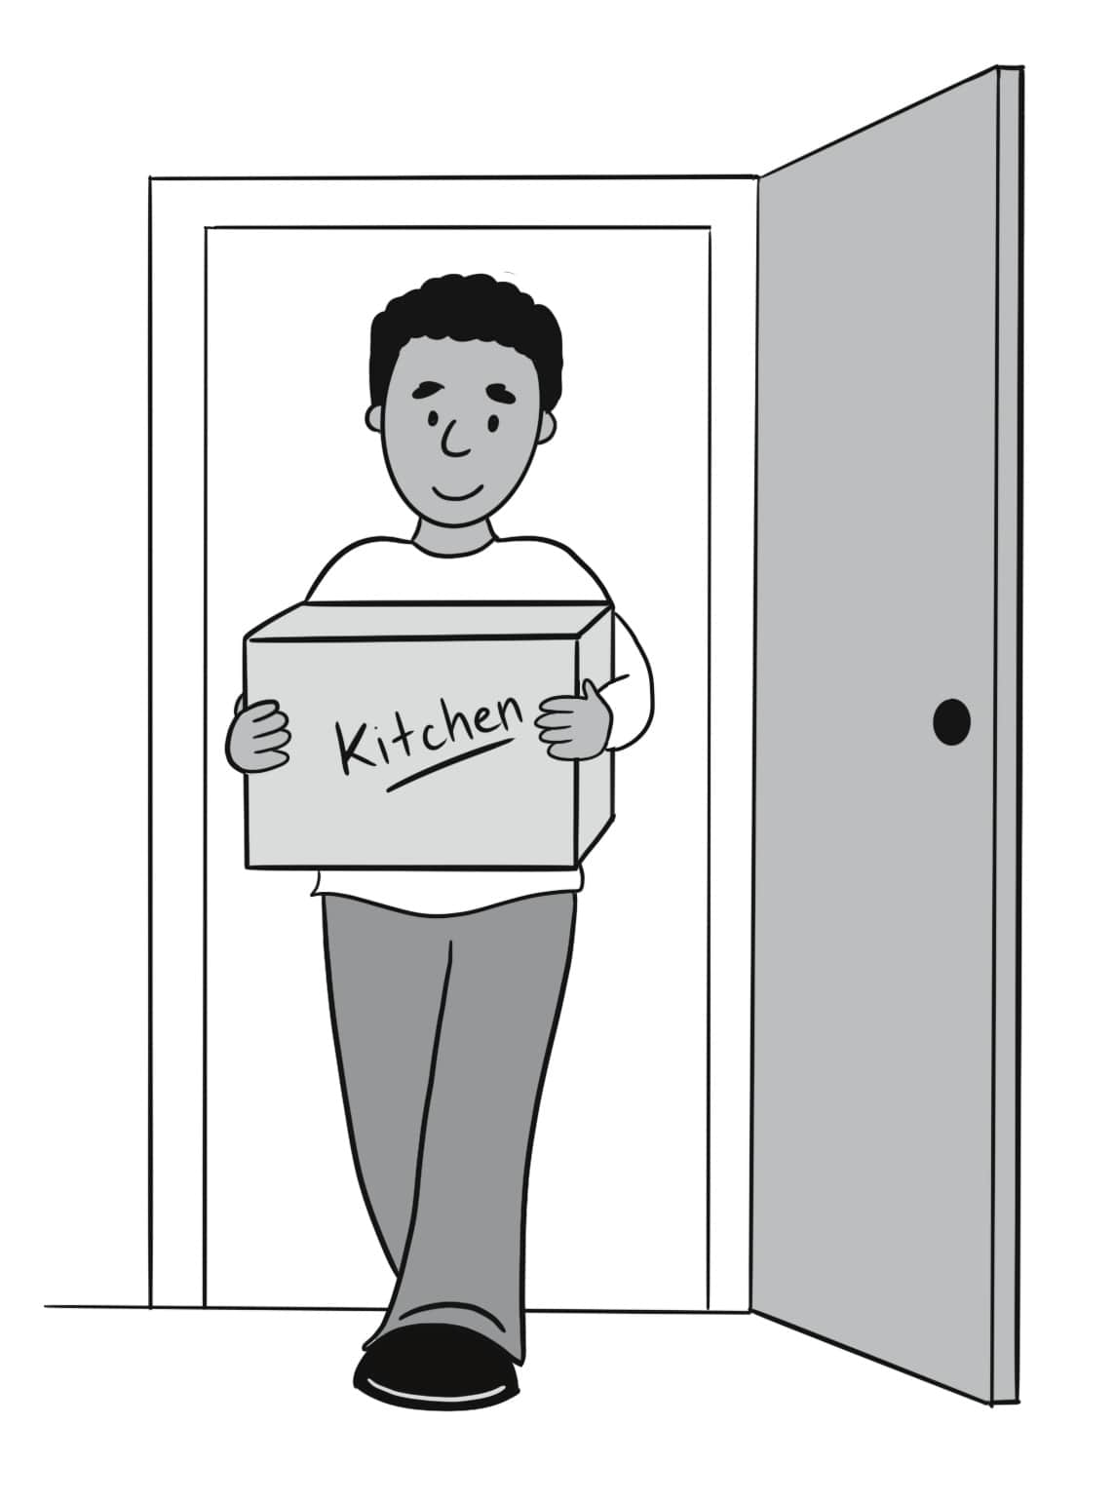
move in move out

Slide 5
shy

Slide 6
cheerful

Slide 7
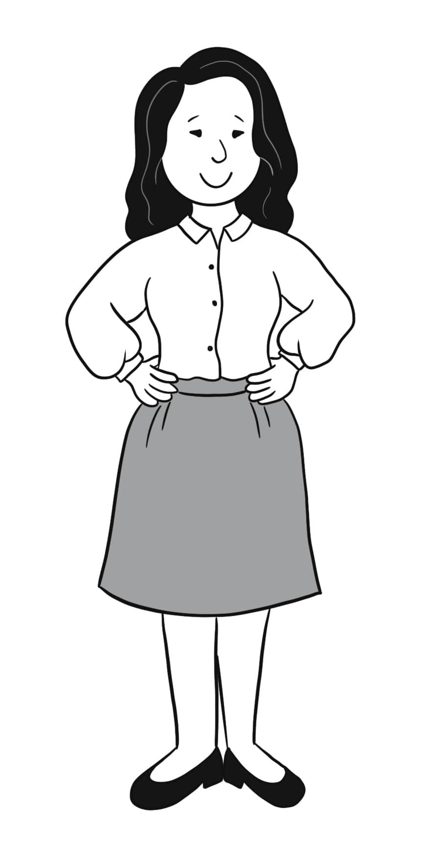
confident

Slide 8
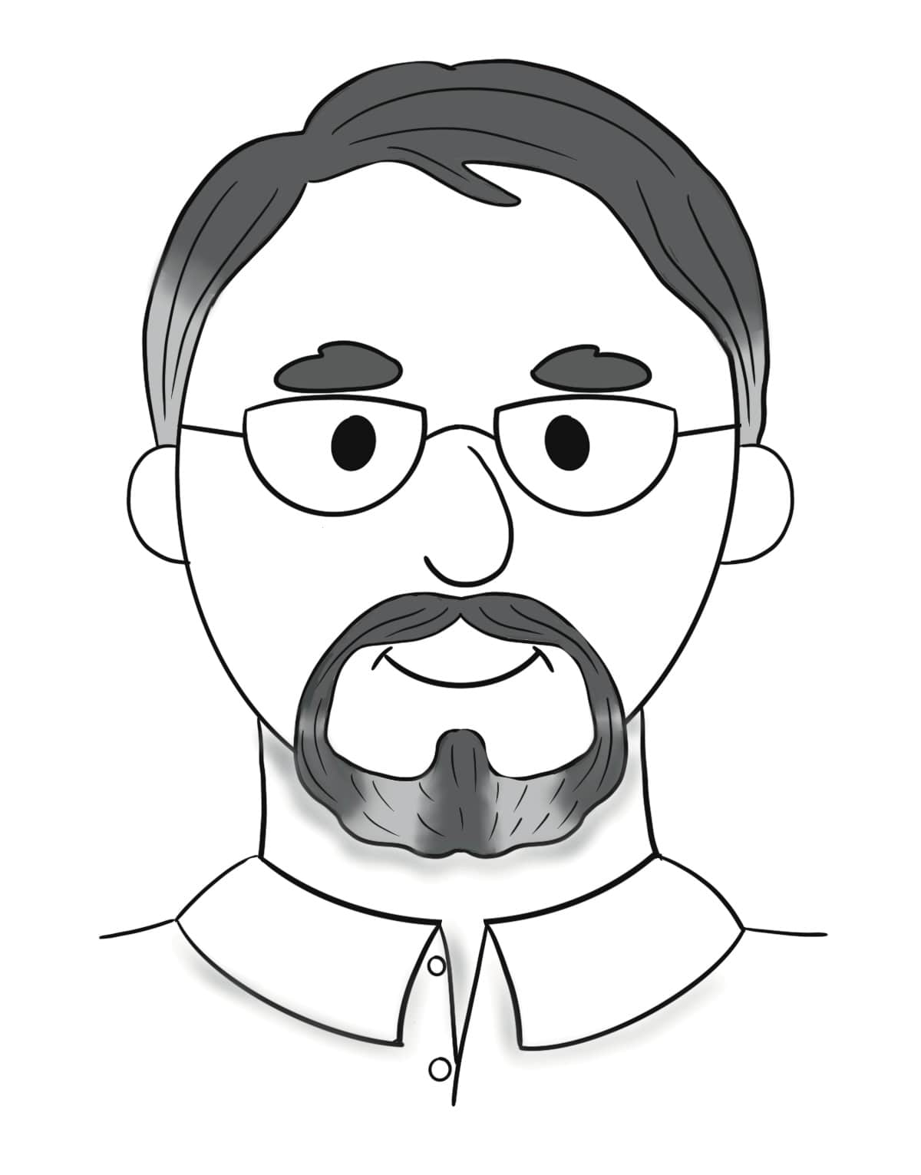
middle-aged

Slide 9
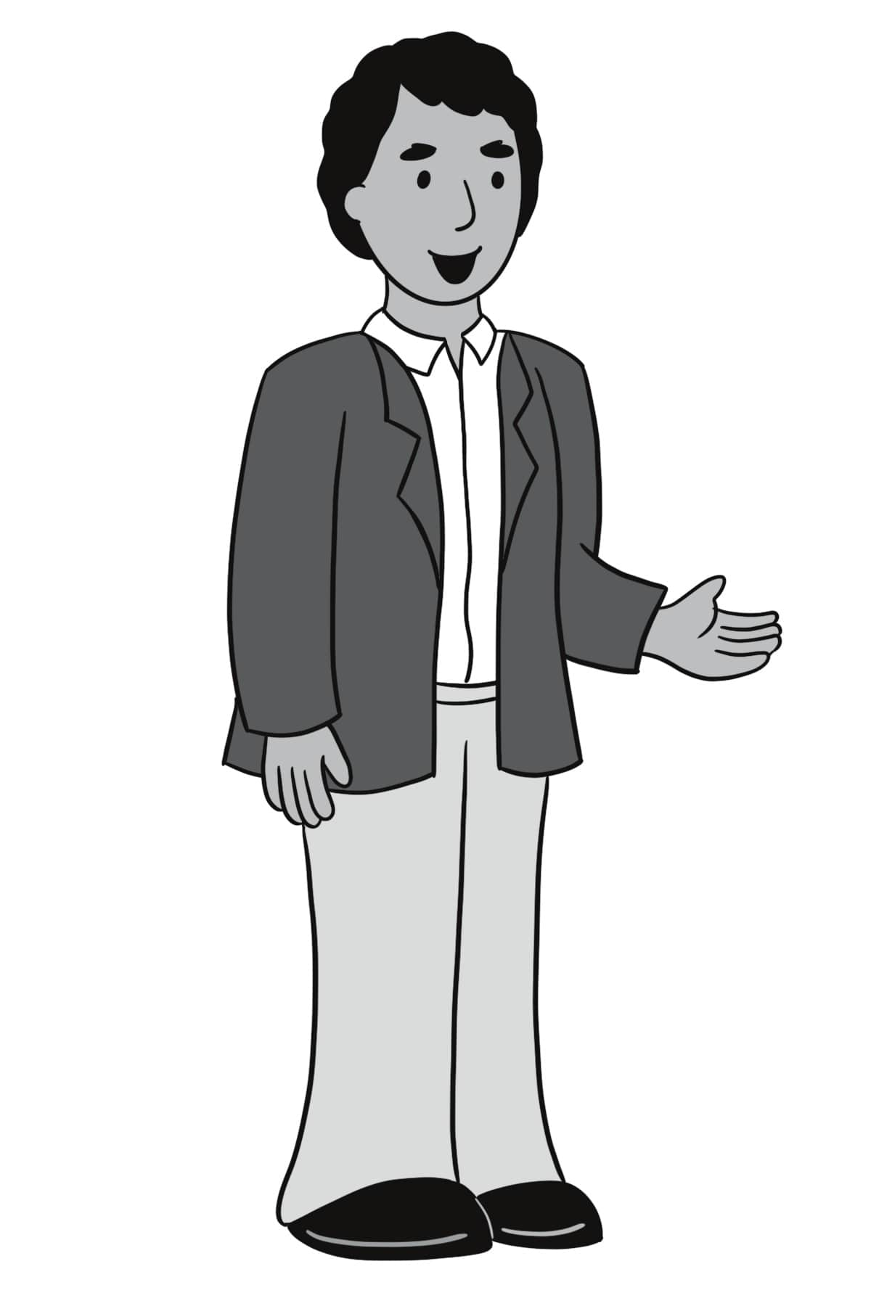
polite

Slide 10
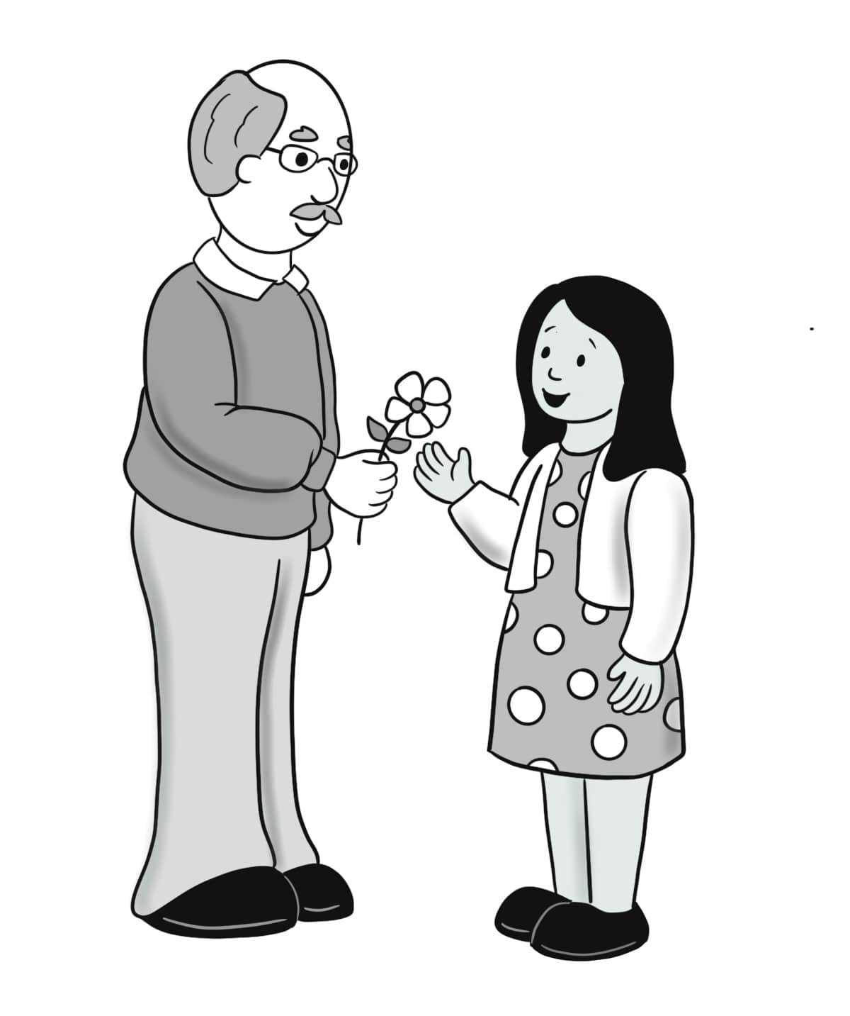
kind

Slide 11
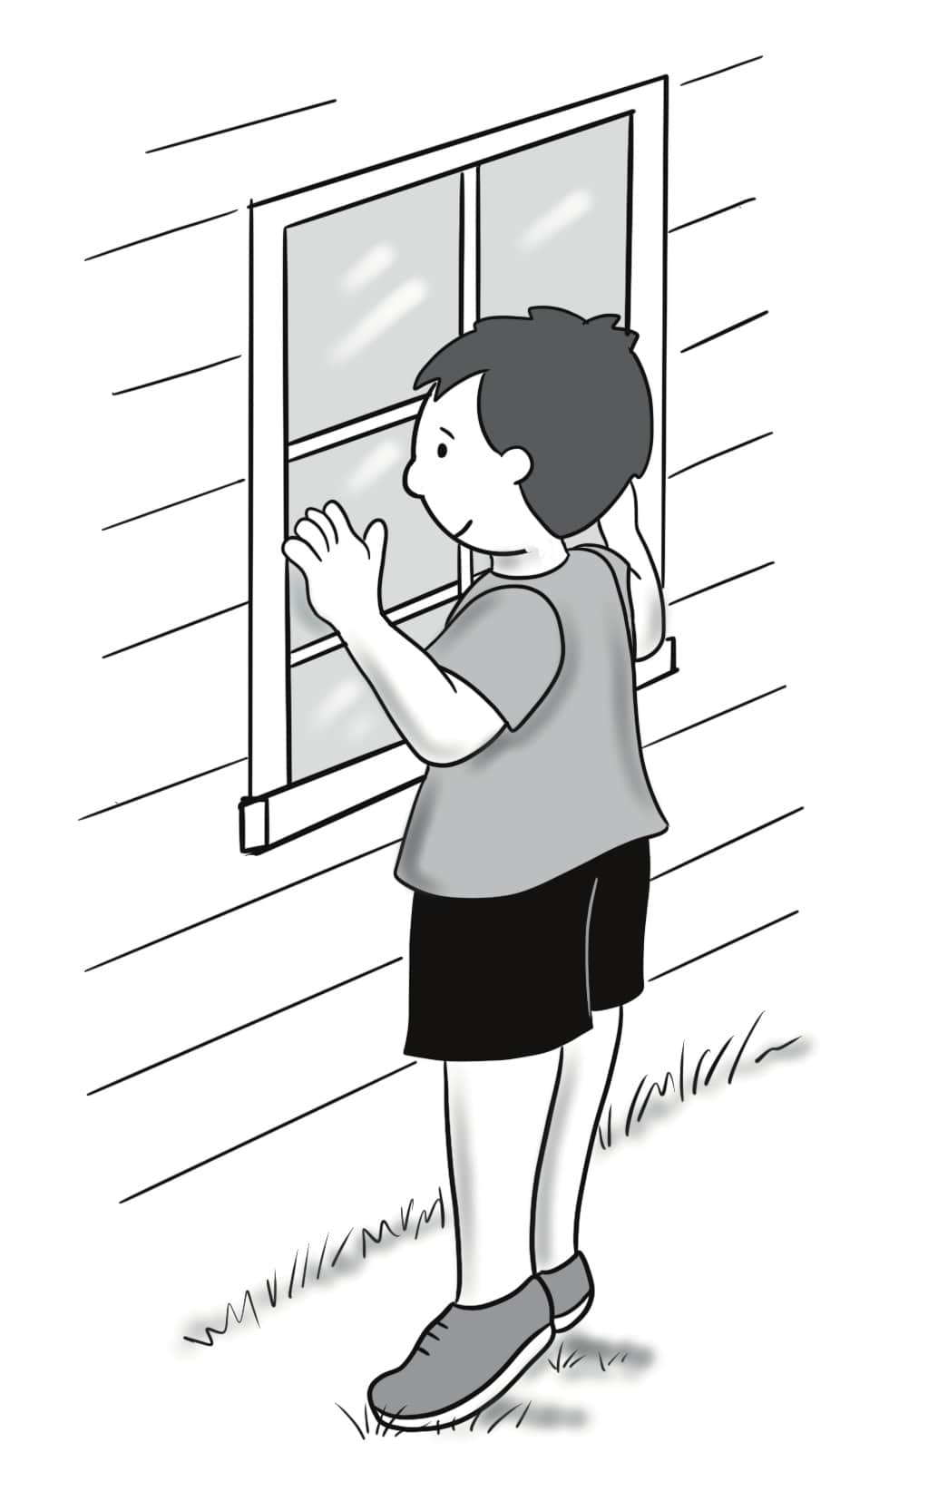
curious

Slide 12
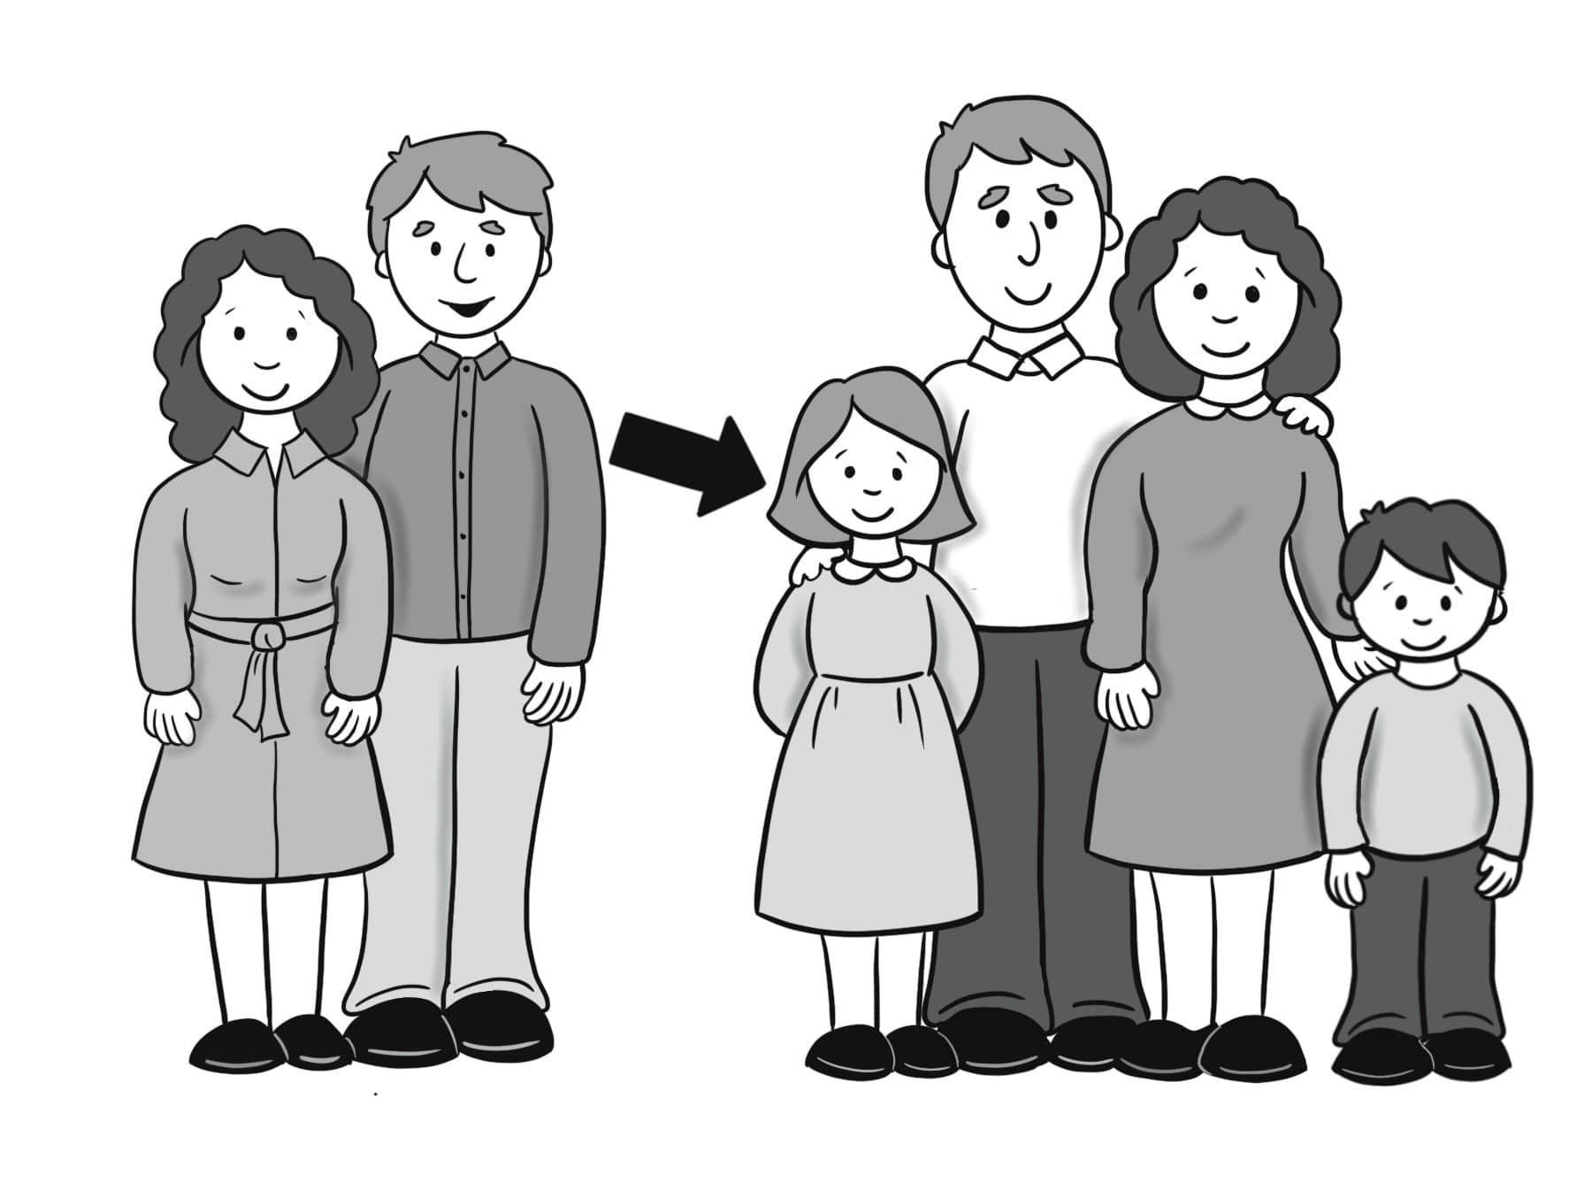
niece

Slide 13
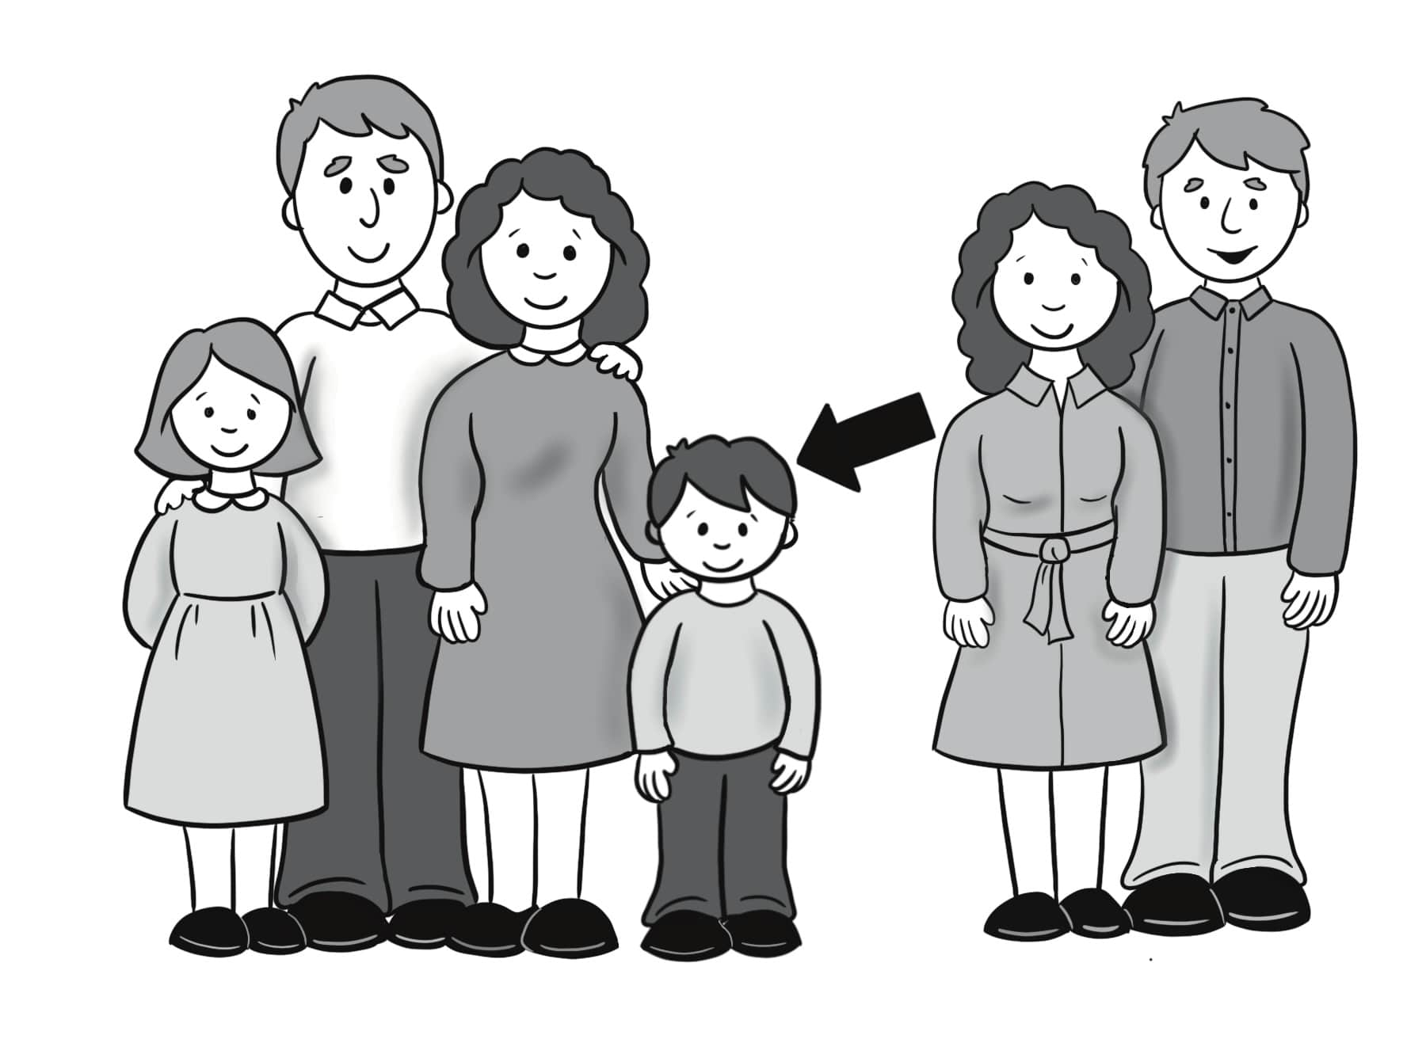
nephew

Slide 14
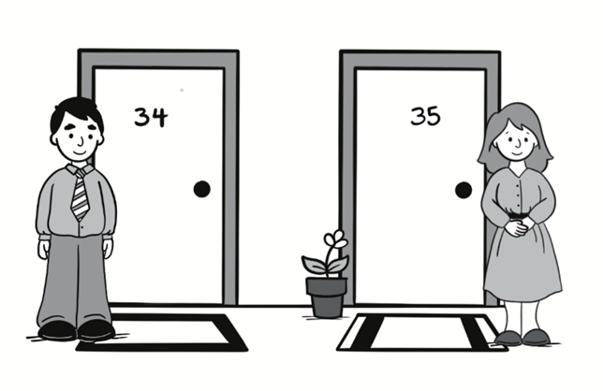
neigbor

Slide 15
A. Did you meet the new neighbors? B. Yes, I did. They are kind.
Sentences Using Vocabulary

Slide 16
A. Hey, did you meet the new neighbors, the Mings? B. Yes, I said hello to them. They’re a family of four and they moved in last week. A. I met the parents, Mr. and Mrs. Ming. They are middle-aged and very cheerful and kind. B. I met their children. Their daughter is shy but polite. Their son is very confident and curious. A. I think I saw two other children with them, too.
Dialogue, Part 1

Slide 17
B. Yes, that’s their niece and nephew. They live on the next street. A. I was sad when the old neighbors moved out, but now I’m happy that the Mings are here!
Dialogue, Part 2

Slide 18
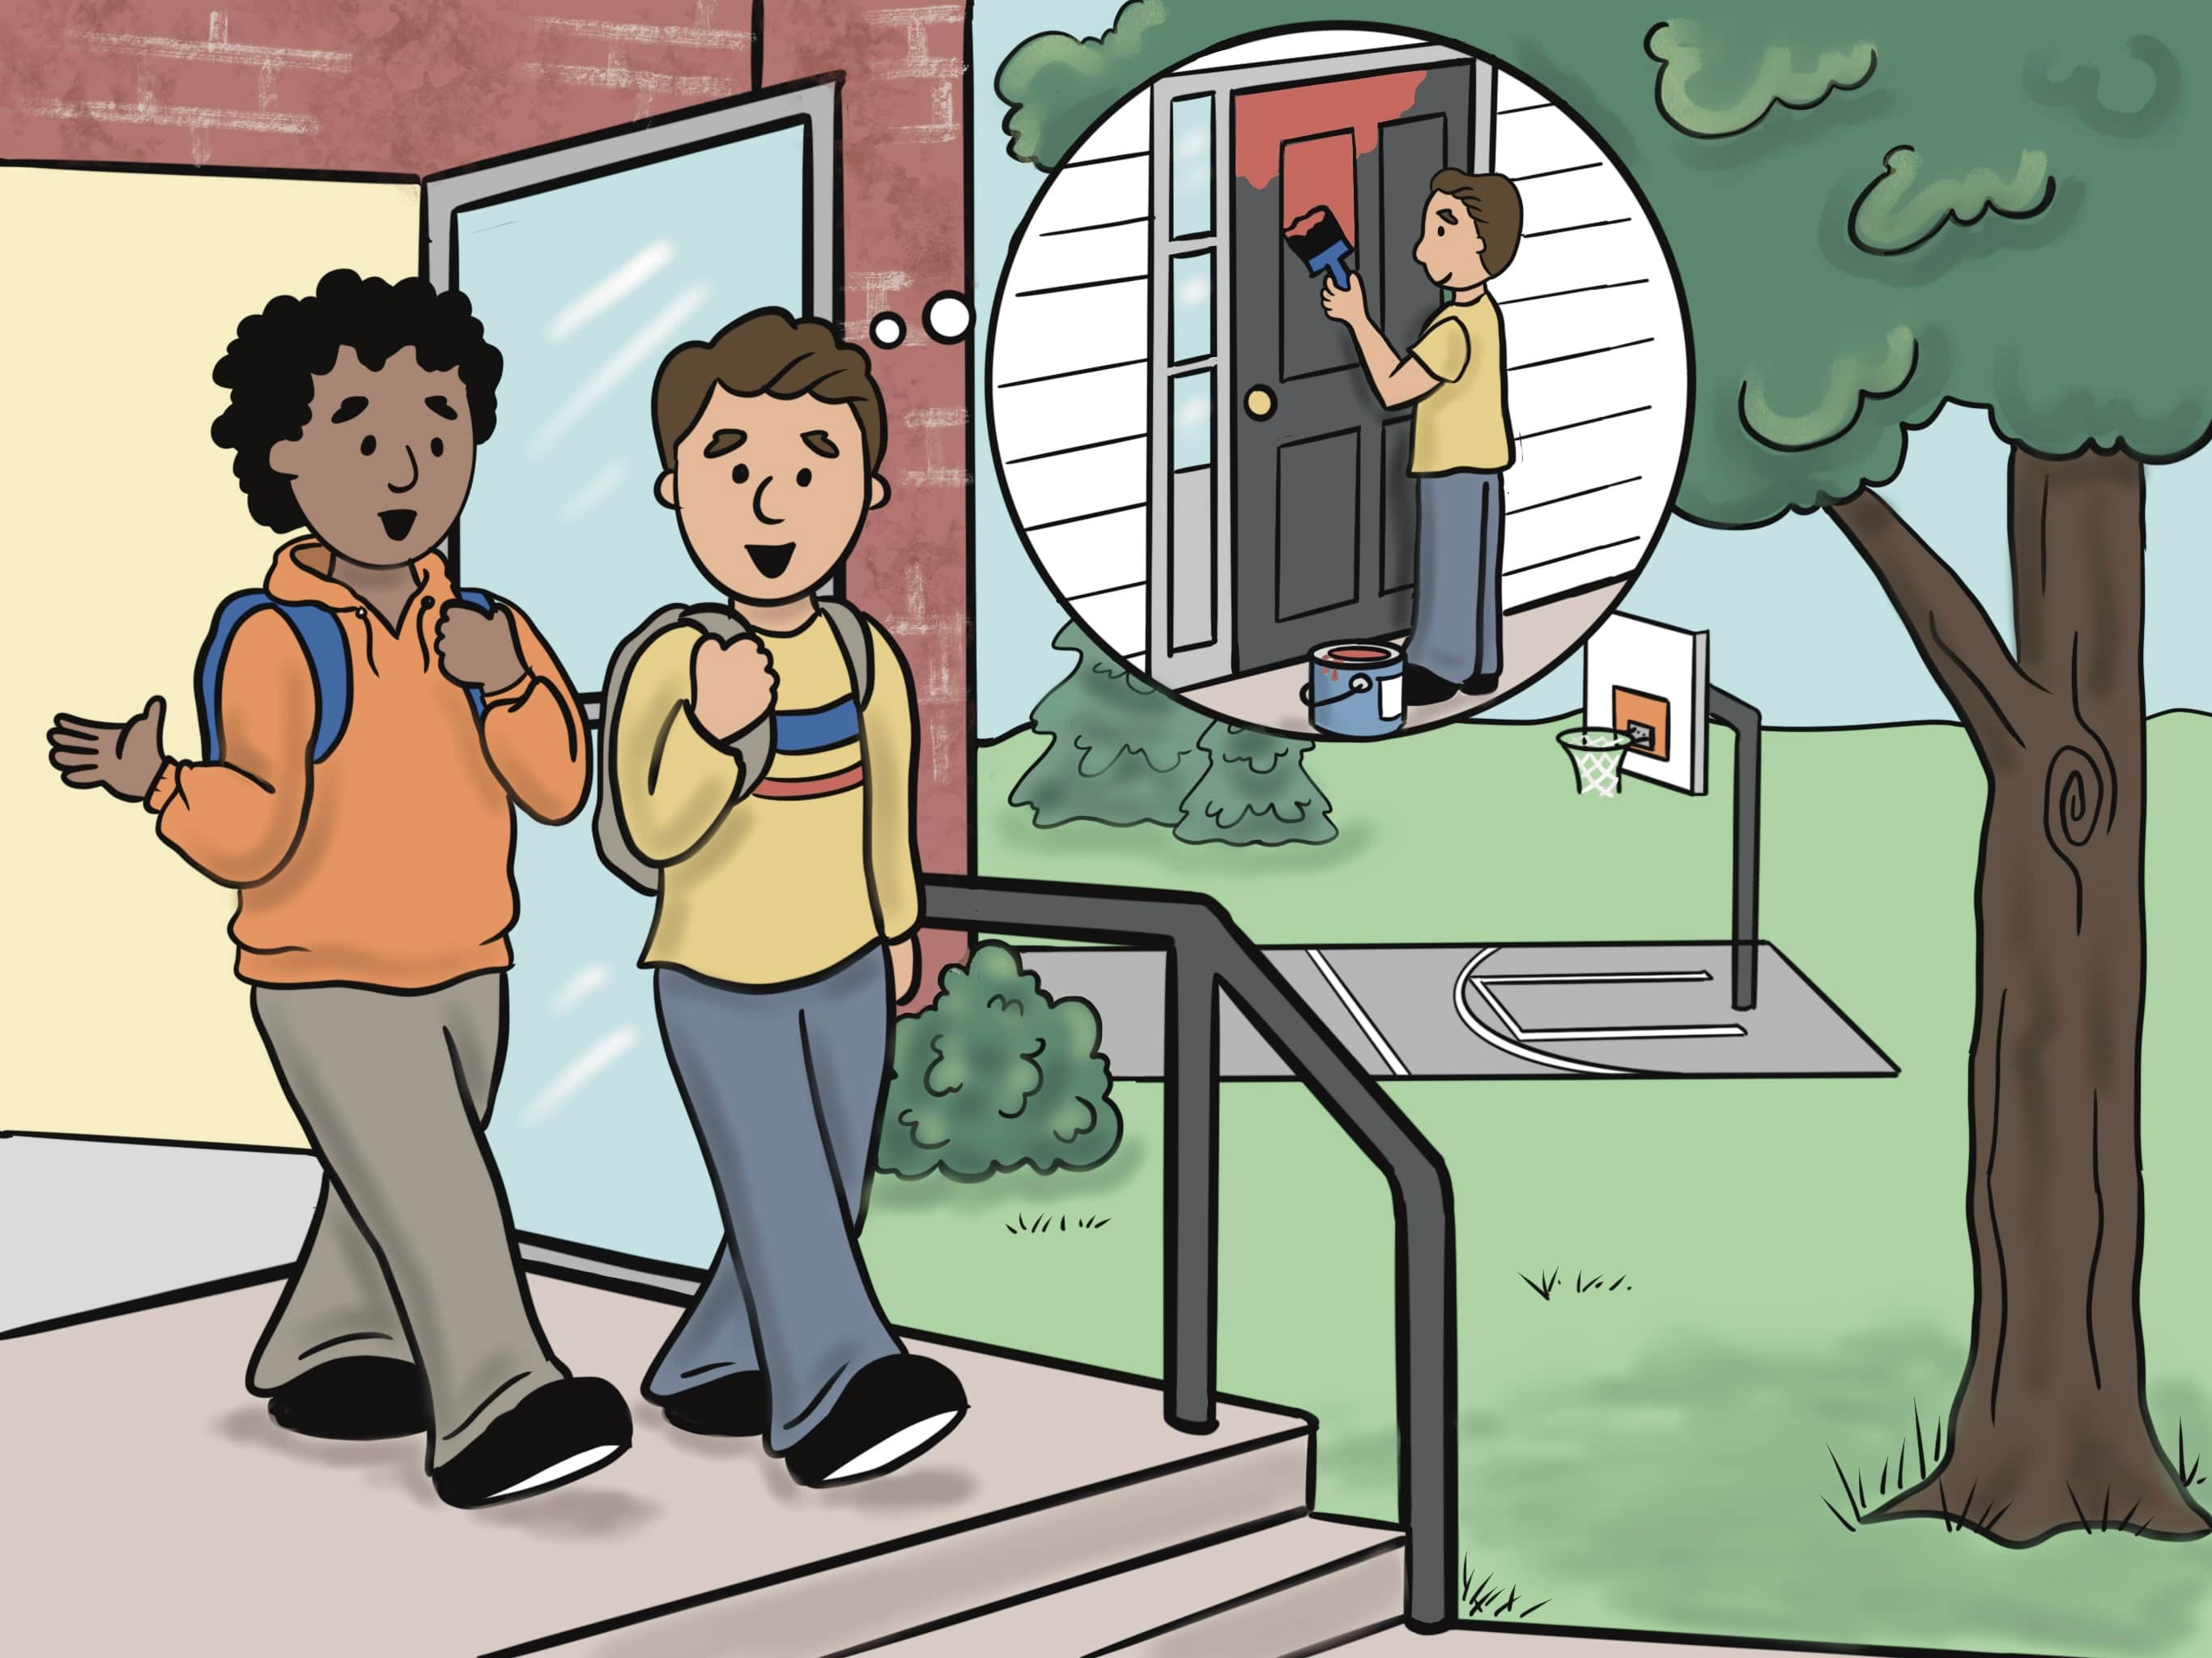
Lesson 2: I’m Going to Help My Neighbors.

Slide 19
why

Slide 20
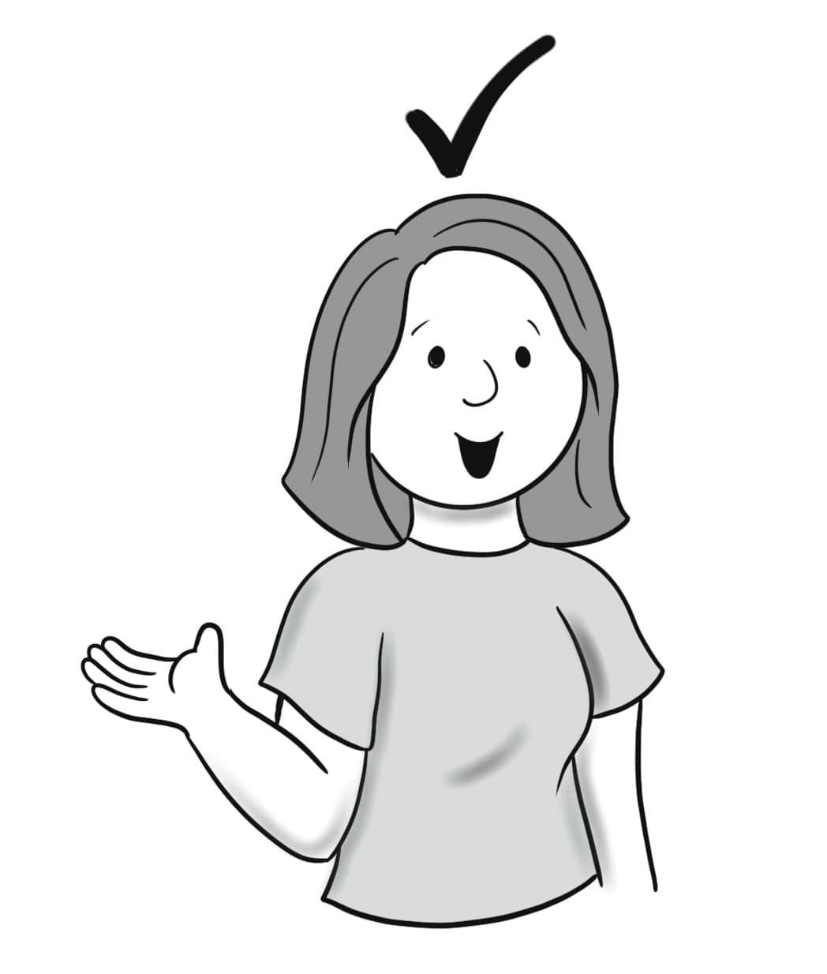
because

Slide 21
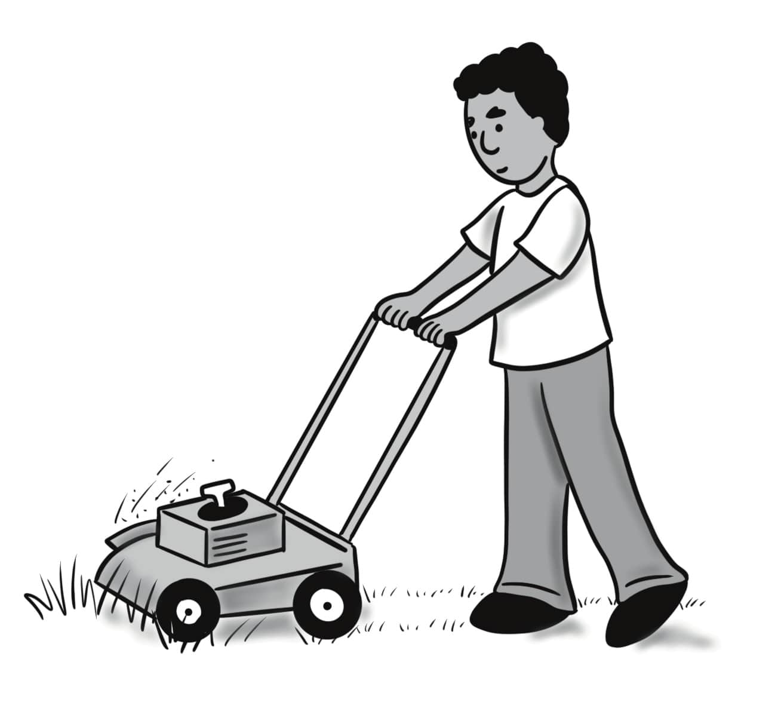
mow the grass

Slide 22
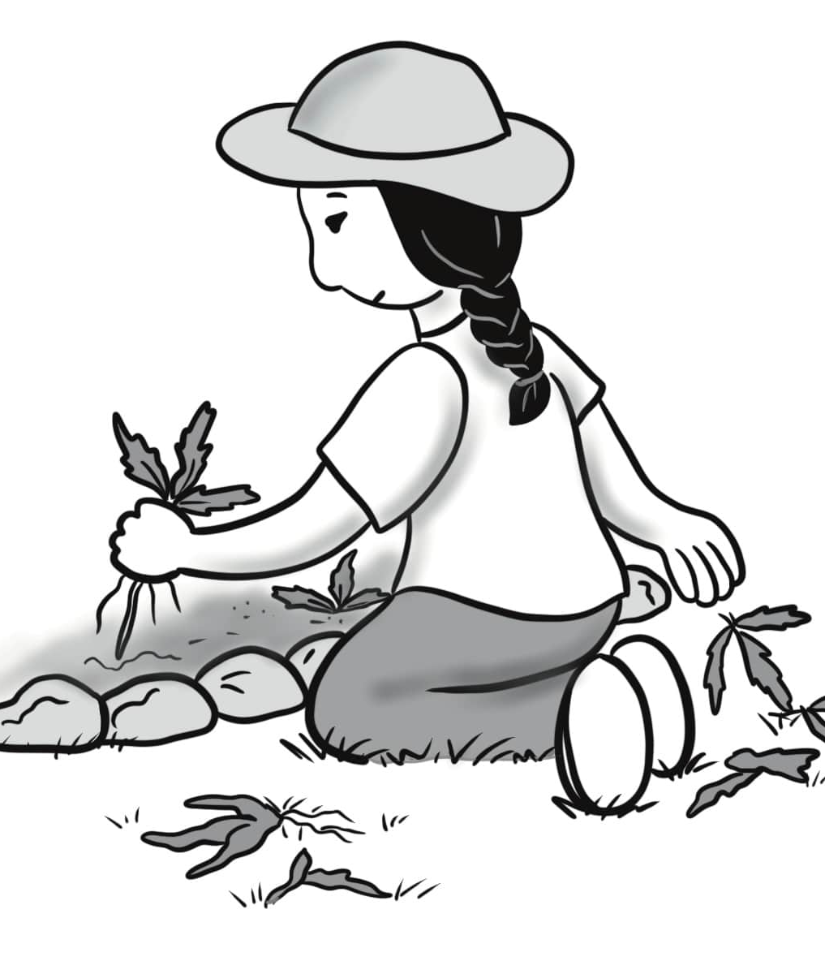
weed

Slide 23
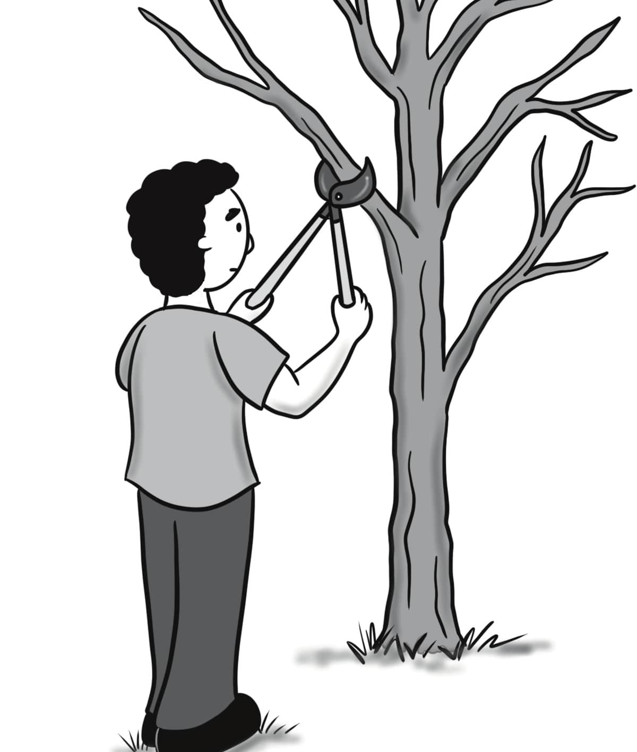
trim a tree

Slide 24
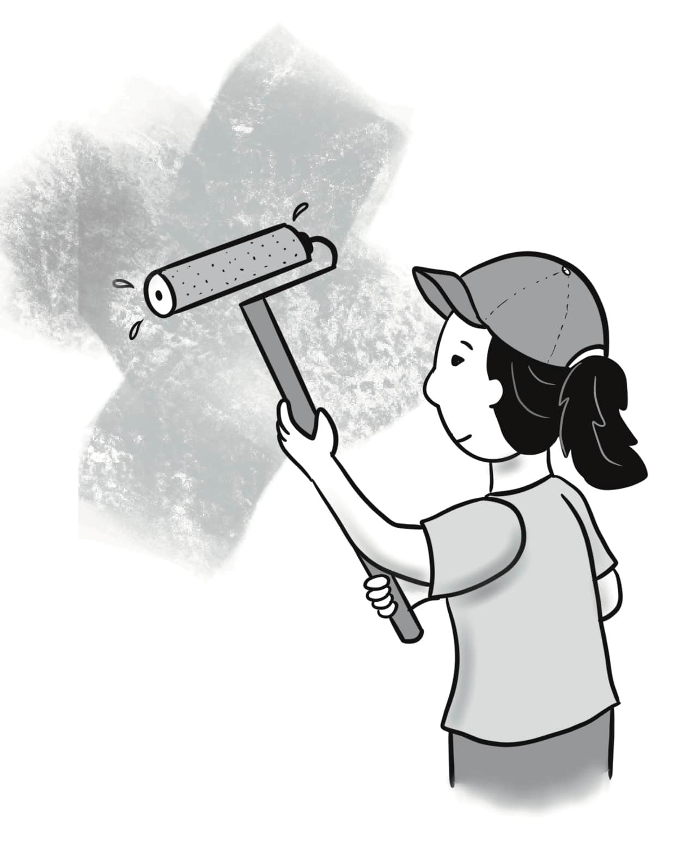
paint

Slide 25
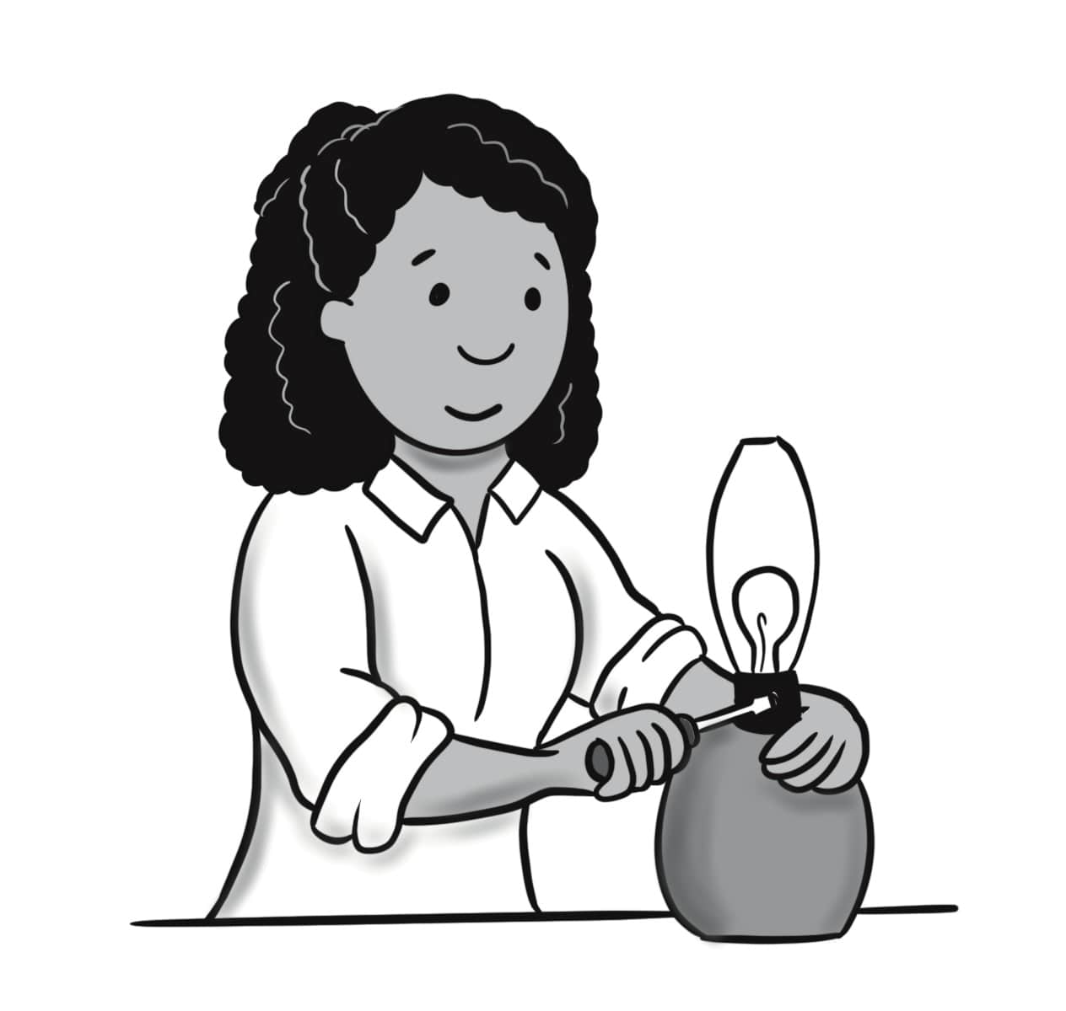
repair

Slide 26
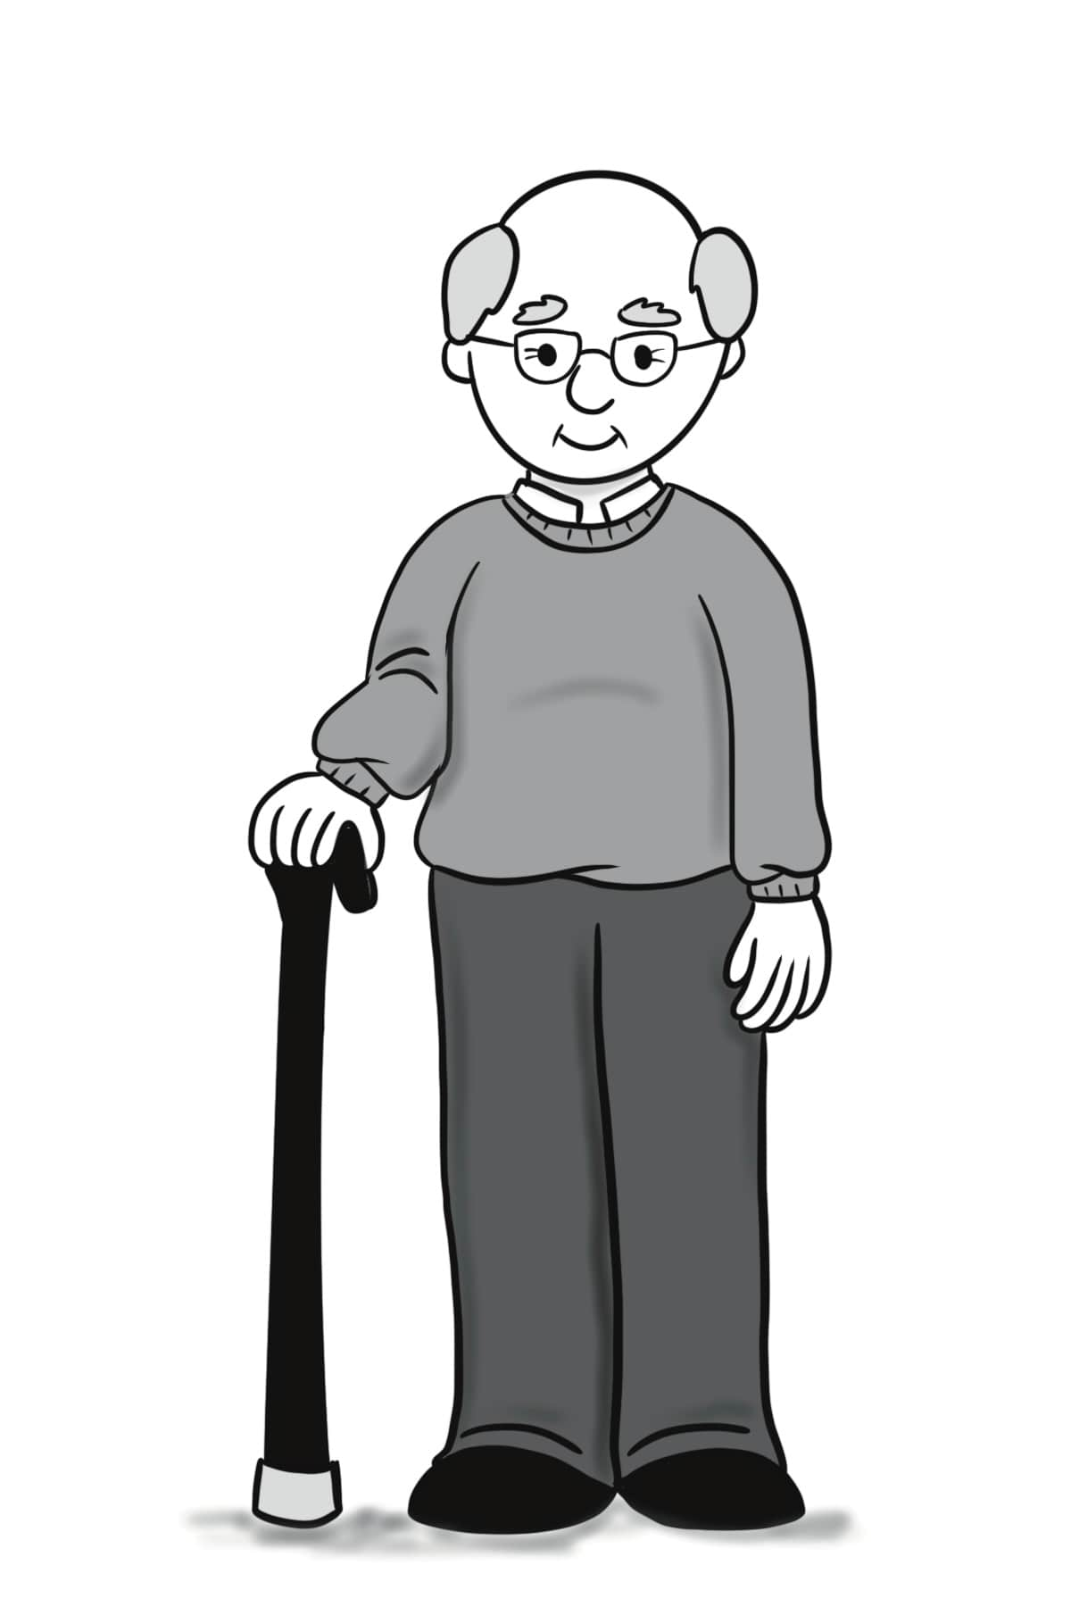
elderly

Slide 27
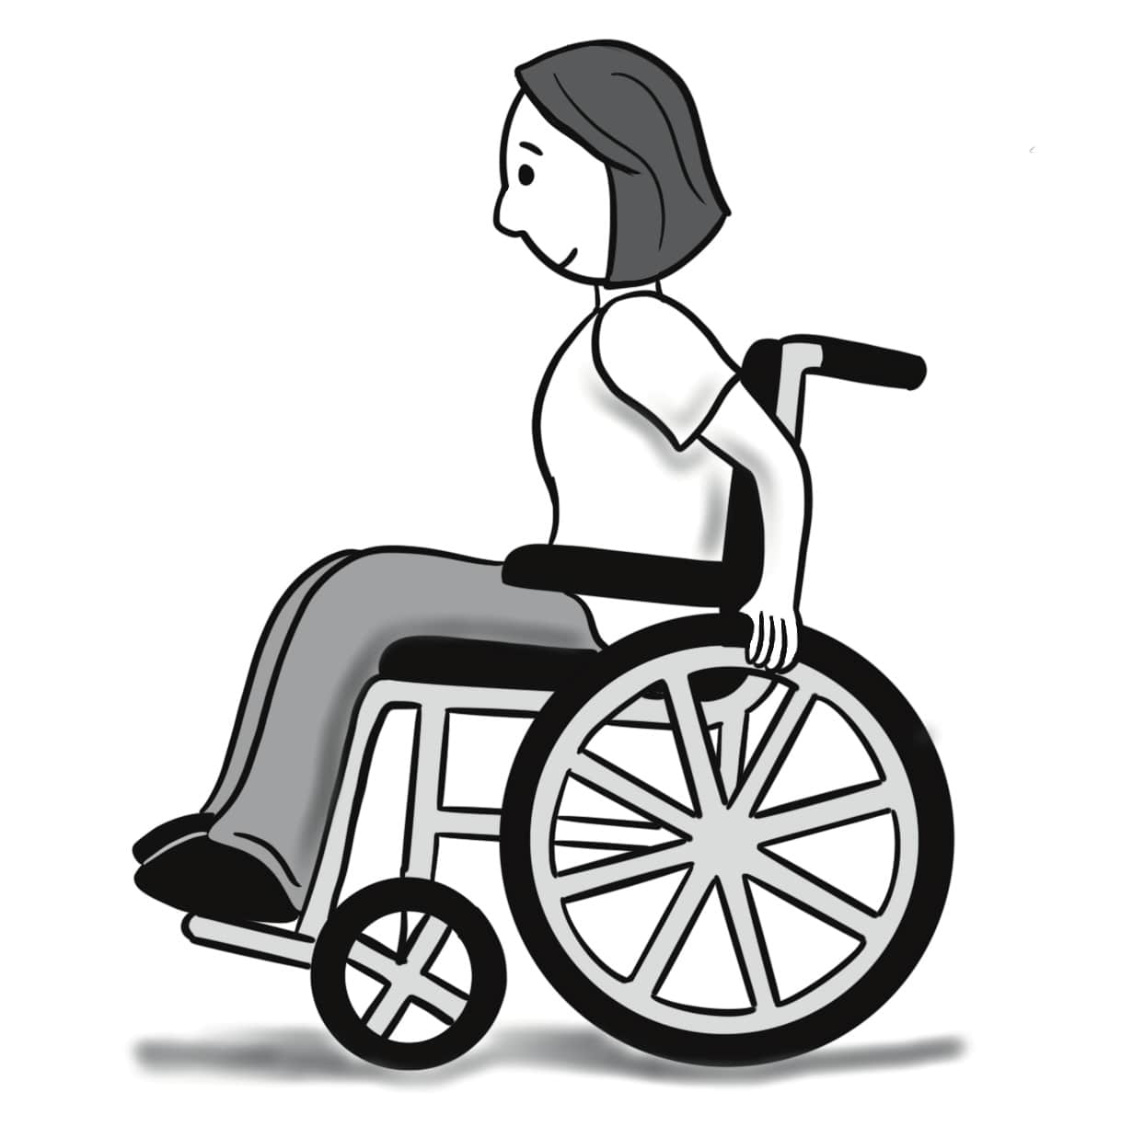
disabled

Slide 28
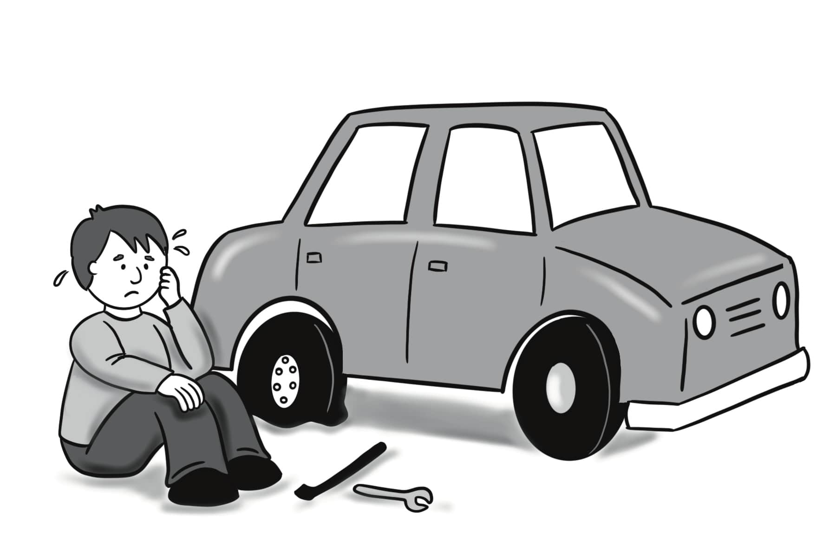
have (had) a hard time

Slide 29
A. Why can’t you come? B. I can’t come because I’m going to mow the grass.
Sentences Using Vocabulary

Slide 30
A. Hey. Are you coming to the party tomorrow? B. No, I can’t. A. Why can’t you come? B. I can’t come because I’m going to help my neighbors. I’m going to repair and paint their door. My sister is going to weed their garden and mow their grass. Then, we will trim a tree.
Dialogue, Part 1

Slide 31
A. That’s really kind of you. B. I’m happy that we can help. Our family likes to help our neighbors who are elderly, disabled, or having a hard time. A. Wow, that’s great. I’d love to help sometime.
Dialogue, Part 2

Slide 32
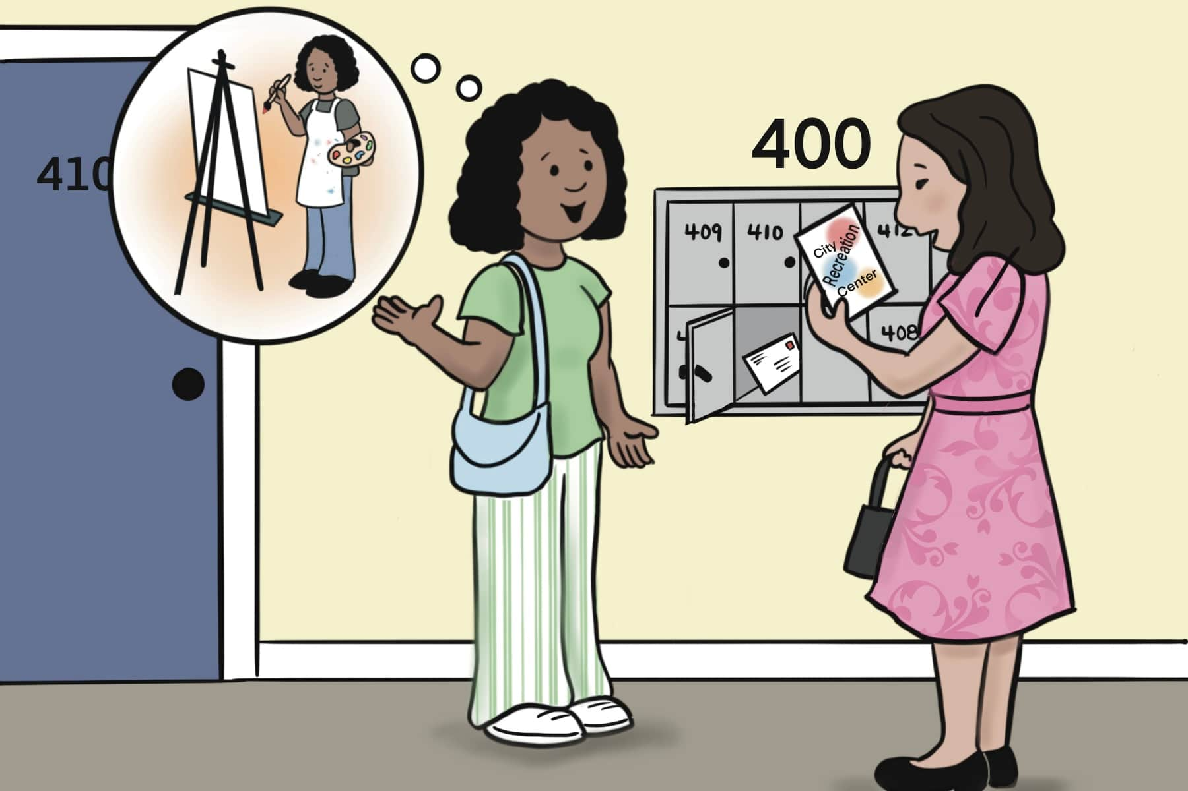
Lesson 3: I Love the Rec Center!

Slide 33
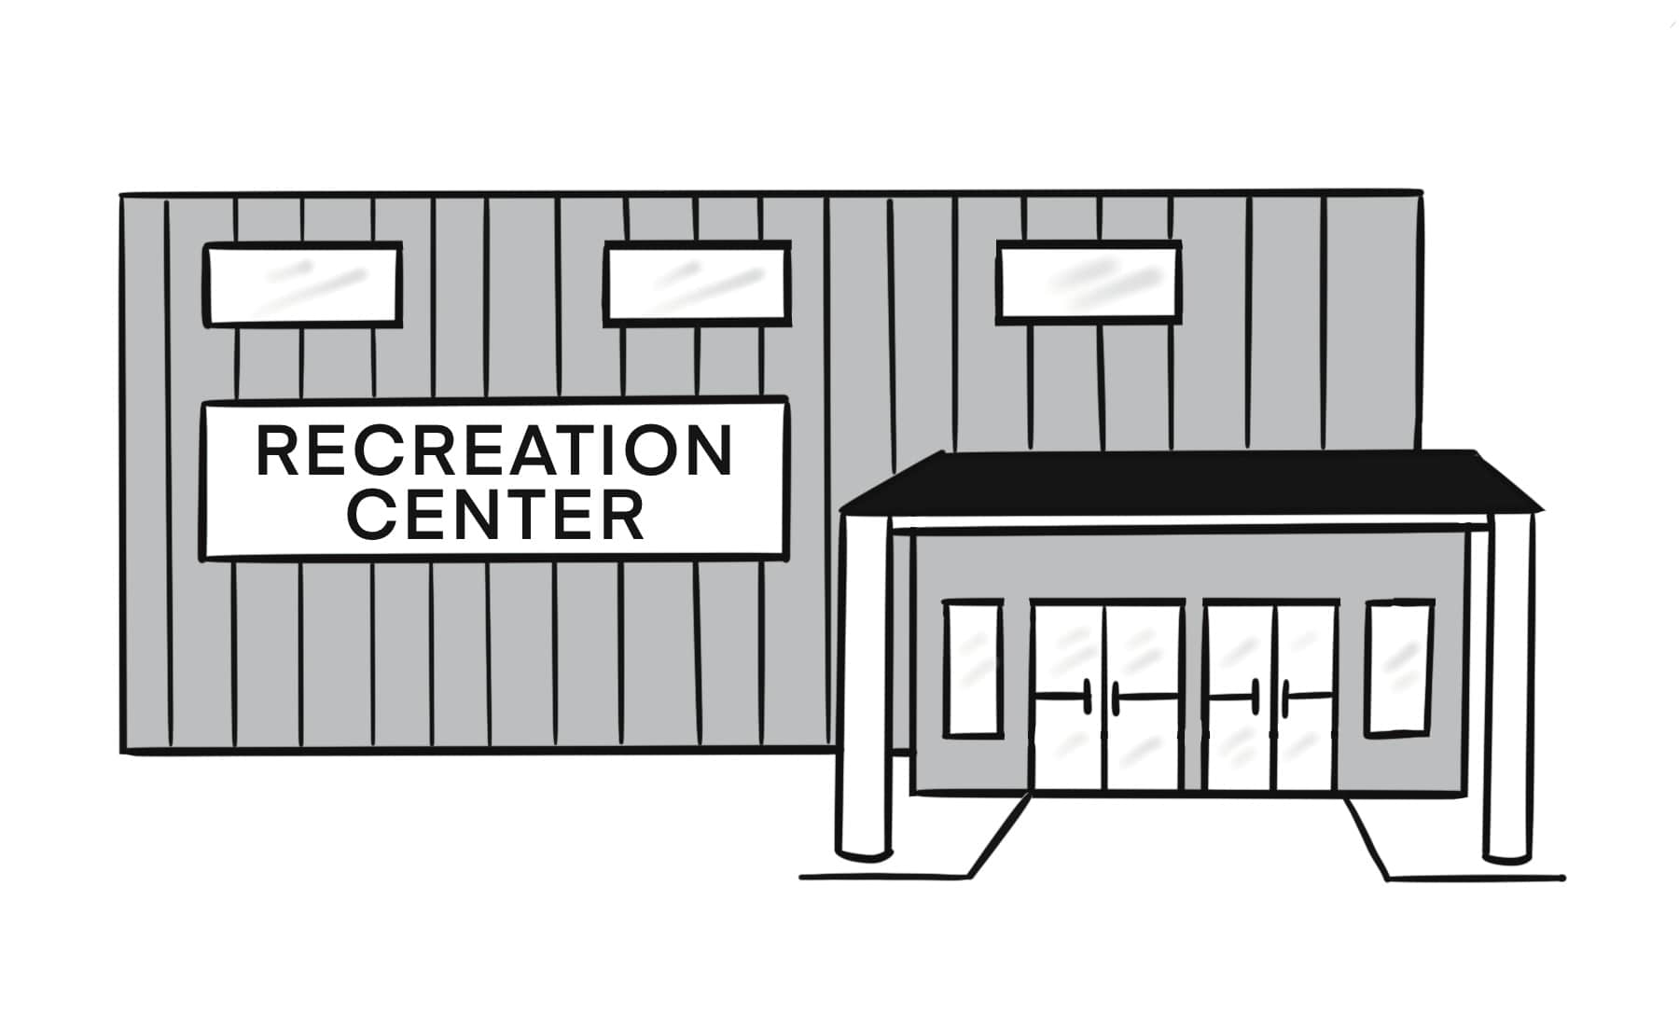
recreation center (rec center)

Slide 34
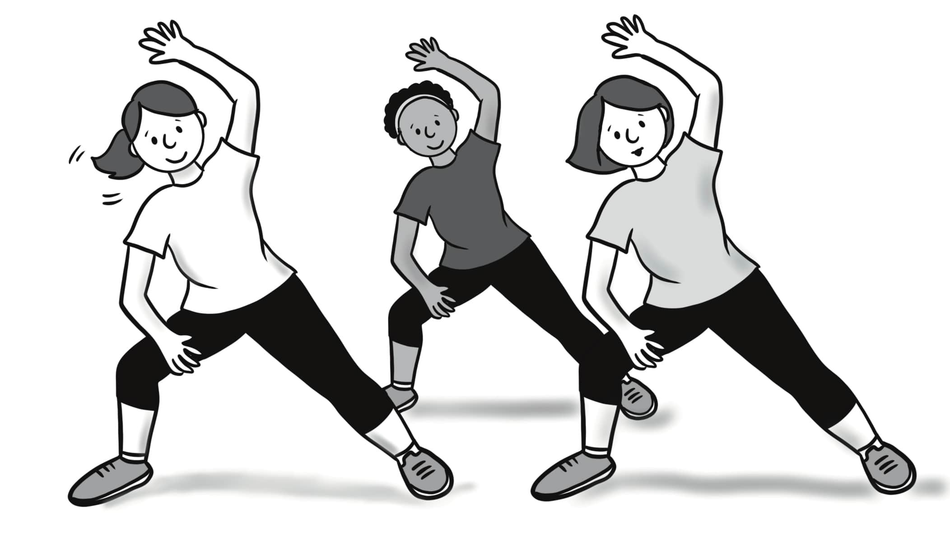
fitness class

Slide 35
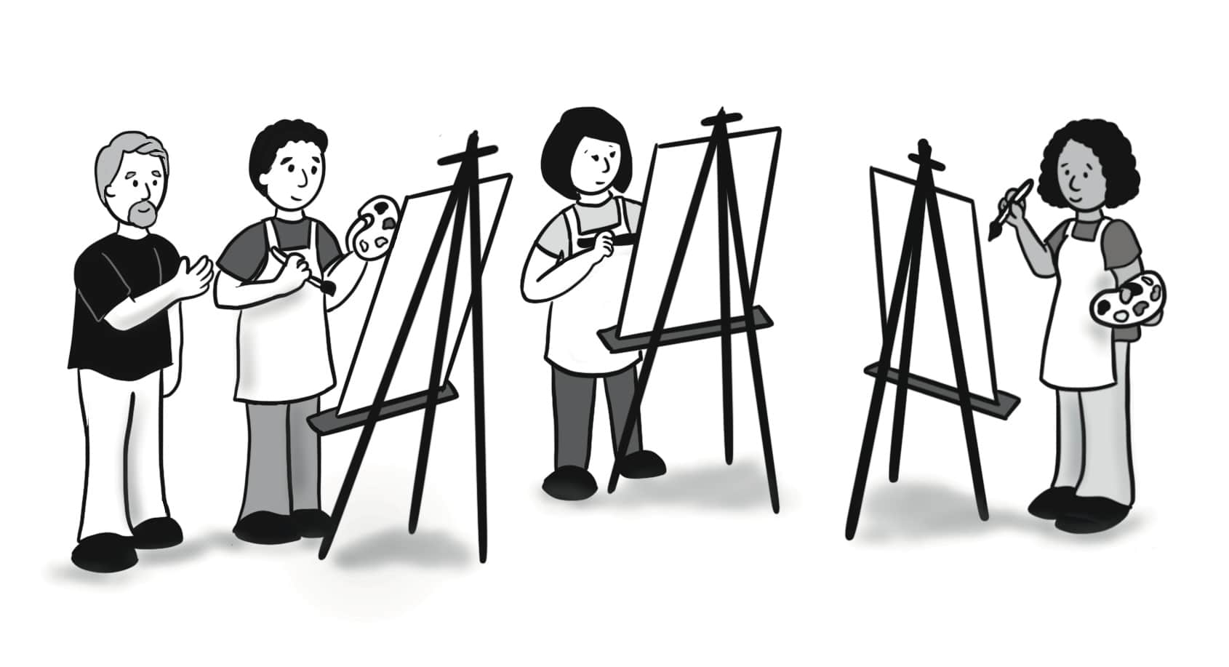
art class

Slide 36
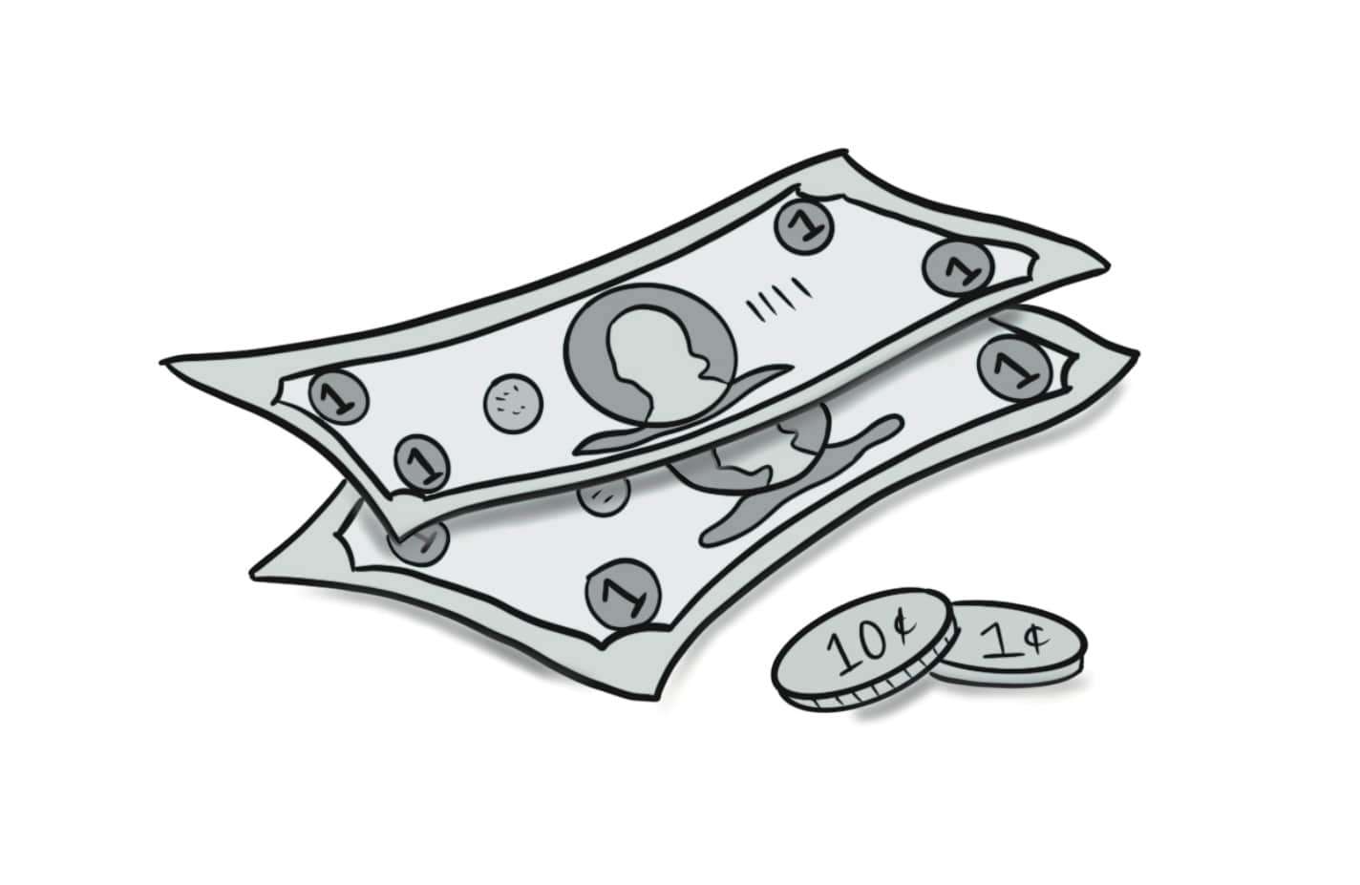
fee

Slide 37
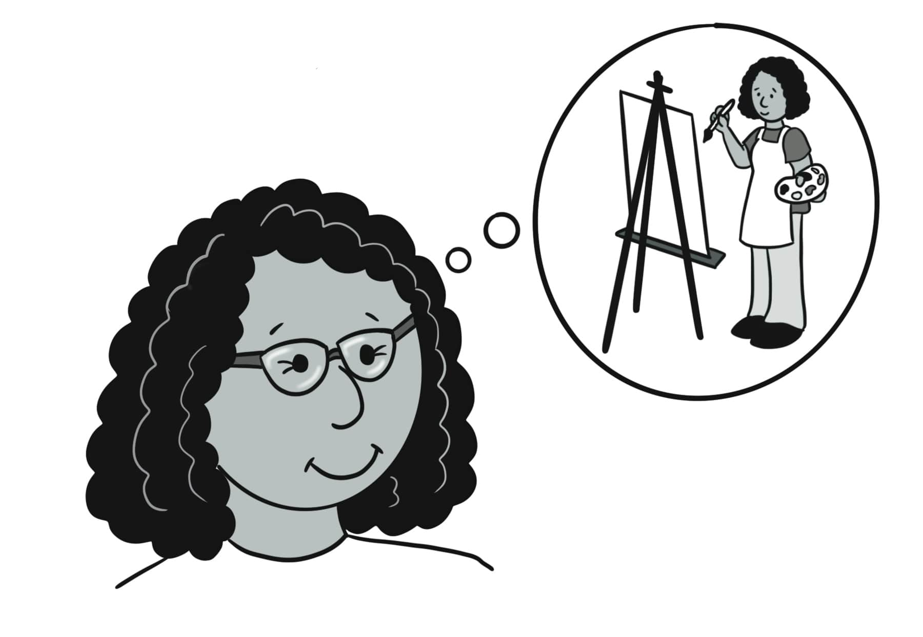
used to

Slide 38
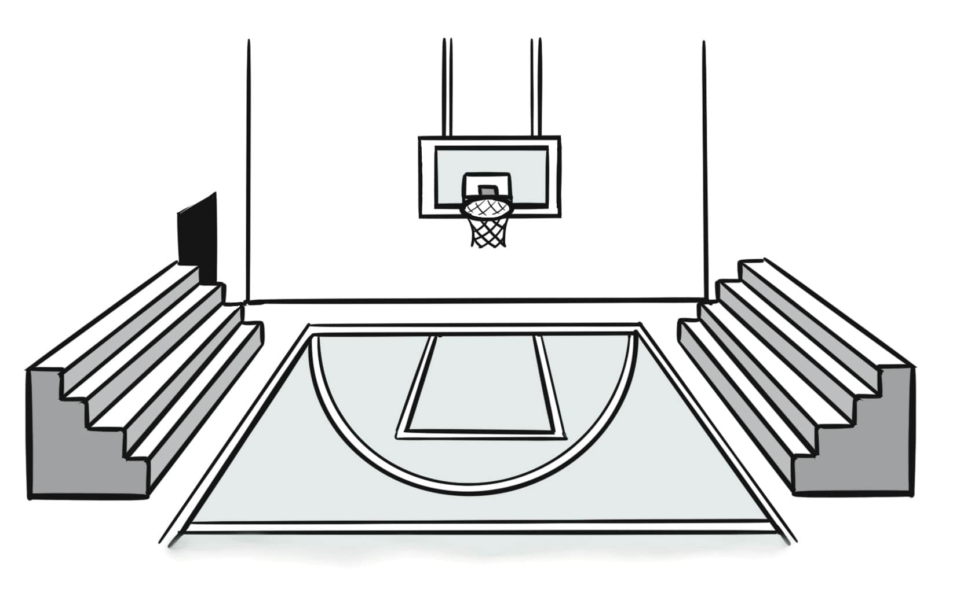
gymnasium (gym)

Slide 39
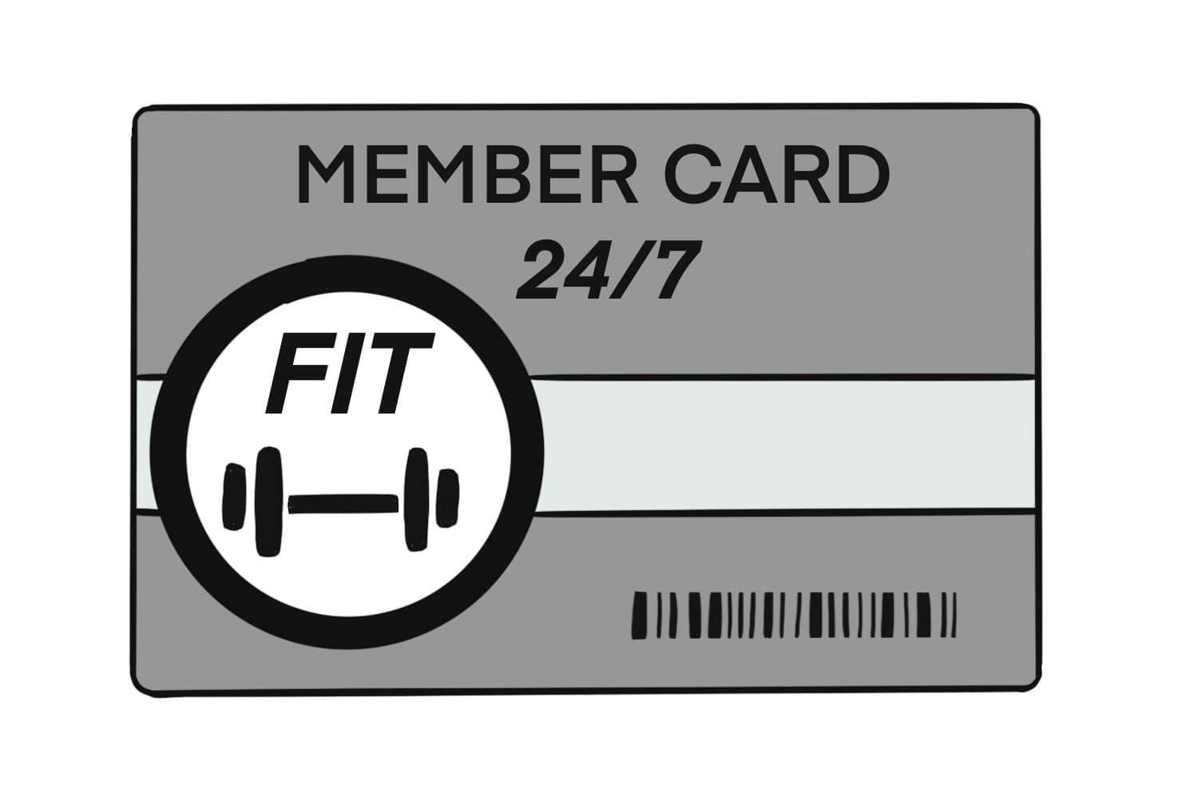
membership

Slide 40
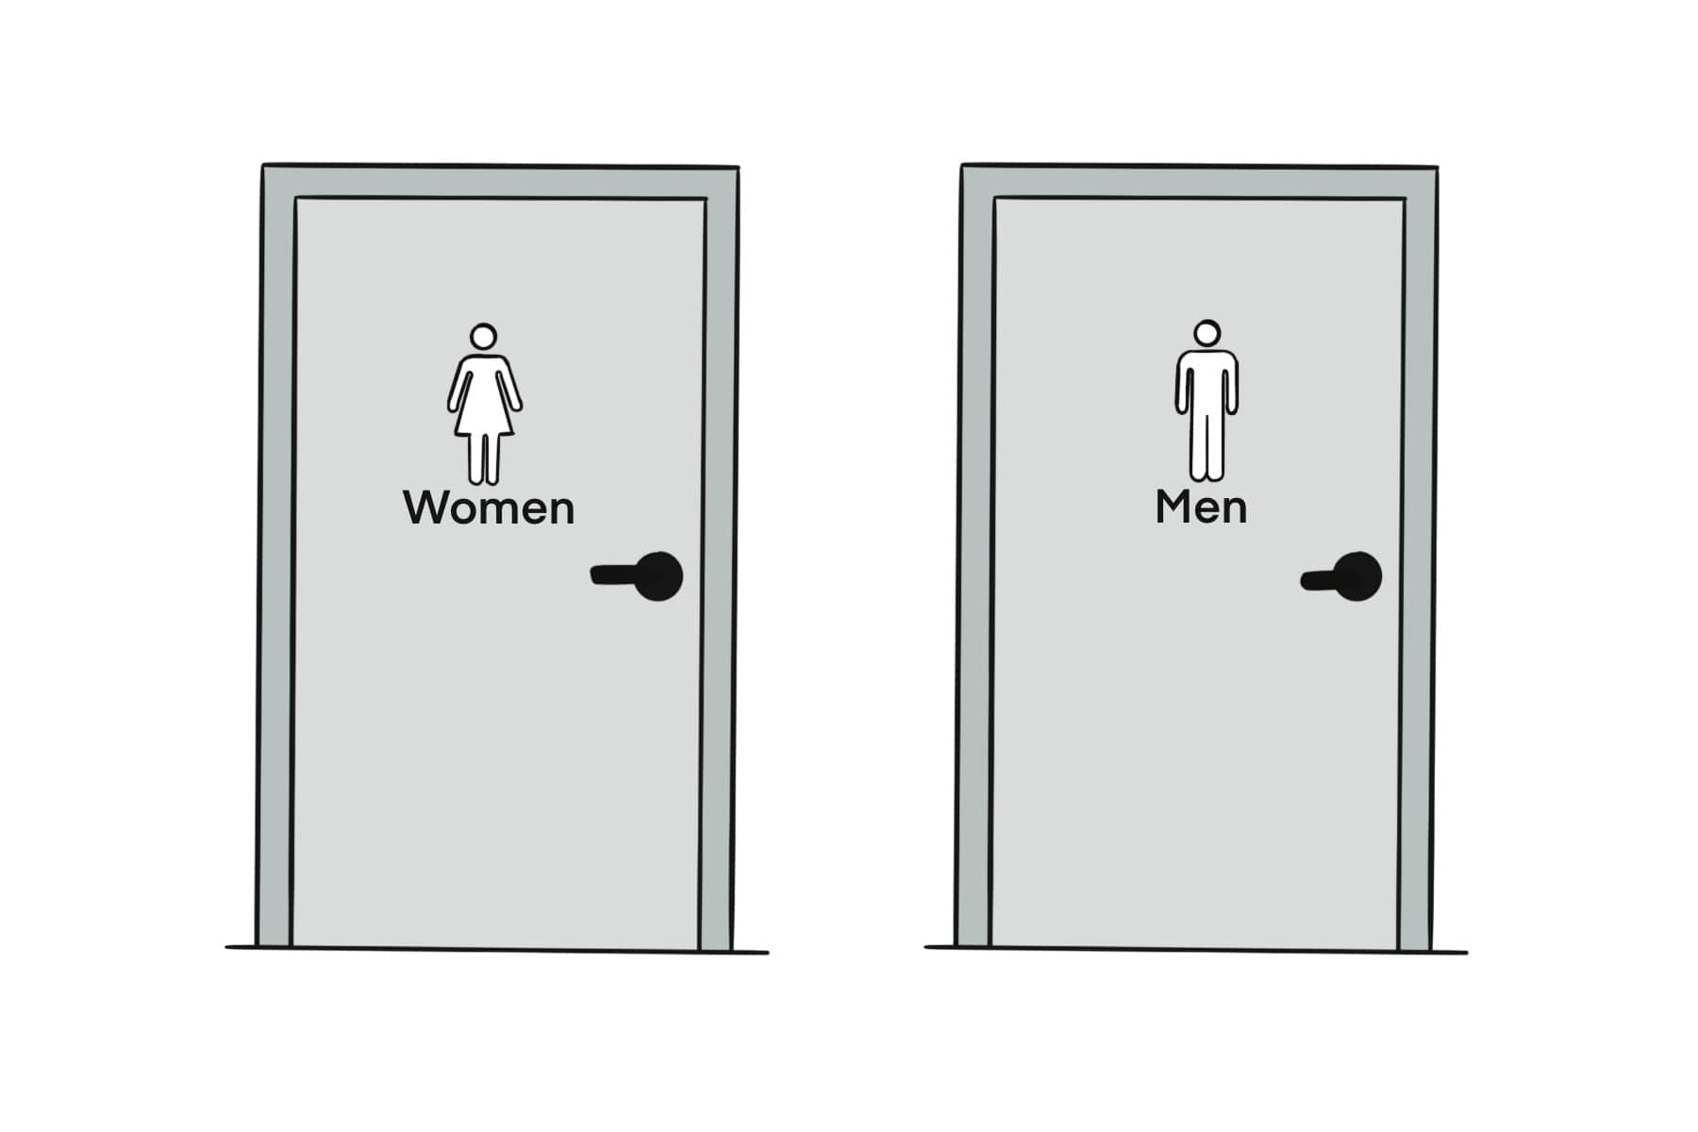
restroom

Slide 41
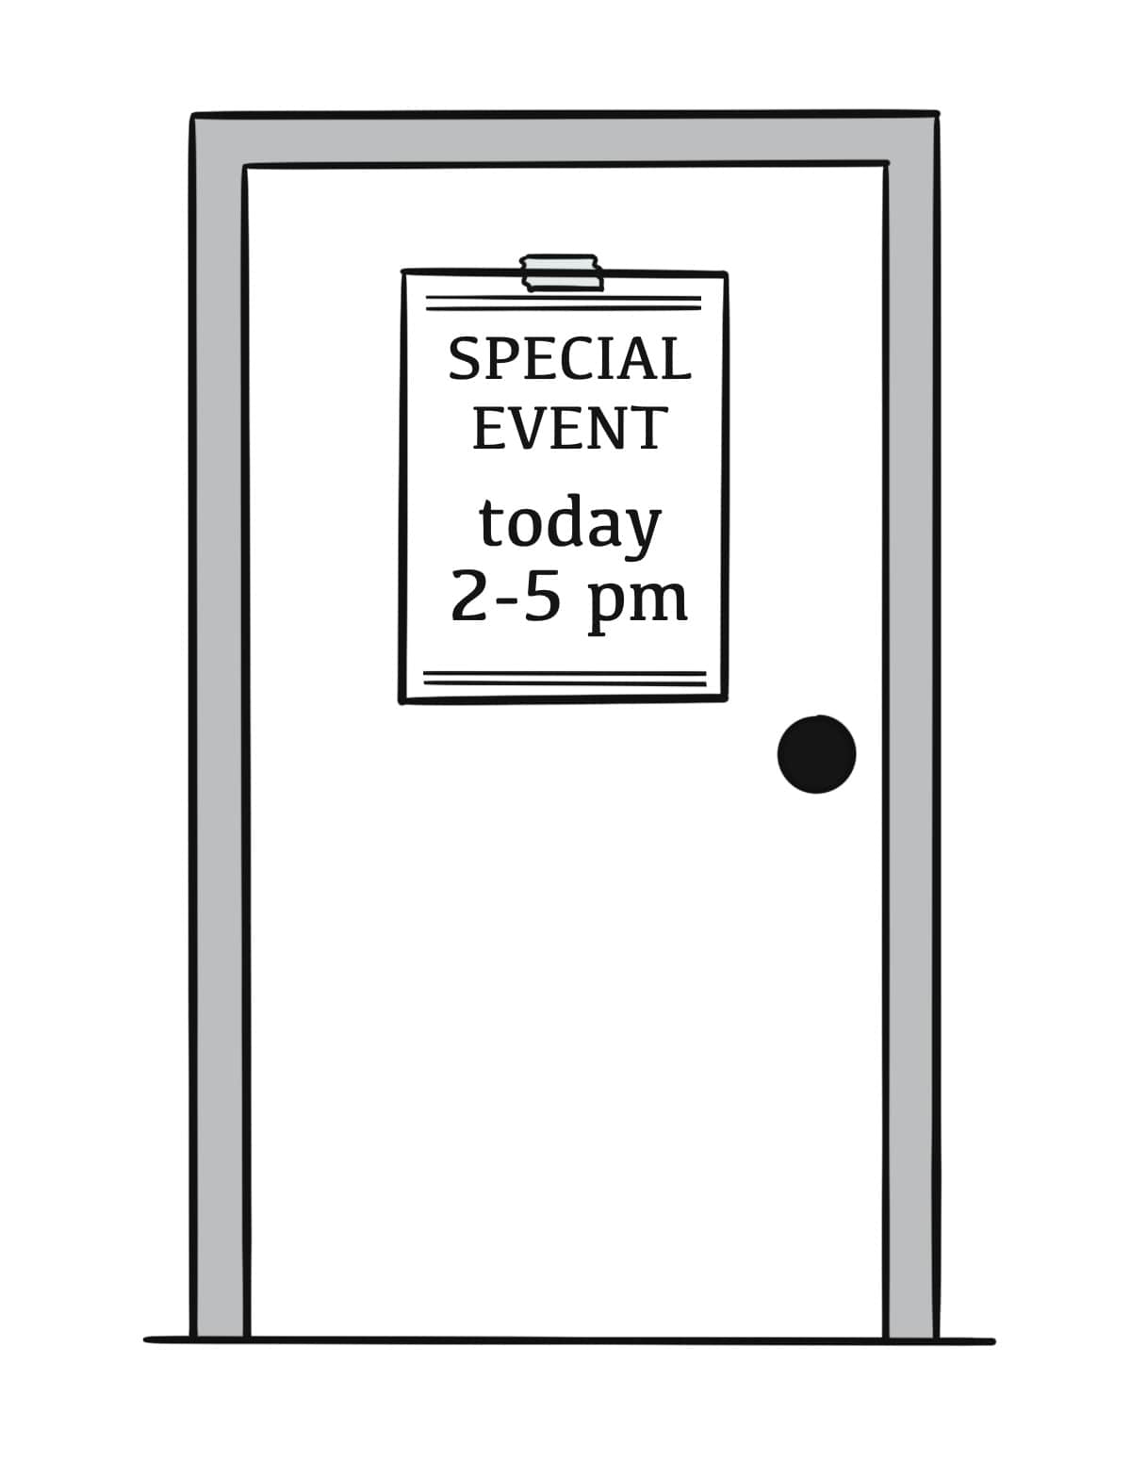
event

Slide 42
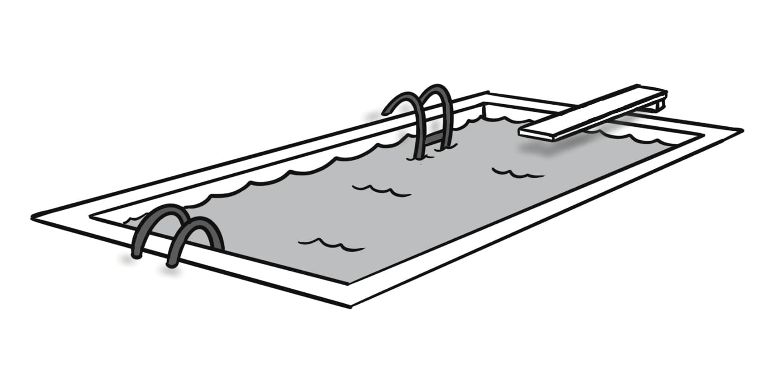
pool

Slide 43
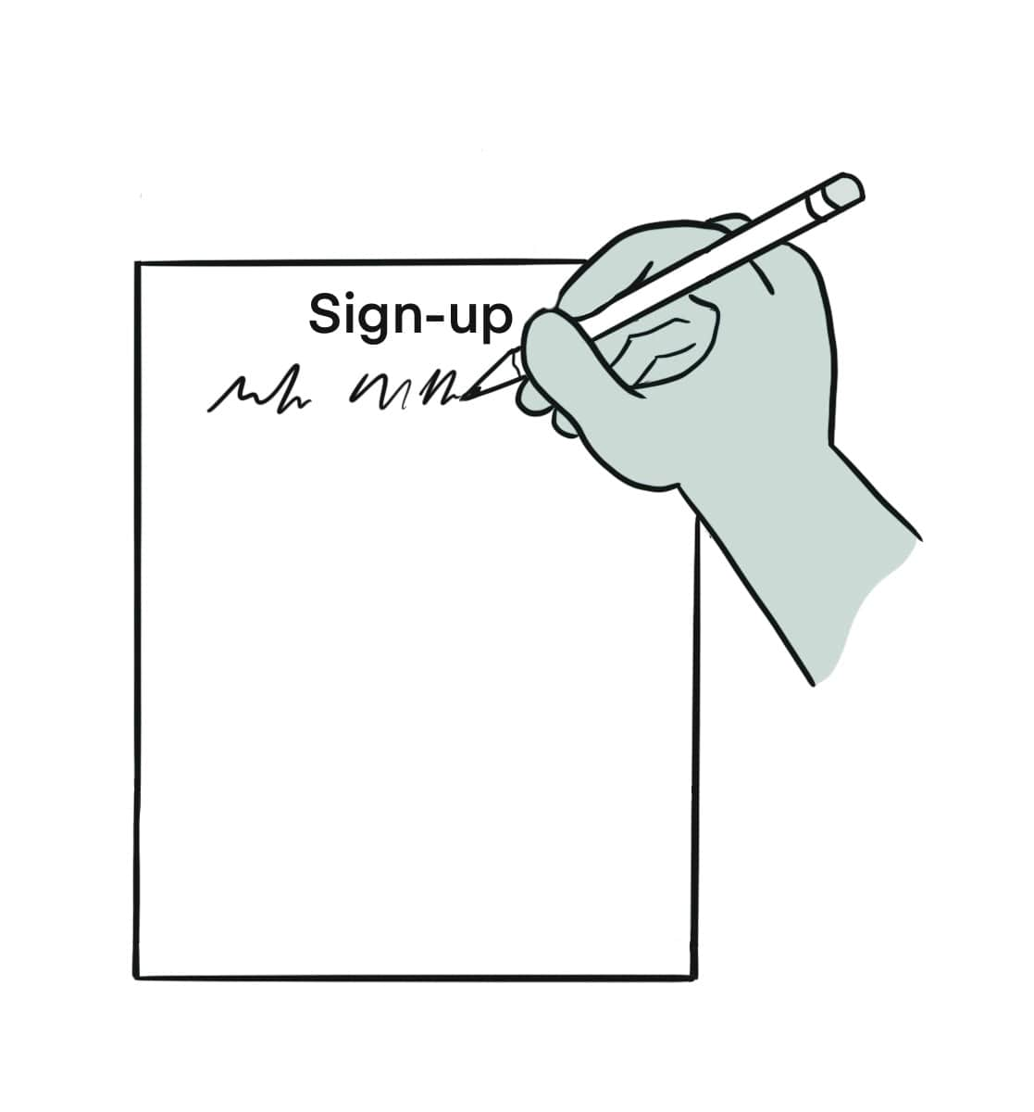
sign up

Slide 44
A. What did you do at the rec center? B. I used to take an art class.
Sentences Using Vocabulary

Slide 45
A. I got a schedule from the rec center in the mail. Do you go there? B. Oh, yes, I love the rec center! I go there often. A. What do you do there? B. I used to take some classes there. I took an art class on Tuesdays and a fitness class on Thursdays. Now, I sometimes go to events there. I like to swim in the pool on the weekends, and my kids play basketball in the gym. The rec center also has restrooms and rooms to shower and change your clothes.
Dialogue, Part 1

Slide 46
A. Oh, that sounds great. Is there a fee to use the rec center? B. Yes, you need to pay a fee for classes and events. If you want to use the gym or the pool, sometimes you need to pay for a membership. A. How do I sign up? B. Let’s go together!
Dialogue, Part 2

Slide 47
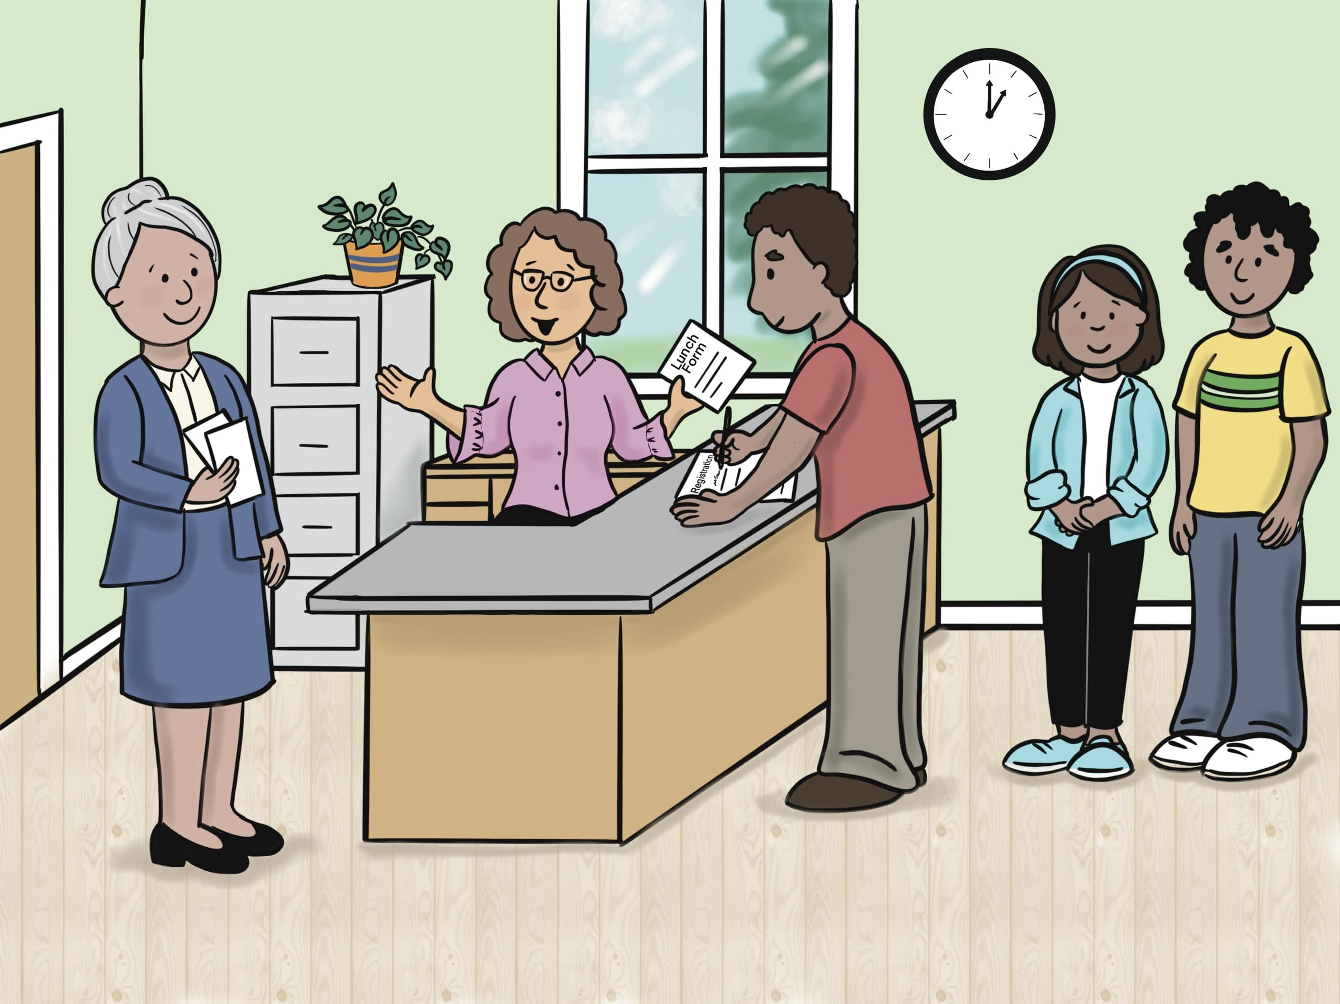
Lesson 4: Welcome to Our School.

Slide 48
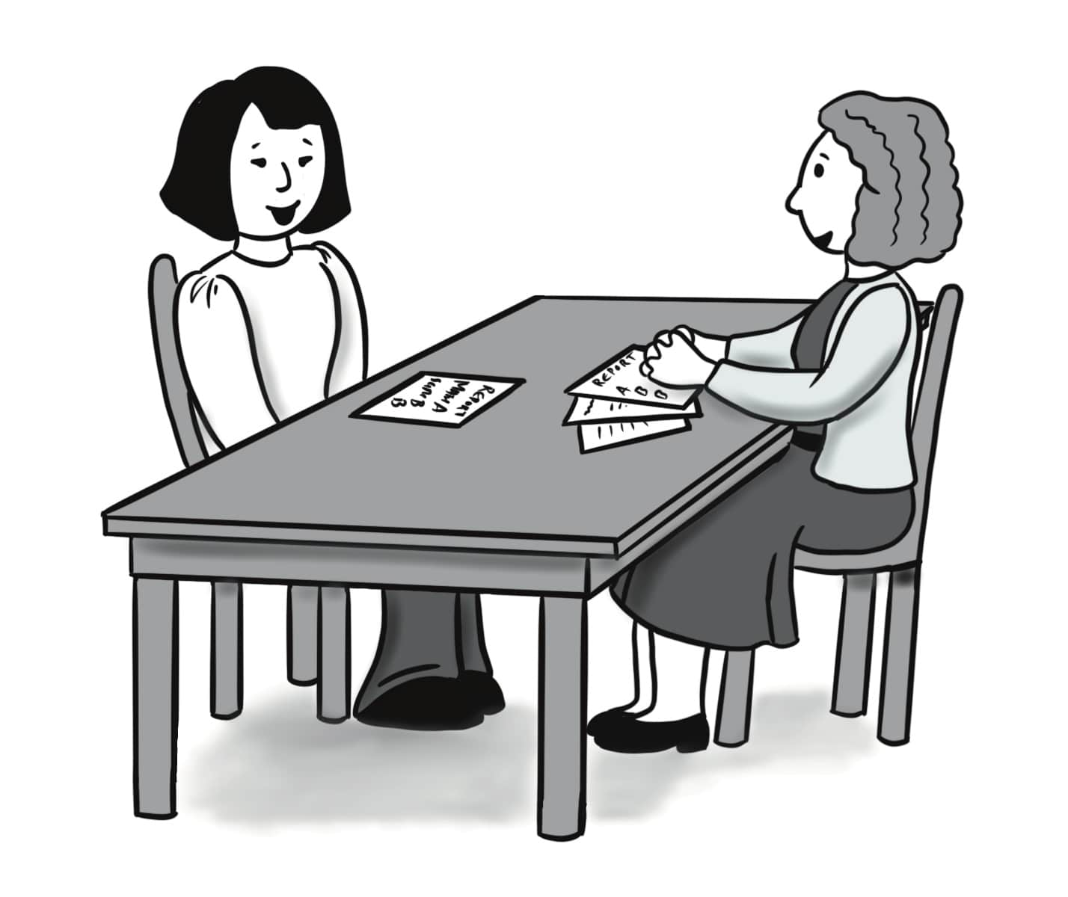
parent-teacher conference

Slide 49
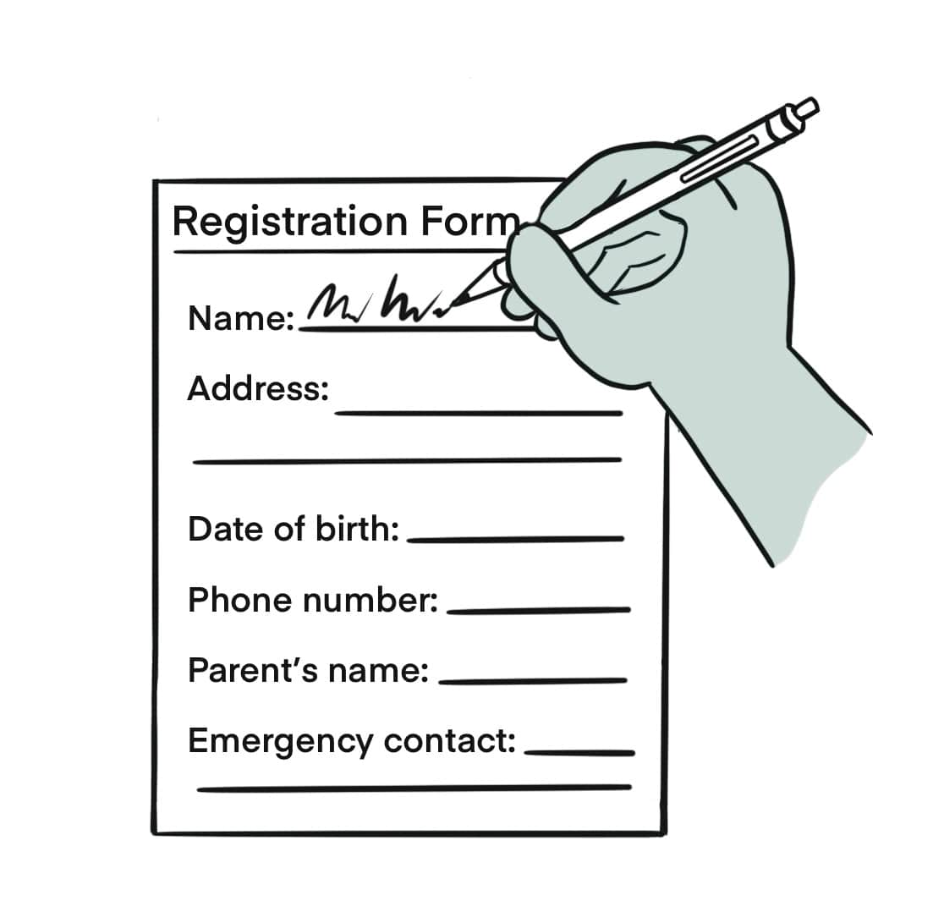
register

Slide 50
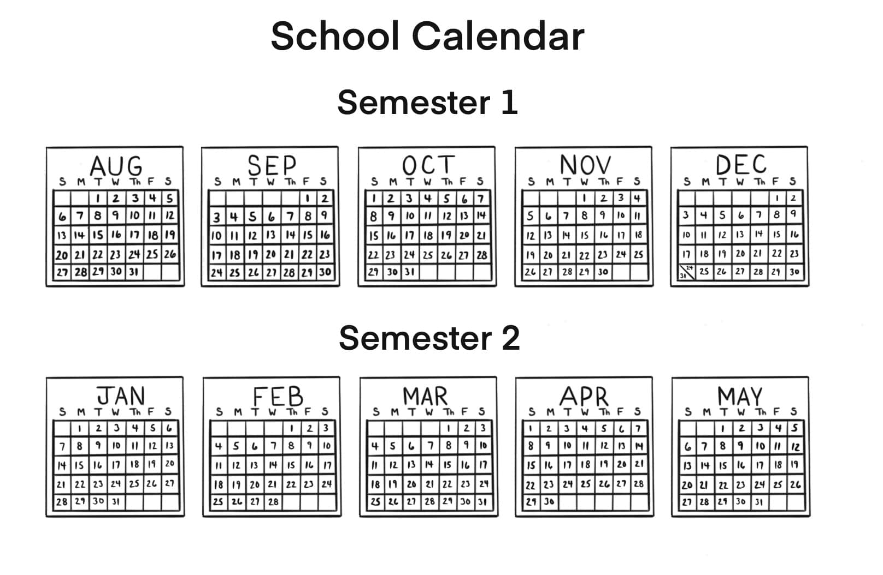
semester

Slide 51
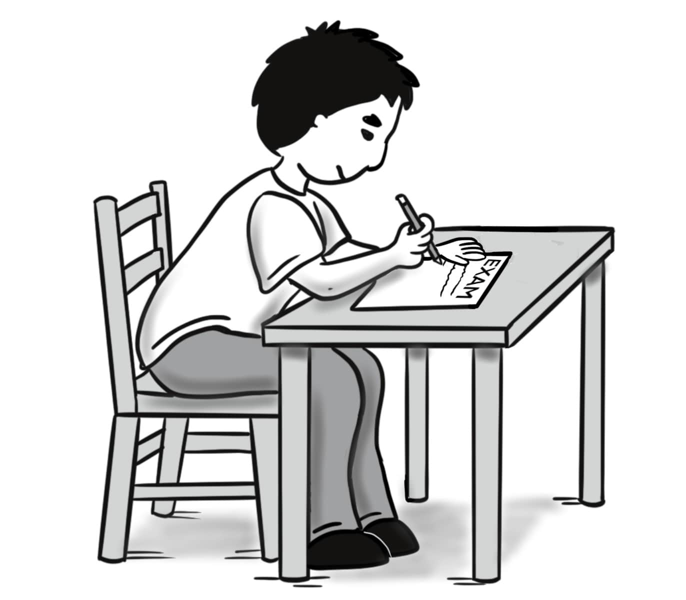
exam

Slide 52
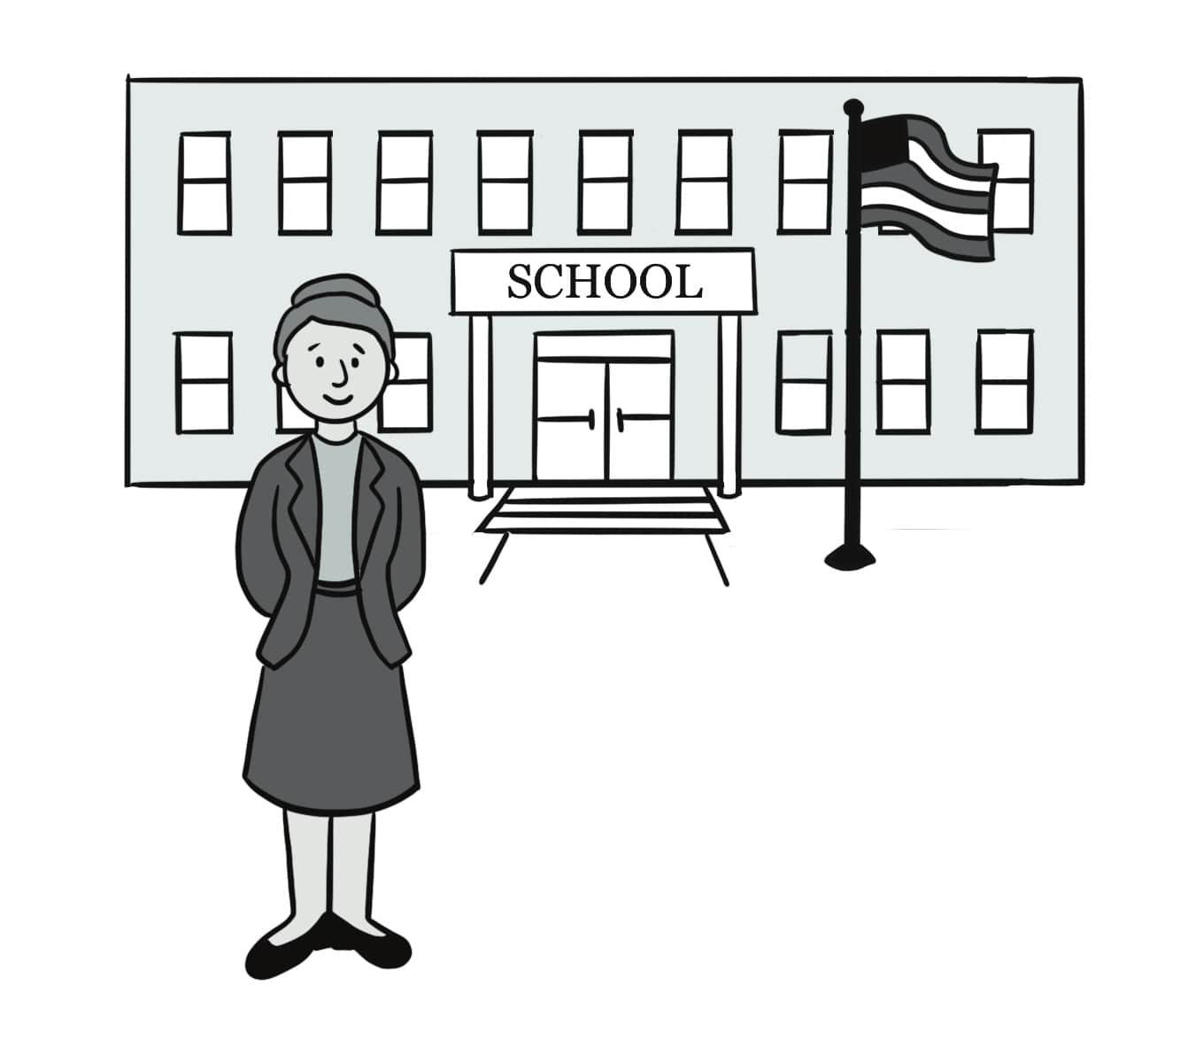
principal

Slide 53
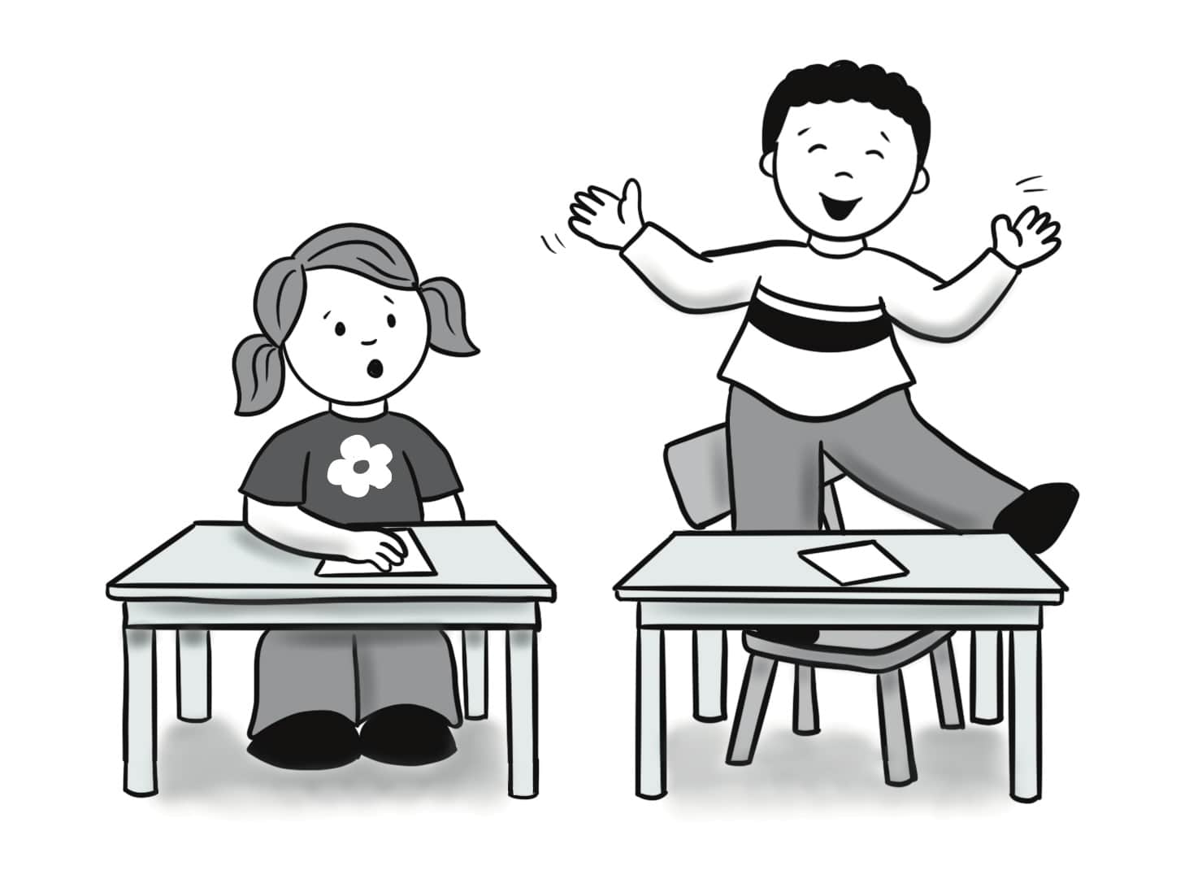
behavior

Slide 54
information

Slide 55
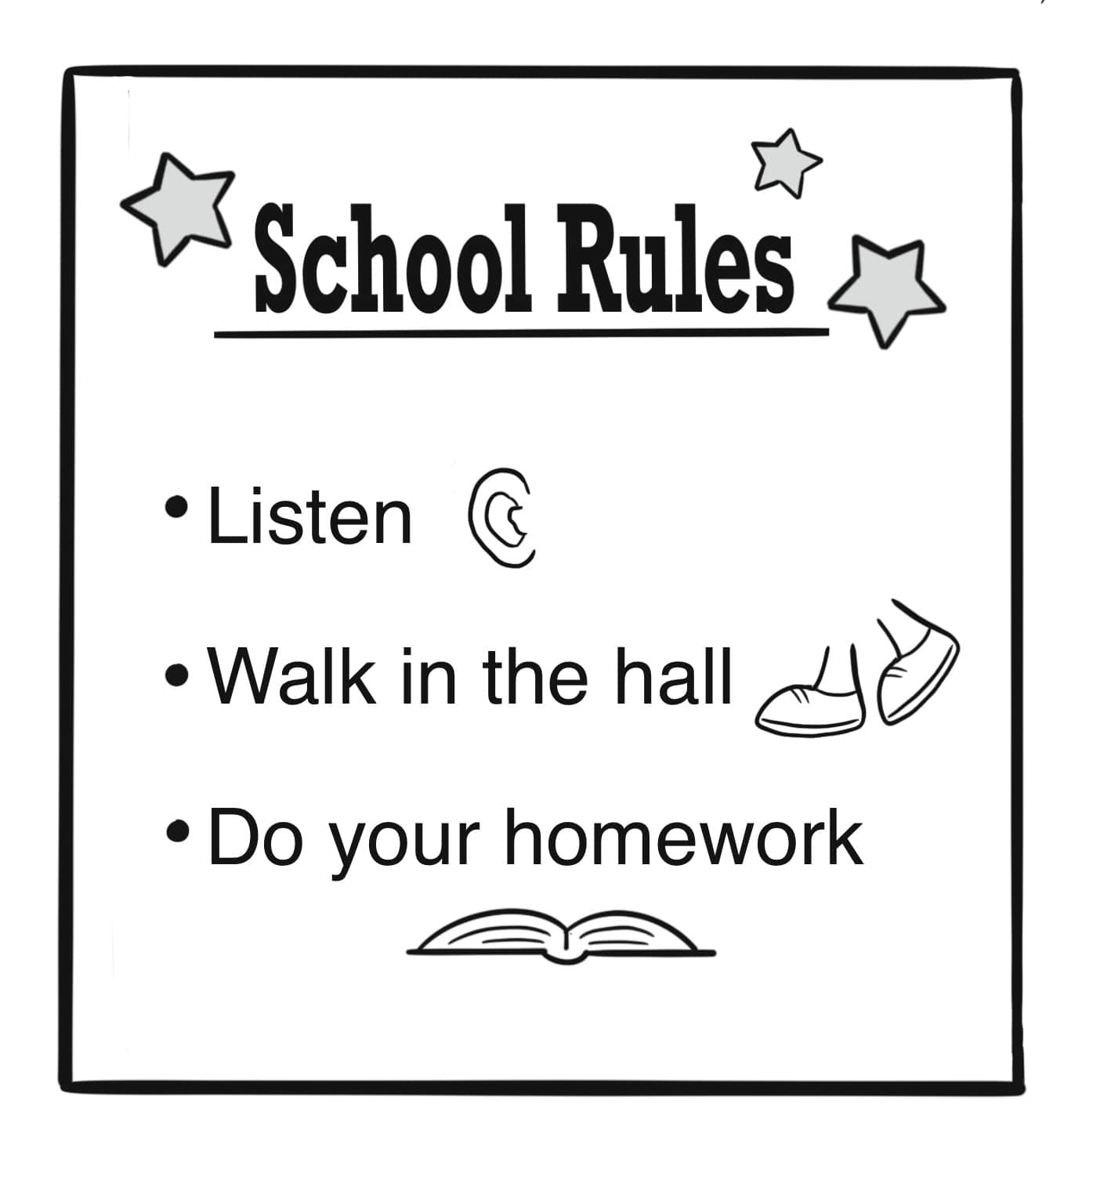
rule

Slide 56
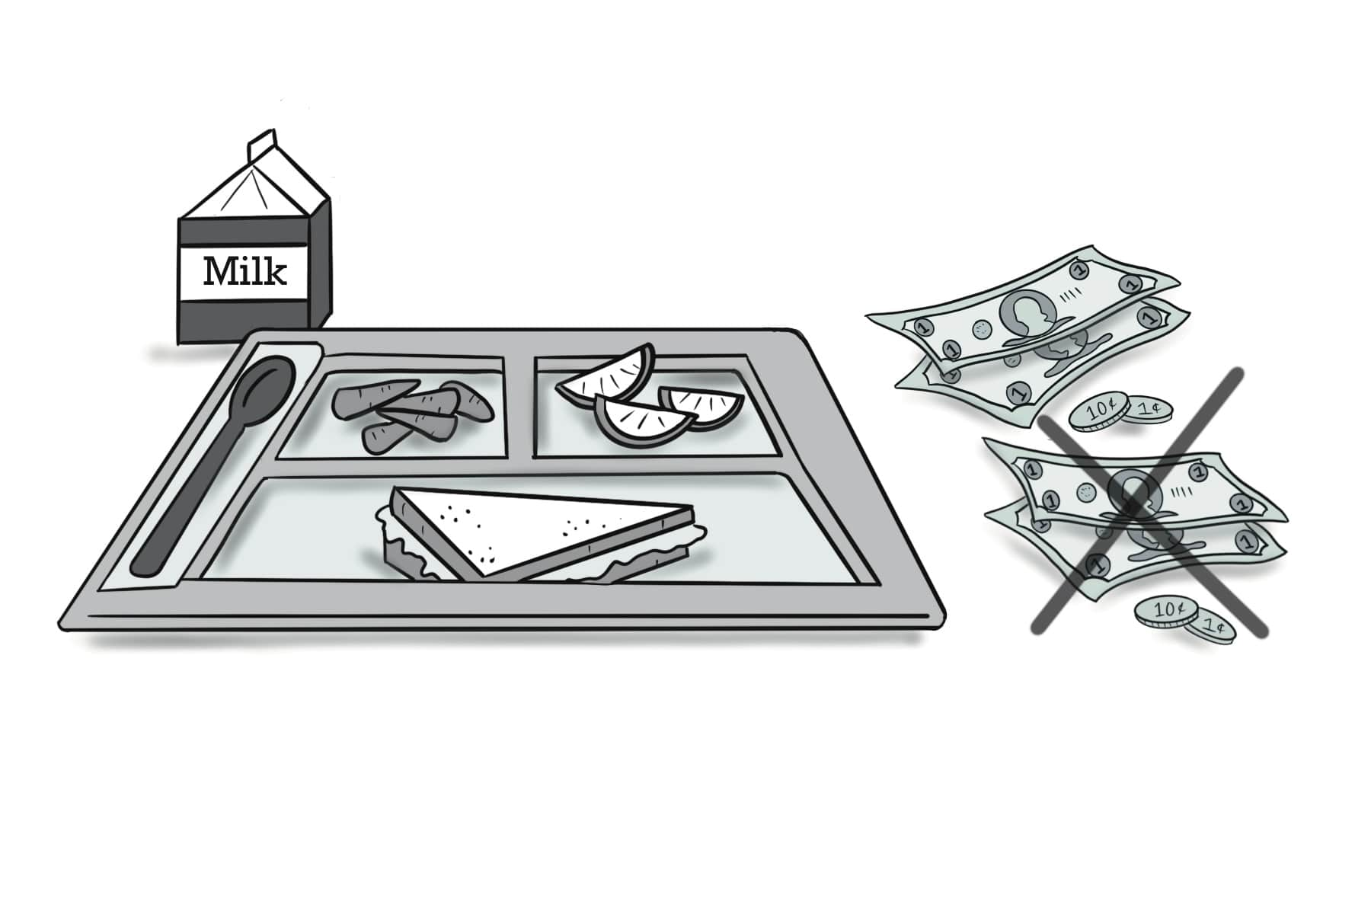
reduced-fee meal

Slide 57
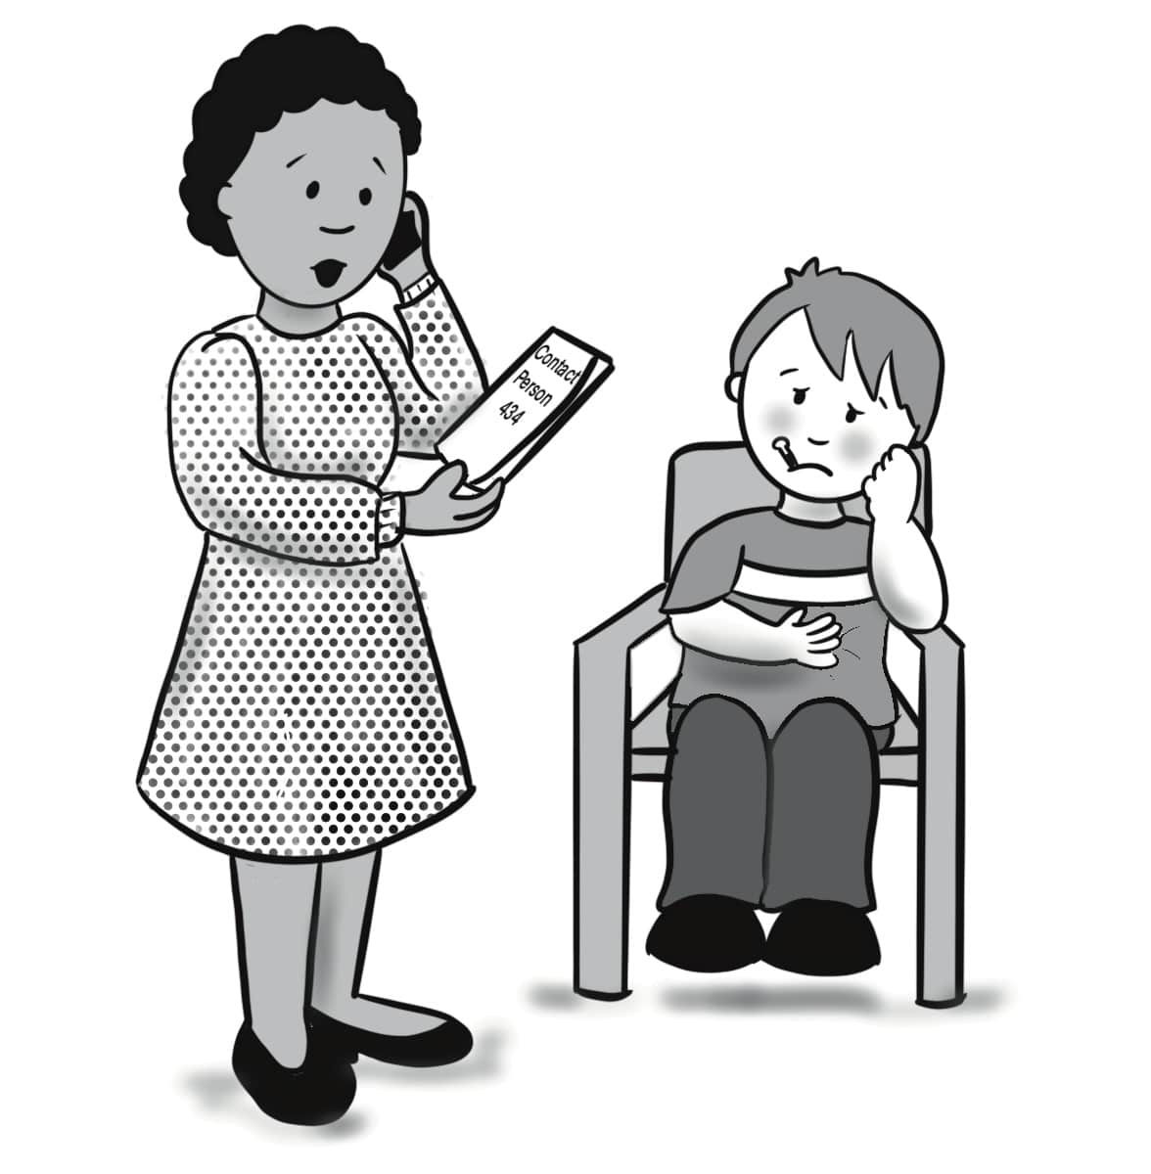
emergency contact

Slide 58
A. I’d like to register my children for school, please. B. Please write your information on these forms.
Sentences Using Vocabulary

Slide 59
A. Hi, I’d like to register my children for school, please. B. Please write your information on these forms. You’ll also need an emergency contact. A. Ok, great. I’d like to apply for reduced-fee meals, too. B. Sure, we have a form for that here. This is Dr. Stevens, our principal.
Dialogue, Part 1

Slide 60
C. Hello. Welcome to our school. Here is a schedule of the fall and spring semesters with our parent-teacher conference days and exam days. Here are the rules for behavior in our school. Please call the school if you have questions. A. Thank you very much.
Dialogue, Part 2

Slide 61
Unit 2: I Have a Problem.

Slide 62
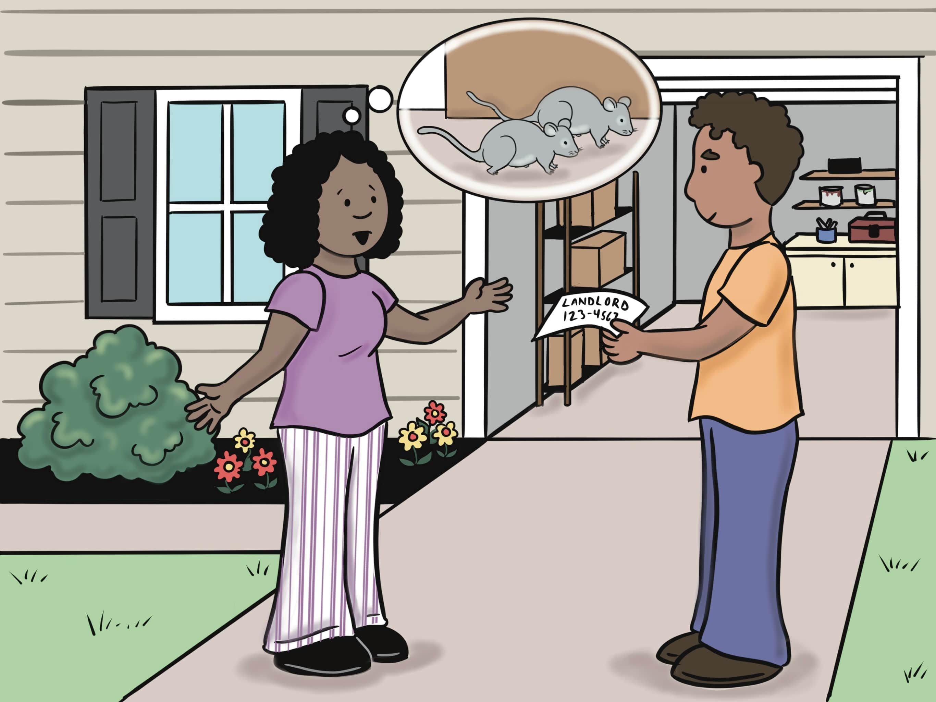
Lesson 5: I Saw Two Mice!

Slide 63
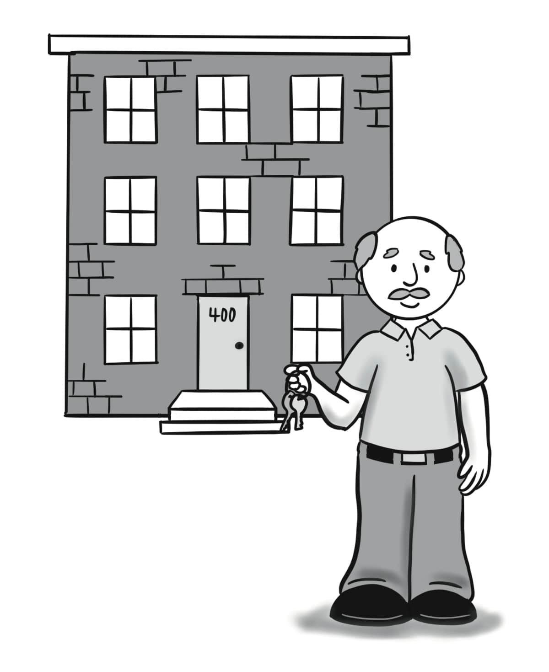
landlord

Slide 64
insect

Slide 65
bat

Slide 66
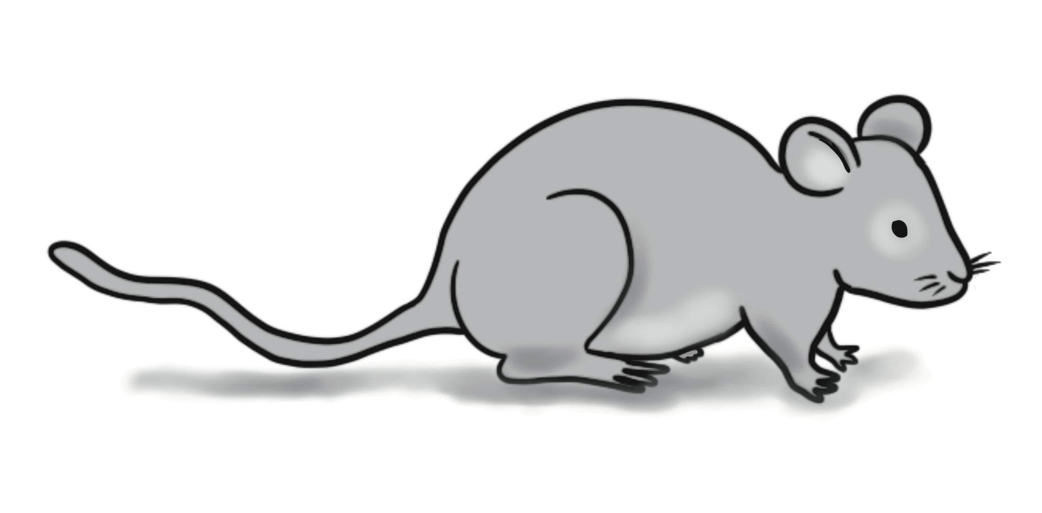
mouse (mice)

Slide 67
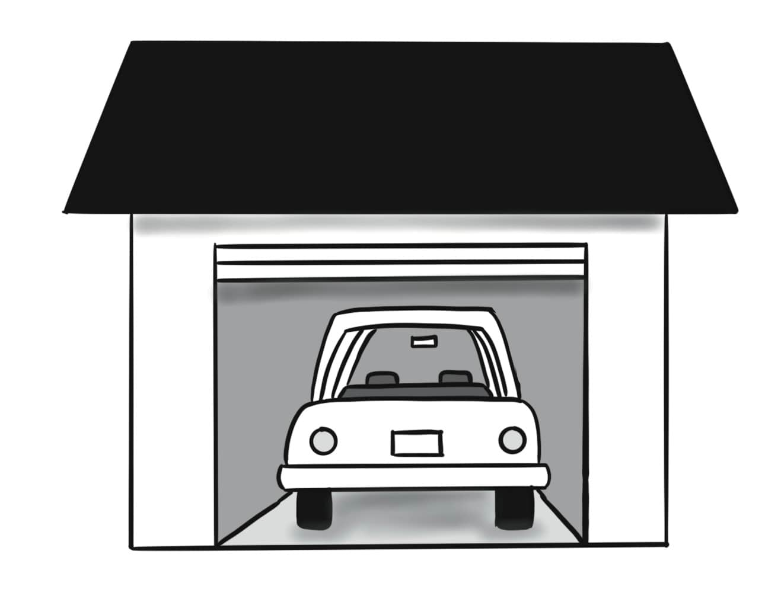
garage

Slide 68
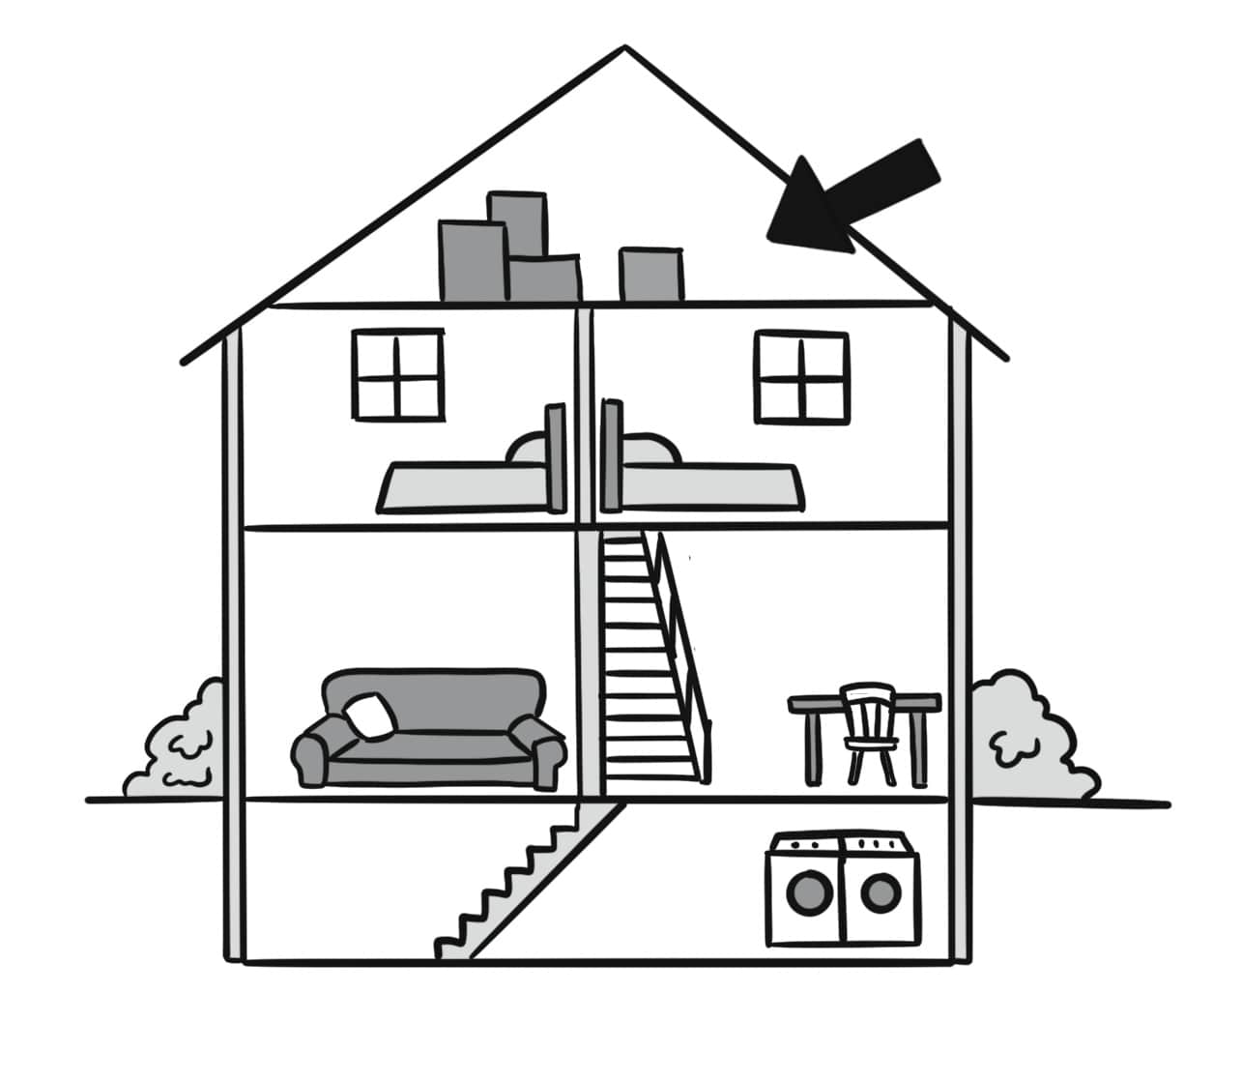
attic

Slide 69
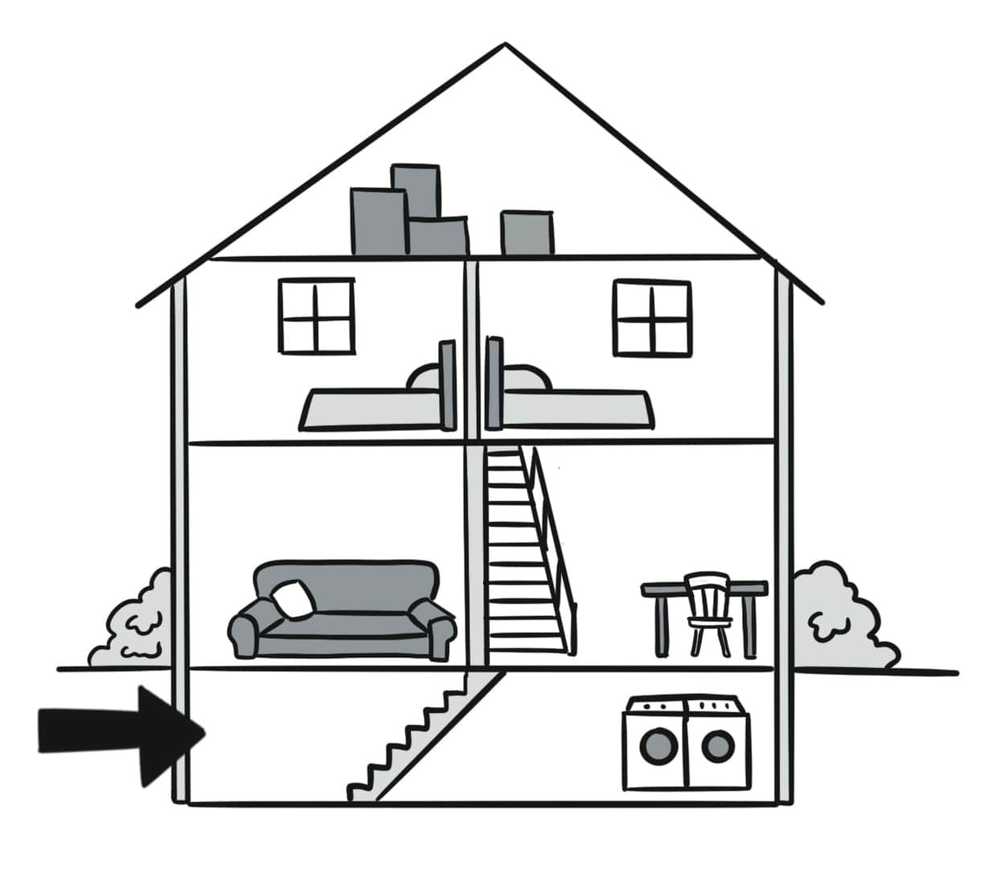
basement

Slide 70
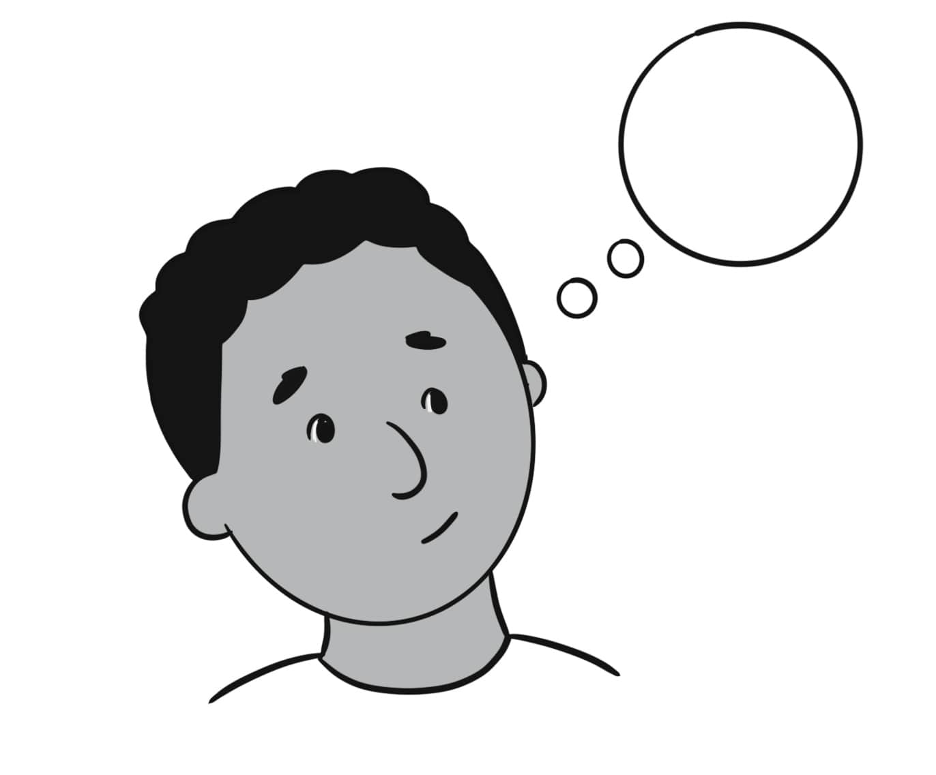
think (thought)

Slide 71
remove

Slide 72
What’s wrong?

Slide 73
A. We have insects in our kitchen. B. Yuck!
Sentences Using Vocabulary

Slide 74
A. You should call the landlord. B. Thanks. I’ll think about it.
Sentences Using Vocabulary

Slide 75
A. What’s wrong? B. I don’t know what to do. I was cleaning my basement when I saw some big insects! Then, I was working in the garage, and I saw two mice! I think there is a bat in the attic, too. A. Yuck! You should call the landlord. Two years ago, we were living in a house with mice, and our landlord removed them. B. Thanks. I wasn’t going to call him, but now I’ll think about it.
Dialogue

Slide 76
Lesson 6: We Had Freeze Alerts.

Slide 77
landslide

Slide 78
earthquake

Slide 79
wildfire

Slide 80
drought

Slide 81
freeze

Slide 82
boil water

Slide 83
fog

Slide 84
power outage

Slide 85
alert

Slide 86
sure

Slide 87
A. What alerts did you have? B. We had landslide alerts.
Sentences Using Vocabulary

Slide 88
A. When I was living in Silver City, we had many alerts on TV. B. What alerts did you have? A. In the spring, we had landslide alerts because it rained a lot. In the summer, we had drought and wildfire alerts. In the fall, we had fog alerts. In the winter, we had freeze alerts.
Dialogue, Part 1

Slide 89
B. Wow! That sounds really bad. I’m glad you didn’t have earthquakes! A. We had earthquakes, too! After the last earthquake we had boil water warnings for a week! After that, I was sure that it was time to move!
Dialogue, Part 2

Slide 90
Lesson 7: Let’s Make a Plan.

Slide 91
might

Slide 92
follow

Slide 93
escape route

Slide 94
shut-off valve

Slide 95
meeting place

Slide 96
emergency kit

Slide 97
safe place

Slide 98
damage

Slide 99
plan

Slide 100
important documents

Slide 101
A. What should we do? B. Let’s make a plan to be ready.
Sentences Using Vocabulary

Slide 102
A. If we have a bad earthquake, what should we do? B. Let’s make a plan to be ready. A. Ok, I’ll write it on this paper. B. First, we need to go to a safe place. We can leave it after we know it’s safe. Then we will see if there is damage to our house. A. That sounds good. Then what should we do? B. We might need to turn off the water and gas with the shut-off valve.
Dialogue, Part 1

Slide 103
A. Ok, I wrote our earthquake plan. But what if we have a wildfire? B. We will meet at our meeting place. If we have to leave, we will follow the escape route. We will take our emergency kit and important documents.
Dialogue, Part 2

Slide 104
Lesson 8: I Think My Laptop Has a Virus.

Slide 105
screen

Slide 106
laptop

Slide 107
password

Slide 108
virus (viruses)

Slide 109
antivirus program

Slide 110
printer

Slide 111
website

Slide 112
lose (lost)

Slide 113
receive

Slide 114
connect

Slide 115
A. Can you tell me about the problem? B. I lost my passwords.
Sentences Using Vocabulary

Slide 116
A. Excuse me, I need some help. I think my laptop has a virus. B. Oh no! Can you tell me about the problem? A. I looked at a new website. Then, the screen changed. Now, I can’t connect to the internet, and I lost my passwords. I also can’t connect to the printer or receive emails. B. I think we can help you. Does your computer have an antivirus program? A. No, it doesn’t. B. Ok. We’ll repair your laptop and install an antivirus program. I’ll call you when your computer is ready.
Dialogue

Slide 117
Lesson 9: I Forgot.

Slide 118
forget (forgot)

Slide 119
remember

Slide 120
pay (paid) taxes

Slide 121
take (took) out the trash take (took) out the recycling

Slide 122
get (got) gas

Slide 123
set an alarm

Slide 124
pack lunch

Slide 125
do laundry

Slide 126
pick up

Slide 127
to-do list

Slide 128
A. Did you remember to take out the recycling? B. I’m sorry, I forgot.
Sentences Using Vocabulary

Slide 129
A. You have to set an alarm tonight. B. Thanks.
Sentences Using Vocabulary

Slide 130
A. Did you remember to take out the recycling? B. I’m sorry, I forgot. I’ll do it after I finish my homework. A. Thanks.
Dialogue 1

Slide 131
A. Hey, where is our to-do list? I can’t find it. B. It’s right here. You should set an alarm tonight to get up early tomorrow. You have to get gas before work. A. Thanks. I’ll pack lunch and do laundry tonight, too. B. I need to pay our taxes tomorrow and pick up our daughter after school. A. Oh, yeah. That’s important, too!
Dialogue 2

Slide 132
Unit 3: Getting on the Road

Slide 133
Lesson 10: Will You Help Me Choose a Car?

Slide 134
used

Slide 135
scam

Slide 136
loan

Slide 137
title

Slide 138
test drive

Slide 139
car dealer

Slide 140
license plate

Slide 141
warranty (warranties)

Slide 142
registration

Slide 143
insurance

Slide 144
price

Slide 145
A. Tell me about the cars. B. This one has a better warranty.
Sentences Using Vocabulary

Slide 146
A. You need insurance for your car. B. Thanks for your help!
Sentences Using Vocabulary

Slide 147
A. I’m looking at some used cars. Will you help me choose one to buy? B. Sure. Tell me about them. A. This car is more expensive, but it has a better warranty. That one is newer, but I’m worried that it might be a scam because it is at a lower price. B. Let’s talk to the car dealer and see if we can take them for a test drive. A. What should I do if I want to buy a car?
Dialogue, Part 1

Slide 148
B. If you want to get a loan, you will need to have car insurance. After you buy the car, you will get papers to show that the car is yours. Later, you’ll get your registration and title. You’ll get a new license plate for the car, too. A. I’m so glad you’re here to help me!
Dialogue, Part 2

Slide 149
Lesson 11: I Need an Oil Change.

Slide 150
mechanic

Slide 151
engine

Slide 152
hood

Slide 153
strange noise

Slide 154
check engine light

Slide 155
headlight

Slide 156
flat tire

Slide 157
brakes

Slide 158
trunk

Slide 159
oil change

Slide 160
A. I need a new headlight. B. Please bring your car at 4:00 pm.
Sentences Using Vocabulary

Slide 161
(on the phone) A. Hello, this is Best Mechanic Service. B. I’d like to make an appointment please. My car is making a strange noise. Also, the check engine light is on, and I need an oil change. A. Ok. Please bring your car today at 4:00 pm.
Dialogue 1

Slide 162
(at the mechanic shop) A. Hi, I’m Tim, the mechanic. I have some bad news. You need a new headlight, new brakes, and an oil change. The headlight will be the cheapest problem to fix, and the brakes will be the most expensive. B. I’m happy I don’t have a flat tire, too! Is there good news? A. Yes. I looked under the hood, and the engine is fine. B. Did you hear the strange noise? A. The strange noise isn’t a problem. You had a bell in your trunk!
Dialogue 2

Slide 163
Lesson 12: I Was in a Traffic Jam.

Slide 164
get (got) lost

Slide 165
pulled over

Slide 166
traffic jam

Slide 167
directions

Slide 168
delayed

Slide 169
parking space

Slide 170
crash

Slide 171
railroad crossing

Slide 172
drive

Slide 173
roadwork

Slide 174
A. I got lost when I was driving to work. B. Wow, that’s a bad morning!
Sentences Using Vocabulary

Slide 175
A. I’m sorry for being late. B. No problem. Are you ok? A. Yes, but it was a long drive! First, I waited for a train at a railroad crossing. Then, there was a car crash, and I was in a traffic jam. After that, a police officer pulled me over because I drove too fast next to roadwork. B. Oh, no!
Dialogue, Part 1

Slide 176
A. There’s more! I got lost and stopped to get help. A kind woman gave me directions to get here. Then, I had to look for a parking space for a long time. B. Wow, that’s a bad morning! I hope you won’t be so delayed next time! A. Me, too!
Dialogue, Part 2

Slide 177
Unit 4: Sharing Meals Together

Slide 178
Lesson 13: Let’s Bake a Cake!

Slide 179
recipe

Slide 180
measuring cup

Slide 181
tablespoon

Slide 182
teaspoon

Slide 183
stir (stirred)

Slide 184
bake

Slide 185
ingredients

Slide 186
usually

Slide 187
occasionally

Slide 188
rarely

Slide 189
A. I rarely follow a recipe. B. I think we should use a recipe for this cake.
Sentences Using Vocabulary

Slide 190
A. What do we need for this recipe? B. We need a measuring cup.
Sentences Using Vocabulary

Slide 191
A. Hey, let’s bake a cake for our friend’s birthday! B. I occasionally bake cookies, but I don’t know how to bake a cake. A. That’s ok. I usually follow a recipe. B. I rarely follow a recipe, but I think we should use one for a cake! What does it say? A. We will need a big bowl, a measuring cup, and the teaspoons and tablespoons.
Dialogue, Part 1

Slide 192
B. Ok, I’ve got them. Where should I put the bowl? A. Give it to me, please. Thanks. Now, we will stir our ingredients together and bake it. B. Sounds good! I can’t wait to eat it!
Dialogue, Part 2

Slide 193
Lesson 14: I’m Allergic.

Slide 194
dairy

Slide 195
bacon

Slide 196
honey

Slide 197
nut

Slide 198
steak

Slide 199
peanut

Slide 200
dish

Slide 201
allergic

Slide 202
almost

Slide 203
order

Slide 204
without

Slide 205
A. Do you have a dish without dairy? B. Yes, we do.
Sentences Using Vocabulary

Slide 206
A. Do you know what you’d like to order? B. I’m almost ready to order, but I have a question. Is there bacon in the salad? A. No, there’s no bacon. B. Great. I’d like a salad and a steak, please. A. Ok. And for you? C. I’d like a steak, too, and maybe a dessert. What desserts do you have without nuts, peanuts, and dairy? I’m allergic.
Dialogue, Part 1

Slide 207
A. We have a dish with baked apples and honey. C. Ooh, that sounds delicious! We’d like two of those dishes.
Dialogue, Part 2

Slide 208
Lesson 15: I Have a Special Diet.

Slide 209
offer

Slide 210
accept

Slide 211
refuse

Slide 212
bring (brought)

Slide 213
rude

Slide 214
nervous

Slide 215
a special diet

Slide 216
snack

Slide 217
vegetarian

Slide 218
A. I might have to refuse some food. B. You should tell her that you don’t eat meat.
Sentences Using Vocabulary

Slide 219
A. I feel nervous about visiting my American friend’s home. B. Why? A. I have a special diet. I don’t eat meat because I’m a vegetarian. B. Oh, I see. But why are you worried? A. I might have to refuse some food if she offers it to me. Is that rude?
Dialogue, Part 1

Slide 220
B. You should tell her that you don’t eat meat. Then, if you don’t accept food with meat, she will understand. A. I can do that. Maybe I can bring a snack to her house, too. B. That’s a great idea! your friend can try food from your country!
Dialogue, Part 2

Slide 221
Lesson 16: Let’s Get Takeout!

Slide 222
burn

Slide 223
cookout

Slide 224
corn

Slide 225
embarrassed

Slide 226
grill

Slide 227
lemonade

Slide 228
marshmallow

Slide 229
roast

Slide 230
shrimp

Slide 231
takeout

Slide 232
A: I’m planning to grill some shrimp. B: Sounds delicious!
Sentences Using Vocabulary

Slide 233
(in the morning) A: Hey, would you like to come over for a cookout tonight? I'm planning to grill some shrimp and corn for dinner. We will have some lemonade, too! After dinner, we can roast marshmallows on the fire. B: That sounds delicious! I'd love to come.
Dialogue 1

Slide 234
(in the evening) A: Hi, come in! B: Thanks for having me. A: I’m embarrassed to say this, but…our dinner burned on the grill. B: Oh, no! Is there any food we can eat? A: No, I’m sorry, but everything is burned. We only have lemonade and marshmallows! B: Well, …let’s get takeout!
Dialogue 2

Slide 235
Unit 5: How’s Your Health?

Slide 236
Lesson 17:
Getting Regular Checkups is a Good Idea.

Slide 237
advice

Slide 238
agree

Slide 239
avoid sweets

Slide 240
disagree

Slide 241
get regular checkups

Slide 242
get more sleep

Slide 243
jog

Slide 244
quit smoking

Slide 245
relax

Slide 246
watch my diet

Slide 247
A: Quitting smoking is a good idea. B: I agree!
Sentences Using Vocabulary

Slide 248
A: How are you today? B: I'm not feeling well. I don't feel healthy. A: Do you want to start jogging in the mornings with me? It might help! B: I agree! But I need to go to bed earlier to get more sleep.
Dialogue, Part 1

Slide 249
A: My doctor gave me good advice about my health. I need to relax more. Quitting smoking and getting regular checkups are good ideas, too. B: I talk with my doctor, too. Avoiding sweets and watching my diet are important for me. A: After we go jogging, we can eat a healthy meal and relax.
Dialogue, Part 2

Slide 250
Lesson 18: I Hope She Will Recover Soon!

Slide 251
backache

Slide 252
blood

Slide 253
cold

Slide 254
disease

Slide 255
the flu

Slide 256
laboratory

Slide 257
patient

Slide 258
recover

Slide 259
run a test

Slide 260
sore throat

Slide 261
A: What’s the problem? B: I have a sore throat.
Sentences Using Vocabulary

Slide 262
A: Hi, Dr. Jones. B: Hi, Sara. What's the problem? A: I started feeling sick two weeks ago. First, I had a cold. Then, I had the flu. Now, I have a sore throat and a backache, too! B: Oh, I'm sorry to hear that. I'll run some tests at the lab to understand the problem. Then, I will give you some medicine. A: Thank you, Doctor.
Dialogue 1

Slide 263
A: Did you hear the news about Maya's health? B: I know the doctors took blood to run tests because she has a very bad cough. A: Maya has a disease and is starting to take medicine now. She is a patient at Memorial Hospital. B: I hope she will recover soon! I'll visit her in the hospital tomorrow.
Dialogue2

Slide 264
Lesson 19: Did He Break a Bone?

Slide 265
bleed

Slide 266
break a bone

Slide 267
breathe

Slide 268
chest pain

Slide 269
cut

Slide 270
emergency room

Slide 271
feel dizzy

Slide 272
heart attack

Slide 273
unconscious

Slide 274
urgent care

Slide 275
A: What was wrong? B: She was feeling dizzy.
Sentences Using Vocabulary

Slide 276
A: Did you hear about Janet's trip to the emergency room? B: Oh, no, what was wrong? A: She was feeling dizzy and had chest pain. Then, she couldn't breathe. She was worried that it was a heart attack. She called 911, and the ambulance took her to the hospital. B: Is she unconscious now? A: No, she’s ok, but she will stay in the hospital until she is better.
Dialogue 1

Slide 277
A: I need you to come right now. We have to take Nikola to urgent care. B: OK, I'm coming. What's wrong? A: He got hurt when he was playing football. His leg really hurts. B: Did he break a bone? A: No, but he cut his leg. It's bleeding. B: I'll be there soon.
Dialogue 2

Slide 278
Lesson 20: How Was Your Day as a Nurse?

Slide 279
bandage

Slide 280
burn

Slide 281
cheek

Slide 282
chin

Slide 283
mouth

Slide 284
injury

Slide 285
need to

Slide 286
nurse

Slide 287
painful

Slide 288
vomit

Slide 289
A: Is he ok? B: He has a burn on his cheek.
Sentences Using Vocabulary

Slide 290
A: Hey! How was your first day as an emergency room nurse? B: I was busy all day! First, a girl came in with cuts on her cheek and lip from a broken cup. I cleaned the blood on her face and put bandages on her. A: Oh, no. Is she ok? B: Don't worry! She is doing well now. After that, I saw a boy with a burn on his cheek and a woman with a painful arm injury. I also helped a man who was vomiting and felt very sick. He needed some medicine.
Dialogue, Part 1

Slide 291
A: I guess you need to take a break now after all those patients! B: Yes, I'm ready to relax!
Dialogue, Part 2

Slide 292
Unit 6: Let’s Go to Work!

Slide 293
Lesson 21: We’re Working Overtime.

Slide 294
busy

Slide 295
career

Slide 296
coworker

Slide 297
employee

Slide 298
employer

Slide 299
lose my job

Slide 300
day off

Slide 301
overtime

Slide 302
take a sick day

Slide 303
team

Slide 304
A: Tell me about your job. B: I work with a great team.
Sentences Using Vocabulary

Slide 305
A: I lost my job. I'm looking for a new one. Where do you work? B: I work at Smith’s Grocery. My employer is looking for new employees. You should apply! A: Tell me about your job. B: I work with a great team, but it's really busy! My coworkers and I are working overtime this week. A: When is your day off?
Dialogue, Part 1

Slide 306
B: I'm off on Sundays. I can also take a sick day occasionally. A: Do you think I'd like working in a grocery store as a career? B: I don't know, but you can try it and see if you like it.
Dialogue, Part 2

Slide 307
Lesson 22: I’m going to Become a Childcare Worker.

Slide 308
a good fit

Slide 309
be able to

Slide 310
become

Slide 311
businessperson

Slide 312
childcare worker

Slide 313
decision

Slide 314
firefighter

Slide 315
look forward to

Slide 316
receptionist

Slide 317
salesperson

Slide 318
A: I’m going to become a childcare worker! B: That’s great!
Sentences Using Vocabulary

Slide 319
A: I have some big news. I'm going to school again. I'm going to become a childcare worker! B: That's great! Why did you make this decision? A: I want to be able to help people, and I love helping children learn. B: That's true, but you could also help people as a firefighter, a receptionist, a salesperson, or a businessperson. A: I think working in childcare is a good fit for me! I'm looking forward to learning more.
Dialogue

Slide 320
Lesson 23: I Have Two Job Offers.

Slide 321
either…or

Slide 322
neither…nor

Slide 323
employed/unemployed

Slide 324
full-time

Slide 325
part-time

Slide 326
health insurance

Slide 327
hourly wage

Slide 328
salary

Slide 329
job offer

Slide 330
raise

Slide 331
A: What should I do?
B: You should take the full-time job.

Slide 332
A: I need some advice. I'm unemployed. I lost my job six months ago. I have two job offers, and I need to choose one of them. B: Ok, tell me about them. A: At Lance’s Workshop, I can get an hourly wage and work part-time. I might get a raise in six months if my boss likes my work. At Harvey’s Workshop, I can receive a salary. It's a full-time job.
Dialogue, Part 1

Slide 333
B: You can either have a part-time job with an hourly wage or a full-time job with a salary. Is that correct? A: Yes, that's correct. Also, neither Harvey’s nor Lance’s has health insurance. What should I do? B: I think you should take the full-time job. You need to be employed and you can use your salary to pay for health insurance.
Dialogue, Part 2

Slide 334
Lesson 24: Does She Have a Bank Account?

Slide 335
bank account

Slide 336
debit card

Slide 337
earn

Slide 338
get paid

Slide 339
paycheck

Slide 340
save

Slide 341
spend

Slide 342
all of

Slide 343
a lot of

Slide 344
some of

Slide 345
none of

Slide 346
A: Will they get paid on Friday? B: All of the employees will get paid on Friday.
Sentences Using Vocabulary

Slide 347
A: Hey, I heard your daughter got her first job! B: Yes, she'll get paid next week. She wants to spend all of the money she earns on clothes! A: Does she have a bank account? She could save some of that money. A lot of young people have bank accounts to save money. B: Yes, she opened a bank account last week so she can use a debit card. She will put her paycheck in the account. A: When I was a teenager, none of my friends had bank accounts. I'm glad your daughter has one! B: I hope she will use it well!
Dialogue

Slide 348
Unit 7: Do You Want to Go Shopping Together?

Slide 349
Lesson 25: I Need a Couch and a Recliner.

Slide 350
coffee table

Slide 351
couch

Slide 352
dining set

Slide 353
furniture

Slide 354
lamp

Slide 355
living room

Slide 356
mine

Slide 357
optional

Slide 358
recliner

Slide 359
rug

Slide 360
painting

Slide 361
A: What do you need? B: I need a couch.
Sentences Using Vocabulary

Slide 362
A: I like your new apartment! B: Thanks. Could you help me choose furniture? A: Sure. What do you need? B: In the living room, I need a couch, a recliner, and a lamp. I think a coffee table is optional, but it would be nice to have one. I also need a dining set with four chairs. A: What about a painting?
Dialogue, Part 1

Slide 363
B: That's optional, too. I don't need a painting, but I want to get one if it isn't very expensive. A: Do you have a rug? B: No, I don't. A: You can have mine!
Dialogue, Part 2

Slide 364
Lesson 26: I’d Like to Return These Items.

Slide 365
blanket

Slide 366
item

Slide 367
manager

Slide 368
pillow

Slide 369
receipt

Slide 370
refund

Slide 371
sheet

Slide 372
soft

Slide 373
hard

Slide 374
tag

Slide 375
towel

Slide 376
A: What are you returning? B: I have a blanket and two sheets.
Sentences Using Vocabulary

Slide 377
A: Hello. I'm the store manager. How can I help you? B: I ordered these items online, but I'd like to return them for a refund, please. A: Ok. Do you have a receipt? B: Yes, the receipt is here, and all the items have tags. A: What are you returning? B: I have a blanket, a pillow, two sheets, and four towels.
Dialogue, Part 1

Slide 378
A: Why are you returning them? B: The blanket and the sheets were the wrong size. The pillow was too hard. The towels were soft, but they were the wrong color. A: Ok, thank you for telling me. I'll give you the refund now.
Dialogue, Part 2

Slide 379
Lesson 27: Try This Cotton Shirt.

Slide 380
belt

Slide 381
cotton

Slide 382
fitting room

Slide 383
leather

Slide 384
mirror

Slide 385
self

Slide 386
suit

Slide 387
sweater

Slide 388
try on

Slide 389
wool

Slide 390
tie

Slide 391
A: You could try this cotton suit. B: Yes, that’s nice.
Sentences Using Vocabulary

Slide 392
A: Do you want to look at clothes with me? I need some new clothes for my interview next week, and I don't like shopping by myself. B: Sure. What are you looking for? A: I'm not sure. Do you think I should wear a suit and tie or just a nice sweater with pants and a belt? B: Good question. These wool sweaters are really nice, but they might be too hot. You could try this cotton shirt.
Dialogue, Part 1

Slide 393
A: Yes, that's nice. I see a black leather belt that would look good, too. B: You should try on the clothes in the fitting room and look at yourself in the mirror before you decide.
Dialogue, Part 2

Slide 394
Lesson 28: Nice Haircut!

Slide 395
barber

Slide 396
color

Slide 397
comb

Slide 398
straight

Slide 399
curly

Slide 400
hair salon

Slide 401
haircut

Slide 402
inch

Slide 403
so

Slide 404
style

Slide 405
stylist

Slide 406
A: Hey, nice haircut! B: Thanks! I went to the hair salon.
Sentences Using Vocabulary

Slide 407
A: Hey, nice haircut! B: Thanks! I went to the hair salon yesterday. I wasn't sure which style to choose, so I asked the stylist for advice. A: How much hair did she cut? B: She cut 4 inches. It feels so different when I come it now! A: Your stylist does a great job with straight hair! Do you think she can cut my curly hair and color it, too?
Dialogue, Part 1

Slide 408
B: Yes, you should make an appointment. A: I'll call today. I need to make an appointment at the barber for my husband, too.
Dialogue, Part 2

Slide 409
Unit 8: We’re Having So Much Fun!

Slide 410
Lesson 29: We Went Camping at the Beach.

Slide 411
go biking

Slide 412
go camping

Slide 413
farmer’s market

Slide 414
go fishing

Slide 415
go hiking

Slide 416
go kayaking

Slide 417
nature

Slide 418
go rock climbing

Slide 419
spend time

Slide 420
sunrise/sunset

Slide 421
A: What do you like to do? B: I like to go rock climbing.
Sentences Using Vocabulary

Slide 422
A: I moved here last month and I want to spend time outside in nature. Could you tell me what you like to do? B: Sure! Last summer, I went rock climbing in the mountains with my family. We also went to the farmer’s market, went kayaking, and went fishing. A: That sounds fun! What did you do in the fall? B: In the fall, my friends and I went camping. A: Where did you go camping?
Dialogue, Part 1

Slide 423
B: We went camping at the beach. We got up early in the morning and watched the sunrise. A: Oh, I love sunrises. What did you do in the spring? B: Every Saturday, I went biking or hiking with a friend.
Dialogue, Part 2

Slide 424
Lesson 30: What Are You Doing for the Long Weekend?

Slide 425
ball game

Slide 426
go bowling

Slide 427
concert

Slide 428
festival

Slide 429
museum

Slide 430
go out to eat

Slide 431
play

Slide 432
road trip

Slide 433
have plans

Slide 434
long weekend

Slide 435
A: What are you doing for the long weekend? B: We’re going to a museum.
Sentences Using Vocabulary

Slide 436
A: What are you doing for the long weekend? B: We are going on a road trip. We'll go to a festival on Friday. On Saturday, we'll go to the history museum and then go bowling. A: That sounds great! B: Did you make plans for the weekend? Do you want to come with us? A: I don't have plans now. I'd love to come! That sounds like a lot of fun.
Dialogue 1

Slide 437
A: What are you doing for the long weekend? B: My friends and I are going out to eat and then going to a ball game on Friday night. After the game, there will be a concert at the ballpark. Do you want to come with us? A: Thanks, but I have plans. My brother and I are going out to eat on Friday, too, but then we're going to a play.
Dialogue 2

Slide 438
Lesson 31: We Want to Celebrate!

Slide 439
banner

Slide 440
celebrate

Slide 441
decorate

Slide 442
find out

Slide 443
cookies

Slide 444
grapes

Slide 445
strawberries

Slide 446
invitation

Slide 447
join in

Slide 448
set up

Slide 449
A: Can I join in? B. Sure!
Sentences Using Vocabulary

Slide 450
A: We found out that our friend got a new job! We want to celebrate with him. I'm planning a party. B: Can I join in? I love parties! A: Sure. I'm going to make a fruit salad with bananas, strawberries, and grapes. Melanie will bring cookies and send invitations. Mike will set up tables and chairs. Could you buy banners to decorate the room? B: Sure! I'm happy to do that!
Dialogue

Slide 451
Lesson 32: I Prefer Serious Movies.

Slide 452
action movie

Slide 453
animation

Slide 454
comedy

Slide 455
documentary

Slide 456
drama

Slide 457
prefer

Slide 458
boring

Slide 459
scary

Slide 460
serious

Slide 461
silly

Slide 462
A: What kind of movies do you like? B: I like dramas.
Sentences Using Vocabulary

Slide 463
A: What did you think about the movie? B: I thought it was going to be a scary movie, but it was silly! I didn't like it. A: Oh, really? I thought it was great! What kind of movies do you like? B: I usually prefer serious movies. I like dramas and action movies.
Dialogue, Part 1

Slide 464
A: I prefer comedies and animations. I like documentaries, too. B: Ugh! Documentaries are too boring for me. A: I can see that we have different ideas about movies!
Dialogue, Part 2

Slide 465
Unit 9: We’re Going on a Trip.

Slide 466
Lesson 33: I Booked Tickets and Packed My Luggage.

Slide 467
airport

Slide 468
book tickets

Slide 469
flight

Slide 470
gate

Slide 471
layover

Slide 472
luggage

Slide 473
pack

Slide 474
passport

Slide 475
stay

Slide 476
stressed

Slide 477
A: Are you ready for your trip? B: Yes. I booked tickets.
Sentences Using Vocabulary

Slide 478
A: I'm going to be off next week. My best friend's husband is in the hospital, so I'm going to stay with their children. B: That's very kind of you. Do you need help with anything? No, thank you. I think I am ready. I booked tickets, got my passport, and packed my luggage.
Dialogue, Part 1

Slide 479
B: Do you know how to find your gate at the airport? I always feel stressed finding the gate. A: I have a long layover before my second flight, so I will have time to find the gate. After that, I'll be able to relax.
Dialogue, Part 2

Slide 480
Lesson 34: How Was Your Vacation?

Slide 481
attraction

Slide 482
check in/check out

Slide 483
perfect

Slide 484
resort

Slide 485
suitcase

Slide 486
take a tour

Slide 487
terrible

Slide 488
thick

Slide 489
thin

Slide 490
vacation

Slide 491
A: Tell me about your vacation. B: It was terrible.
Sentences Using Vocabulary

Slide 492
A: Tell me about your vacation. B: It was terrible. We both got sick! We planned to take a tour and visit some attractions, but we checked in and went to sleep in the hotel. Well, we tried, but we weren't able to sleep. The walls in our room were too thin, and we could hear the neighbors’ TV. A: Oh, I'm so sorry. B: How was your vacation? A: Actually, it was perfect! Our resort was beautiful. We had dinner on a boat one night! We were sad to check out.
Dialogue, Part 1

Slide 493
B: Wow, that's great! Did you have any problems? A: Yes, we had one problem. Our suitcases were too thick to fit under the seats on the plane, so they went under the plane. Then, the suitcases got lost, but the airport returned them to us the next day. B: Well, I guess no one's vacation is perfect!
Dialogue, Part 2

