Slide 1
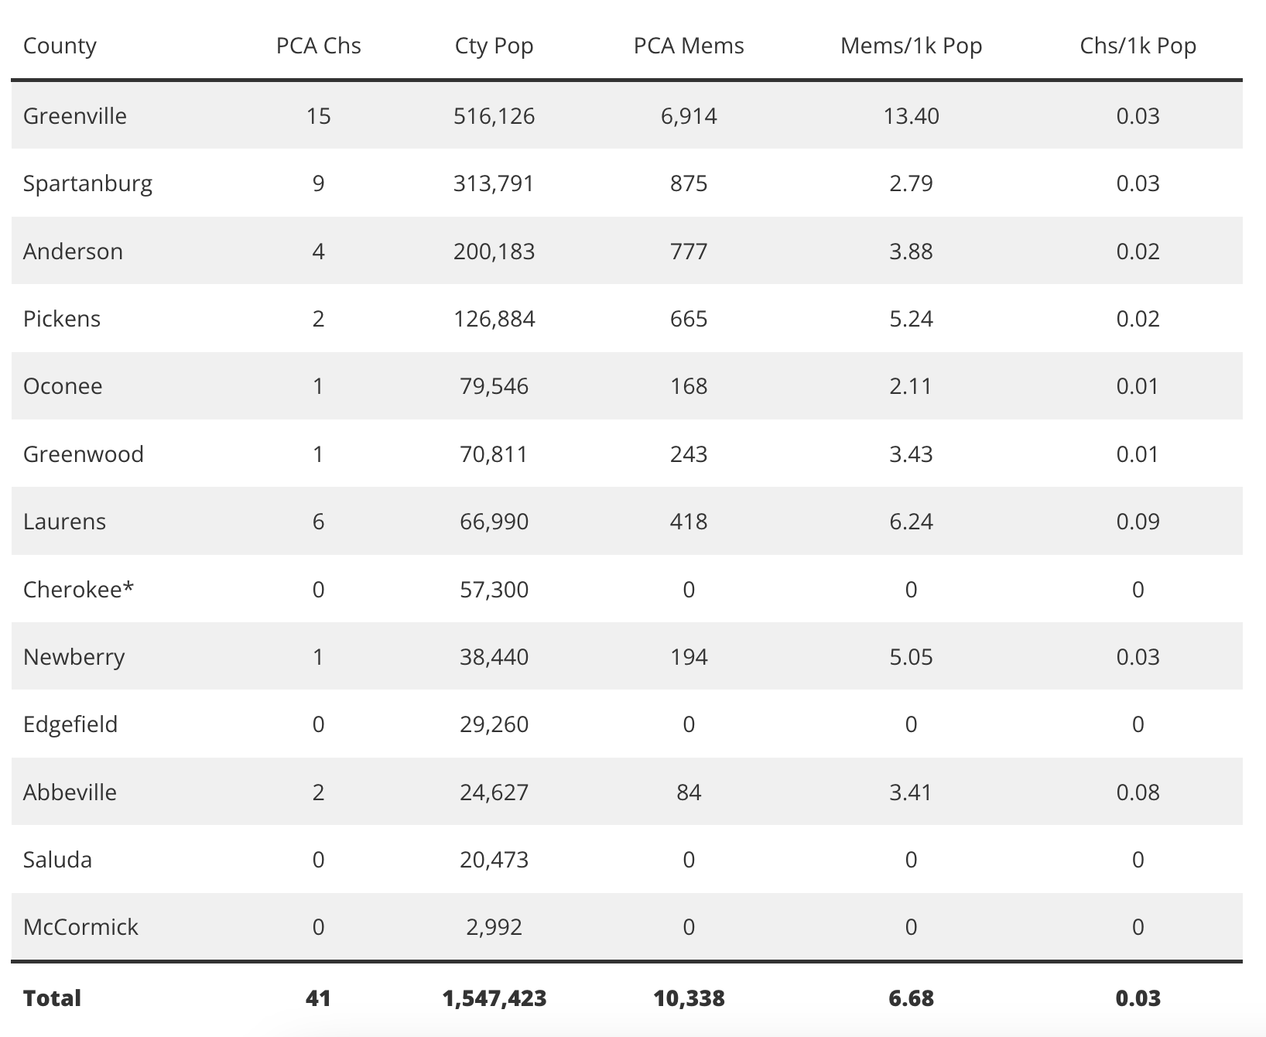

Slide 2
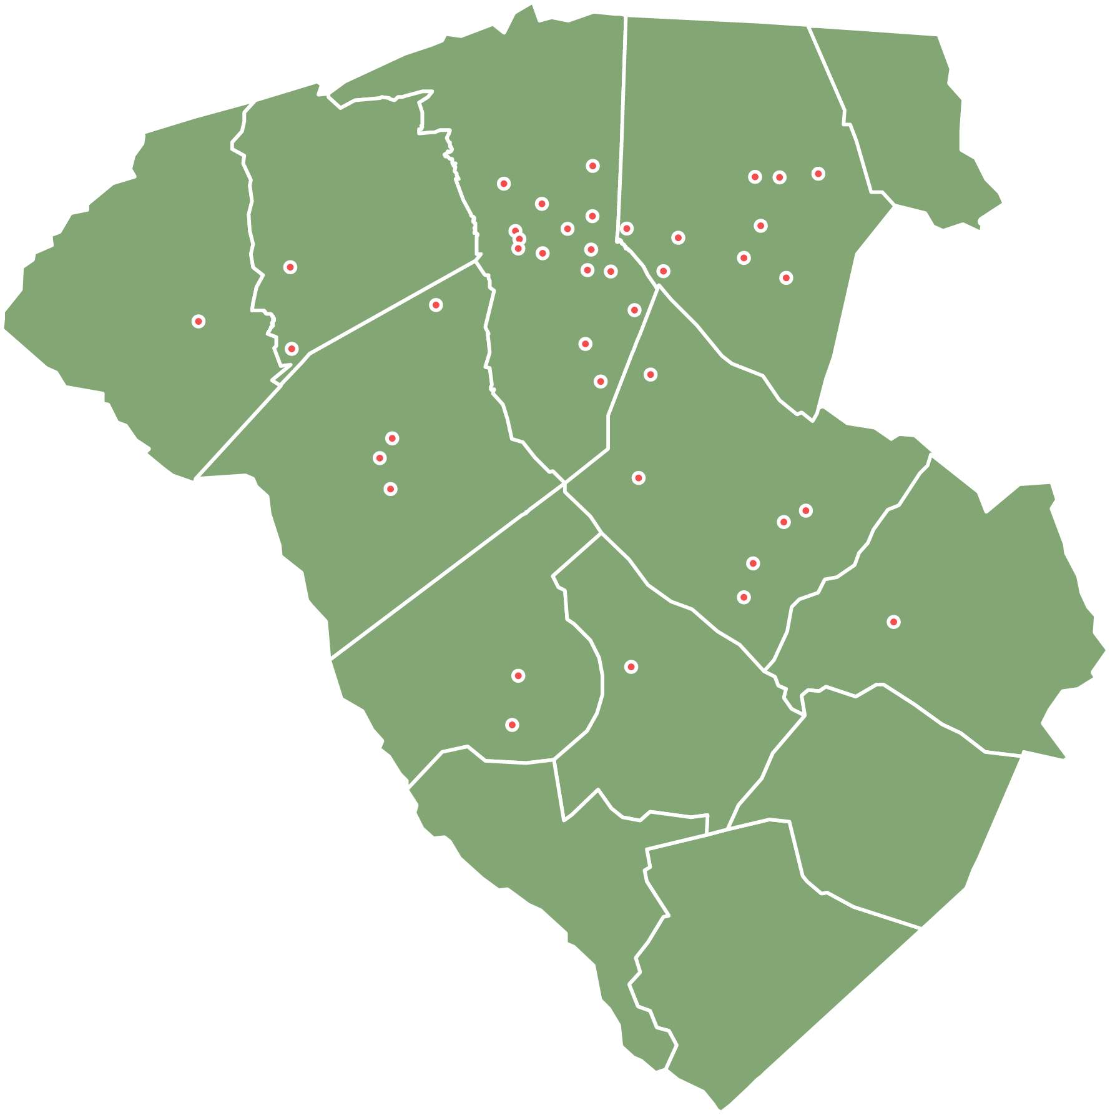

Slide 3
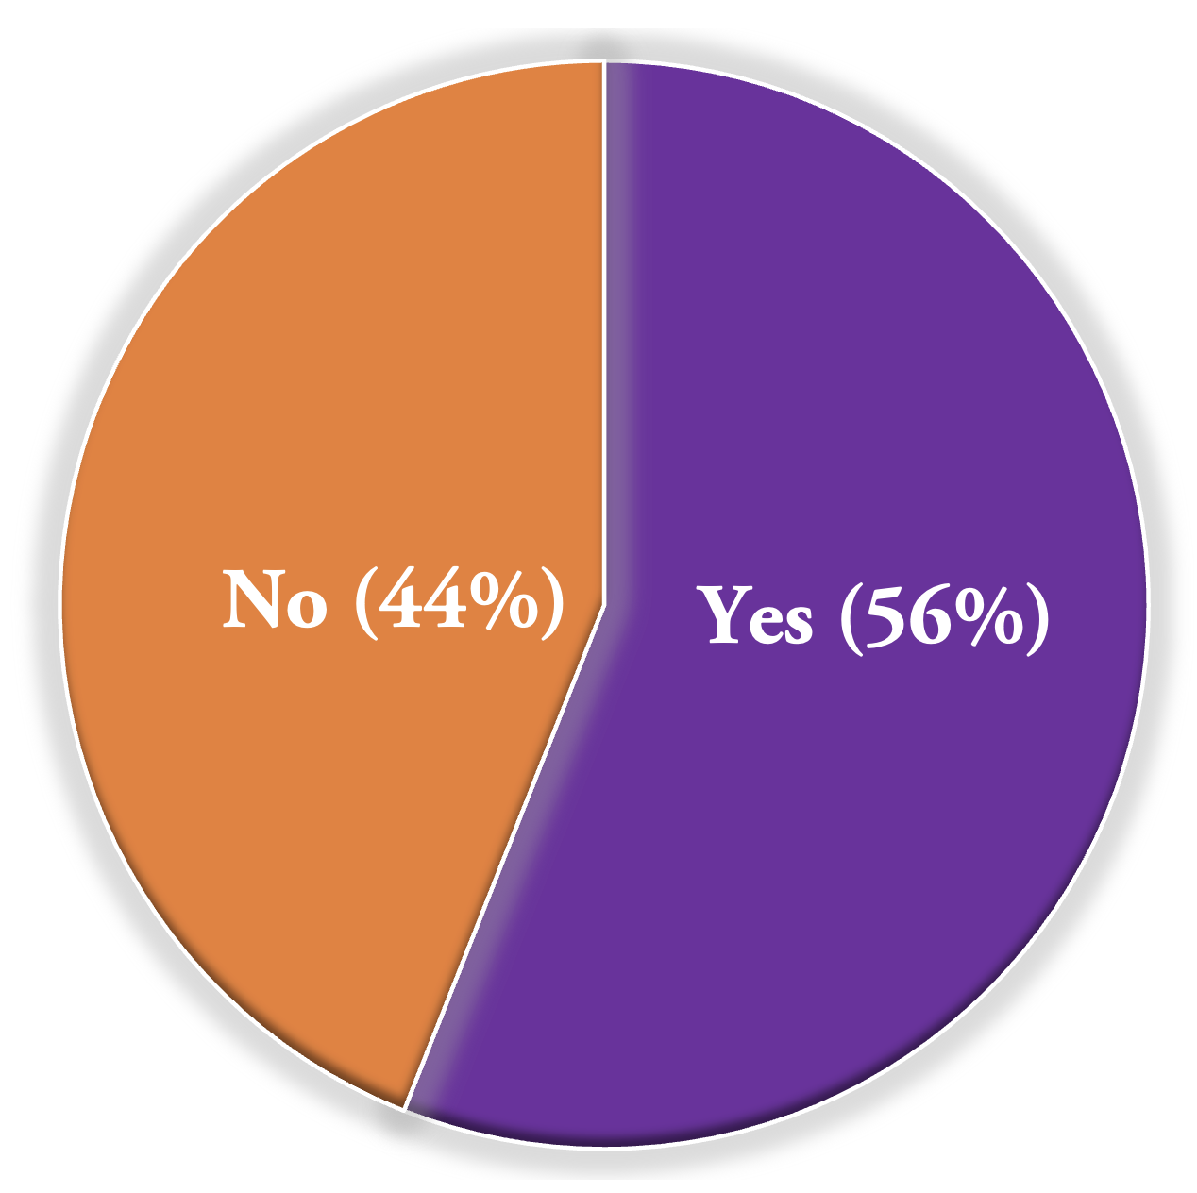
1. Have you or your session recognized a need for a new work within or adjacent to your congregation's geographic footprint?
Locations Mentioned
Greenville
Woodruff
Spartanburg
Seneca
McCormick County
North Greenville County

Slide 4
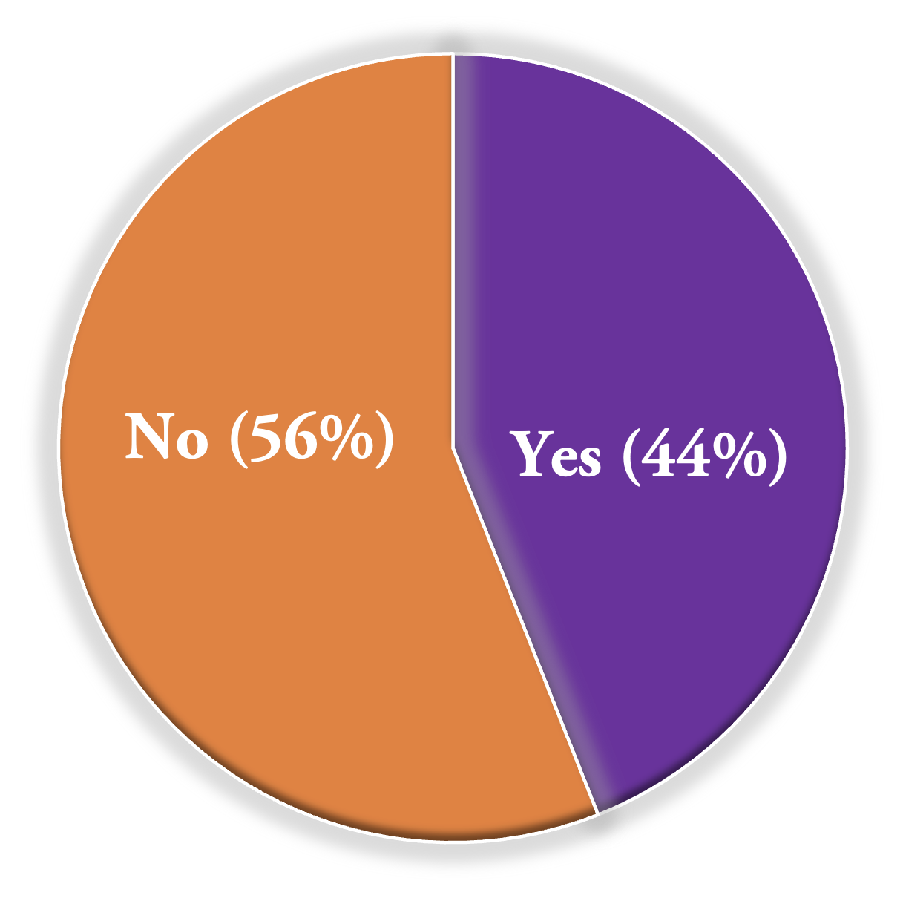
2. Do you have people driving a long distance to your church from an area without a PCA congregation?

Slide 5
3. Is your church hoping to plant a church within the bounds of Calvary Presbytery in the next five years?

Slide 6
4. Do you currently have any pastors or interns on staff at your church who are interested in church-planting?
Only TWO of our churches answered YES to this question.

Slide 7
5. Would your church be willing to provide financial support for a new church plant in Calvary Presbytery?
ALL respondent churches answered YES to this question.

Slide 8
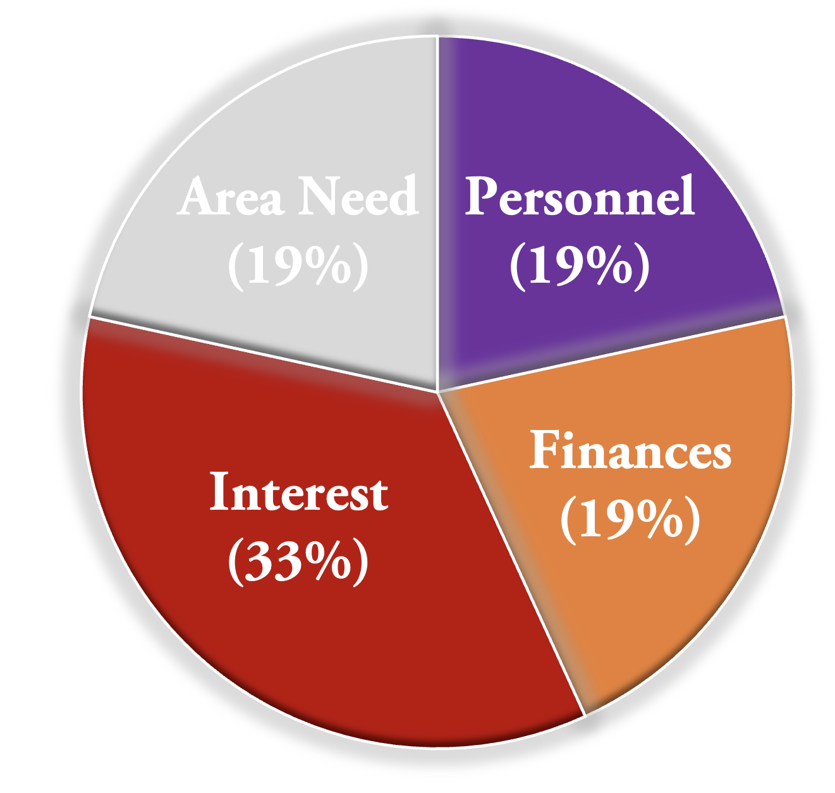
6. What is the single most significant hurdle to your church being involved in church-planting in Calvary Presbytery?

Slide 9
7. Is your church currently setting aside money in your church budget to support church-planting?

Slide 10
Most popular Means of Participation in Church-Planting
81% of respondent churches are willing to consider a mother/daughter relationship to a church plant.
50% of respondent churches are willing to consider participating in a provisional session for a church plant.

Slide 11
Key Takeaways
1. The majority of respondent churches recognize the need and opportunity for more church-planting within our bounds, and these churches are prepared to engage in some way.
2. As a whole, Calvary Presbytery is not currently raising up or nurturing church-planters within our bounds.
3. There are at least six possible target areas within our bounds worth considering for near-term church-planting works: Greenville, Woodruff, Spartanburg, Seneca, McCormick County, and North Greenville County.

Slide 12
Possible Next Steps
1. Plan to repeat the survey in 3 years (in CY 2025)
2. Identify or create avenues or opportunities for receiving additional input.
3. Follow up with respondent churches that have indicated an interest in planting in the near-future, especially to encourage and resource them to create church-planter apprenticeship programs.
4. Investigate the feasibility of leveraging current plants and revitalization efforts that can serve as incubators for future church-planters and church-planting teams.

